Slide 1
YAIM tutorial on gLite configuration tool (http://www.pd.infn.it/~aiftim/ )
Cristina Aiftimiei (INFN)
EMI Release Manager
EGI Technical Forum 2012
17-21 Sep. 2012

Slide 2
Overview
What is it?
What is it used for?
How is it organized?
How to use it?
How to develop it?
“real” use case – siteBDII

Slide 3
Short history
European DataGRID project (2001 – 2003)
WP4 – Fabric Management
“To deliver a computing fabric comprised of all the necessary tools to manage a center providing grid services on clusters of thousands of nodes.”
LCFG (Local ConFiGuration system)
LCFGng (LCFG next generation) - Client/server architecture
Quattor – community effort, open source software
EGEE projects (I, II and EGEE, 2004 - 2010)
YAIM

Slide 4
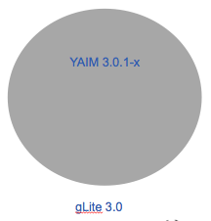
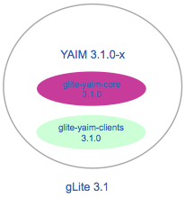
YAIM Evolution
YAIM 3.0.1-x
- single rpm, install & configure all node types
YAIM 3.1.1
First split – UI(WN)

Slide 5
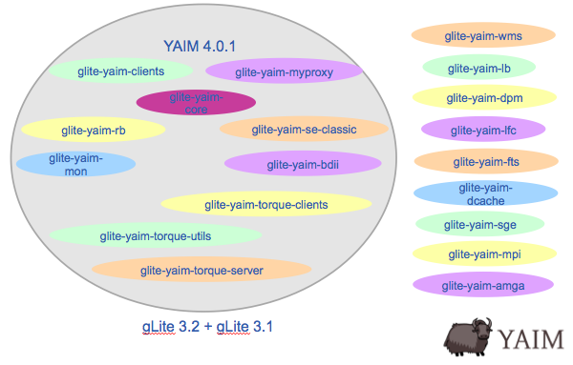
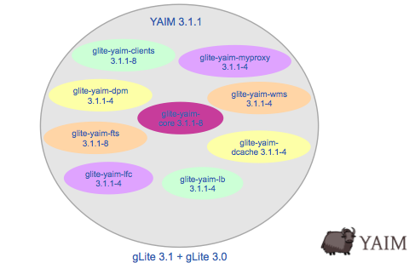
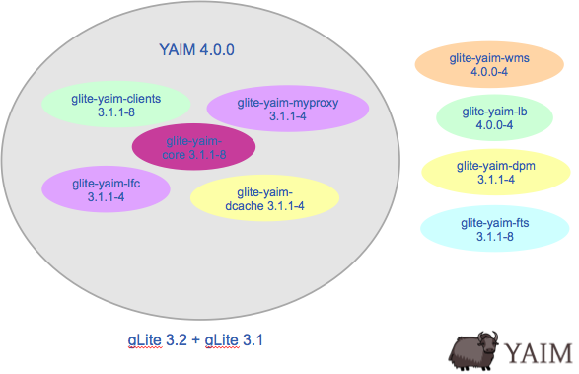
YAIM Evolution

Slide 6
YAIM – present & future
YAIM in EMI
All modules under the responsibility of PT
yaim-core/clients – mainly bug fixes
EMI recommendation:
adopt standard configuration methods recommended by the operating systems supported
YAIM post-EMI
up to PTs
WLCG TEG Operations & Tools – final report:
Middleware configuration should be improved and should not be bound to a particular configuration management tool

Slide 7
YAIM Acronym/Logo
YAIM
initially Yet Another Installation Manager
known as YAIM Ain't an Installation Manager
2007 – Logo Contest
David O’Callaghan- “yak shaving”:
“Any seemingly pointless activity which is actually necessary to solve a problem which solves a problem which, several levels of recursion later, solves the real problem you’re working on.”

Slide 8
YAIM – configuration tool
YAIM
implements a configuration method for the gLite software.
aims to provide a simple configuration method that can be used to set up a simple Grid Site but can be easily adapted and extended to meet the need of larger sites.
Main features:
Modularized Structure
Bash Script Syntax
Node Type Configuration Facility
Well Defined Directory Structure
Basic Configuration Files

Slide 9
YAIM - modular structure
yaim-core (glite-yaim-core-5.1.0-1)
common functions and definitions
one yaim module per node type/service
specific functions and configuration files
21 modules
dpm-yaim-4.2.7-1
glite-apel-yaim-1.0.2-4
glite-ce-yaim-cream-ce-4.3.0-4
glite-lb-yaim-4.4.3-3
glite-px-myproxy-yaim-4.1.7-1
glite-yaim-bdii-4.3.11-1
glite-yaim-clients-5.0.1-2
glite-yaim-cluster-2.1.0-4
glite-yaim-ge-utils-4.3.0-4
glite-yaim-lsf-utils-5.0.0-2
glite-yaim-mpi-1.1.11-1
glite-yaim-torque-client-5.1.0-1
glite-yaim-torque-server-5.1.0-1
glite-yaim-torque-utils-5.1.0-2
glite-yaim-wms-4.1.5-1
lfc-yaim-4.2.4-1
yaim-argus_server-1.5.1-1
yaim-fts-4.1.14-1
yaim-glexec-wn-2.3.2-1
yaim-storm-4.2.2-1
yaim-voms-1.1.1-1

Slide 10
YAIM’s directory structure
/opt/glite/yaim
/bin
/examples
/siteinfo
/vo.d
/functions
/local
/services
/libexec
/utils
/nodes
/log
/pre
/node-info.d
/post
/defaults
/etc

Slide 11
YAIM’s directory structure (II)
In /opt/glite/yaim/ the following get created “by default”:
bin/yaim - the main yaim executable
defaults/ - config files with defaults shipped with the yaim core and module rpms
etc/ - scripts for setting grid environment
examples/ - some example configuration file shipped with the yaim rpm
functions/ - functions executed during the configuration
functions/local/ - adapted/improved/local version of functions
log/ - location of yaim's log file
libexec/ - main scripts used by yaim
node-info.d/ - function list definition files for the service

Slide 12
YAIM’s directory structure (III)
The following directories, can/must be used for advanced configuration - they should be created by the site-admin
functions/pre/ - functions to be executed before the main one
functions/post/ - functions to be executed after the main one
<path>/siteinfo/vo.d/ - VO (DNS-like VOs) specific info
<path>/siteinfo/nodes/ - host specific config.

Slide 13
YAIM’s configuration “storage”
examples/ directory – EXAMPLES config. files
edgusers.conf –details of the UNIX users needed to run service relevant daemons and processes
groups.conf – UNIX groups details, for pool accounts configuration
groups.conf.README
users.conf – UNIX users details, for pool accounts configuration
users.conf.README
wn-list.conf - list of WN hostnames (FQDN) in the site
wn-list.conf.README
siteinfo/site-info.def – MAIN configuration file
siteinfo/services/[emi|glite]-<service> - service specific settings
defaults/ directory
variables with meaningful default values
site-info.pre & site-info.post – provided by yaim-core
<node-type>.pre & <node-type.post> - provided by specific yaim modules

Slide 14
How to use YAIM
Prepare configuration files:
recommended way - make a copy of the examples/ directory
# cp –r /opt/glite/yaim/examples <somewhere_safe>
# chmod o-rwx <somewhere_safe>
customize config. files to your site
Run yaim

Slide 15
Configuration Flow
Files are sourced in this order:
/opt/glite/yaim/defaults/site-info.pre
/opt/glite/yaim/defaults/[emi|glite]-node-type.pre
<siteinfo_dir>/site-info.def
<siteinfo_dir>/services/[emi|glite]-node-type
<siteinfo_dir>/nodes/machine.domain
/opt/glite/yaim/defaults/site-info.post
/opt/glite/yaim/defaults/[emi|glite]-node-type.post
<siteinfo_dir>/vo.d/vo_name
/opt/glite/yaim/node-info.d/[emi|glite]-node-type
And then functions are executed
/opt/glite/yaim/functions/pre/myfunc
/opt/glite/yaim/functions/local/myfunc OR /opt/glite/yaim/functions/myfunc
/opt/glite/yaim/functions/post/myfunc

Slide 16
YAIM command
/opt/glite/yaim/bin/yaim <action> <parameters>
Actions:
-c | --configure : Configure already installed services. Compulsory parameters: -s, -n
-r | --runfunction : Execute a configuration function. Compulsory parameters: -s, -f;
Optional parameters : -n
-v | --verify : checks that the required variables for a given nodetype are all defined.
Compulsory parameters: -s -n
-d | --debug : Define a loglevel, overwrites YAIM_LOGGING_LEVEL defined in site-info.def. Values: 1-7
-e | --explain : Explains what the functions are doing by printing out the comments found inside them.
Compulsory parameters: -s -n
-a | --available : Prints out the available configuration targets. Compulsory parameter: -s
-p | --package : Creates an rpm package from the configuration directory structure, that can be installed on other nodes. It installs under:
/opt/glite/yaim/examples/siteinfo/mysiteinfo-${SITE_INFO_VERSION}
Compulsory parameter: -s
-h | --help : Prints out this help.
Specify only one action at a time !
Parameters:
-s | --siteinfo: : Location of the site-info.def file
-n | --nodetype : Name of the node type(s) to configure
-f | --function : Name of the functions(s) to execute

Slide 17
Examples
Check what can you configure:
# /opt/glite/yaim/bin/yaim -a -s /etc/yaim/site-info.def
Configuration:
# /opt/glite/yaim/bin/yaim -c -s /etc/yaim/site-info.def -n emi_dpm_mysql
Running a function:
# /opt/glite/yaim/bin/yaim -r -d 6 -s /etc/yaim/site-info.def -n emi_dpm_mysql \ -f config_mkgridmap
Verify your site-info.def:
# /opt/glite/yaim/bin/yaim -v -s /etc/yaim/site-info.def -n emi_dpm_mysql
Create an rpm package from site-info.def:
# /opt/glite/yaim/bin/yaim -p -s /etc/yaim/site-info.def

Slide 18
Hints on usage
Method A
Create only one site-info.def, user.conf and group.conf for all the nodes in the cluster
put all the custom varibles in nodes/ or services/ directory, distinguish it by profile installed or by hostname.
Export via NFS in all hosts of the cluster this directory with all configurations.
Method B
Create in each hosts a site-info.def, user.conf, group.conf and put it in /root directory (if you scratch the host remember to save the site-info.def)

Slide 19
Advanced usage
Add new VO – use vo.d/, create new config functions
VO specific information:
http://operations-portal.egi.eu/vo
Add new/more users – pool accounts generation script, use new config functions

Slide 20
Enable new VO
ALLVOs should be defined in the <site-info.def>:
VOS="vo1 [vo2 [...]]"
2 ways of defining VOs related info:
<site-info.def>: - “classic” names
vo.d/<vo_name>: - DNS-like names
##########
# biomed #
##########
VO_BIOMED_SW_DIR=$VO_SW_DIR/biomed
VO_BIOMED_DEFAULT_SE=$SE_HOST
VO_BIOMED_STORAGE_DIR=$CLASSIC_STORAGE_DIR/biomed
VO_BIOMED_VOMS_SERVERS="vomss://cclcgvomsli01.in2p3.fr:8443/voms/biomed?/biomed/"
VO_BIOMED_VOMSES="'biomed cclcgvomsli01.in2p3.fr 15000 /O=GRID-FR/C=FR/O=CNRS/OU=CC-IN2P3/CN=cclcgvomsli01.in2p3.fr biomed 24'"
VO_BIOMED_VOMS_CA_DN="'/C=FR/O=CNRS/CN=GRID2-FR'"
SW_DIR=$VO_SW_DIR/computer
DEFAULT_SE=$SE_HOST
STORAGE_DIR=$CLASSIC_STORAGE_DIR/computer
VOMS_SERVERS="'vomss://voms2.cnaf.infn.it:8443/voms/comput-er.it?/comput-er.it'"
VOMSES="'comput-er.it voms2.cnaf.infn.it 15007 /C=IT/O=INFN/OU=Host/L=CNAF/CN=voms2.cnaf.infn.it comput-er.it' 'comput-er.it voms-02.pd.infn.it 15007 /C=IT/O=INFN/OU=Host/L=Padova/CN=voms-02.pd.infn.it comput-er.it'"
VOMS_CA_DN="'/C=IT/O=INFN/CN=INFN CA' '/C=IT/O=INFN/CN=INFN CA'"

Slide 21
Enable new VO
Specific variables in <site-info.def>
QUEUES should contain short VO names:
QUEUES=“biomed computer”
For LFC:
LFC_LOCAL=“biomed”
LFC_CENTRAL=“comput-er"
<QUEUE-NAME>_GROUP_ENABLE variable should be named after short VO name (in capital letters):
COMPUTER_GROUP_ENABLE=“comput-er /comput-er/ ROLE=lcgadmin /comput-er/ROLE=production"

Slide 22
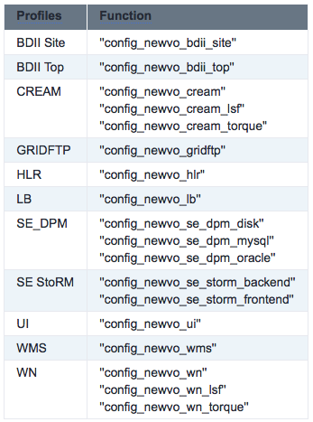
Enable new VO
For each profile create a specific configuration function, config_newvo_<profile>
Partial configuration:
# /opt/glite/yaim/bin/yaim -r -s <site.def> -n <profile> -f config_newvo_<profile>
More details
Examples

Slide 23
Add new pool accounts
A “comprehensive” generation script
ig-generate-users-conf.sh
creates a complete ”local-users.conf” for ALL of VOs you support
A “per-vo” generation script
ig-generate-vo-users-conf.sh
creates a section of your ”local-users.conf” for one VO
Thanks to Branimir Ackovic & Antun Balaz
Details:
https://wiki.italiangrid.it/twiki/bin/view/IGIRelease/CreateLocalUserAndGroup#Local_users_conf_generation
After modifying <users.conf> - run config_users
After modifying <groups.conf> - run config_newvo_<profile>

Slide 24
How to build a YAIM module
It's pretty simple to produce your own rpm. Simplest way to download the template and modify it:
http://grid-deployment.web.cern.ch/grid-deployment/yaim/examples/org.glite.yaim.lemon.tar.gz
How it goes ?
Create your function definition list: LEMON_server_FUNCTIONS='config_lemon1,config_lemon2
Create your functions:
functions/config_lemon1
functions/config_lemon2
Notes:
Gergely Debreczeni

Slide 25
How to build a YAIM module
Edit an example service specific configuration file in:
examples/services/lemon-server
Optionally you can specify 2 additional files:
defaults/lemon-server.pre:
LEMON_LOG_LEVEL=6
LEMON_SEND_EMAIL=yes
unset JAVA_HOME
defaults/lemon-server.post:
LEMON_WS_HOST=${LEMON_WS_HOST:-$LEMON_HOST}

Slide 26
How to build a YAIM module
Comment your code!
The lines having the
####@ This is my comment
form could be printed by using the 'yaim -e|--explain’ switch.
For each of your function define 2 other function having the same name and an additional '_check' and '_setenv' suffix.
function config_lemon_check() {
requires LEMON_HOST
}
This is called when yaim is invoked with -v|--verify switch.
The setenv function is just to separate the piece of code which affects the environment.
function config_lemon_setenv() {
yaimgridenv_set LEMON_HOST $LEMON_HOST
yaimgridpath_prepend PATH $LEMON_BIN_PATH
}

Slide 27
Documentation
Main YAIM reference – old but very useful
https://twiki.cern.ch/twiki/bin/view/EGEE/YAIM
Guide for Site Administrators
https://twiki.cern.ch/twiki/bin/view/LCG/YaimGuide400
YAIM in EMI
https://twiki.cern.ch/twiki/bin/view/EMI/EMIYaim
YAIM Developers Guide
https://twiki.cern.ch/twiki/bin/view/EGEE/YaimDevelopersGuide
Dissemination level
http://en.wikipedia.org/wiki/Yaim

Slide 28
Thank you
EMI is partially funded by the European Commission under Grant Agreement INFSO-RI-261611

