Slide 1
ITS OB DETECTOR BARREL h-layers produced in Padova
Ancillary jigs produced and delivered (isostatic support and handling frames)

Slide 2
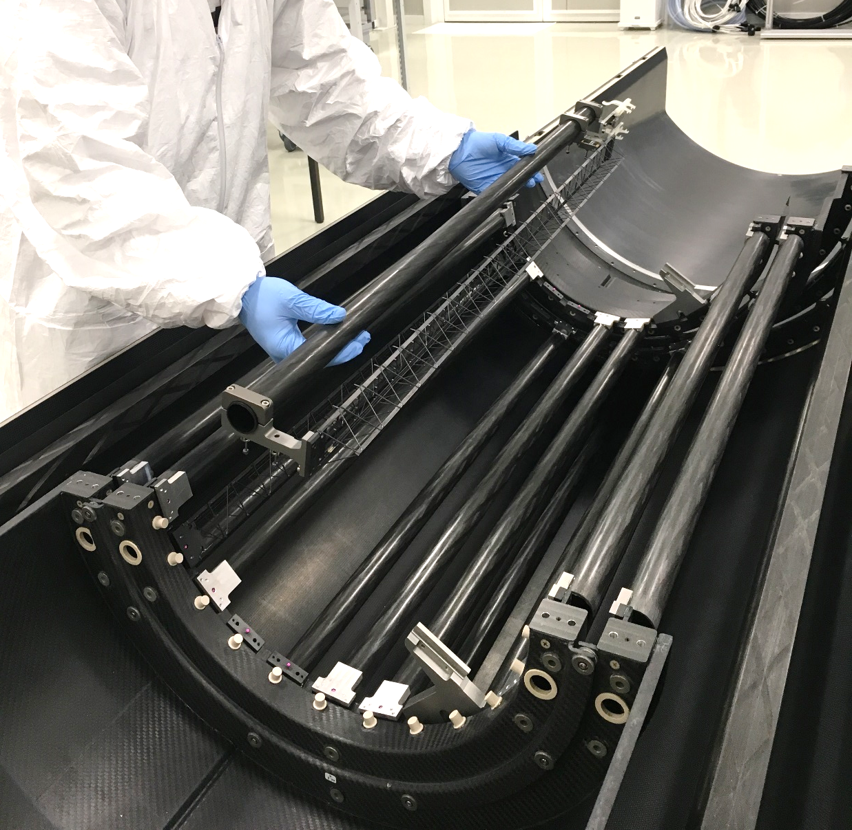
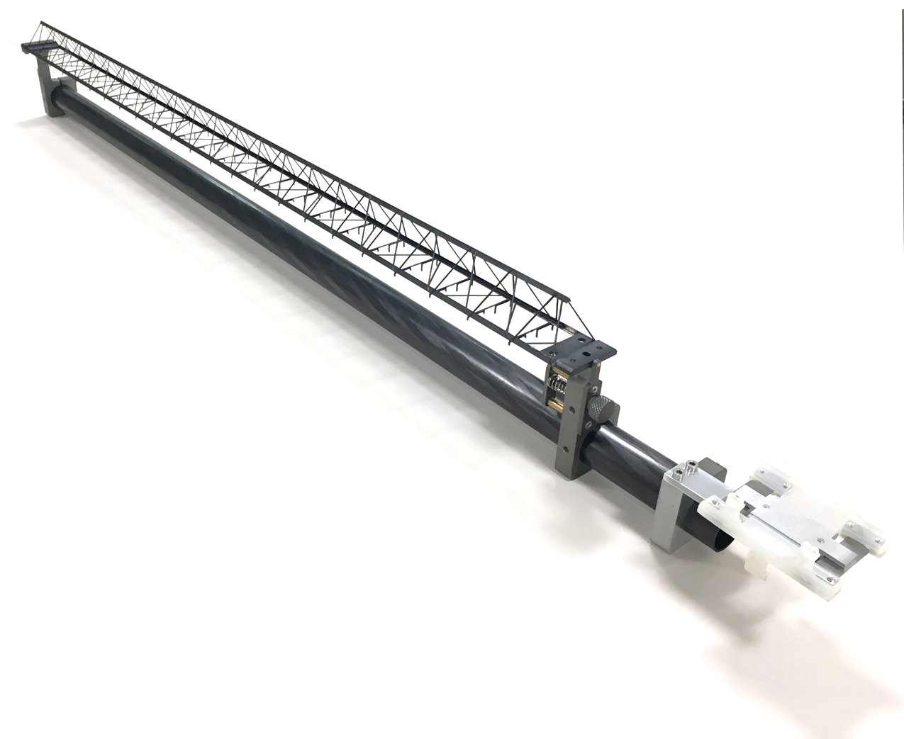
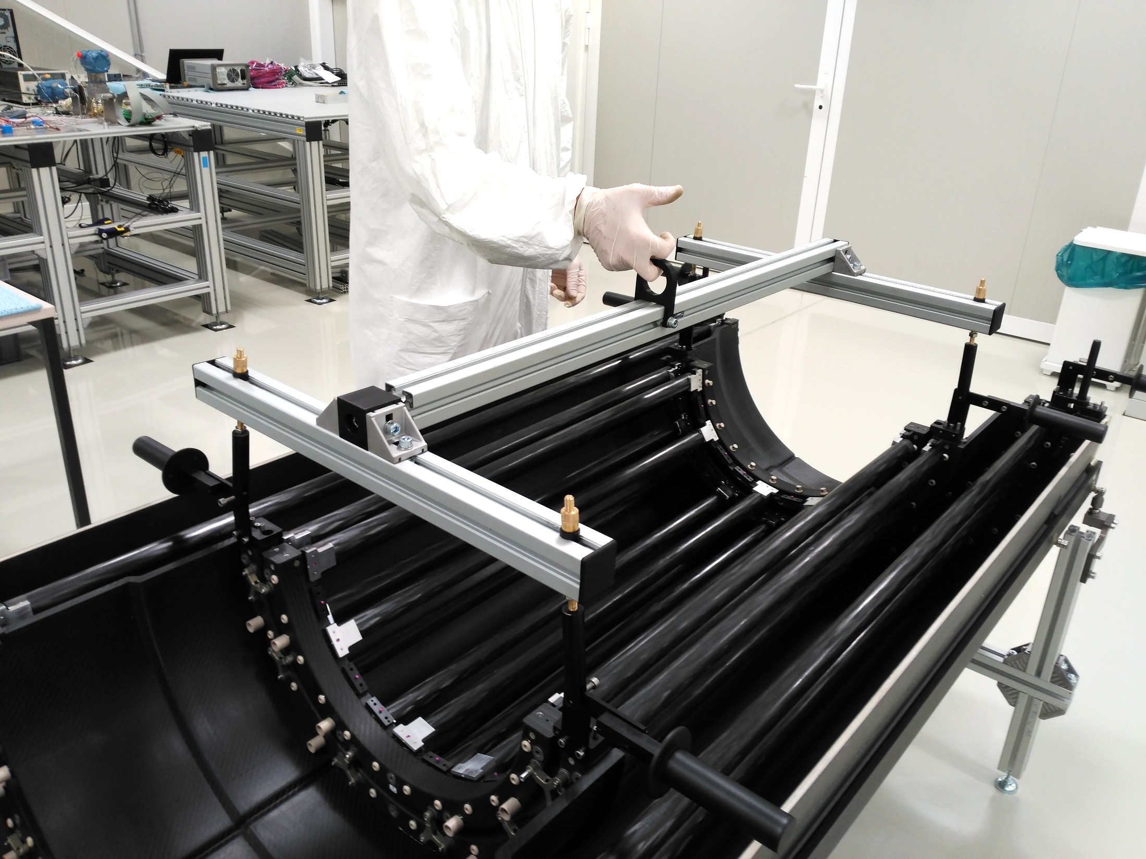
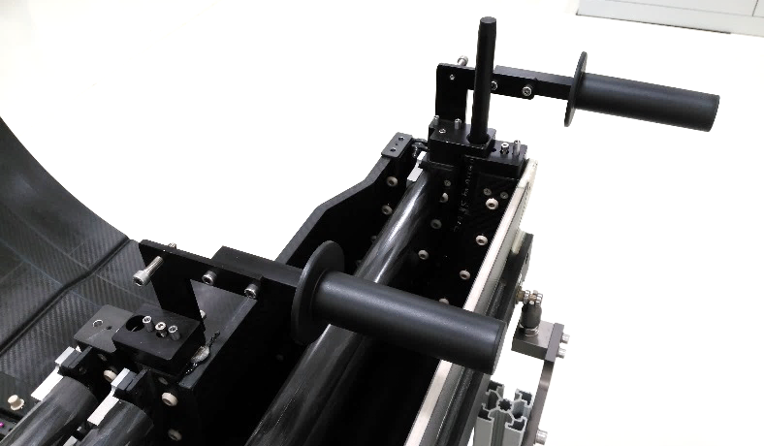
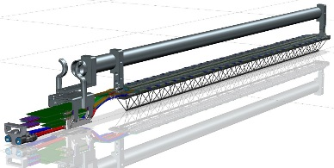
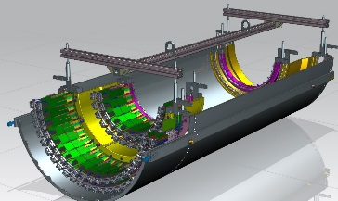
ITS OB DETECTOR BARREL assembly: jigs
The Detector Barrels jigs for staves and layers assembly produced at INFN Padova, delivered to CERN
Half Layer support frames produced n. 4x2, WK 12- 2018 (n.4), WK 18 -2018 (n.4)
Stave installation jig produced n. 2 WK 26 - 2018
Half Layers handling jig produced n. 2 WK 30 (n.2) 2018
Massimo Benettoni,
Matteo Turcato, …
Stave handling
and guided insertion jig
HLs handling jigs

Slide 3
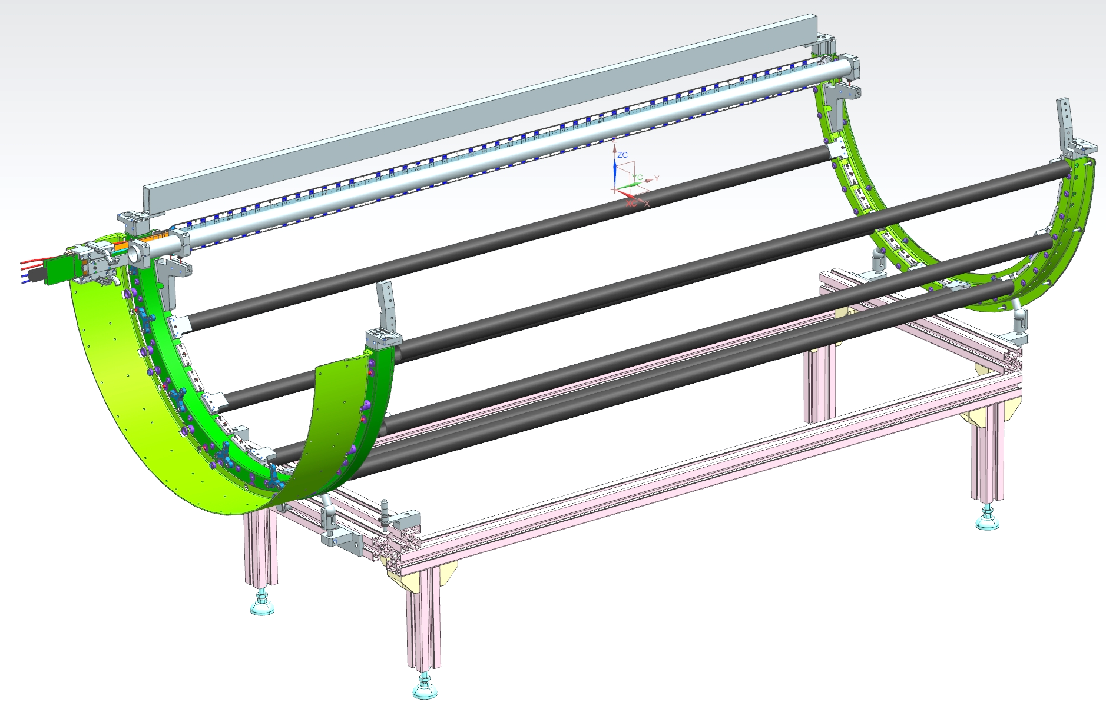
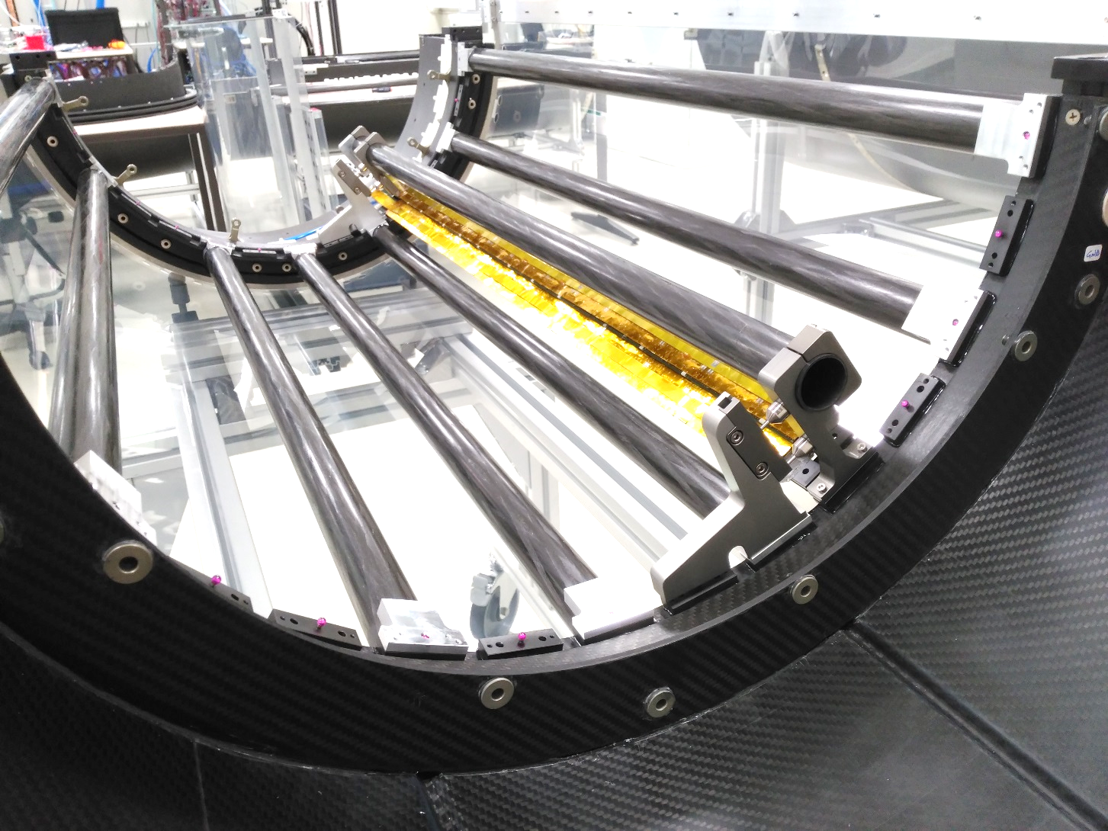
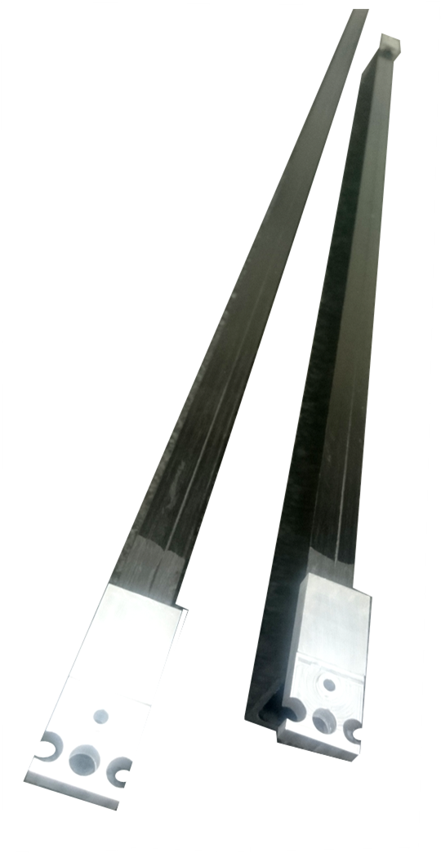
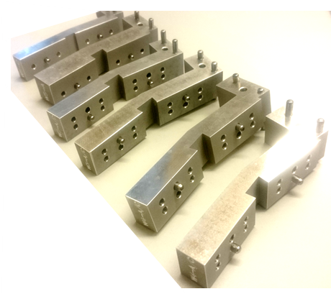
ITS OB DETECTOR BARREL assembly: jigs tools & procedure
Stave installation jigs and procedure validation at CERN.
@CERN
Massimo Benettoni,
Matteo Turcato, …

Slide 4
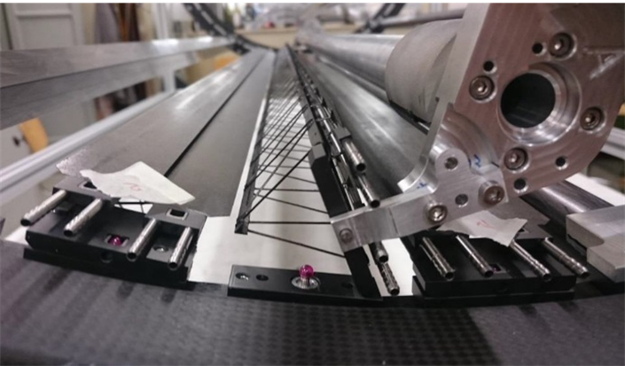
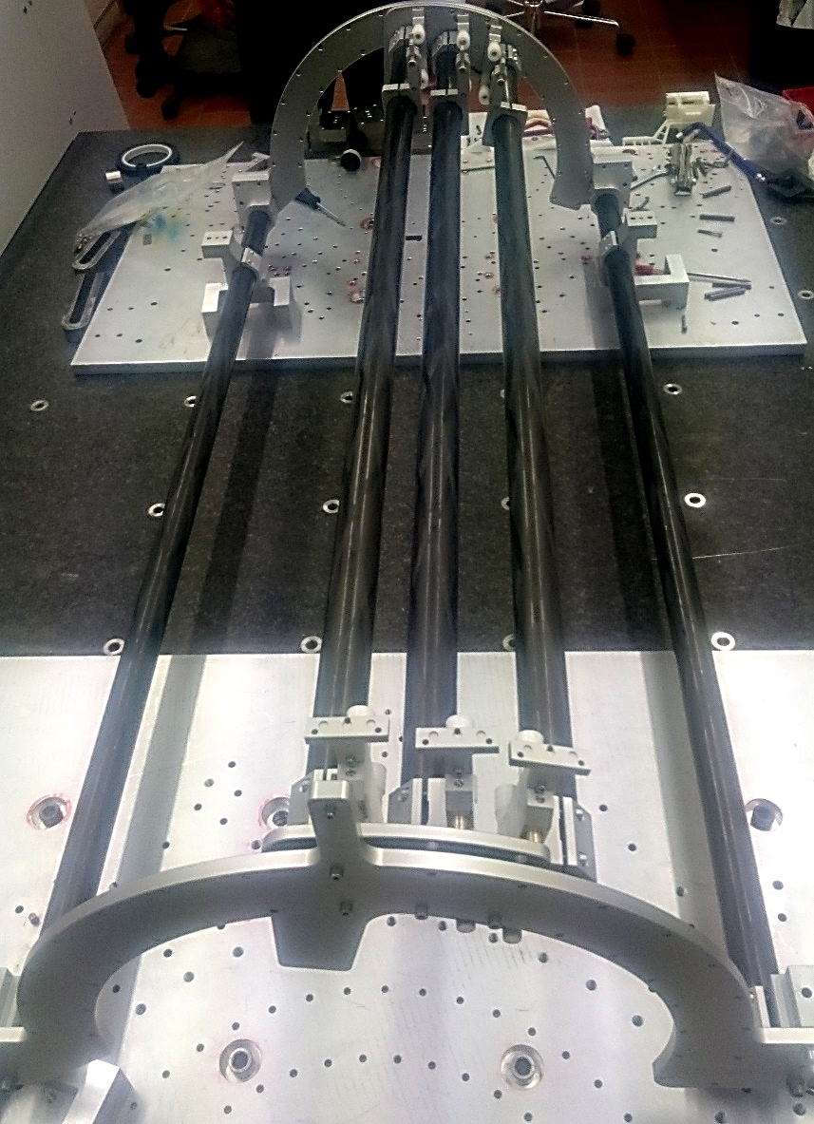
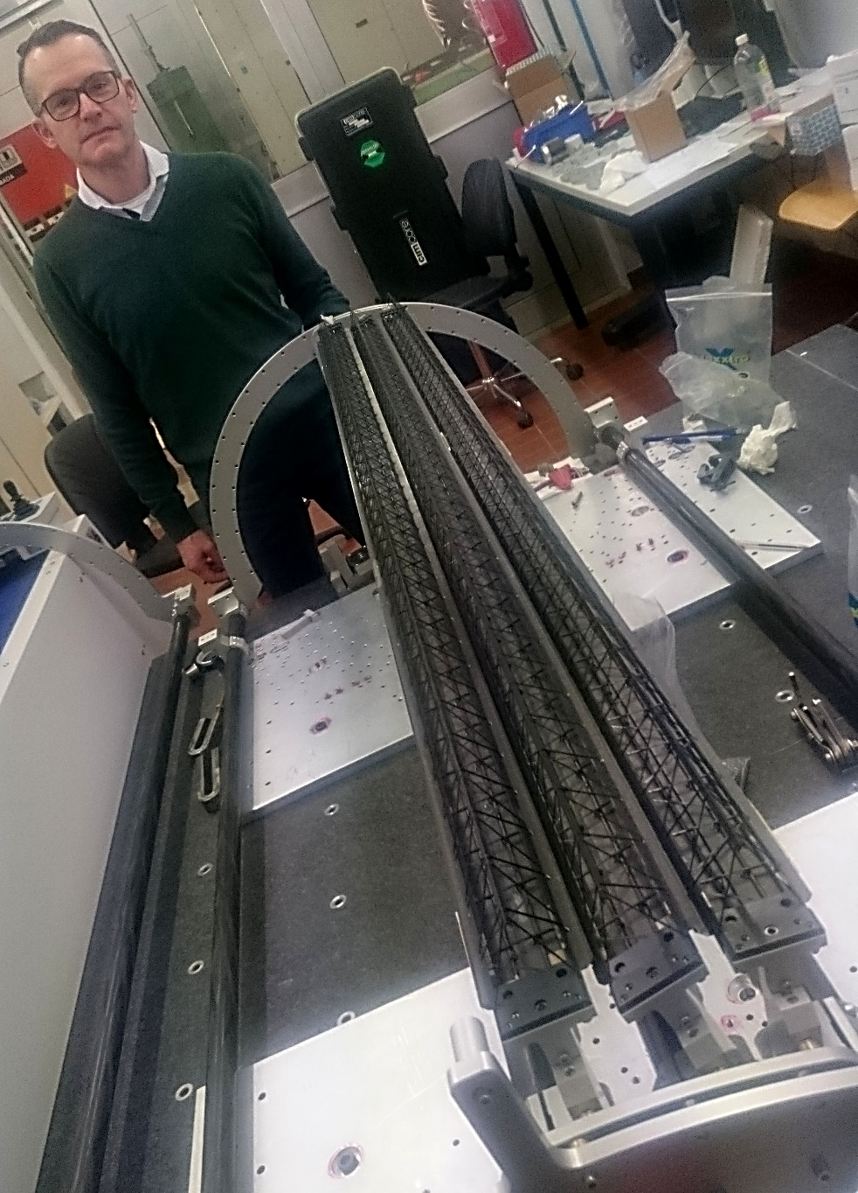
DETECTOR BARREL assembly: Stave replacement jig
The Stave replacement jigs are in production at INFN Padova
Stave replacement jig new revised designed finalized production done delivered at CERN
Massimo Benettoni,
Matteo Turcato, …
>70 production drawings for tool parts and tool assembly masks. Suffered delays due to late parts delivery and defective machining recovery
Dry test performed in Padova sliding SF on assembled tools (flipped on table)
Further trials done at CERN on the actual hL structures, to debug

Slide 5
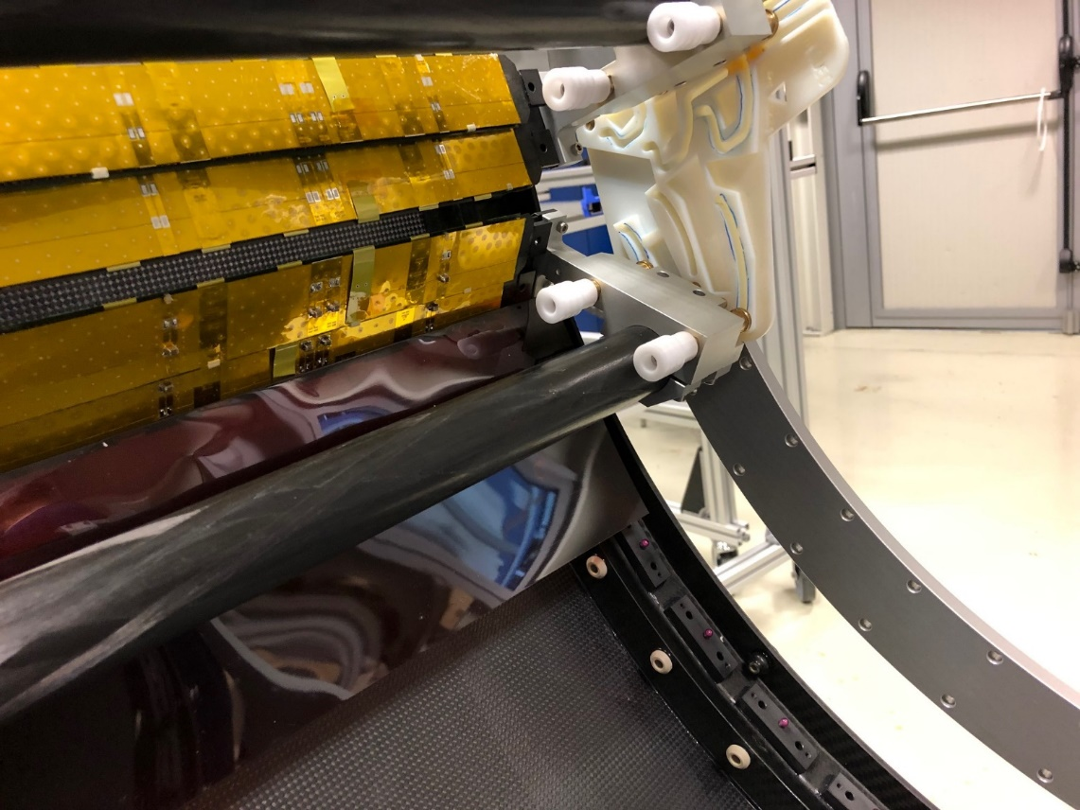
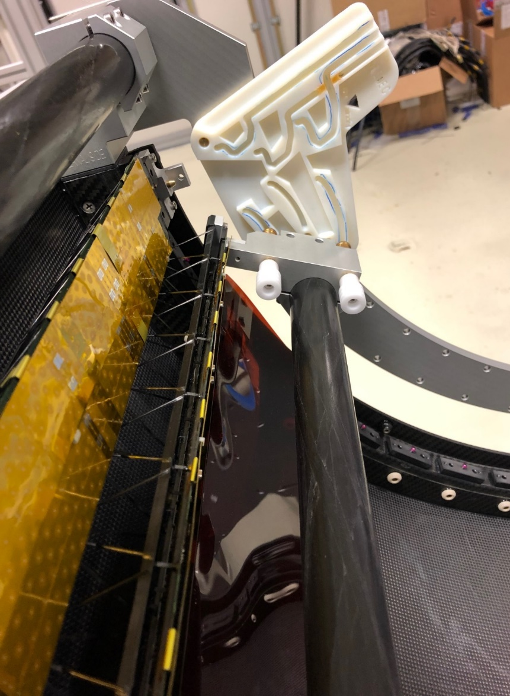
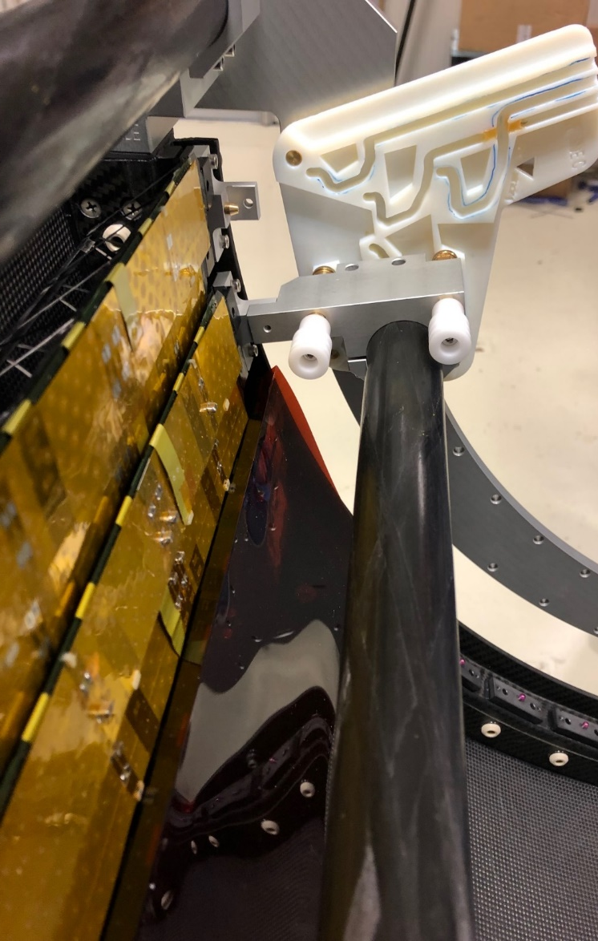
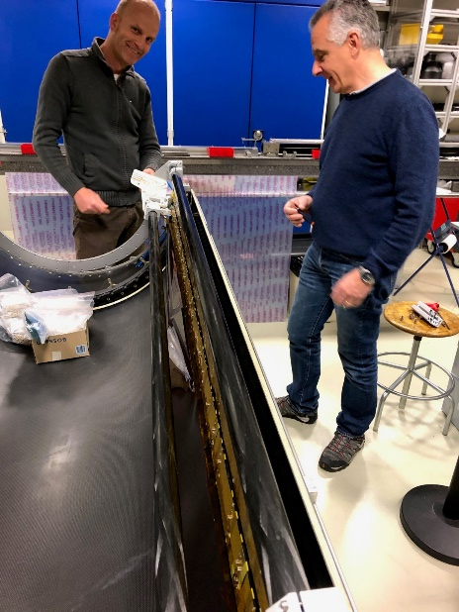
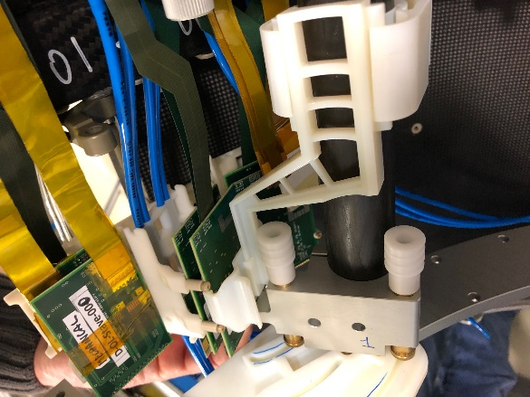
DETECTOR BARREL assembly: Stave replacement jig
Refining extraction path still ongoing to improve movement smoothness and reduce risk of staves clash
Producing 3d printed plates with guiding slots to validate extraction/insertion paths.
Massimo, Matteo

