Slide 1
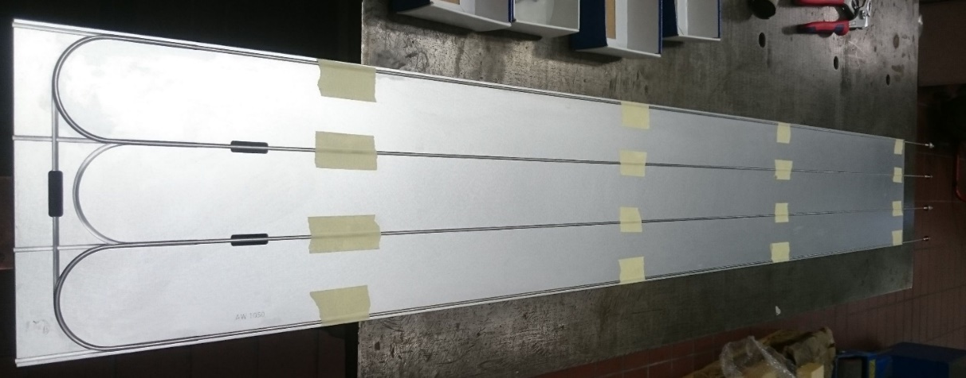
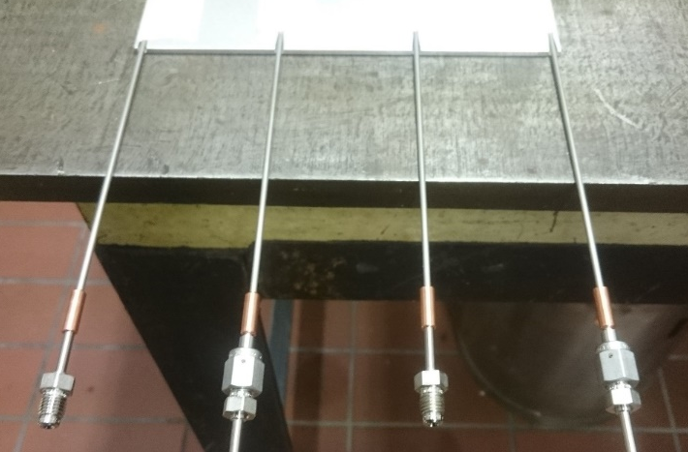
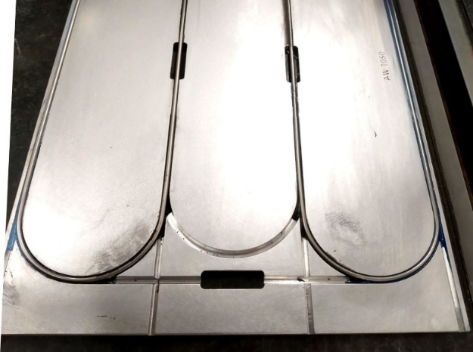
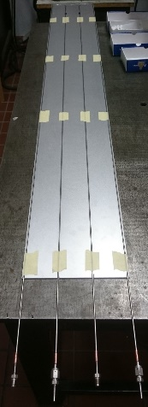
CMS BTL @ INFN Padova– M. Benettoni, N. Bez, D. Mazzaro, F. Veronese
CAD design in collaboration with INFN MiB
Thermal simulation for different layout options
Production of full size cold-plate prototypes for thermal test in Padova and distributed to collaborating Institutes

