Slide 1
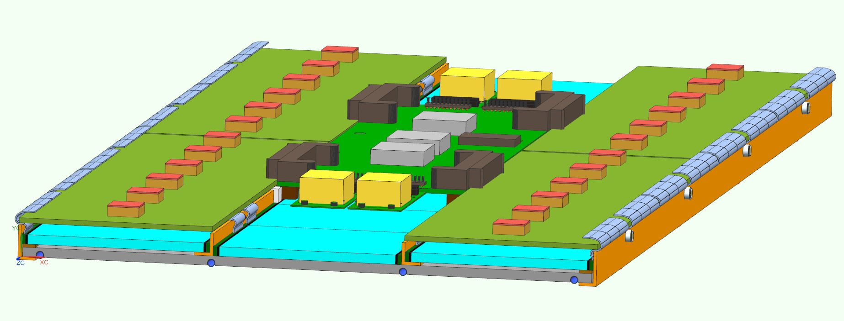
CMS BTL @ INFN Padova– M. Benettoni, N. Bez, D. Mazzaro, F. Veronese
CAD design in collaboration with INFN MiB, integrating LYSO crystals with SiPM boards, FE Tofhir boards, Concentrator card, FeastMP
Different constructive approaches (single piece full tray vs assembly of separated RU approach) going to be evaluated with mock-up

Slide 2
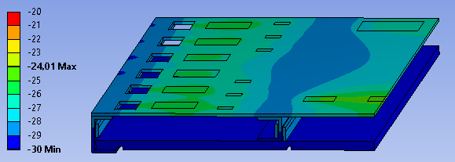
FEA thermal simulation on ¼ RU aluminium skeleton of different tray layout N.Bez – INFN Padova
Thermal simulation of different layout options to compare various design approaches
CASE 1 |  |  |  |  |  |  | CASE 2 |  |  |  |  |  |  | CASE 3
Cold plate @ inner radius |  |  |  |  |  |  | Cold plate @ inner radius |  |  |  |  |  |  | Cold plate sandwiched, electronics in contact with cold plate
Elettronics heat loads on footprints on "sink plate" |  |  |  |  |  |  | Elettronics heat loads on footprints on "top cover" |  |  |  |  |  |  | Elettronics heat loads on footprints on cold plate

Slide 3
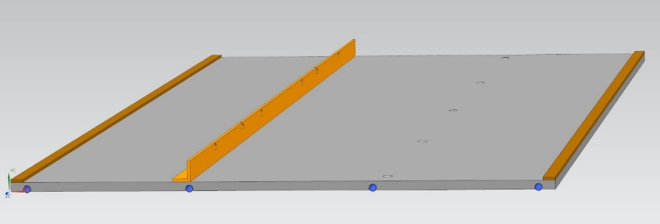
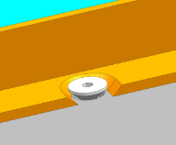
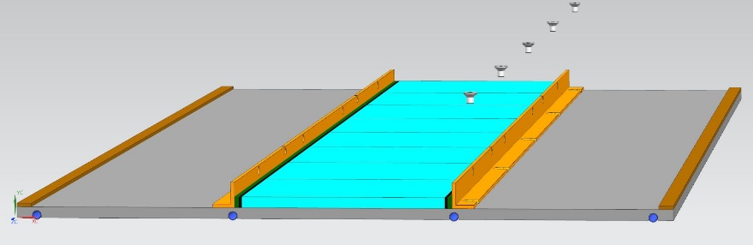
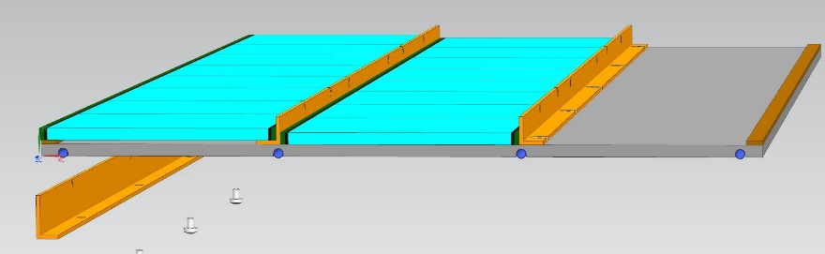
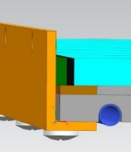
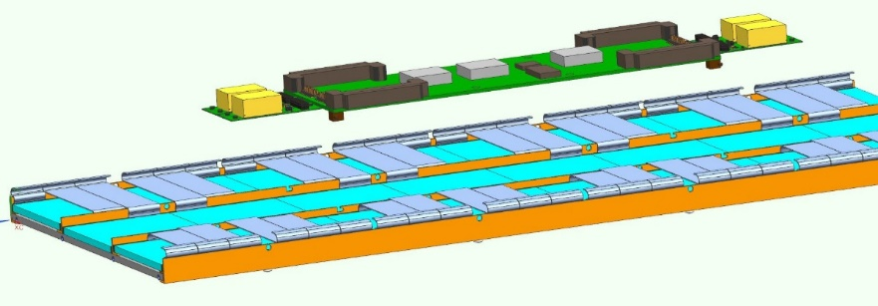
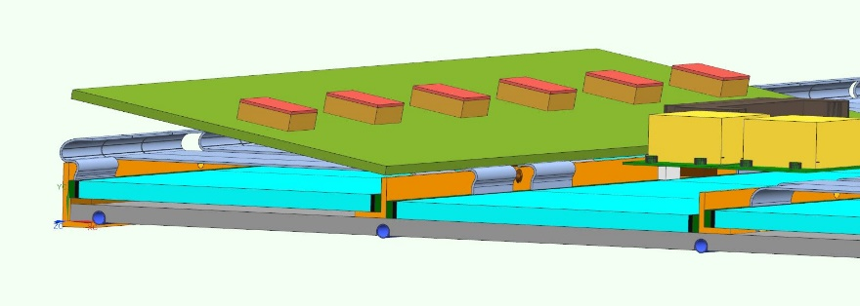
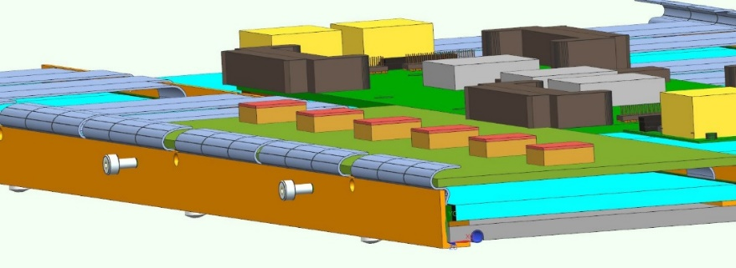
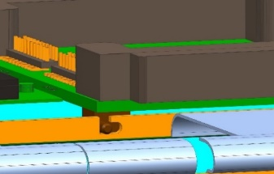
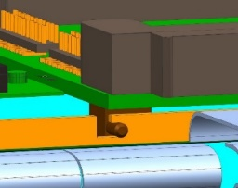
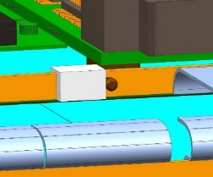
“LYSO Bars layout” RU assembly sequence– M. Benettoni, N. Bez – INFN Padova
Study of tray assembly sequence vs tray design, to assess assembly feasibility
1 fix L profile and 2 spacers (glued with thermal glue)
Countersunk slot and screws, ensure thermal contact
Outer L profiles floating to fit packages tolerances
L profiles to be put in contact to sensors and screwed …
No thermal pads interposed, a thin thermal compound layer may help
Kapton FPCs folding (to connect SiPM boards to Tofhir boards)
Concentrator card mounting (sliding-in and locking / snap-fit)
Tofhir cards mounting and connectors to CC coupling
Tofhir cards fixing and FPCs coupling

Slide 4
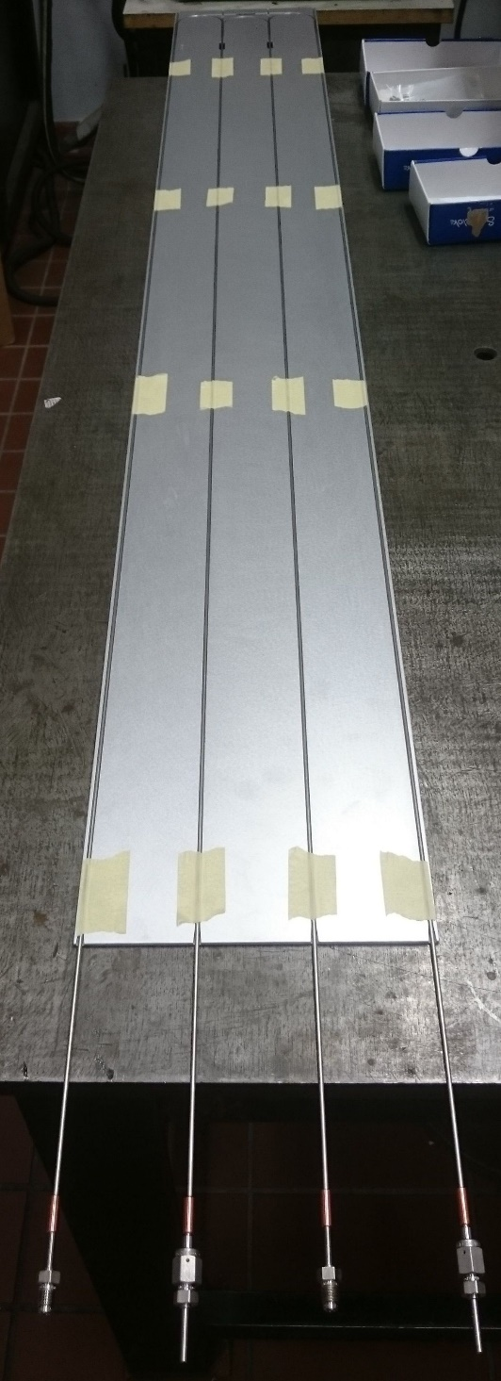
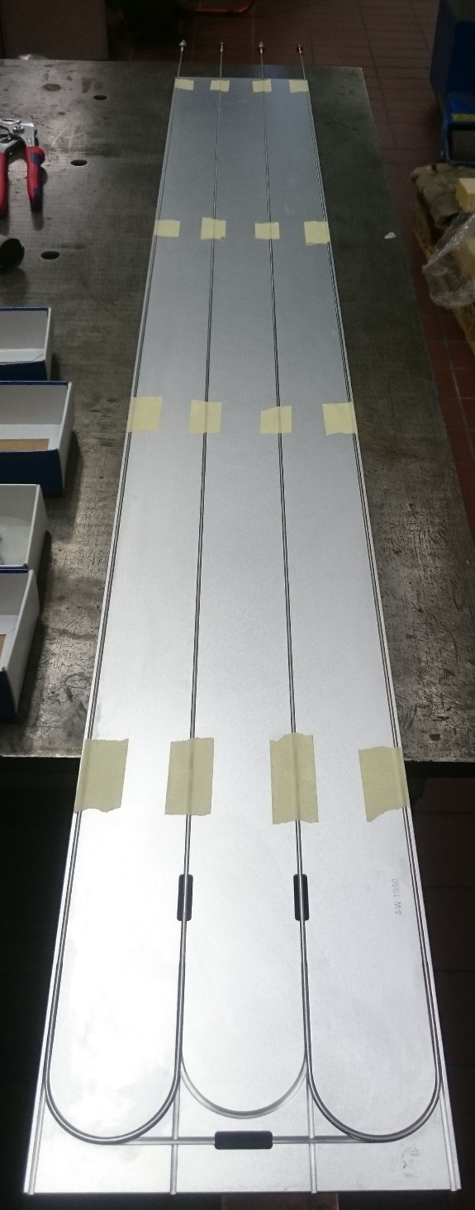
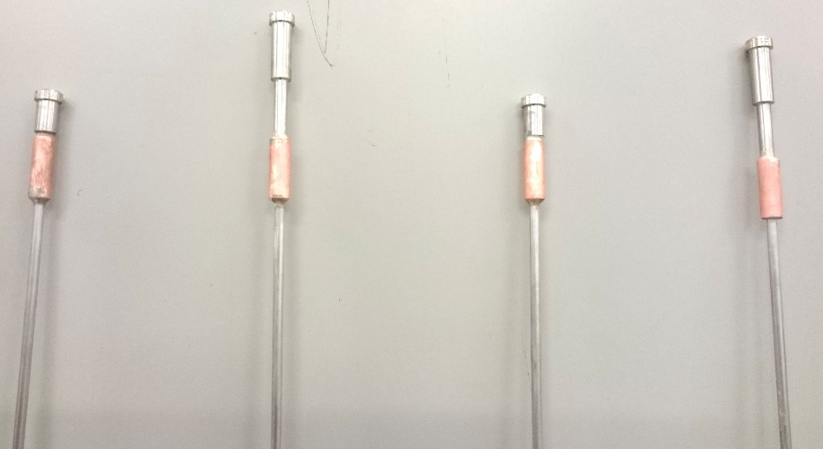
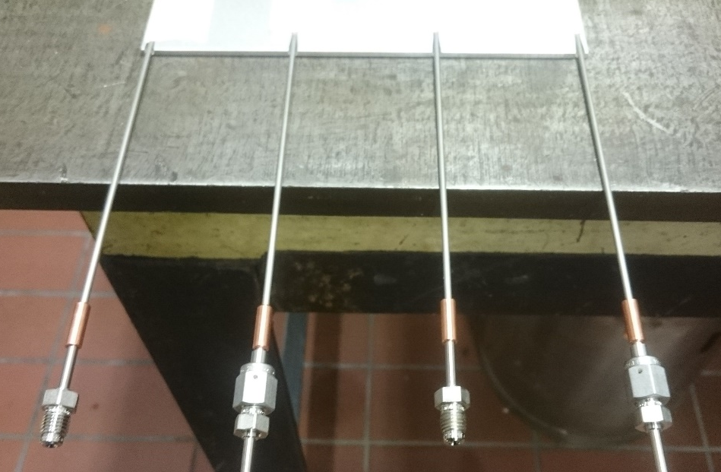
Prototyping production for thermal test - Benettoni, Bez, Mazzaro, Veronese - INFN Padova
Bending tool produced
First prototype: Φ 2.4 mm capillaries bent, fitting brazed
circuit tightness test at ~ 30 bar (N2).
glueing of capillaries to plates done at LAE, LNL
In progress: resistors and L profiles procurement to dress mock-up
In progress: Insulated box procurement
Full size prototype with 2 loops of brazed capillaries delivered to CERN week 26

Slide 5
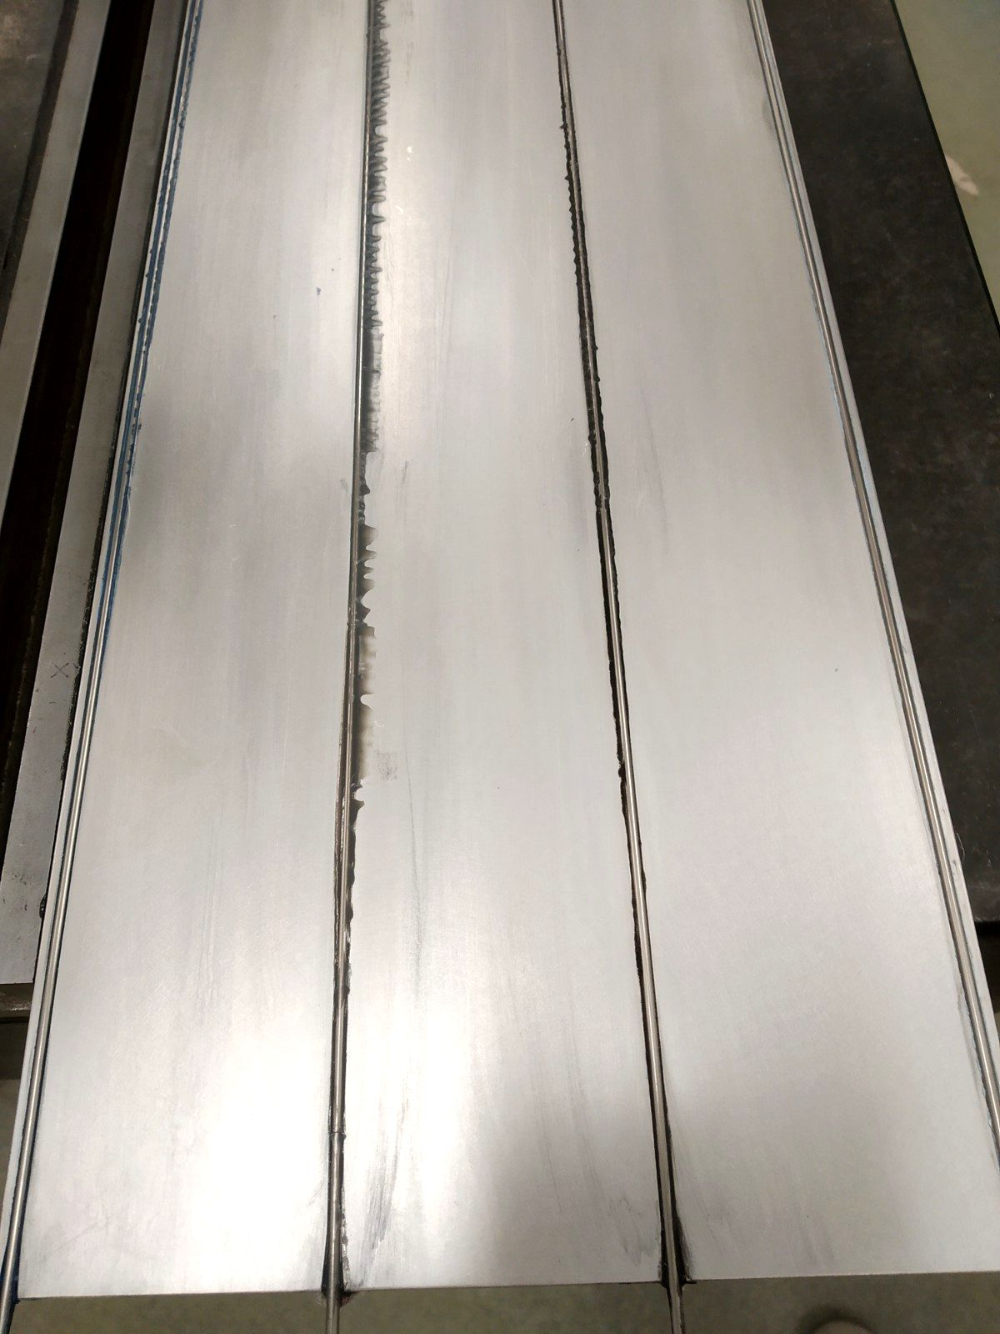
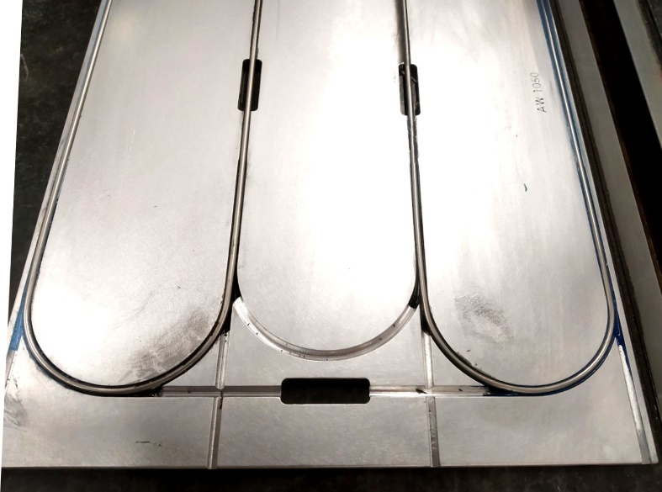
Cold plate prototypes for thermal test - Benettoni, Bez, Mazzaro, Veronese - INFN Padova
Thermal glues are supplied in two siringes/jars/vials each,
Not comfortable, to be dosed and mixed “by hand”
Epoxy glue in standard cartridge with static mixer and gun
Fischer Electronic WLK 30 (thermal epoxy)
3M DP 190 (structural epoxy): lowest viscosity
Loctite Ablestik 45 (structural epoxy)
Electrolube TBS20S (thermal epoxy): highest viscosity
Electrolube more problematic one
wasn't properly squeezed, overall plate+pipe thickess up to 3.9 mm
overall thickness of glue up to ~ 0.5 mm
still sticky after a few days
Not glued properly everywhere
Fischer electronic still soft ….
Structural glues fine apart glue excess
What learned:
Most time consuming operation is glue excess removal, yet not enough
Glue dosing to be improved (dispenser on controlled axis …?)
To improve cleanliness would add aluminum coating
(conductive or anodization?)

