Slide 1
BTL mechanical design
Massimo Benettoni on behalf of CMS BTL Collaboration
September 19, 2023

Slide 2
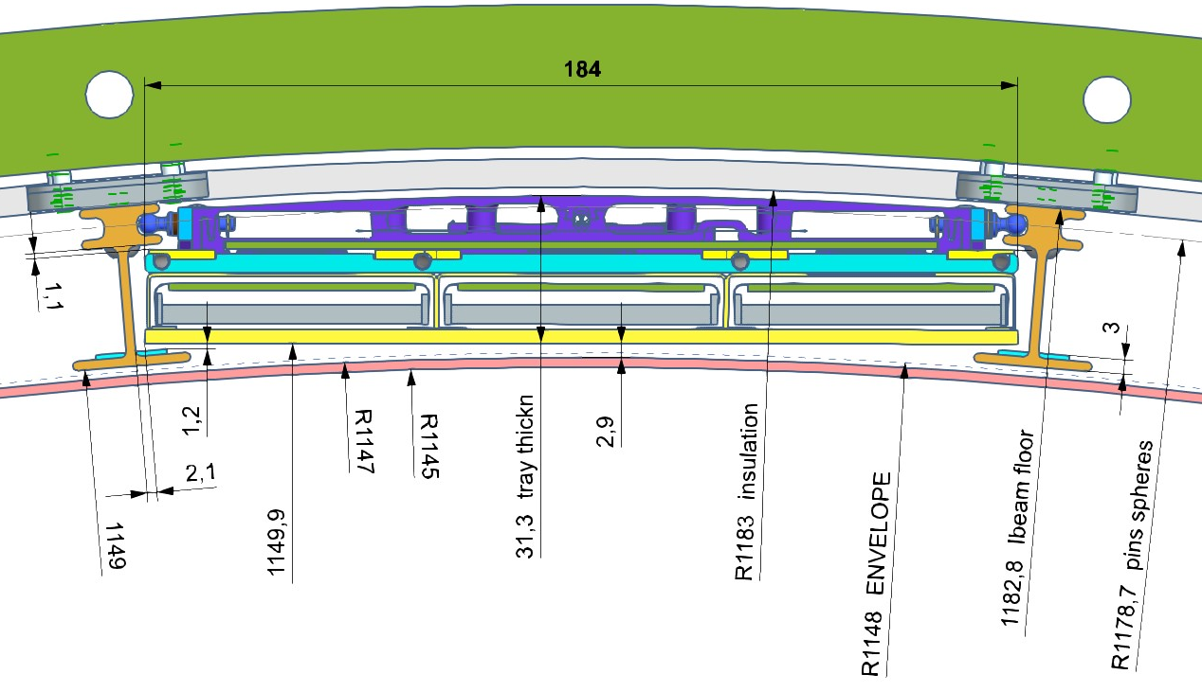
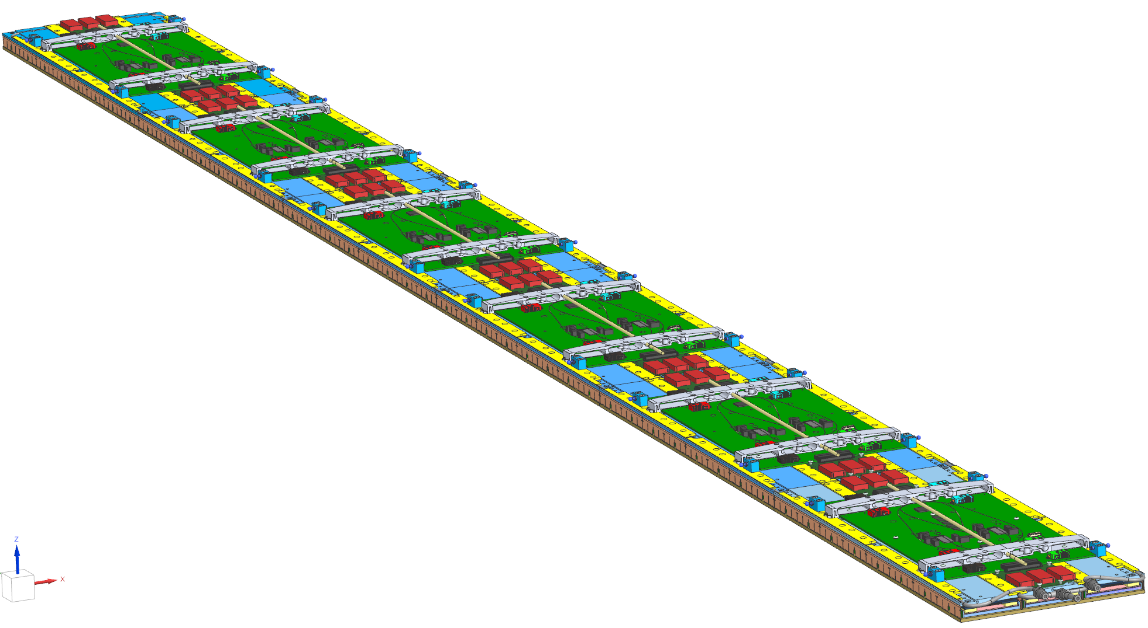
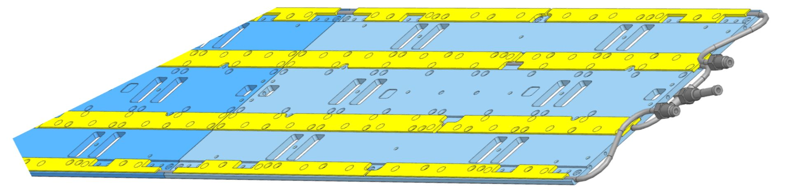
Tray scheme
“TOM” Design : Tubes On Middle
Cooling Loop clamped with clamping laminas
to Cooling Plates
The 6 Cooling plates constitute the structural backbone placed between Detectors Modules and electronic boards
Choice of split cooling plate
for compliance to rails
shape

Slide 3
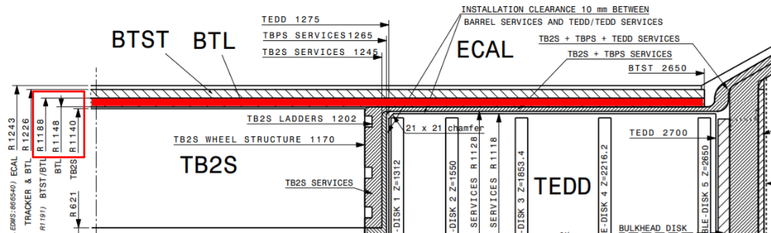
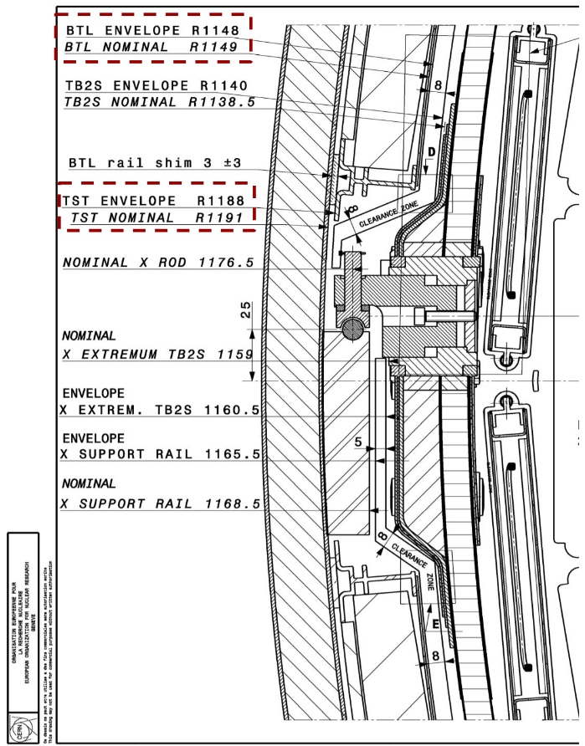
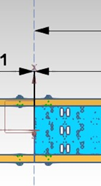
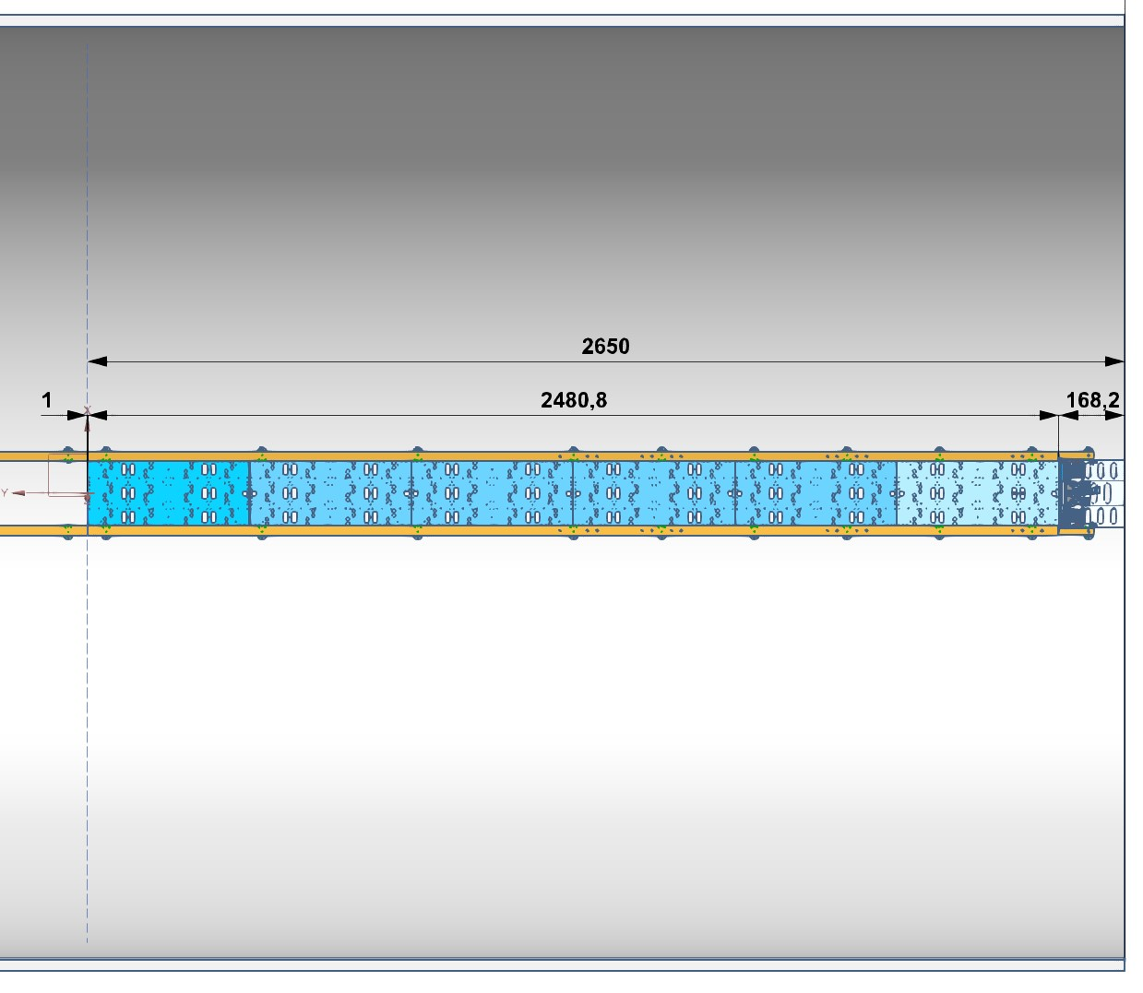
BTL trays dimensions and envelope
https://edms.cern.ch/nav/P:CERN-0000192329:V0/D:1698464:V0
BTL radial envelope R1148 – R 1188 mm
Cold Tray from Z +/- 1 mm to Z +/- 2481.8 mm

Slide 4
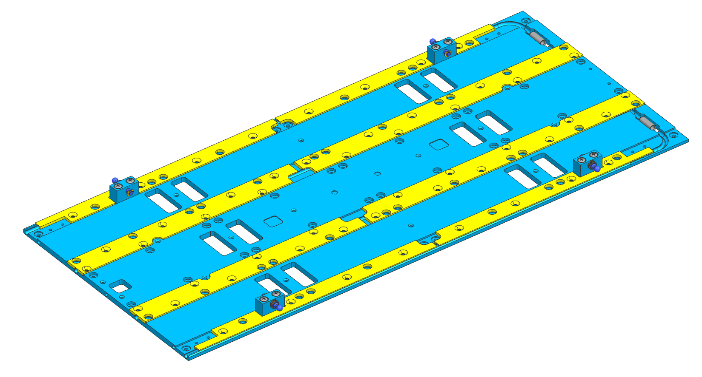
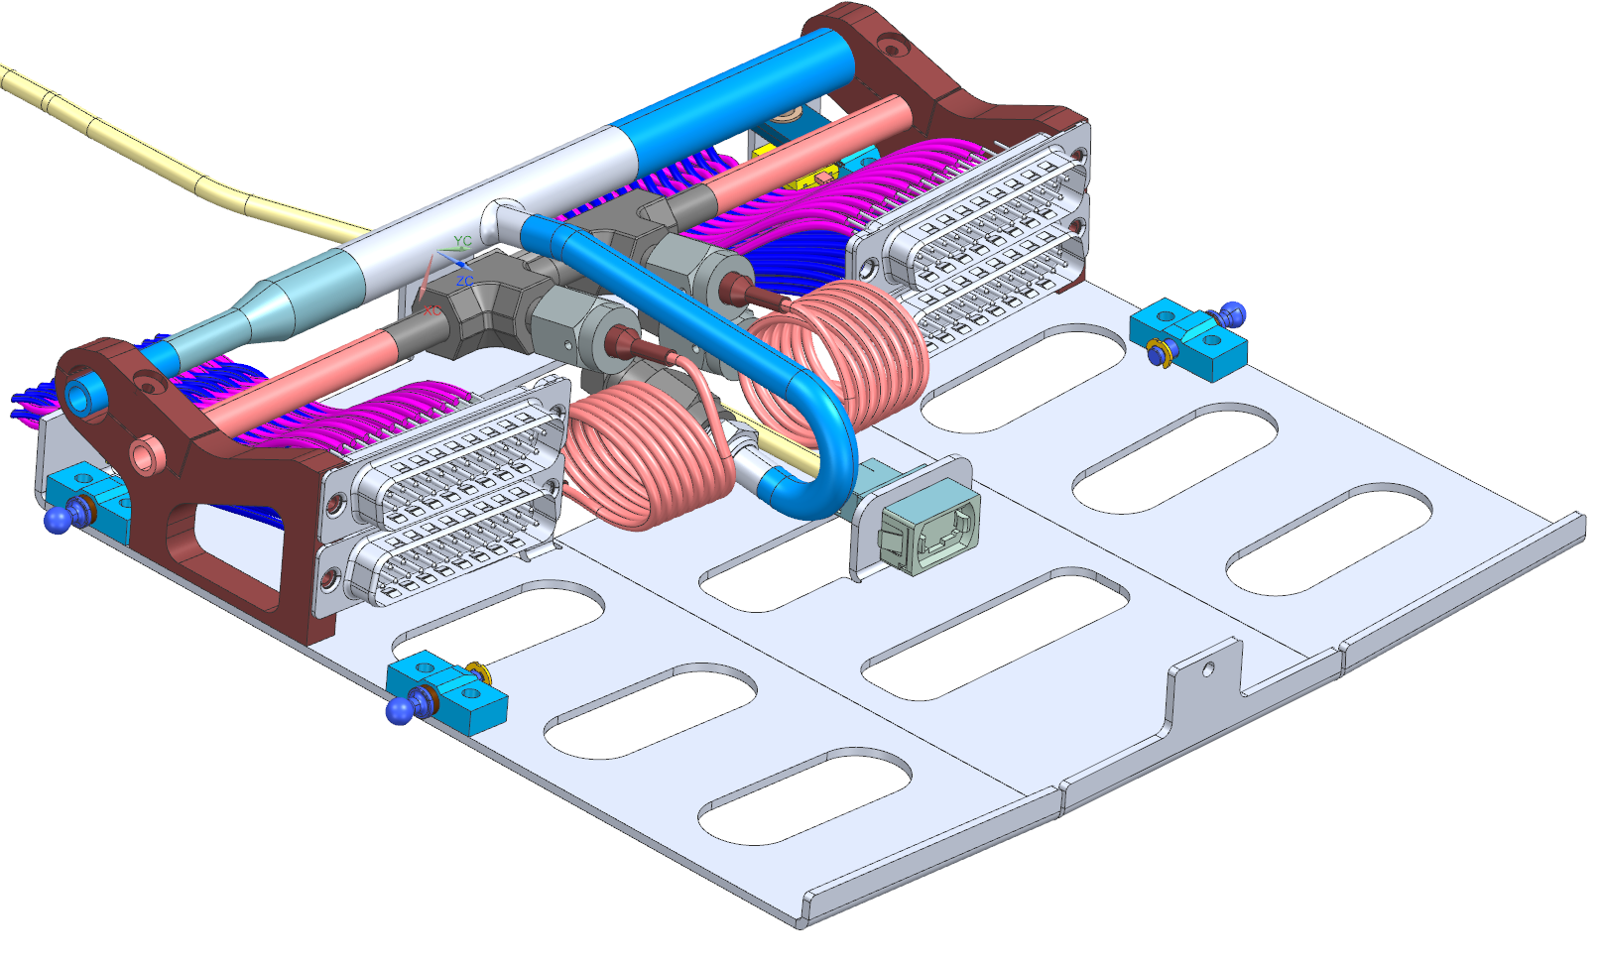
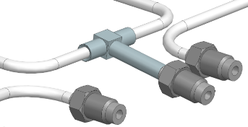
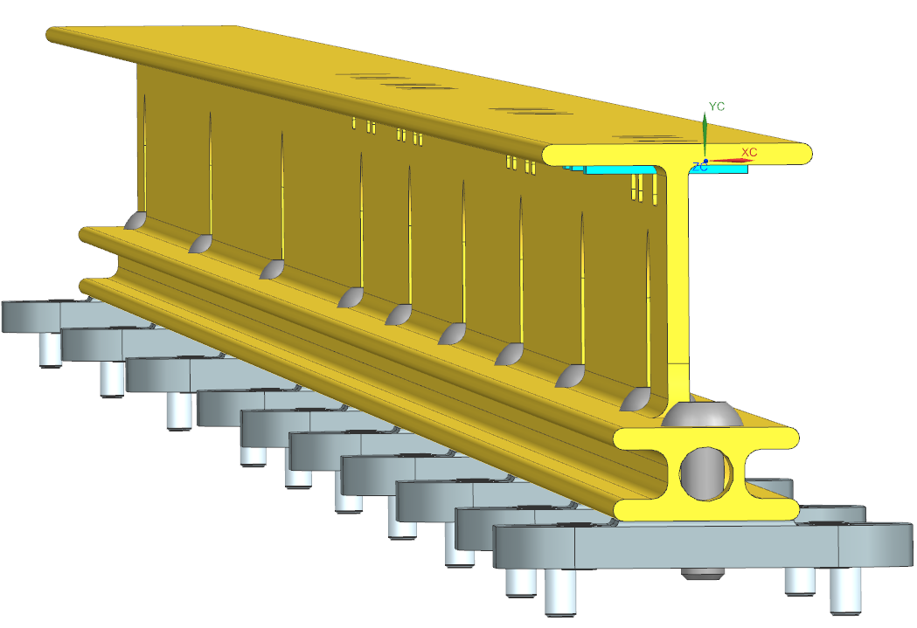
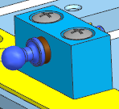
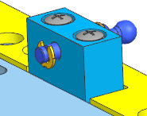
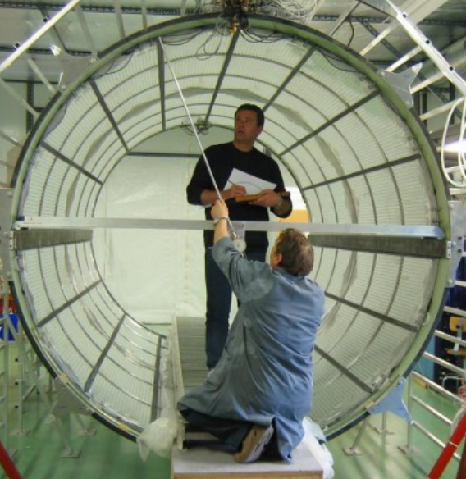
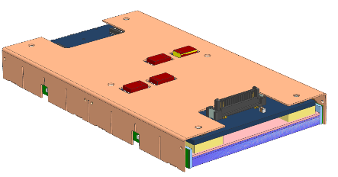
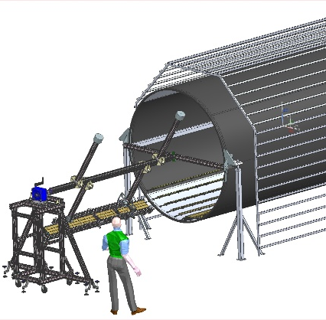
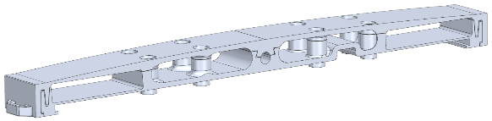
Tray components and jigs (only “mechanics” considered)
Cold tray (CT)
6 Cold Plates (CP) /tray
48 Laminas /tray
1 Cooling loop (CL) including
  Tee
  Fittings (Swagelock VCR glands)
Tray to rails interfaces
Roller pins
Rollers blocks
Screws, pins
Detector modules mechanics
Copper cases (DMs)
DMs to CPs Thermal interfaces
Other tray components
Cables brackets
Tray «bottom» insulation
Service tray
Manifold
Fittings and capillaries
Service support tray and rollers
Interface to BTST and TRK services
I-beams (rails)
I-beams feet
BTST insulation
Insert on I-beams to fix ribs and TRK/BTL screen
Main Jigs for trays assembly
Pipes assembly and transport cradles
Tray assembly and transport cradles
Tray assembly «skewer holder»
Main Jigs for installation
I-beams installation jig
Dummy tray for go/no go check
Tray installation jig

Slide 5
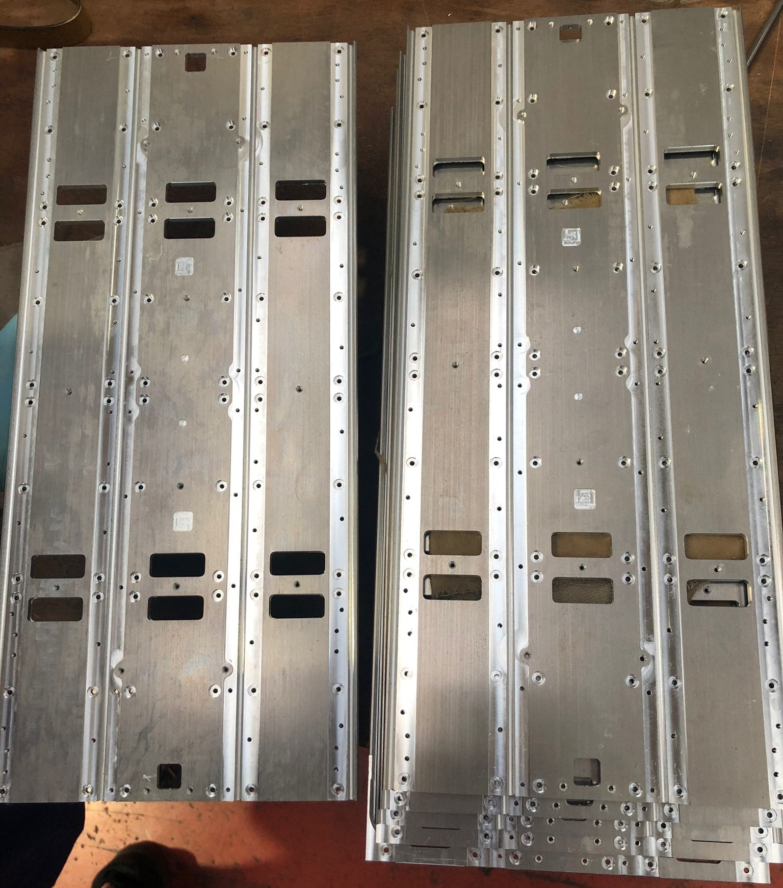
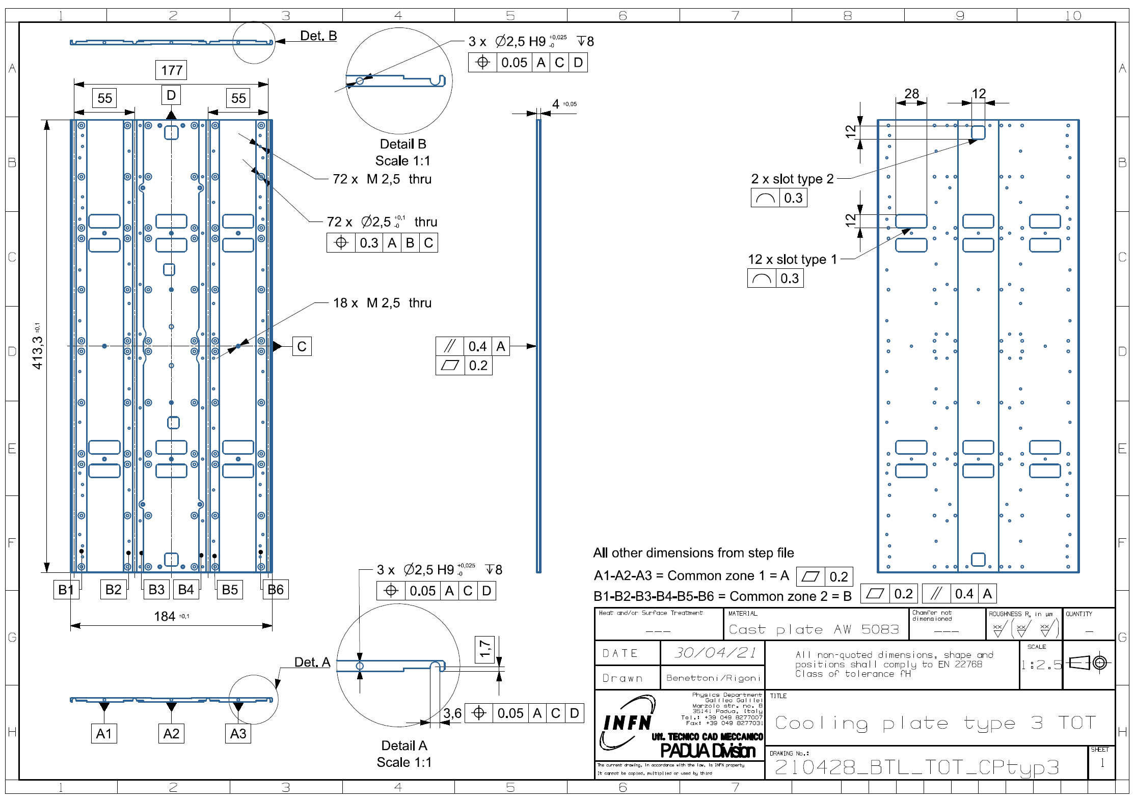
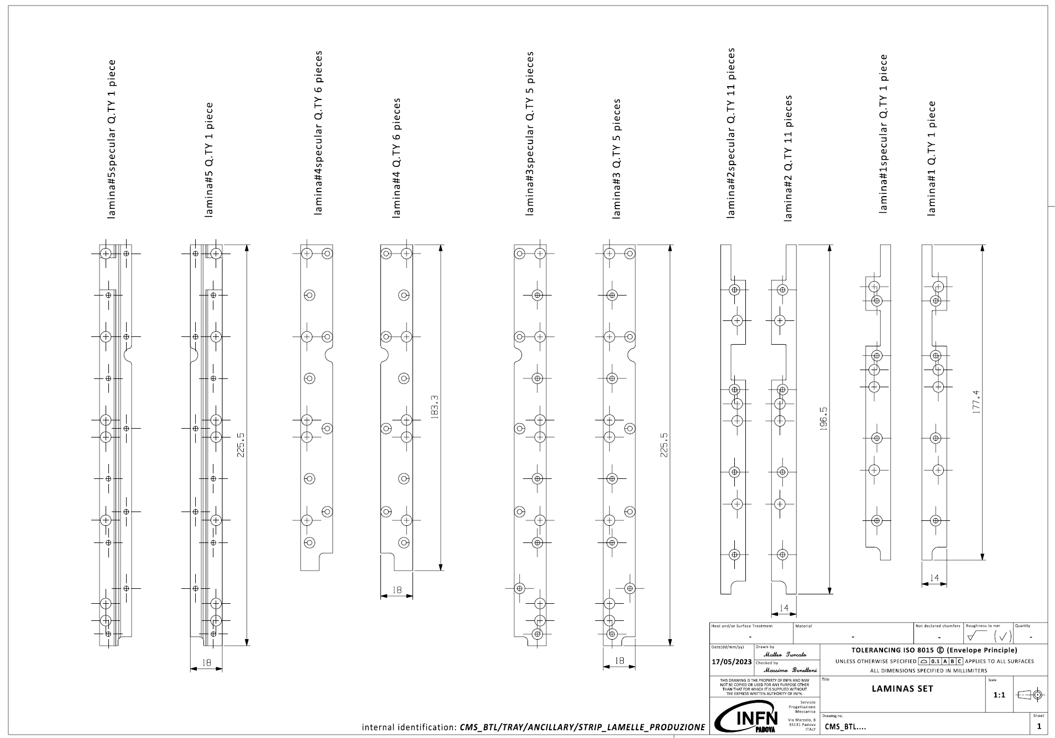
Cold Plates and laminas
n. 6 Cold Plates per tray, 450 overall
Aluminum alloy AW6082
Pipes embedded in the grooves machined in the plates
Tapped and through holes to fix clamping laminas, DMs, rollers and boards (CC)
Through slots for DMs to CC connectors
Features / holes for
Handling, cables fixing
tray hooking for Insertion
Laminas to clamp pipes to CPs in order to minimize CP-to-CL thermal resistance
Shaped to avoid conflict wrt electronics, rollers, screws, brackets for assembly
Preserved distance of CC bottom components to laminas: > 2 mm
n.8 laminas/CP , 48 laminas/tray
3.5k pieces individually machined
Surtec 650 coating
7 sets of full CT produced up to now
No major issues
Final check of CAD models before launch production:
interferences
required holes and features

Slide 6
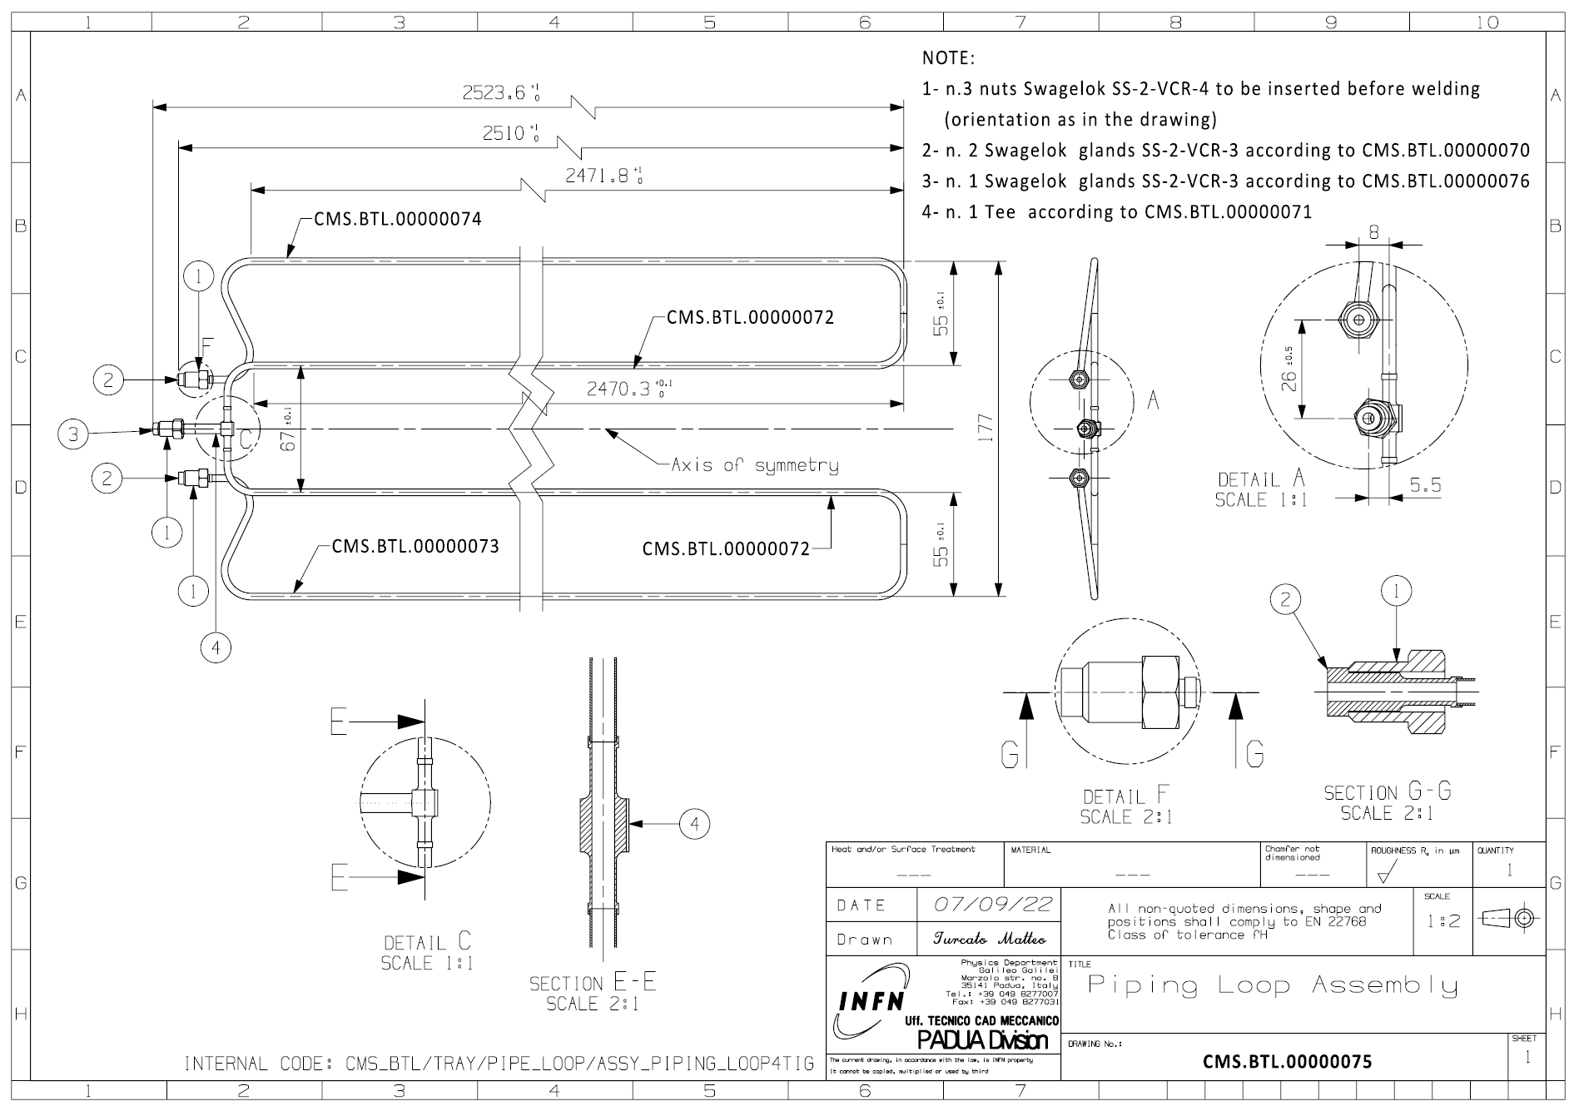
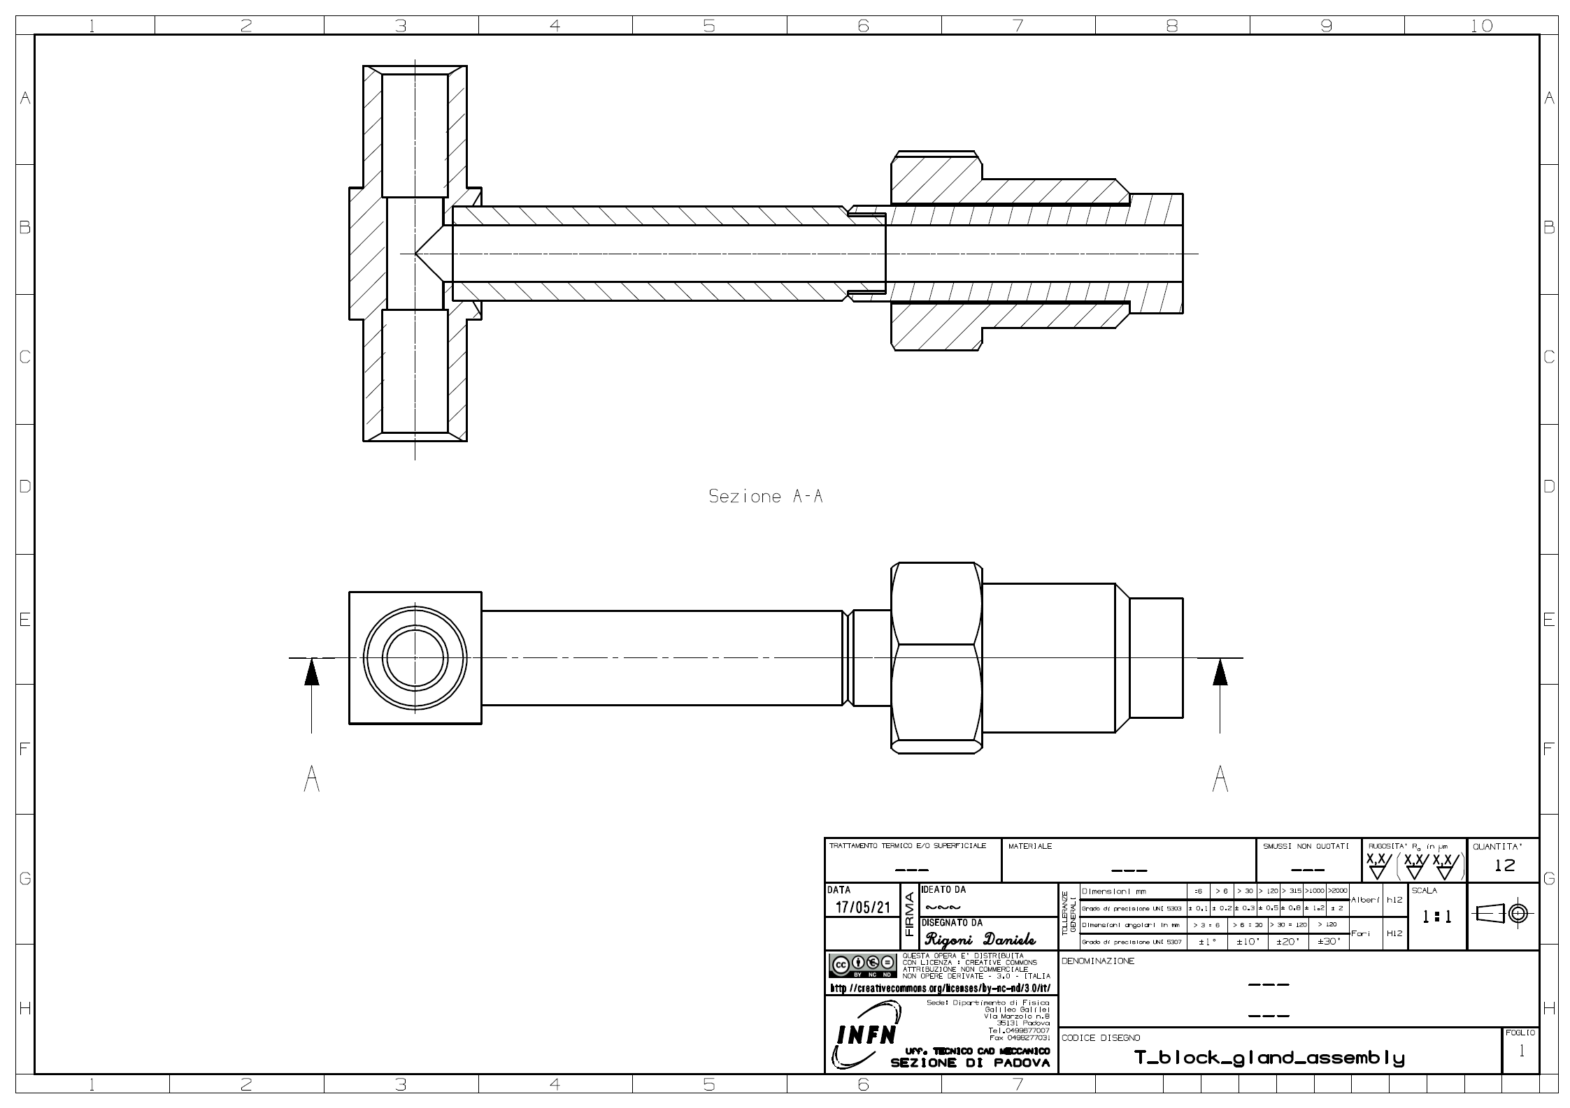
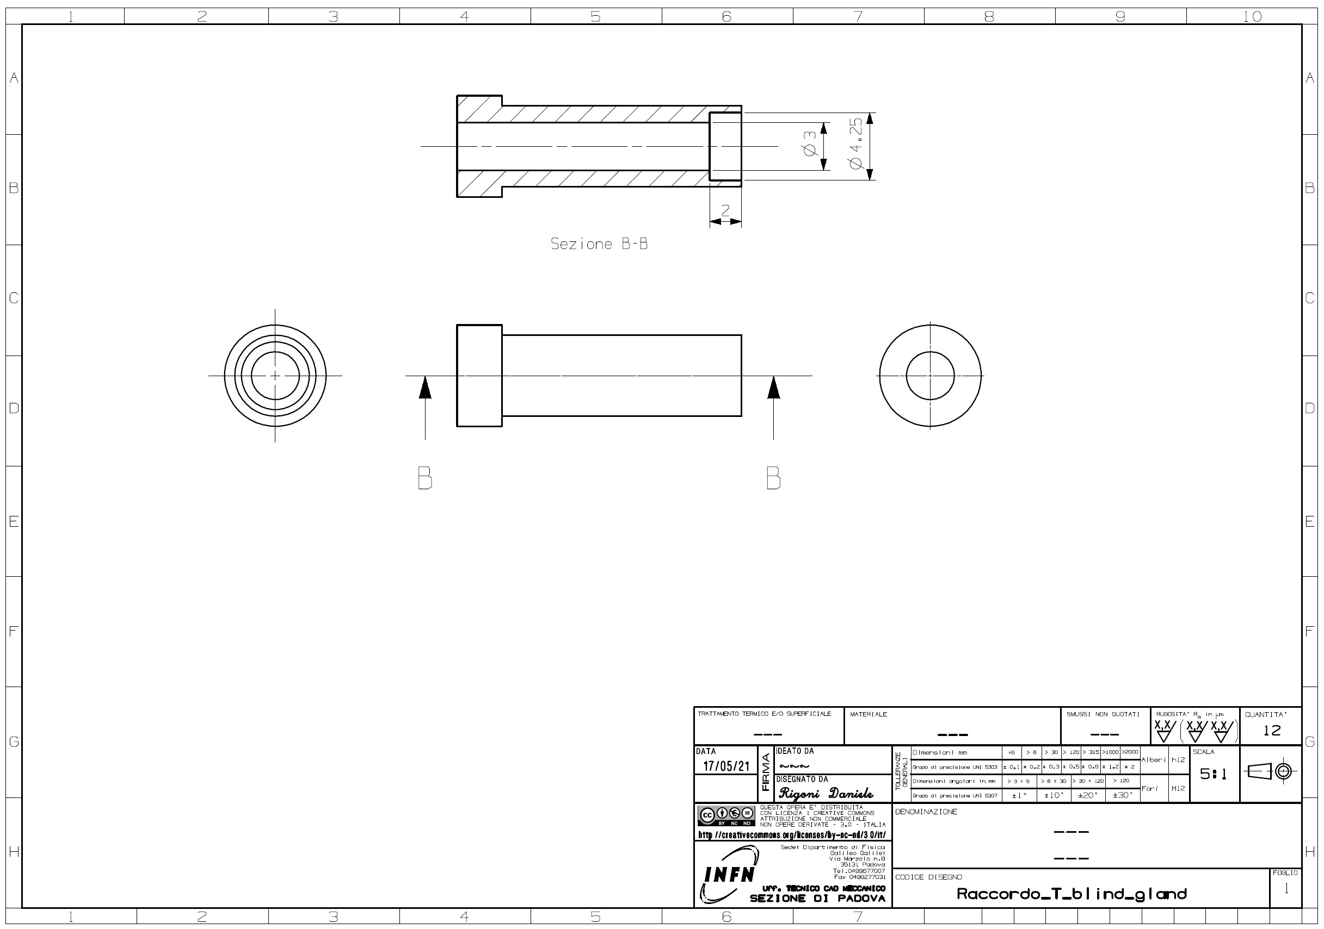
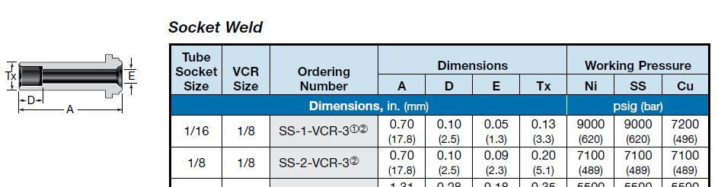
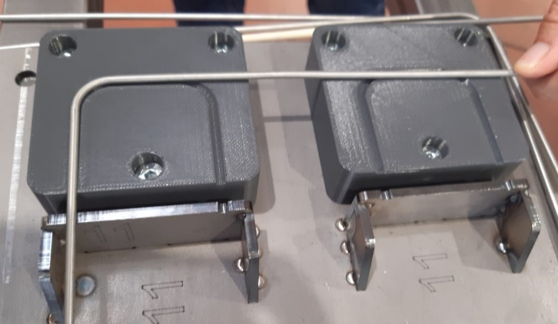
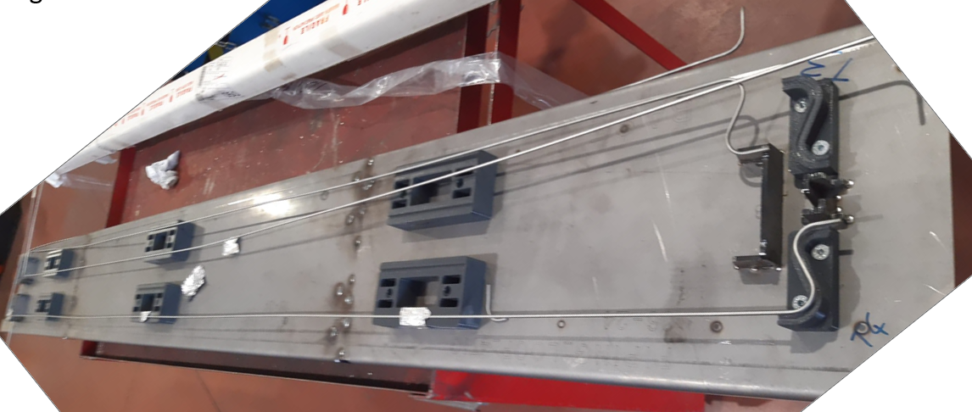
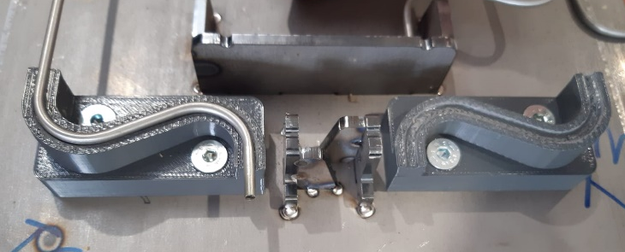
Cooling loops prototyping and qualification
Pipe loops prototypes produced up to now:
- 1x EB brazed prototype
- piping bending, Tee and glands @ INFN Padova
- vacuum EB brazing @ CERN
- 2 x TIG welded prototypes
All made of 3.5 mm O.D., 3 mm I.D. Aisi 316L pipes, tee and
Swagelok glands
Both types passed qualification process …
- CNC bending
- on full size jig for bending shape and length check
- Tuning of welding parameters on samples
- X-ray check to verify welding tuning on samples and on CLs
- Tee and glands produced/machined by INFN Padova workshop
- 100% X-ray check of all (7/loop) TIG weldings
- got offer for full production … ready for order
- bare pipes production ~ 10 weeks lead time
Prototyping of TIG welded Cooling loop @ supplier workshop

Slide 7
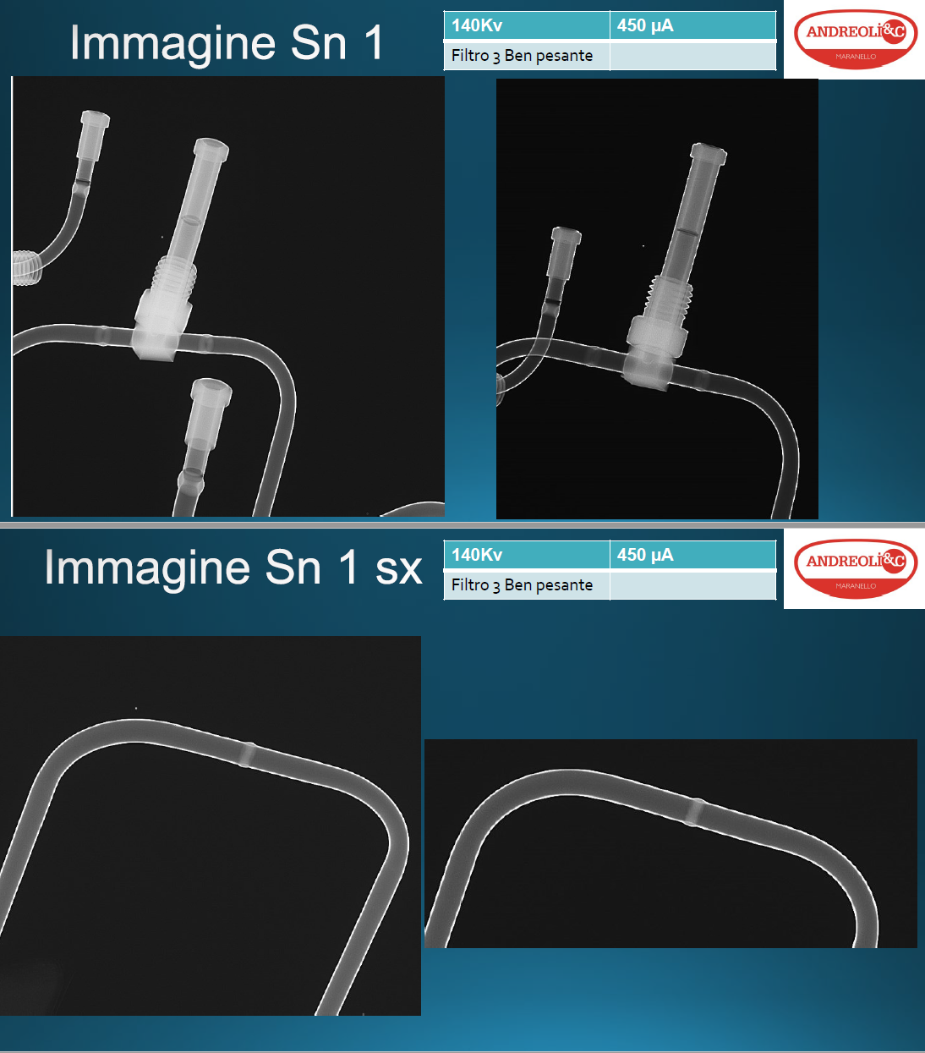
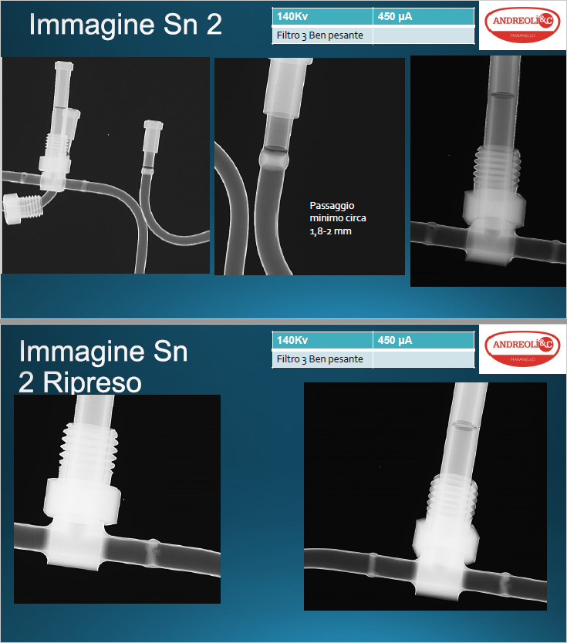
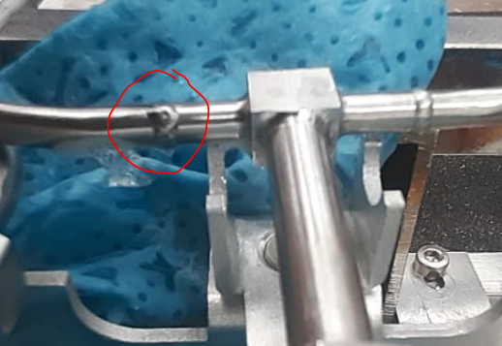
Cooling Loops qualification
X-ray:
CL prototypes brazing and welding X-ray scanned
Brazed prototype tomography:
https://edms.cern.ch/ui/#!master/navigator/document?D:100941045:100941045:subDocs
TIG welded prototypes X-ray report provided by the supplier.
Pressure and leak test according https://edms.cern.ch/document/2631824
Pressure test at CERN @ 125/S-03 HSE-OHS
All CL prototypes passed 186 bars pressure test
https://edms.cern.ch/ui/#!master/navigator/document?D:101335700:101335700:approvalAndComments
https://edms.cern.ch/ui/#!master/navigator/document?D:101335701:101335701:approvalAndComments
Leak test at CERN @ PH-DT lab 168/R-F05
TIG welded CLs passed He leak test , leak rate < 4 E-10 mbar l/s
One re-welded joint damaged btw disconnection of leak detector and connection CO2 bottle
Provisional clamping/stiffening to put in place to avoid stresses during plugging/unplugging
QA / QC will be performed at CERN (likely @ PH-DT lab 168/R-F05) by BTL Group
Foreseen 0.5h / CL => one week overall

Slide 8
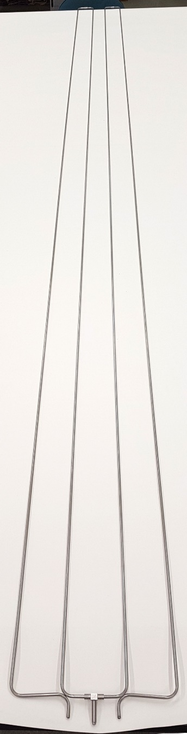
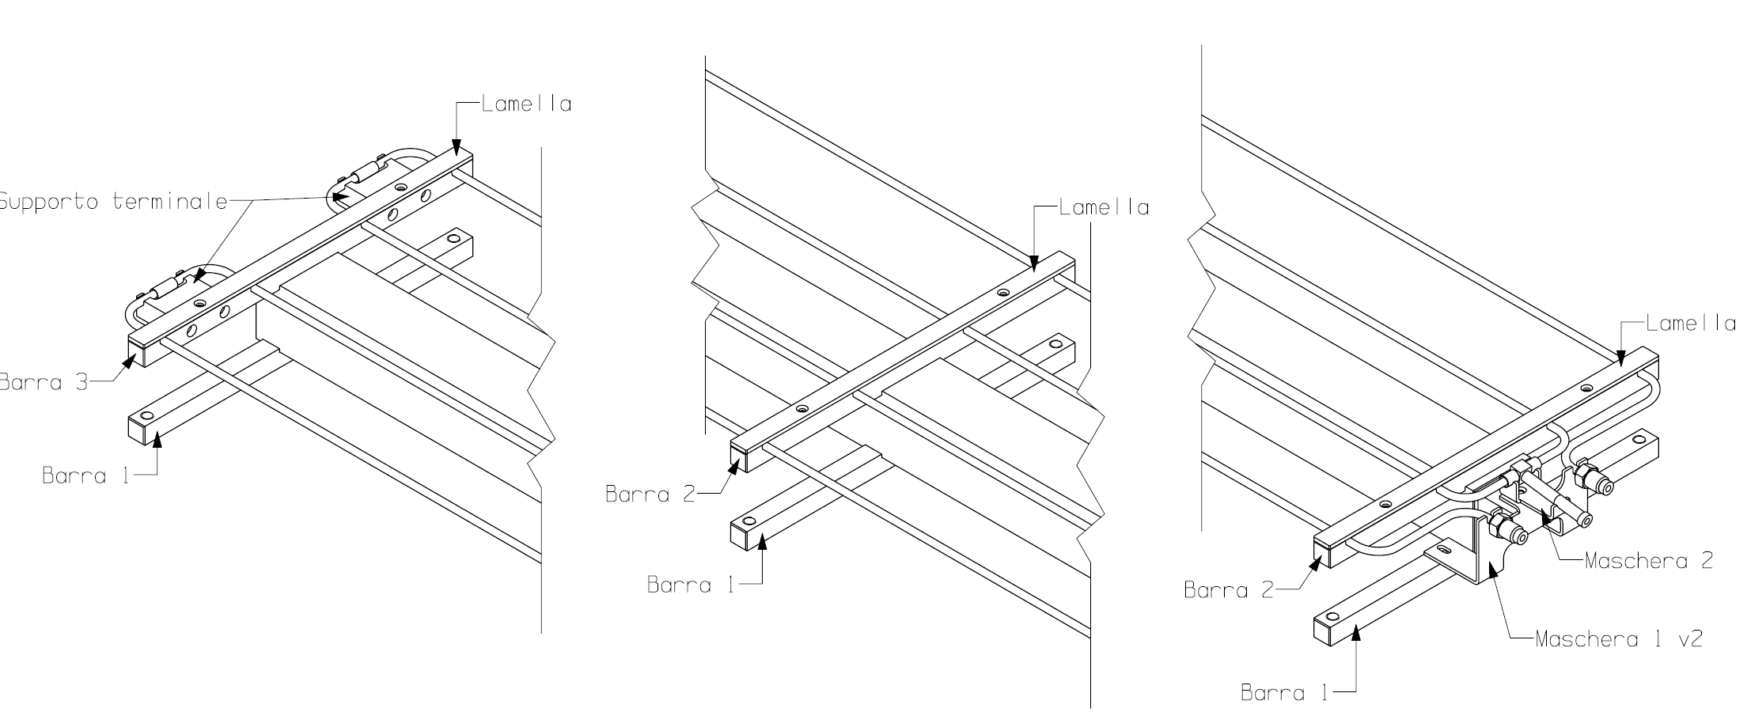
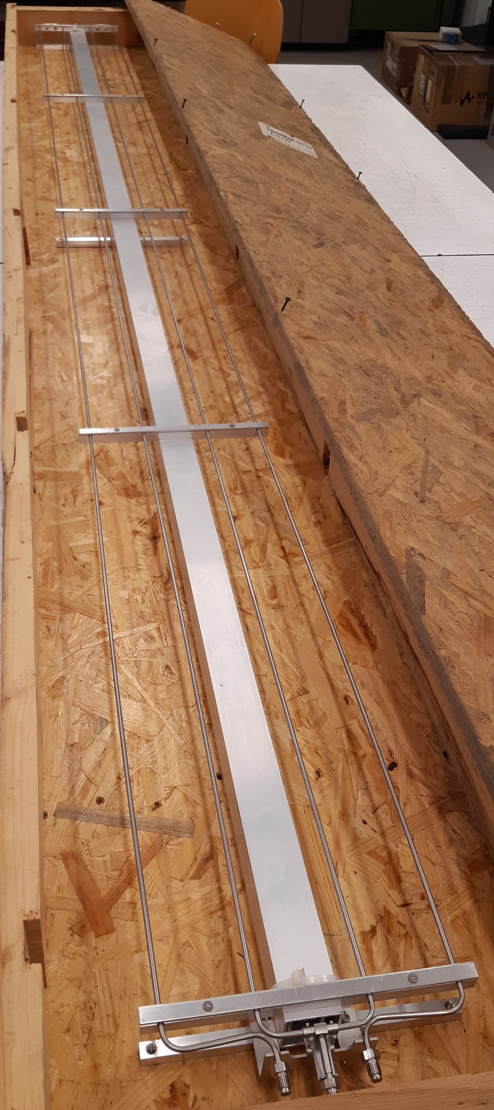
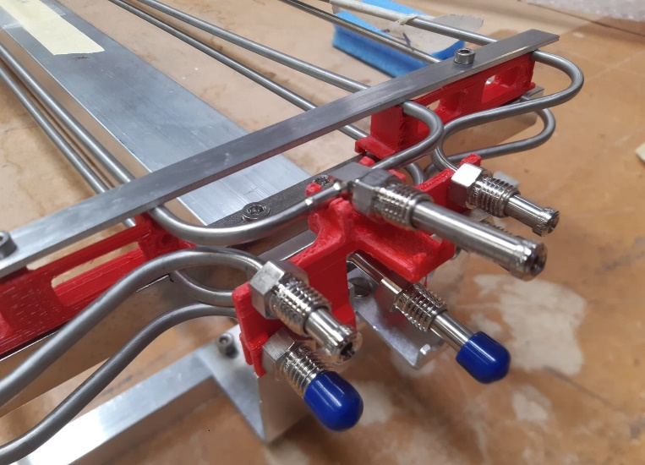
Pipe loop assembly frame
2.5 m long frame …. for loops shipping and storing.
Will be updated to lodge a few superposed loops
E.g. prototypes
Two loops overlapped on same frame
Pitch among CLs to be increased for better access to the connections

Slide 9
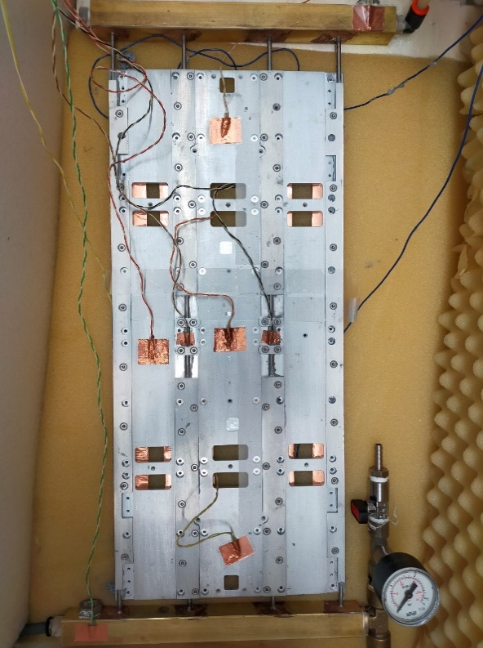
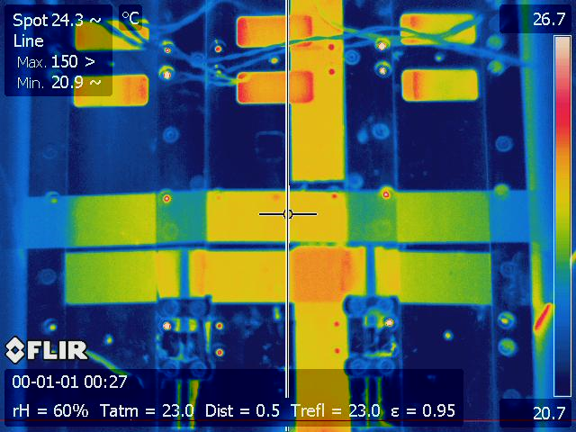
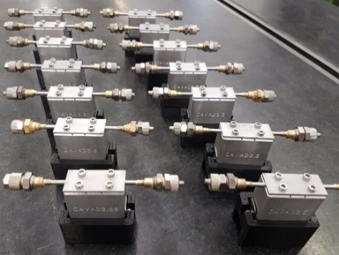

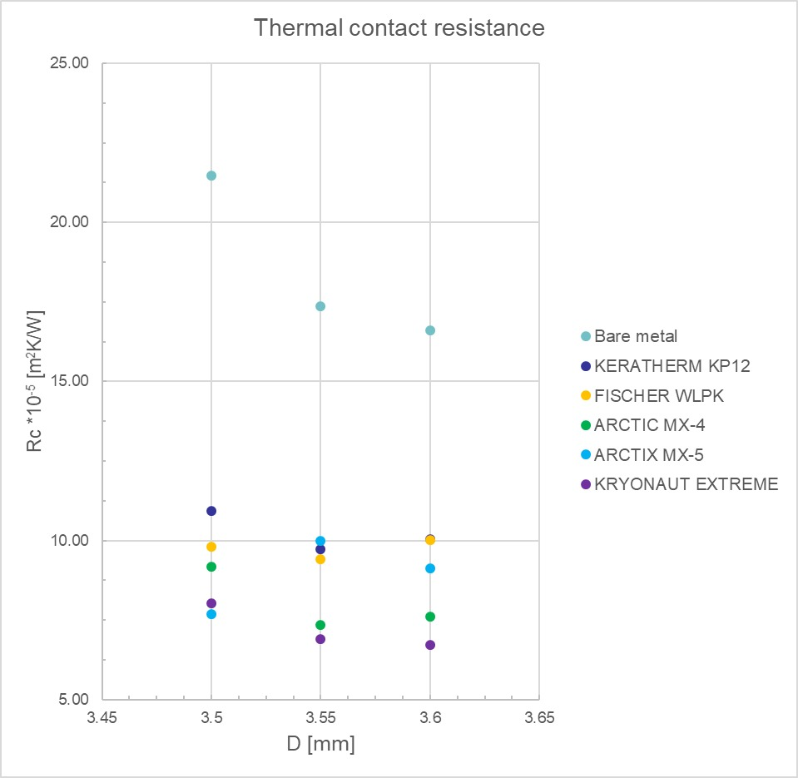
Tray design thermal qualification
 | T CP max [°C] | T pipes [°C] | ∆T max [°C]
λ TIM = 10 W/mK | 25.6 | 23.3 | 2.3
λ TIM = 5 W/mK | 26.1 | 23.3 | 2.8
NO TIM | 36.6 | 23.9 | 12.7
λ TIM = 5 W/mK Grooves fully filled | 25.8 | 23.1 | 2.7
Various test performed by varying:
- CP design
- thermal compound (TIM)
- different filling of grooves
~ 100W/CP distributed along 4 «belts» under pipes to simulate DMs heat distribution
Temperature drop between CP and pipes minimized to ~ 2.1 °C
Thermal compounds qualification
Samples to test thermal coupling efficiency of different compounds
Simulating short portion of tray groove geometry, different groove width 3.5, 3.55, 3.6 mm
Measuring temperature at pipe to alu block interface wrt steady heat flow and pipes temperature
Comparison of different compounds: Kerafol KP12, Fischer WLPK, Arctic MX-4 (8.5 – 10 W/mK)
Radiation resistance qualification in progress as other items
Arctic MX-4 better one at reasonable cost, easy to spread
Kryonaut Extreme, seems much higher cost
To consider other candidates e.g. already qualified
Parameters : thermal performance, workability/spreadability, radiation resistance …

Slide 10
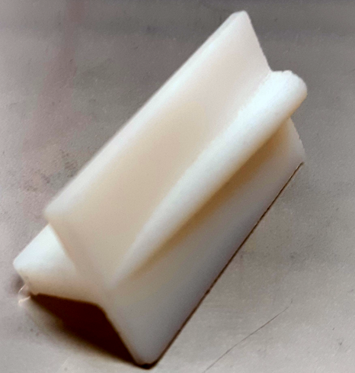
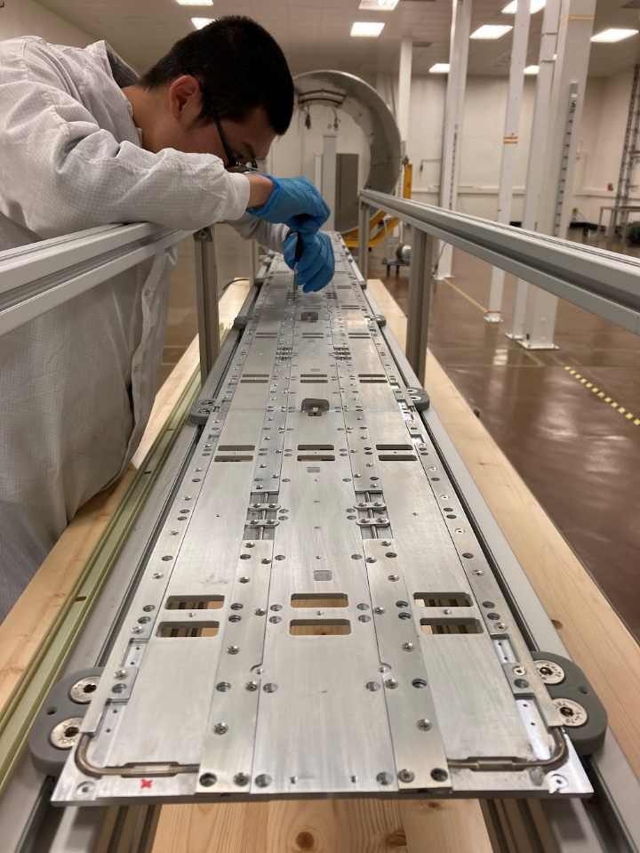
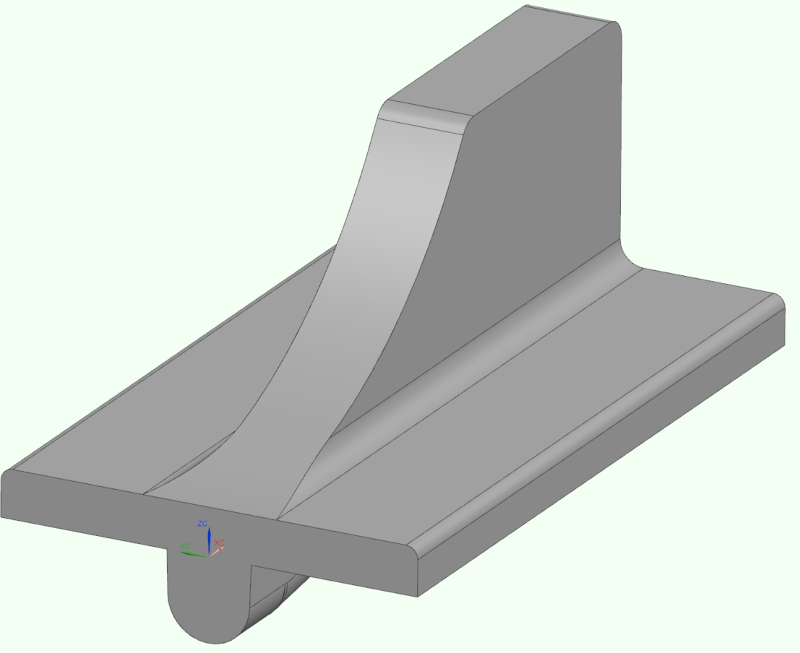
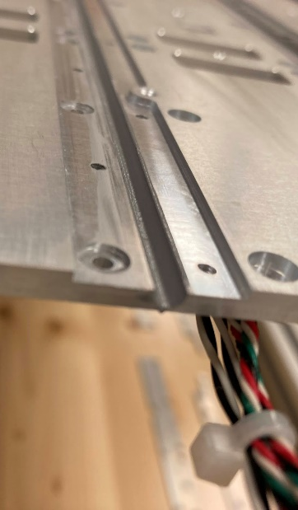
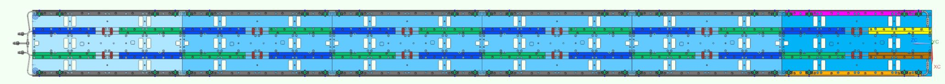
Cold Tray assembly procedure
Align plates with Φ2.5 mm pins and 0.2 mm shims
Verify overall lenght, CP alignment and pipes grooves alignment
Dry test pipe loop insertion and laminas fixing
Clean
Spread compound with shaped tool and remove excess
Spread compound in the laminas groove with shape tool and remove excess
Insert pipes loop in the tray grooves
Realize a uniform thickness , order of ~ 0.1 mm, before inserting the pipes and screwing the laminas
further test coming to better define tool, procedure and QA/QC
Place laminas from U end to front, and screws (torque t.b.c.)
Laminas screwed using M2.5 x 4 mm countersunk head screws.
52 screws/CP, overall 312 screws/tray.
Lam1
Lam1speculare
Lam2
Lam3
Lam4
Lam5
Lam6
Lam7

Slide 11
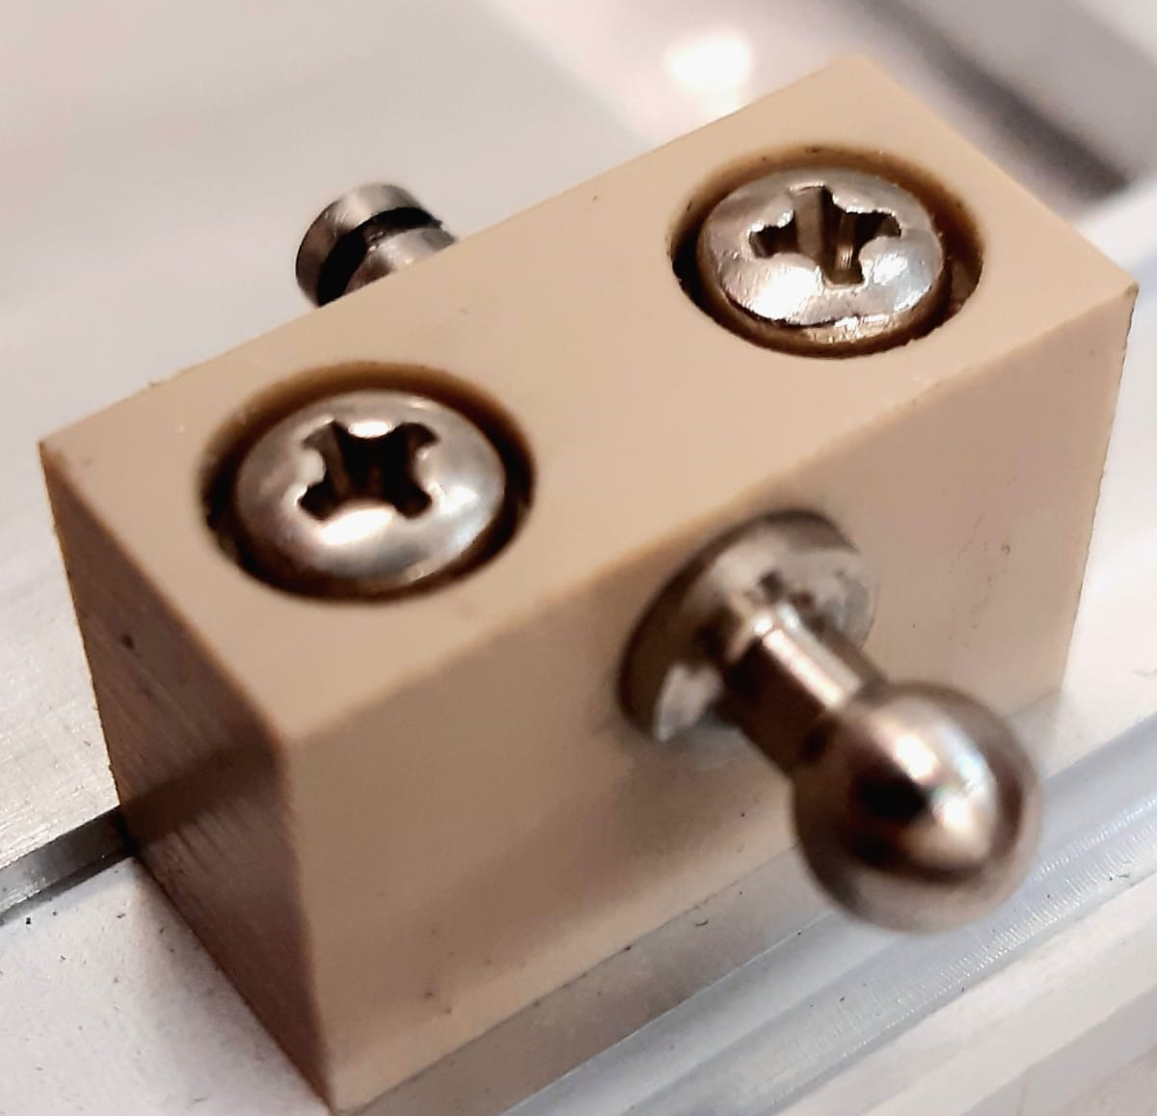
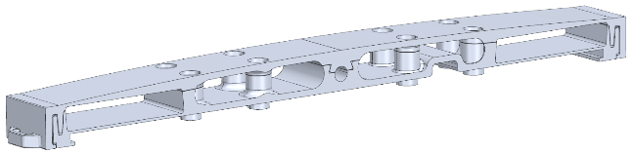
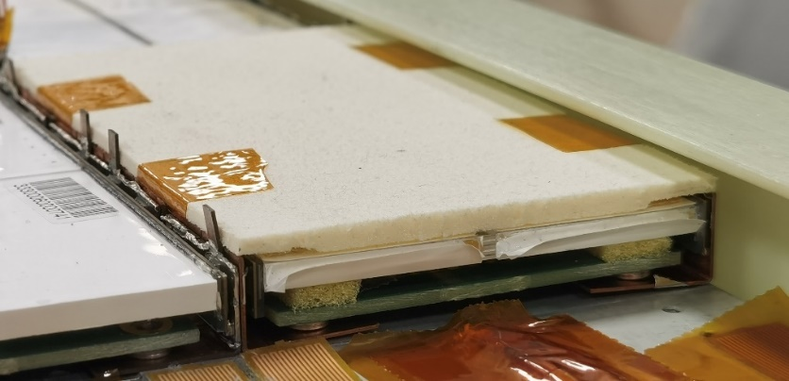
Rollers, rollers blocks, cable fastners, insulations
Various prototypes produced and used for mock-up, test, TIF ….
Rollers Ti or SS offers available
Block, GF (CF) Peek? G10-11? … Got offer for GF-Nylon, to refine
Belleville washers (spring washers) on upper side rollers (pitch compliance)
Cable fastners, 3D printed
Insulation: thickness avalability, rad hardness, «dustyness»
Got samples of:
Rohacell IG51, IG-F 51 , Airex T92, T10, TegraCore
Rohacell rigid, dusty
Airex T92/T10/TegraCore (PET) not much rigid, clean, rad hardness?
Airex R82 (PEI) as baseline, can be cleaned to avoid dusty appearance
Tray protection covers if needed
  Trays well protected by BTST and TRK/BTL cover plate
  If needed Mylar foils to prevent protruding elements from getting caught

Slide 12
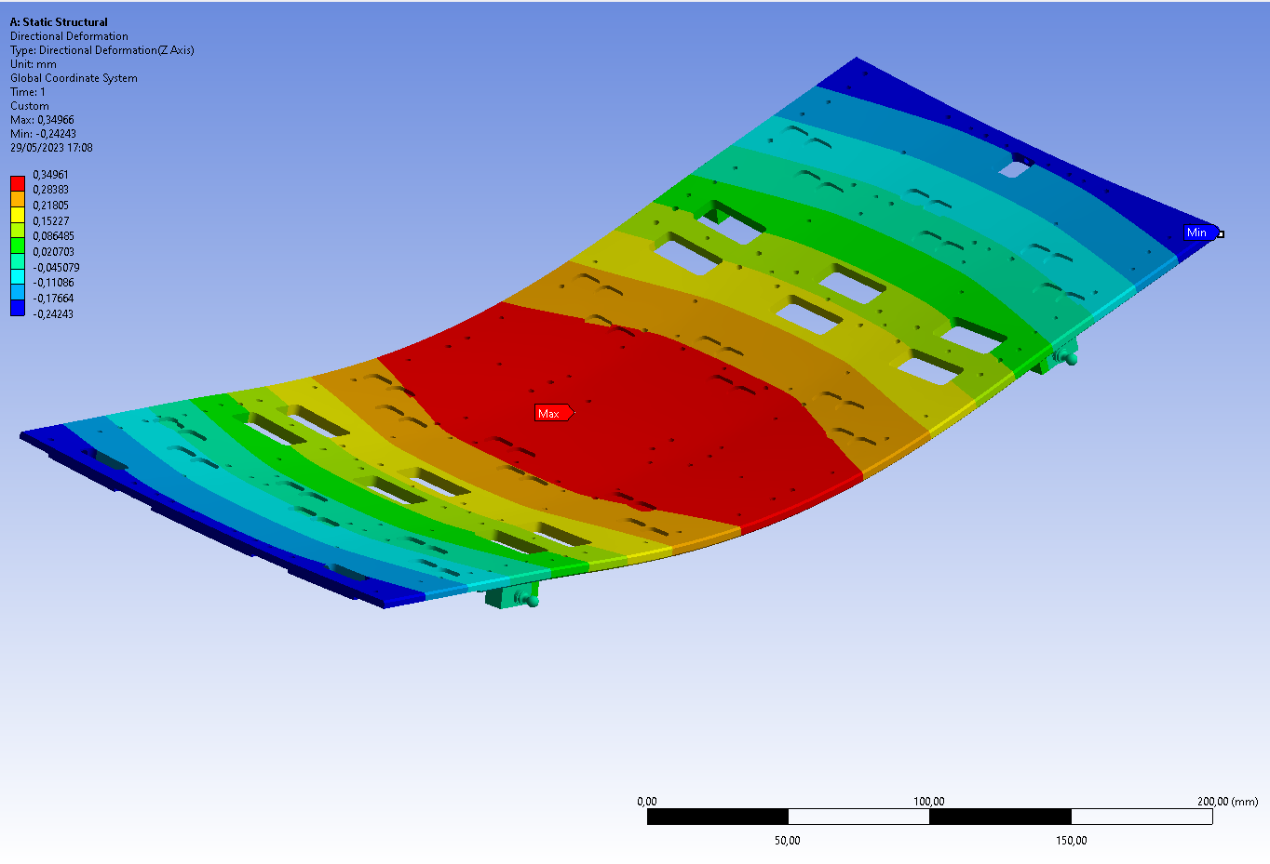
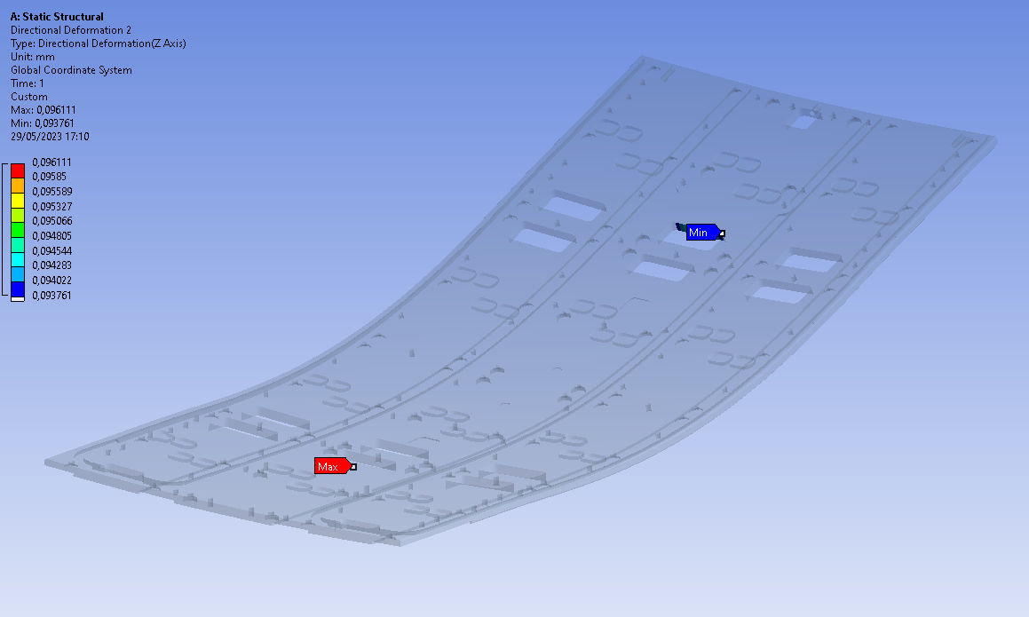
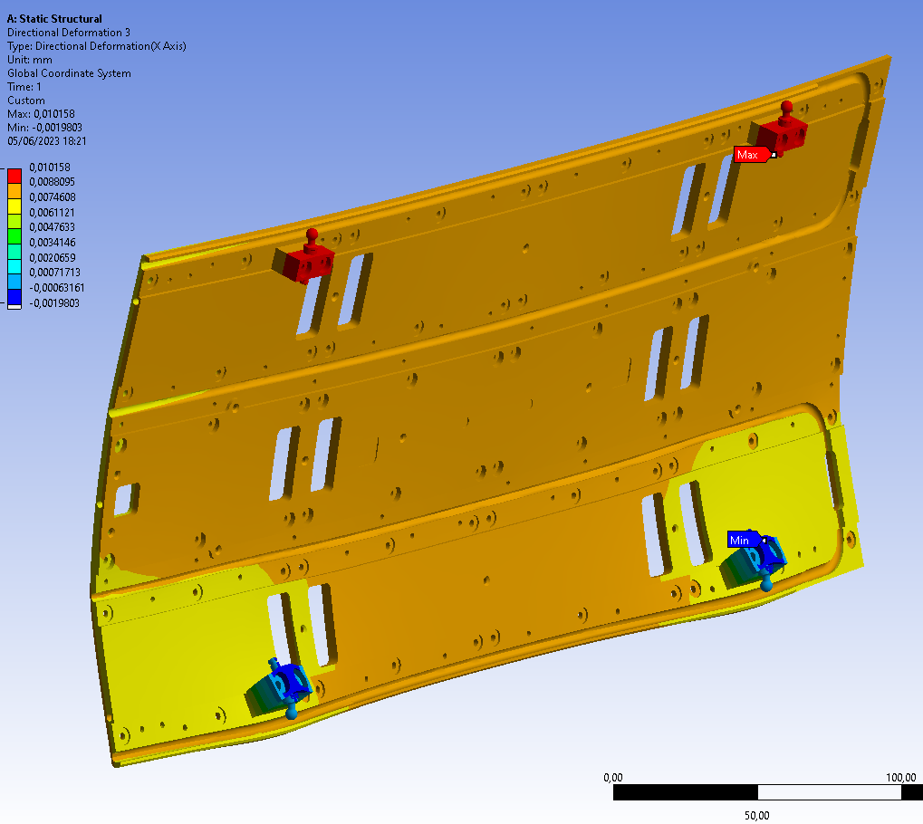
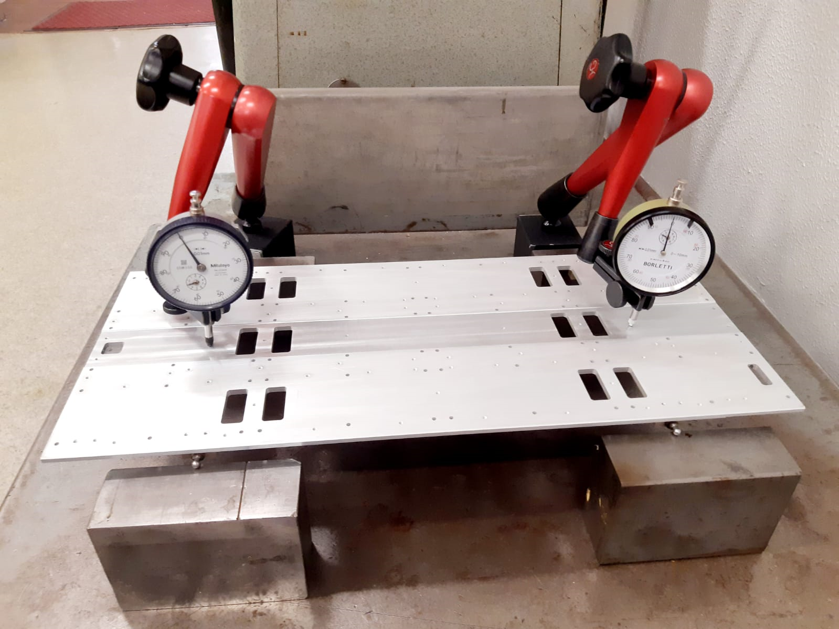


Load test for tray design structural qualification
Load (at CP center) perpendicular to CP plane:
deformation at mid points btw rollers: ~ 0.09 mm/daN
FEA: ~ 0.02 mm /daN, (~ 0.07 mm/daN in the CP center)
Refined prototype with zero clearance btw blocks and roller pins:
- deformation at mid points btw rollers: ~ 0.06 mm/daN
(tighter coupling tolerances, cost, rollers may not roll/slide… )
Load parallel to CP plane:
- deformation of top CP edge: 0.01 mm/daN
- FEA: 2 um/daN
Roller blocks by GF or CF peek
Roller pins with no clearance w.r.t. roller block hole
Worst expected sag
(polar positions)
mostly due
to rollers sag
up to ~ 0.25 mm
(vs ~ 0.1 mm FEA)
Simulation of test setup with single force at CP center, 5daN
Deformation
due to 5 daN
uniformely applied load

Slide 13

Rollers position on the CP
To minimize effect of rails deviation, rollers shall be as near as possible to CP corners
0.9 mm gap
0.9 mm gap
RUs rotation propagate to all the RUs and to all tray
1.8 mm gap
1.8 mm gap
1 mm rail deviation
0.9 mm gap
RUs rotation is smaller and does not propagate, limited to only two RUs
0.45 mm gap
0.45 mm gap
1 mm rail deviation
Rollers at CP corners maximize sag perpendicular to tray plane (tray at and near polar positions)
Rollers position as trade off between the two requirements

Slide 14





I-beams
As presented at BTST EDR
https://indico.cern.ch/event/1097318/contributions/4616812/attachments/2355293/4022573/EDR_20211201.pdf
Pultruded Glas Fiber,
Feet position ~ in correspondence of TRK service ribs, doubled at service ends, plus other positions
Larger pitch < 500 mm
“Special” (half “wing”) I-beams near TRK rails (2 specular types)
“Special” longer I-beams every 6 trays
(supertray)
Overall 4 I-beams types from same pultrusion

Slide 15





I-beam to BTST fixing brackets (feet) design
Set
screw
Set
screw
Set
screw
Set
screw
Set
screw
+/-2 mm floating nut
Fixing screw
Set
screw
+/-2 mm floating nut
+/-2 mm adjustable position wrt screws
Fixing screw
+/-2 mm adjustable position wrt screws
Section view
allows adjustment in phi, r, z
2xM3 screws fixing bracket to M3 riveted inserts, +/- 2 mm adjustment to compensate rivets φ tolerance
set screws to adjust radial position and tilting in all directions
1 embedded M4 nut, +/- 2 mm floating in Z
pre-mounted on BTST, aligned and positioned on jig , still adjustable with I-beam on it.
            Pre-production ready soon

Slide 16







I-beam elastic properties qualification and I-beams deformation esteem
Load test to esteem GF I-beam elastic properties, assumed as unidirectional orthotropic:
E_{z} ~ 40 GPa, E_{x, y} ~ 4 Gpa (corresponding to ~ 60% of GF … depending on fibers modulus)
Measurement of I-beam-on-feet deformation w.r.t. esteemed load in BTST
UltraPul 821049 - 82% fiberglass reinforced aromatic polyurethane
Varius check of I-beam deformation vs load position and feet pitch

Slide 17

Design qualification: I-beam + feet deformation
Worst case tracker service load ~ 137N/sector
Assuming load distributed on ….3 I-beams?
transversal/tangential load on I beam «wing»: ~ 45 N/I-beam
(worst case scenario, sectors near equator)
Test of different types of material for feet vs
FEA: ~ 0.38 mm (@50N load, GF resin ) ~ 0.08 mm/daN
ABS 3d printed feet
~ 1.1 mm (@50N load on top wing border) ~ 0.22 mm/daN
Factor ~ 3 discrepancy (local deformation due to nut & screws)
PA12 30% GF 3d laser printed feet: ~ 0.14 mm/daN
Sample from TIF/Guillermo, bulk: ~ 0.14 mm/daN
Aluminum feet, bulk: ~ 0.06 mm/daN
Peak deformations on wings => affecting services, effect on trays negligible
G11 and Aluminum feet pre-production in progress for final test and material choice
Actual deformation will depend on
actual load per each I-beam,
stifness of ribs … vs rotation of I-beam wing
stiffness of BTST surface where the 4 set screws sit (coupling to BTST)
…….

Slide 18






I-beams Coupling to BTST and TRK services support
Inserts in BTST to fix Ibeams feet
See BTST EDR
https://indico.cern.ch/event/1097318/
Ibeam inserts for TRK ribs fixing and BTL cover plates

Slide 19





Tray assembly jigs and sequence
CT assembly on assembly
frame
CP aligned and coupled with dowel pins,
0.2 gap
in btw
CT assembled
CPs, pipes, laminas
Cradle frame placed and fixed to CT by brackets to leave tray as accessible as possible
Cradle frame and green clamps to transfer assembled tray to BBQ

Slide 20


Tray assembly tools and sequence (@ Assembly Centers)
Tray moved on “skewer support” : both faces accessible
Tray dressing:
DMs installation, CC cards installation, fasteners, cables, fibers, rollers,
Tray testing, qualification
Preparation for installation (mechanics only considered)
Rails mounting to engage rollers, rails fixing
Tray support brackets removal

Slide 21







Tray installation jig concept and installation sequence
Fine tuning af rails alignment
Slide cradle in Z to couple the cradle rails to I-0beams.
Lock cradle in Z
Insert the tray
Move cradle under jig, lift cradle e.g. on scissor trolley,
fix the tray cradle to the installation jig
Rotate to given slot by acting on worm gear unit
Remove trolley
Tray Cradle fixed to kinetic mount, fully adjustable for fine alignment with the rails inside BTST (6 adjustable connections on ball hinges)
Jig and scaffolding inside BTST to be compatible each other… in progress

Slide 22



Tray installation jig assembly, functional test and 50% overload test
Ballast counterweights applied to reduce torque and stick slip effect on worm gear
Jig tested with up to 40 daN of dummy load (> 1.5 x nominal tray weight)
Will move asap to TIF for test and refinement

Slide 23





Service tray and connection procedure
Supertray concept: tray services collected in group of 6 trays
Trays connected to common sector of BTST enclosure
To gain access to service:e trays provisional support guides fixed to the BTST Provisional support on sliding brackets mounted on the guides
Trays fixed to the enclosure or provisional blade, acting as Z tray constraint
Allows to extract the trays by ~ 20 cm to allow access to both sides
enclosure sliding support
Provisional support guides
enclosure sliding support

Slide 24
Thank you !
Backup

Slide 25
Status of the pre-orders and orders for mechanics,
CPs and laminas:
Prototypes from various supplier
Order procedure in progress to qualified supplier (officinacannarozzi.it)
Final CP design after EDR completion
Delivery schedule: pre-production (2 trays) end October, first batch (>20%) end December – mid January, delivered at CERN by end January . Latest batch delivery by end April 2024
Cooling loop:
prototypes (3 loops) produced
Baseline:
Order complete TIG welded circuits: pipes procurement, bending, welding, 10% sample basis X-ray
Delivery schedule: pre-production (2 loops) end December - January, first batch (>20%) end January-February, latest delivery April 2024
Backup: bending by supplier, EB brazing at Cern (as 1st prototype) more expensive

Slide 26
Status of the pre-orders and orders for mechanics
Swagelok glands procurement: got offer, to order, 1st batch ~ November
Swagelok glands machining: got offer, to order, 1st batch ~ December
Tees production: got offer, to order, 1st batch ~ December
roller-pins, roller block: got offer, to update for GF or CF peek
I-beams: prototyped, qualified, to be machined
thermal paste tbd
Screws washers nuts … Ready for orders
Frames / boxes for loops to produce
Cradle for trays BAC

Slide 27




Tools - jigs for parts acceptance check
Design in progress of jigs/masks in order to check produced parts as qualification process :
CPs: overall dimensions, holes presence and position, grooves width and depth
Laminas: overall dimensions, holes presence and position
Bent pipes before welding
Checks and controls to be performed at suppliers, INFN Padova, CERN

Slide 28

Estimated cost
Mechanics cost book, up to date as possible:
https://docs.google.com/spreadsheets/d/1r-tzdiBCrDjZQsFyFK1sXQLv7r0cD3JUW_pdU9ogSSU/edit?usp=sharing

Slide 29

BTL tray mechanics status for production
Piping pre-production:
Modified bending radius (now suited to allow Swagelok nuts to slide along bent pipe, to free welding/brazing zones)
Order issued for 2 circuits: bending and orbital welding at loops ends (as available pipes are only 3m long)
Going to order small quantity of Swagelok glands for this production
Iterating with the «bending company» way to make all joints by TIG orbital welding
Cheaper, faster, finished circuits including in-house X-ray inspection on required % samples
Going to produce in house the small quantity of Tees and glands for pre-production circuits assembly
Will test and qualify fully assembled circuits by orbital TIG welding joints
Piping full production
Got offer for Swagelok glands and nuts (BLind version much expensive than other/expected)
Getting offers for full quantities of Swagelok glands machining and Tee production
Bare pipes will be procured by the bending company
Unless major problems the bending company can provide full TIG welded loops
Should be ready to start order procedure by mid July, looking if possible to anticipate bare pipes order
CPs:
To launch request of offer for CPs and laminas production, INFN tender, by June
Shall re-check models before finalize drawings e.g.
any point/holes/features to fix cover if any
Any point/holes/features to fix puch/pull brackets for the insertion
Small parts:
Getting offers for Small parts: Rollers, Rollers blocks, need to refine requirements e.g. coupling tolerances

Slide 30




Cooling loop design for orbital welding
Adapting cooling loop «joints details design» for Orbital welding
Cheap, fast, repeatable industrial process
Requirements:
- Same diameter of the the two «items extremities» to weld
- Clear lenght (at constant and identical diameter) of > 6 mm on both sides
Company can perform X-ray in house, as needed for qualification and production
(10% sample basis of full production … t.b.c.)
Welding may require to reduce hole diameter inside Tee and gland to increase thickness to a «safe value» for machining: now ID 3mm, may be ID 2.5 mm … assuming acceptable ?

Slide 31



Tray in plane deformability
4 CPs put on granite interposing rollers to minimize friction
Sides clamped at ~ 1250 mm pitch,
Force up to 20N applied in the middle, displacement measured
Deformability depend on
Number of clamping elements on pipes
Which pipes are clamped/locked, which can slide freely
Gap between CPs (0.2 and 0.4 mm considered)
Plastic behavior, likely pipes slides above certain force
Stiffer results ~ 0.25 mm/daN, more deformable ones ~ 0.8mm / daN
To be compared to expected rails deviation, but compliance to reasonable rail shape shall be ok

Slide 32
CPs and piping procurement procedure and possible suppliers

Slide 33
Tray production procedure (mechanics only): parts delivery and acceptance
Copper housing (6k pcs)
  E.g. masks to check housing main dimensions, holes position
Cold plates and laminas (450 + 3.6k pcs)
  E.g. masks to check CP dimensions and holes position
Pipe sectors/bars … any check? (300 pcs)
Bent pipes (300 pcs)
    E.g. masks to check pipes overall shape and compliance to CPs grooves
    Cleanliness?
Small parts for cooling ciruits: Tees, machined fittings (~ 450 pcs)
  E.g. go-no-go «gauges» to check relevant dimensions e.g. holes diameter and depth
2° priority ?
Thermal pads interfaces
Roller pins and roller blocks (2k + 2k)
Cooling manifold capillaries (150)
Manifold support trolley, manifold other mechanics, rollers, preheaters ..
Tray covers
To be defined the acceptance procedures, what to check, if on sample basis or full production …

Slide 34
Assembly sites tray production procedure (mechanics only)
                how, who, where
DMs assembly
  Lyso, SiPM, copper cases, thermal interfaces acceptance checks
  SiPM to Lyso gluing
  Copper preparation with Thermal interfaces to TEC and CPs
  Package insertion in the copper housing, finishing
  Mechanical/dimensional check?
  Thermal check of correct thermal contact? E.g. Dtemp at given TEC power? ? ? ?
    E.g. cooled plate/block where to fix one or more DMs to check Dtemp powering TEC … cycling?
Production of frames/cradles for trays handling/assembly
Mounting on cradle the 6 CPs with connecting pins and spacers (quick dimensional check)
Thermal grease deposition, pipes insertion, laminas fixing
  Quality check of correct thermal contact? (CO2 and large heaters needed) ? ? ?
    E.g. full surface heaters, CO2 cooling and IR camera(s) to check for hotspot … meaningful? … cycling?
Mounting of DMs on tray
  Dimensional/alignment check? or by construction
  Quality check of correct DMs to CPs thermal contact? (CO2 needed?) ? ? ?
    E.g. full powering, CO2 cooling and R/O PT1000 on DMs and board…… cycling?
    To be done with final CCs or testing boards?

Slide 35
Assembly sites tray production procedure (mechanics only)
                how, who, where
Mounting of DMs on tray
  Dimensional/alignment check? or by construction
  Thermal check of correct DMs to CPs thermal contact? (CO2 needed?) ? ? ?
    E.g. full powering, CO2 cooling and R/O PT1000 on DMs and board…
    To be done with final CCs or testing boards?
Tray dressing and finishing
  CC mounting
  Thermal check of correct CCs to CPs thermal contact? (CO2 needed?) ? ? ?
  Cabling
  Rollers
  Covers/enclosures,
  overall X-section thickness / dimensions check
Final qualification check at assembly sites ?
Packing
Shipping
Delivery at CERN and delivery acceptance test/procedure
Procedure cons: DMs to CPs thermal coupling test? Piping loops to be sent to assembly sites …

Slide 36
I-beams
Missing for full validation
campaign of X-section measurement on current prototypes/pre-production
deformation and load test
CTE data/measurement wrt to BTST

Slide 37


I-beams feet / fixing posts
Two version foreseen:
standard one 5.7mm thick
thin one to compensate BTST deviation 4.3 mm thick
Prototypes can be made by 3D printing or machining
Full production: GF reinforced polymer (Peek or others)
To check production cost in case of machining, molding, 3D printing, quantity 1.4k not easy to “match”

Slide 38
Missing items
Manifold and manifold support?
BTST insulation and facing: e.g. armaflex + thin G10 facing
Rails installation jig
Dummy tray for go/no go check
Jig to move super-tray for manifold connecting/disconnecting
QA/QC procedures for …. all!
Production and assembly flow, logistic, thus quantity of jigs
And any other forgot item …
Conclusions
Need joint effort to :
Review and finalize design, test items/solutions, find standard material on the market, find producers for custom items, define QA / QC …
Cost and funds to review….
THANKS!

Slide 39




About thermal compound radiation resistance
Alice SPD detector: AOS 52029 (discontinued)
https://iopscience.iop.org/article/10.1088/1742-6596/41/1/039
tested up to 27MeV protons up to a fluence of 5 x 10¹² proton/cm2. This irradiation is equivalent to the dose of about 500 kRad
Atlas Micro-strip detector: Dow Corning 340, Fischer Elektronik WLPG
http://cdsweb.cern.ch/record/1238166/files/ATL-UPGRADE-PUB-2010
equivalent fluence of 1.10¹⁴ 1Mev neq/cm2
http://cds.cern.ch/record/686031
ATL-INDET-97-177 ; ATL-I-PN-177: Radiation Hardness of thermal compound

Slide 40





About thermo-elastic stresses in case of pultruded GF I-beams
Assuming :
CTE along longitudinal direction ~ 8 ppm/^C (glass CTE dominant)
6 ppm/^C of differential CTE between BTST and I-beams
30^C of Δt between inner BTST skin and I-beam
=> ΔL/L difference ~ 180ppm between BTST and I-beams
GF/resin ratio: GF 82% in weight (Bill), => ~ 70% GF in volume
=> GF x-section A = 160mm2 x 0.7 =110 mm2
BTST much rigid than I-beams due to larger section and higher E,
what the force to stretch a GF I-beam by 180 ppm?
F = E A ΔL/L = 0.7E5 x 110 x 18E-5 = 1386N ~ 140 kgf/ beam
36 beams => ~ 5 tons of compression along Z on BTST…
(Bad… or….may be exploited to reduce BTST deflection …)
Aramid, carbon glass and mixed composite samples procured,
(woven fabric layup only, not uni-directional)
water-cut specimens ready (FG seems affected/damaged ….)
going to measure CTE (above RT only), will take time …
Much higher deformation 6.5x wrt CFRC (for comparison only)
Higher (~2.5 x) stresses than CFRC (likely due to much higher DCTE)

Slide 41




Tray assembly tools and sequence
Rails mounting to engage rollers, rails fixing
Tray “support clamps” removal
Finishing, test …
Top Cover
Bottom insulation
Finishing, test …

