Slide 1
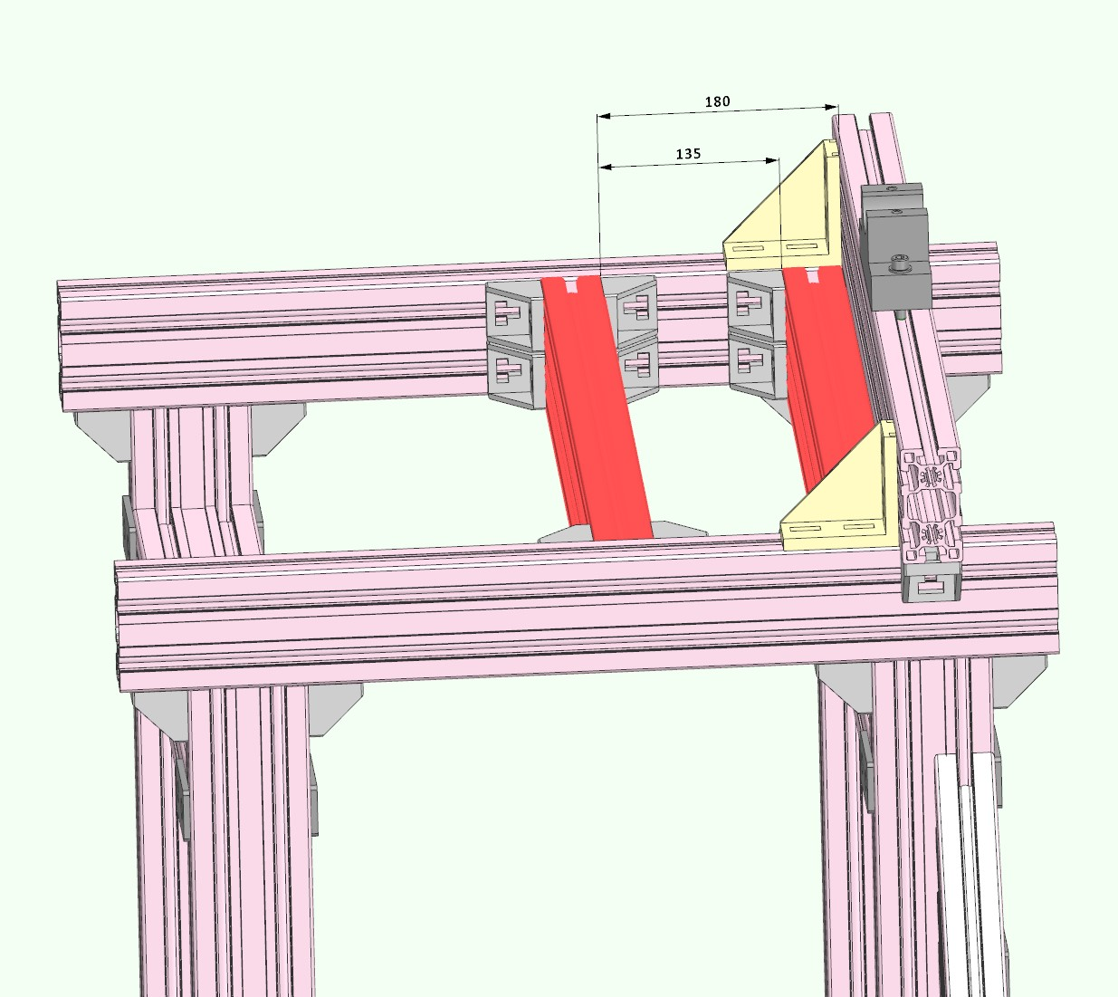

Slide 2
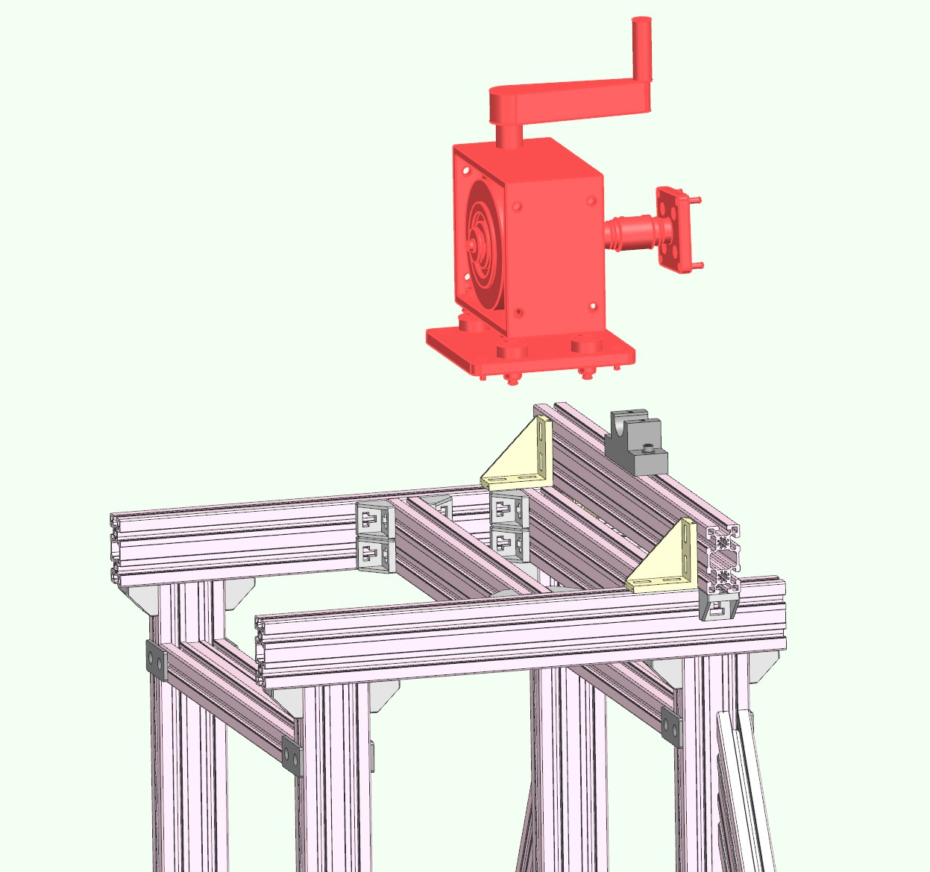

Slide 3
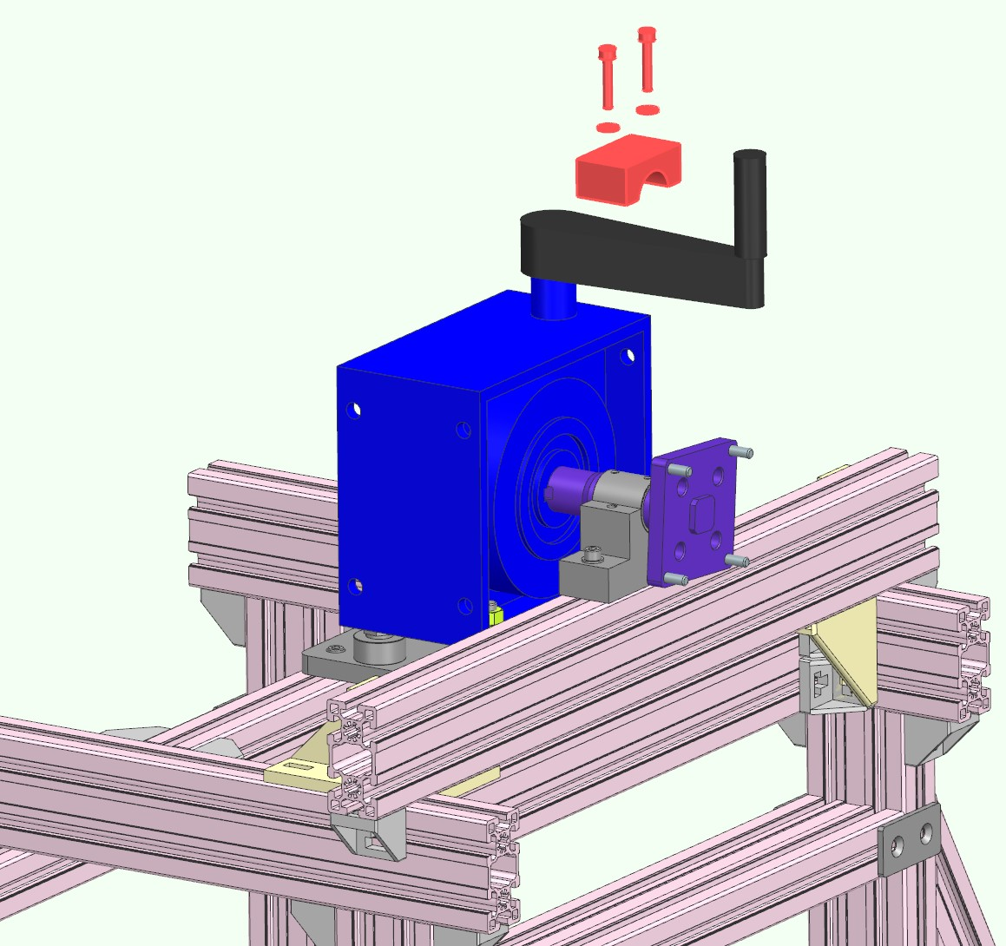

Slide 4
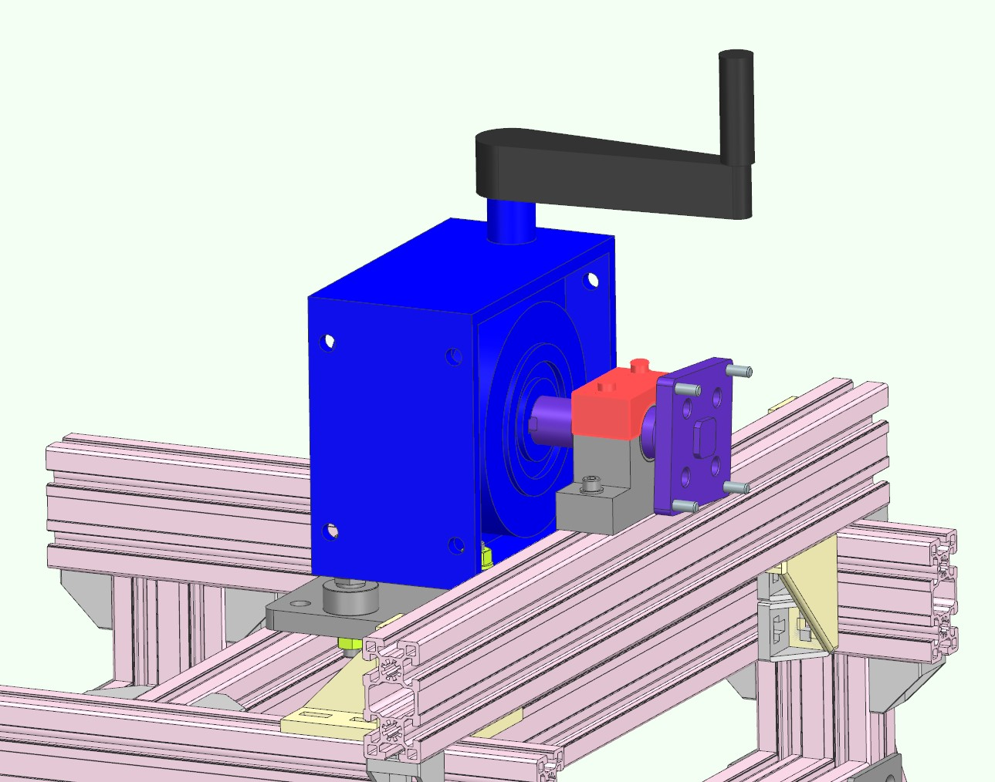

Slide 5
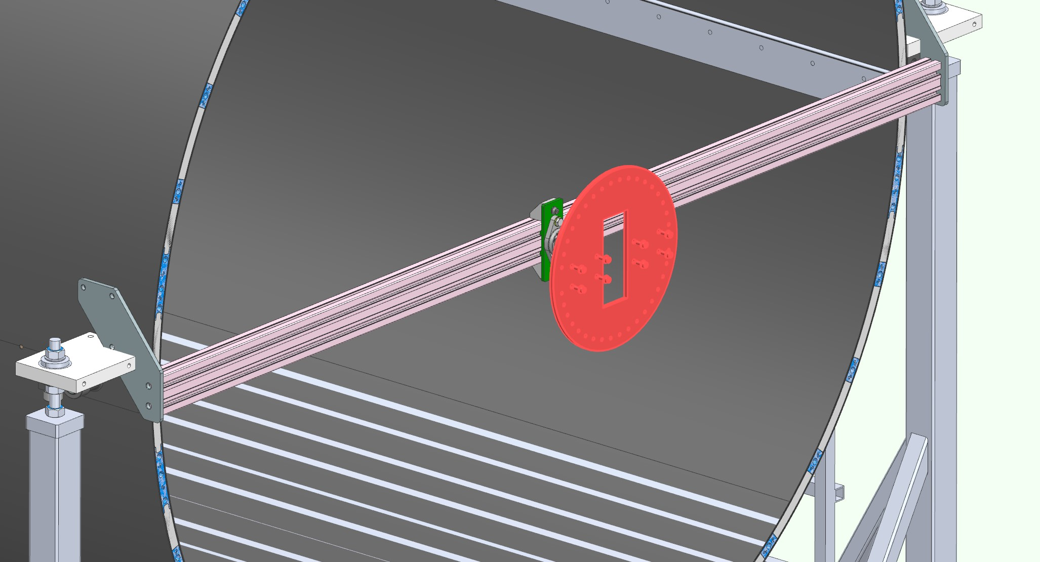

Slide 6
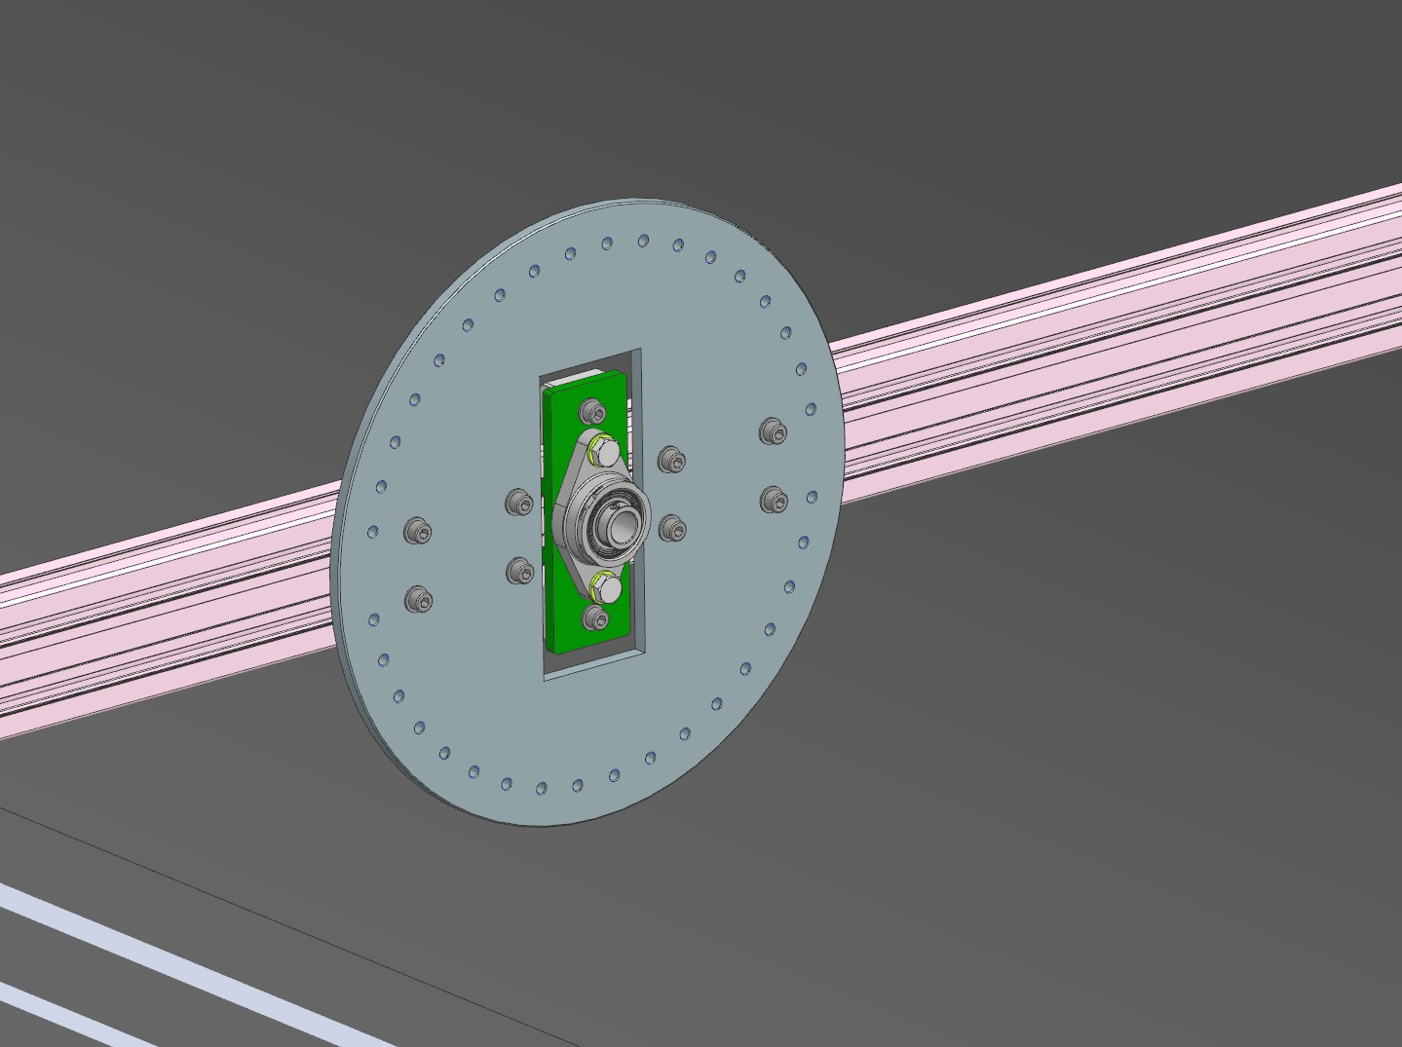
Nr.8 M8X20 with washer
Do not tight, leave loose

Slide 7
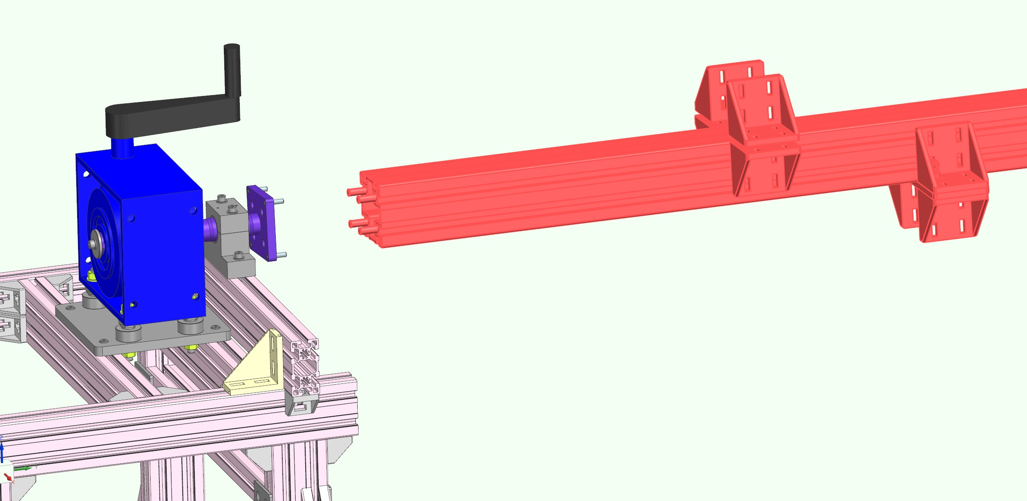

Slide 8
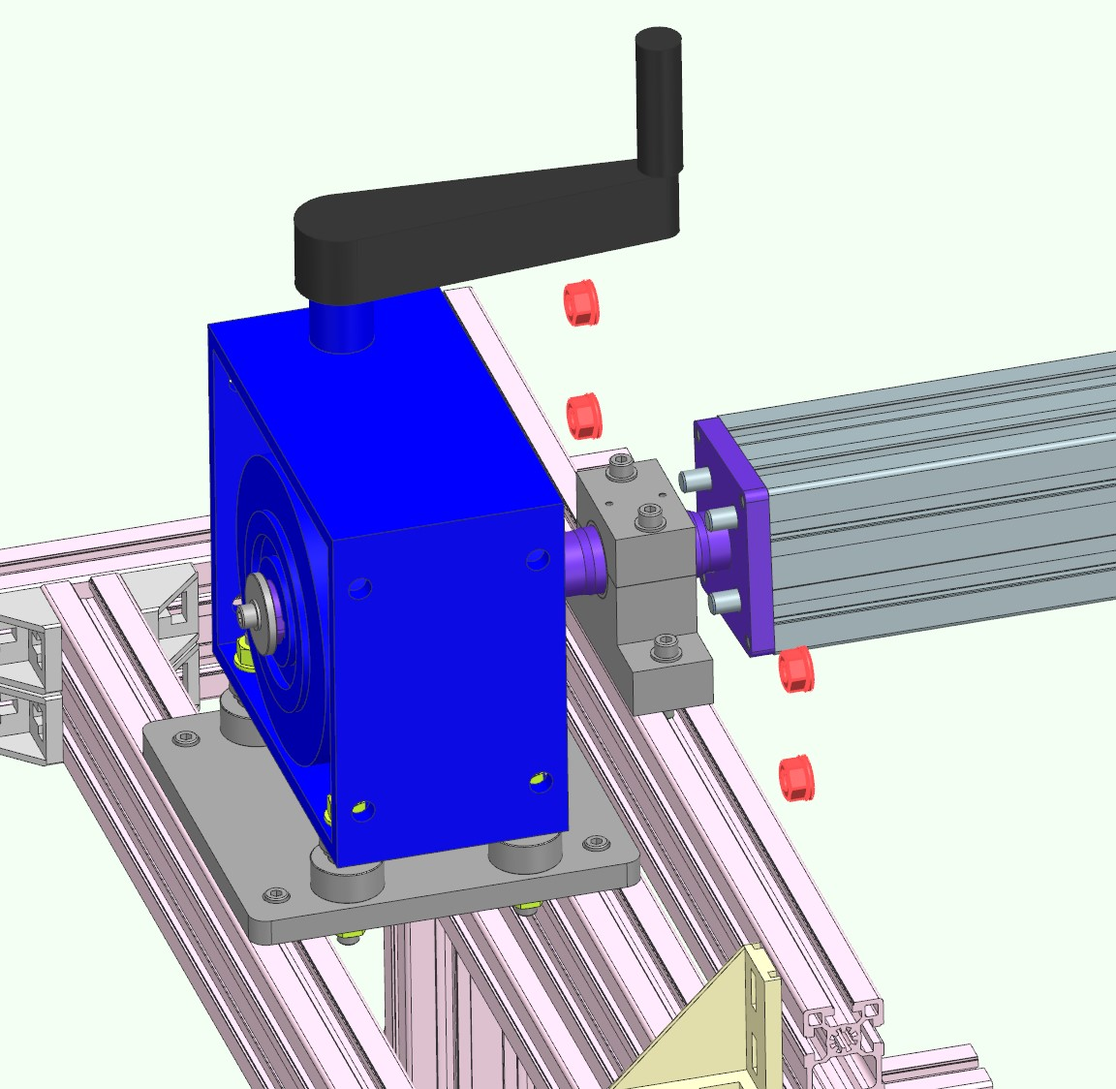
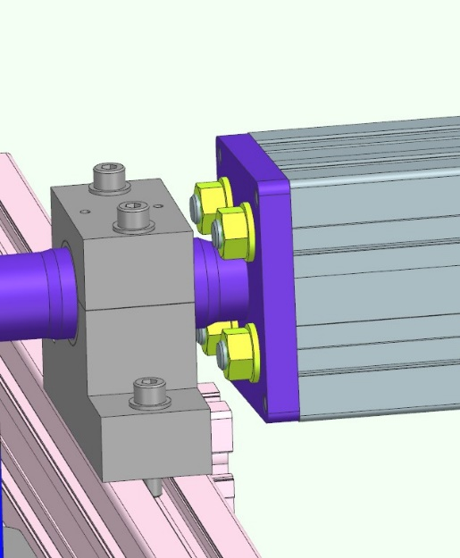
Nr.4 M12 nuts with washers

Slide 9
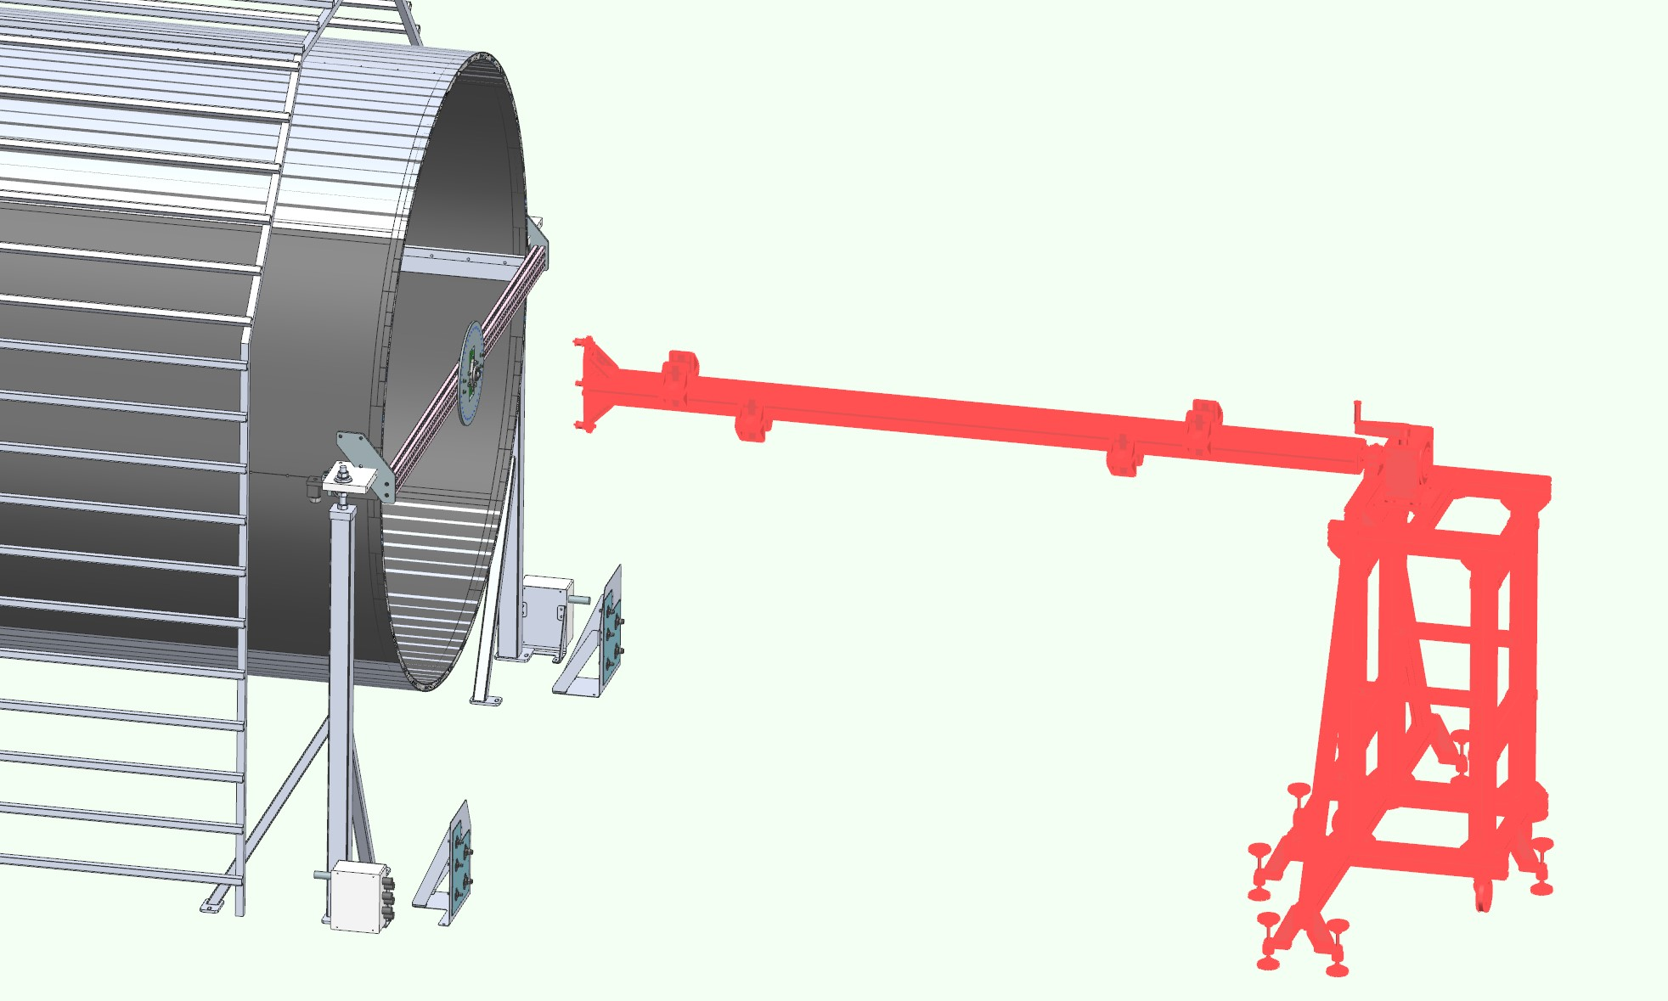

Slide 10
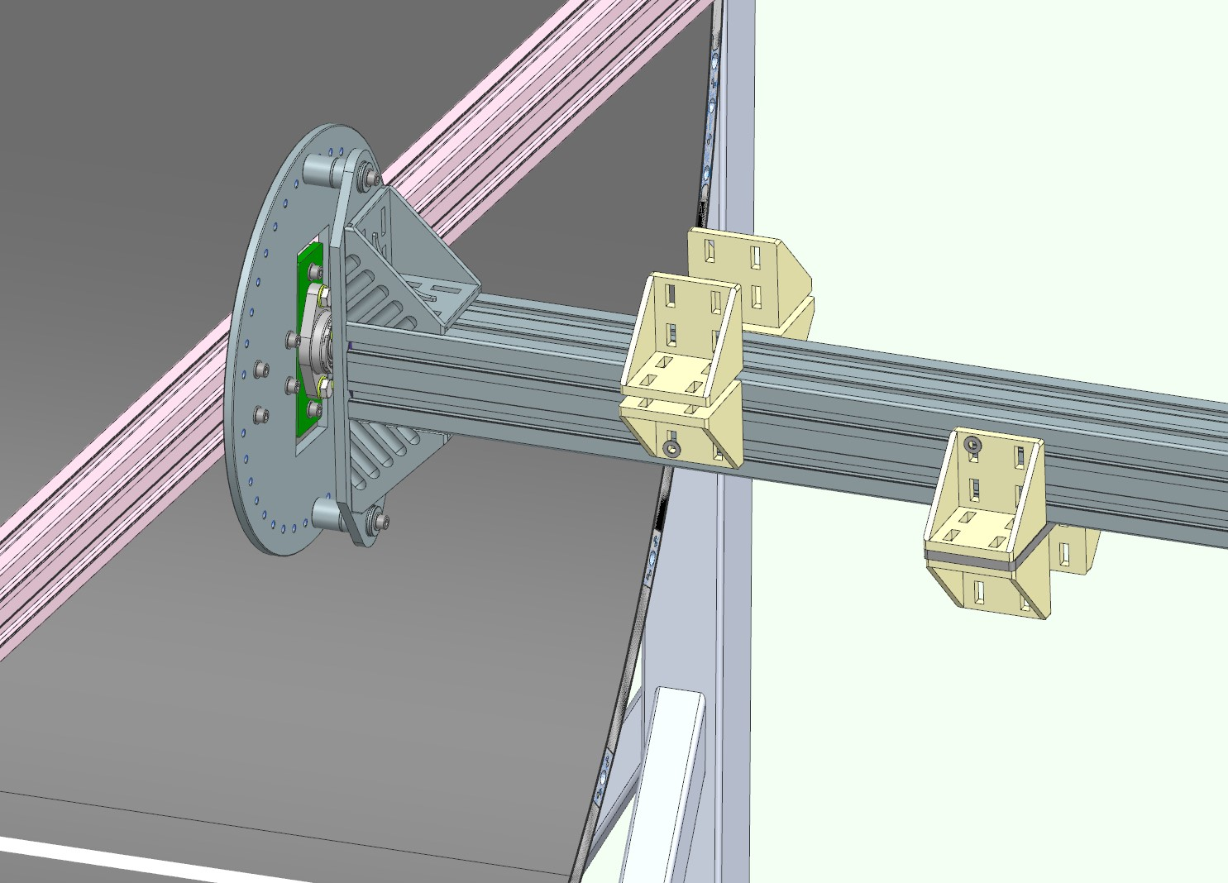
Adjust position of the circular flange checking insertion of the two screws M8x70, in different angular positions
After adjusting, fix the eight screws M8X20
Note: for the four less accessible screws short hex key needed, or use hexagonal head screws

Slide 11
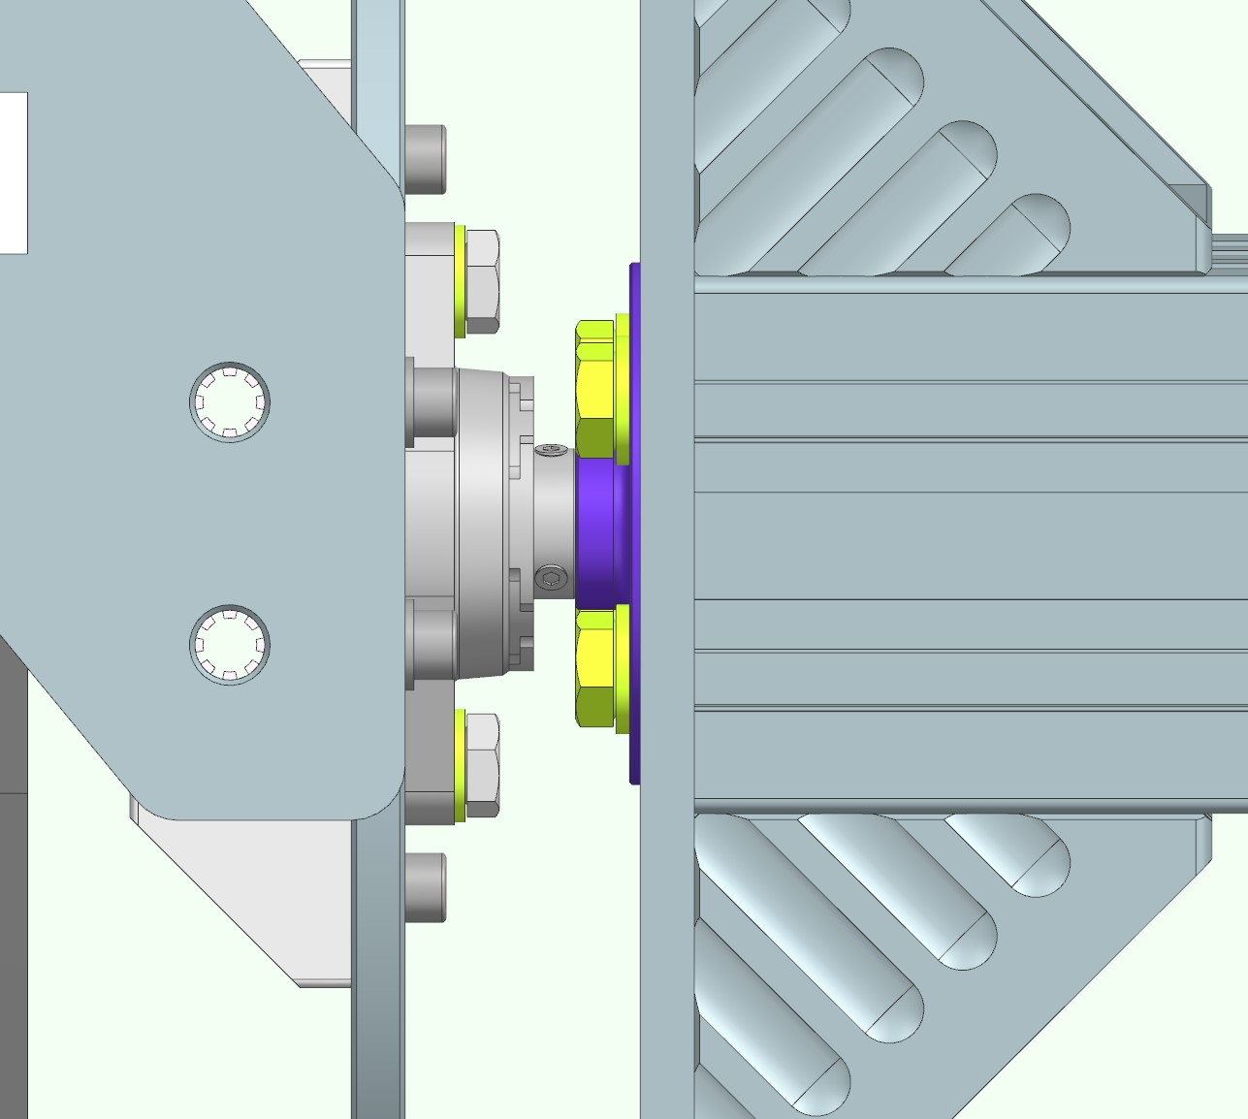
Tight asap these headless screws!! Otherwise the axis profile could fall down!!

Slide 12
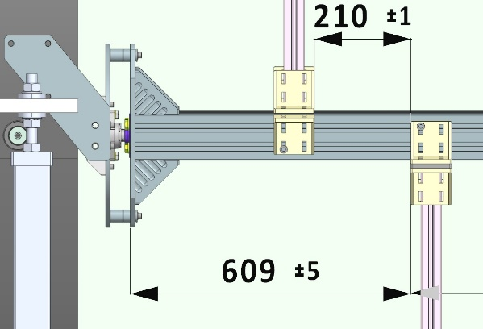
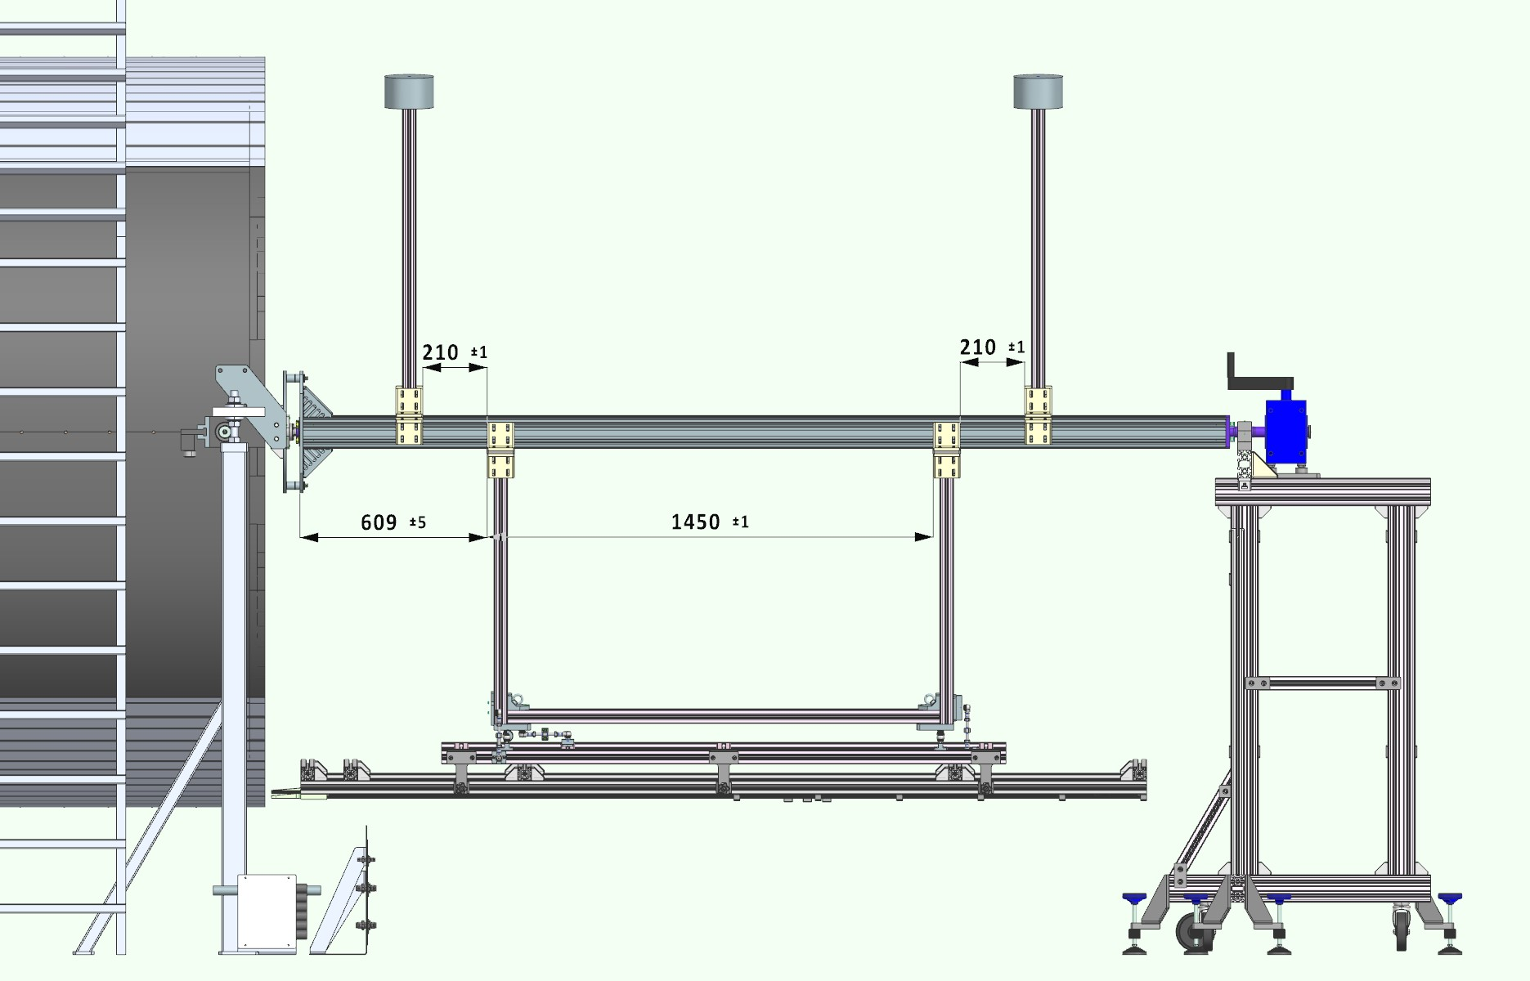
Use the 100x100 brackets to couple to the main axis
Coupling to the 45x90 struts requires do drill holes on the 100x100 brackets

