Slide 1
RICH2 detector mechanics PRR
Massimo Benettoni – INFN Padova with thanks to all contributors

Slide 2
The RICH2 EDR:
https://edms.cern.ch/document/1685891/1.0
The referee’s report can be found here
https://edms.cern.ch/document/1699763/1
  Many thanks to our referees Chris Densham, Antonio Pellegrino and Eric Thomas

Slide 3
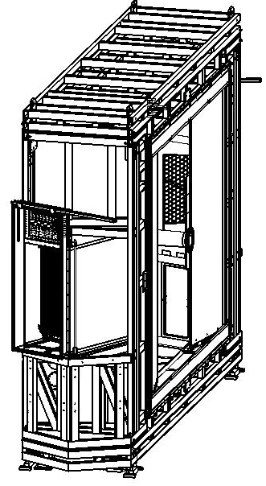
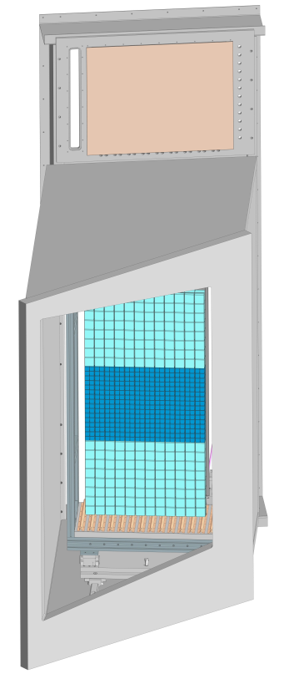
RICH2 overview
RICH2 detector layout unchanged
Two PDAs on both sides of beampipe,
1.065 rad tilting toward Velo
PDAs lodged inside photon detector enclosure, facing quartz window
PD Enclosure: magnetic shield and gas enclosure
Patch panel for services placed on top the access door.
3

Slide 4
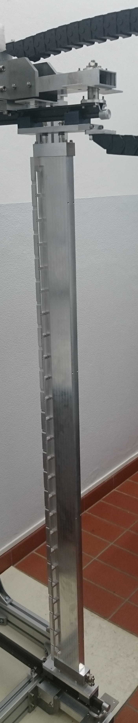
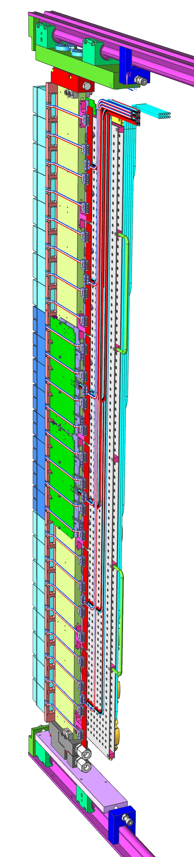
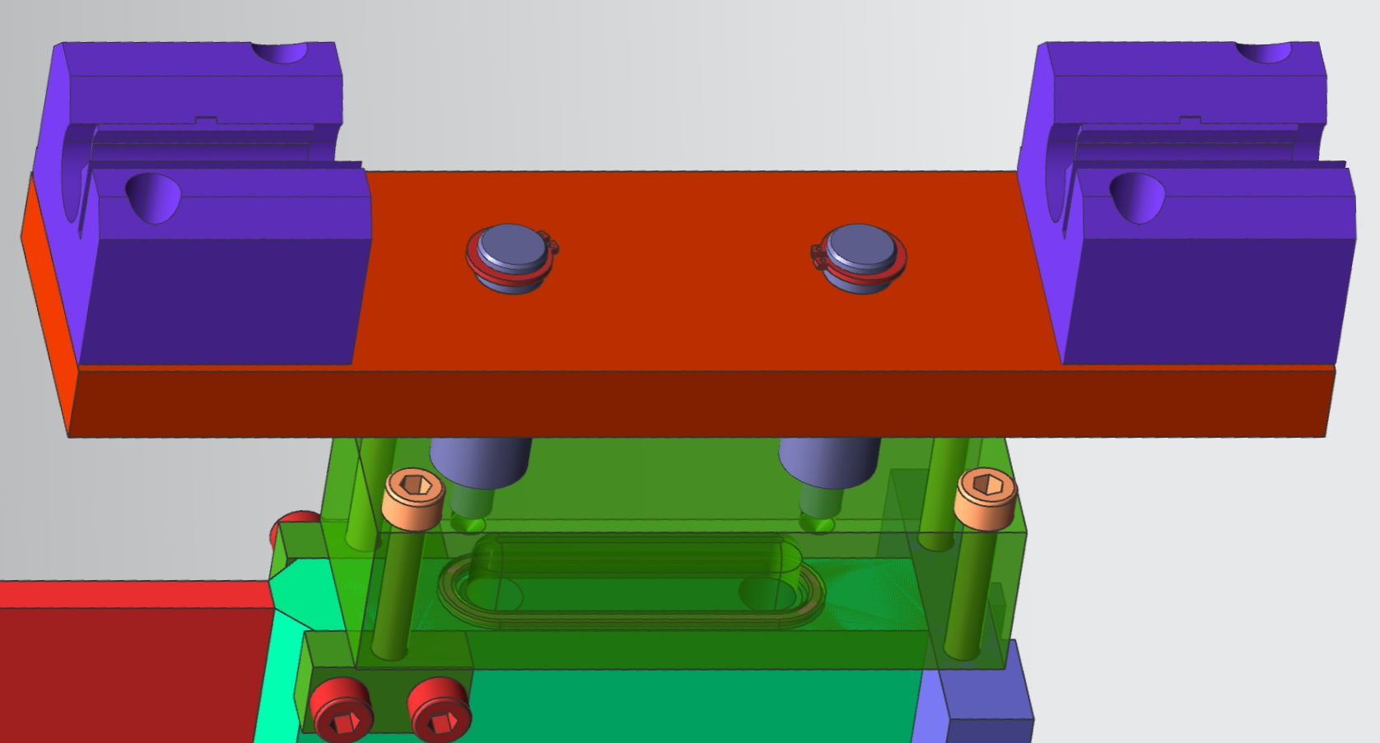
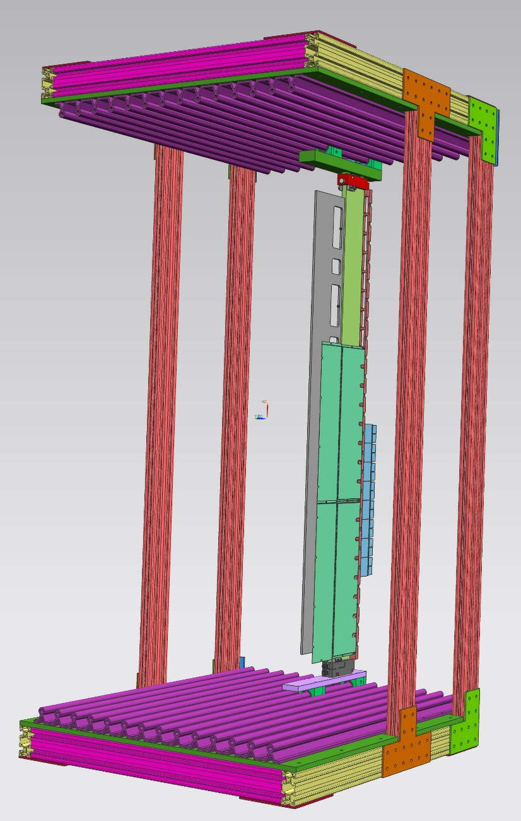
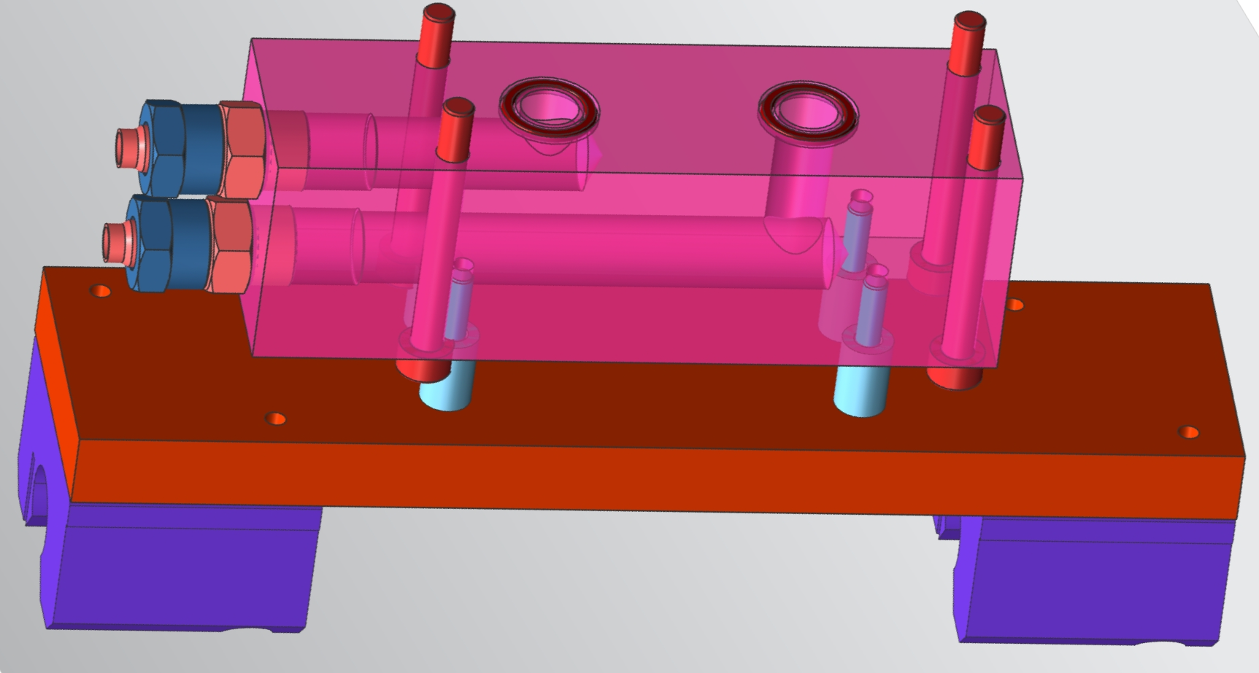
Column endblocks: support bearings and cooling connections
Top of column:
Cooling U return block and top cylindrical bearings
Out
In
Foot of column:
Cooling Inlet/outlet manifold block and bottom bearings

Slide 5
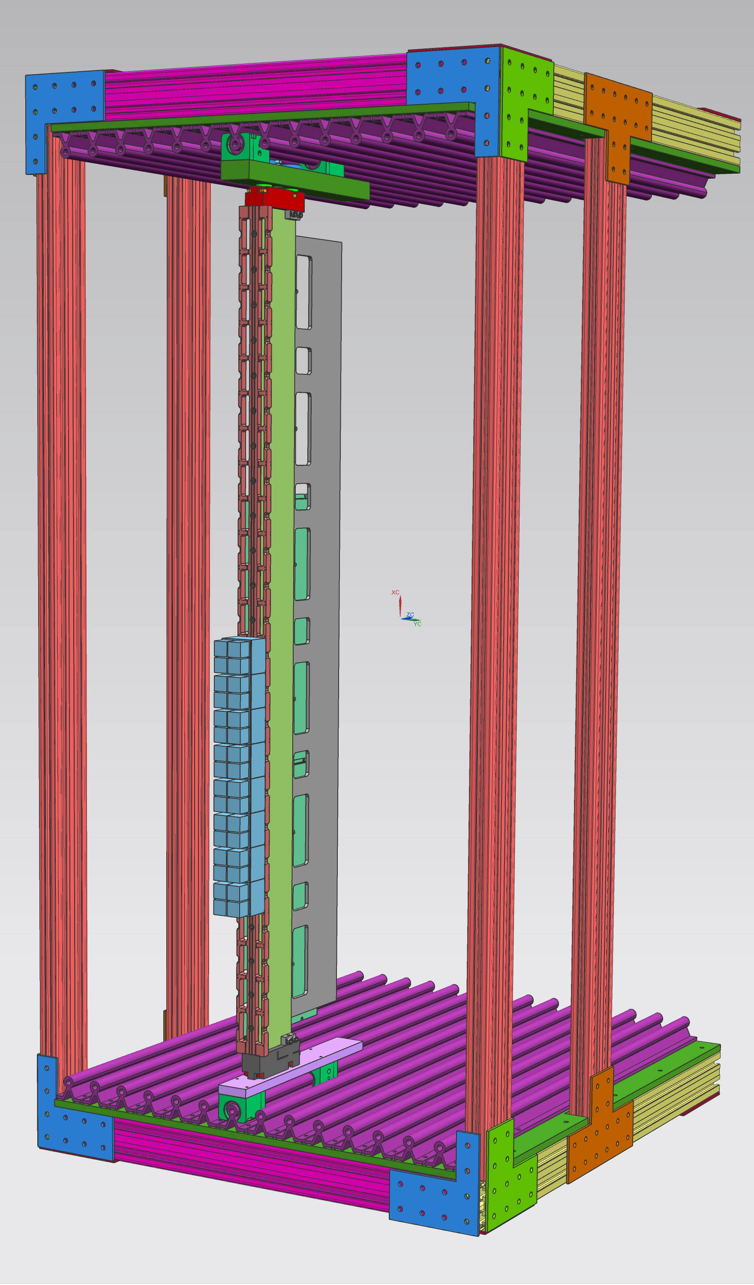
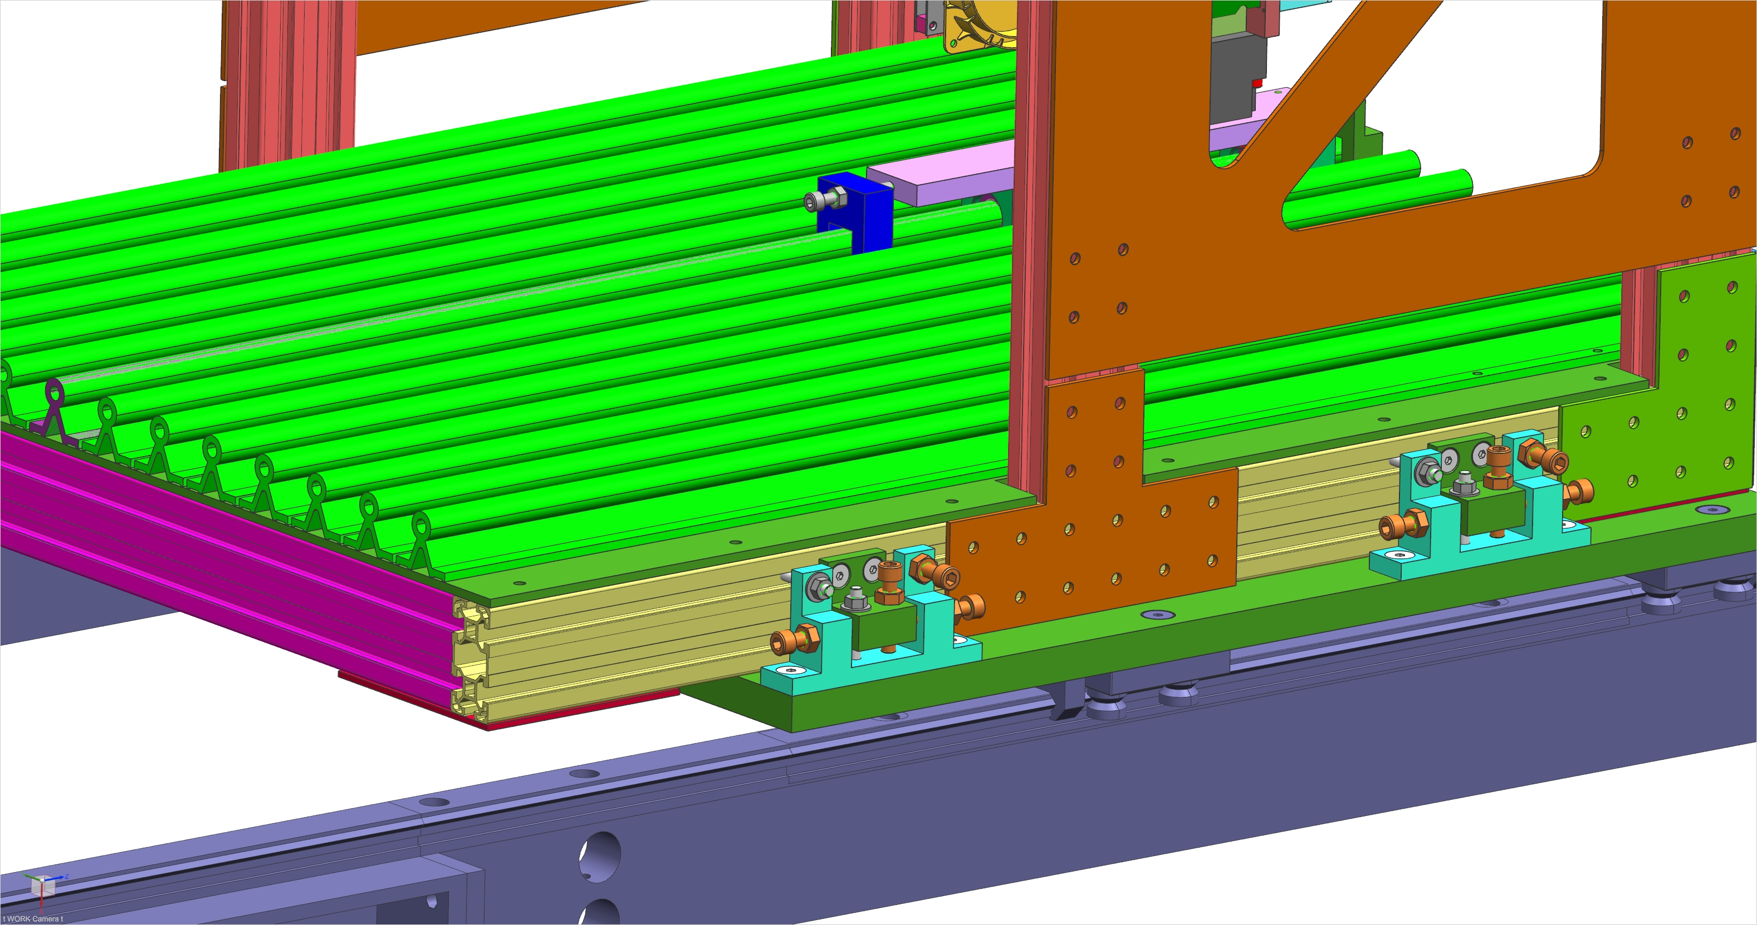
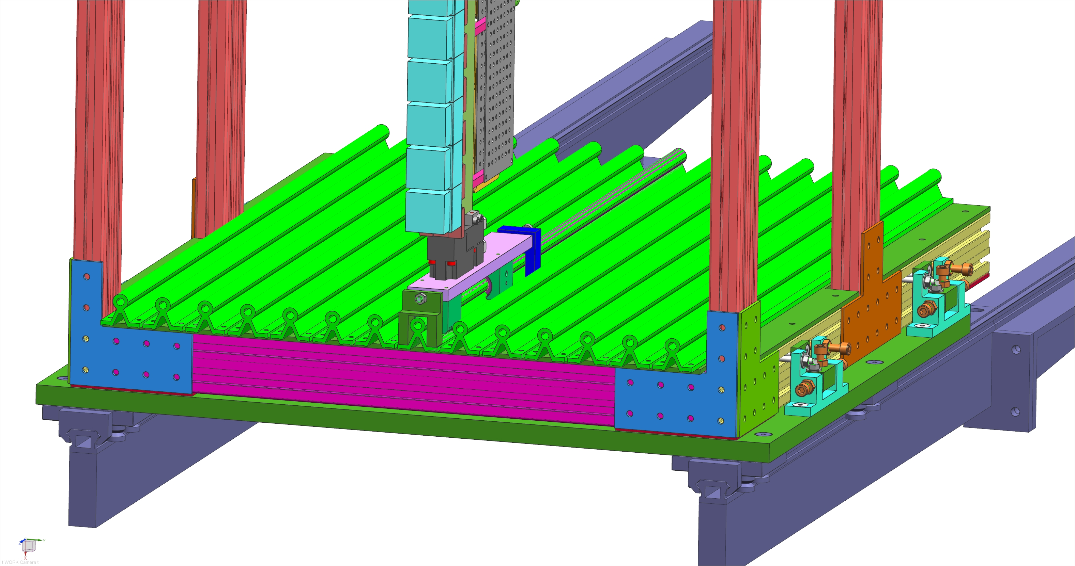
Rack structure and rack rails

Slide 6
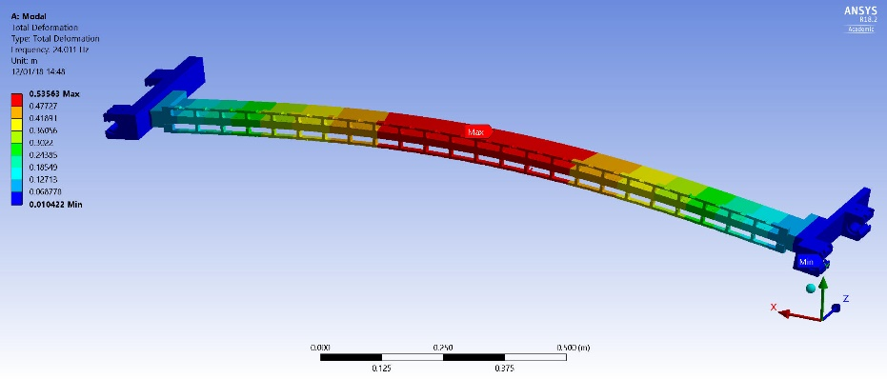
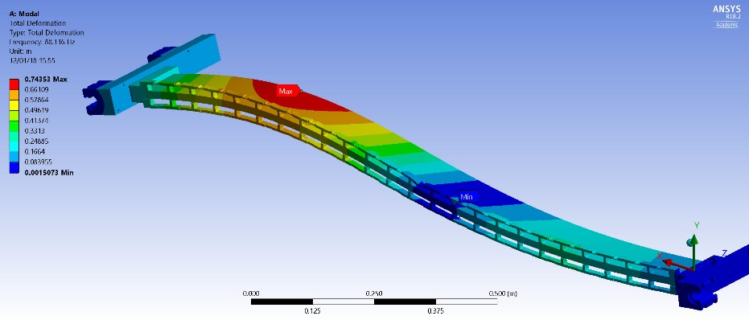
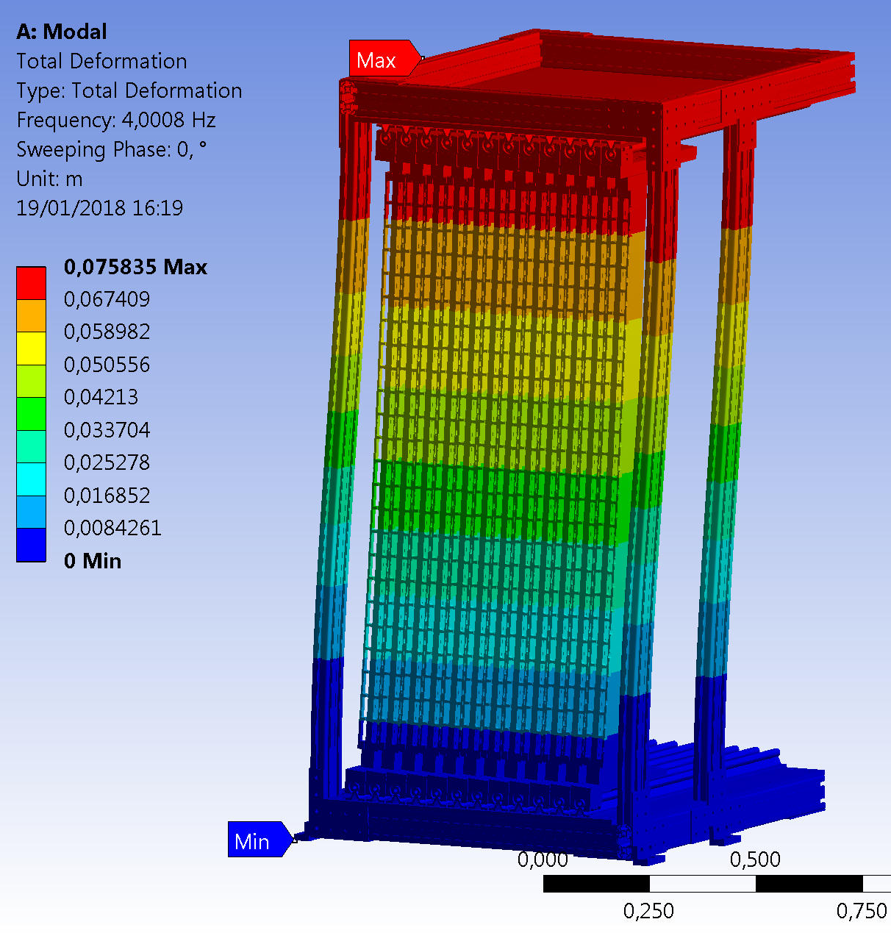
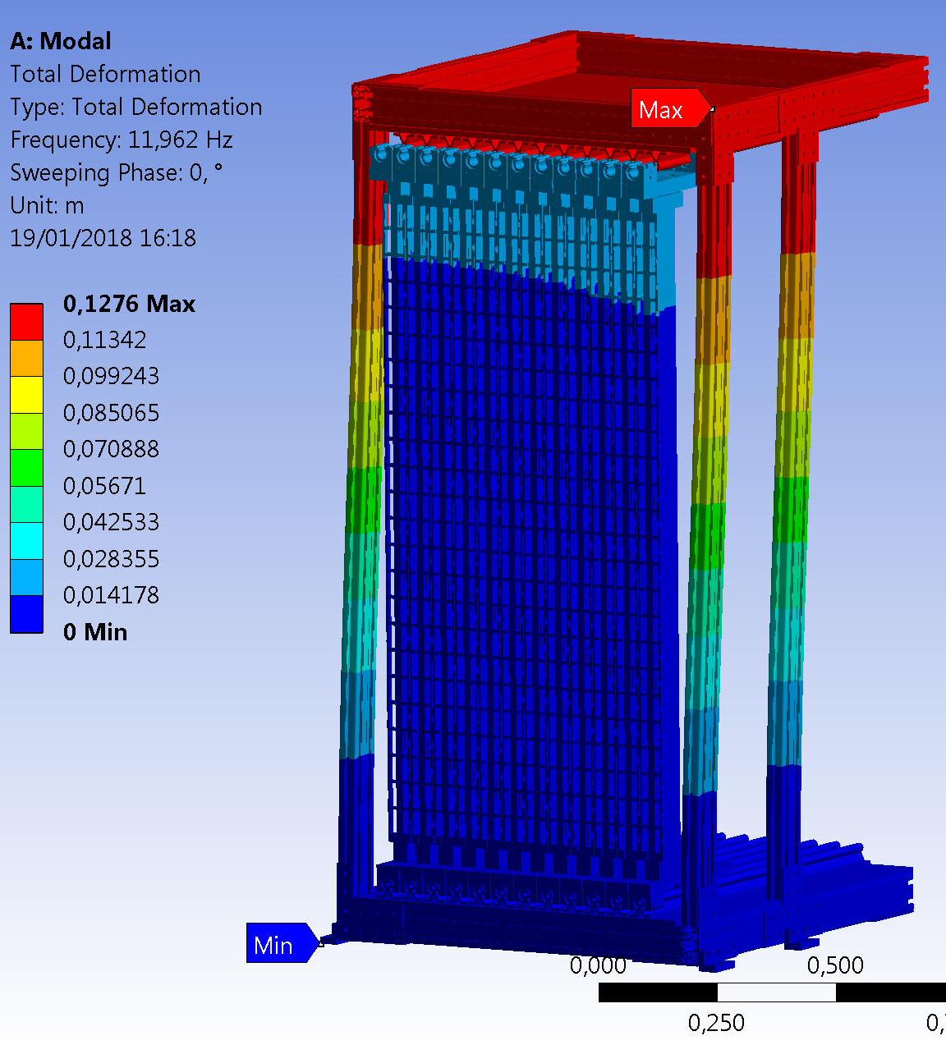
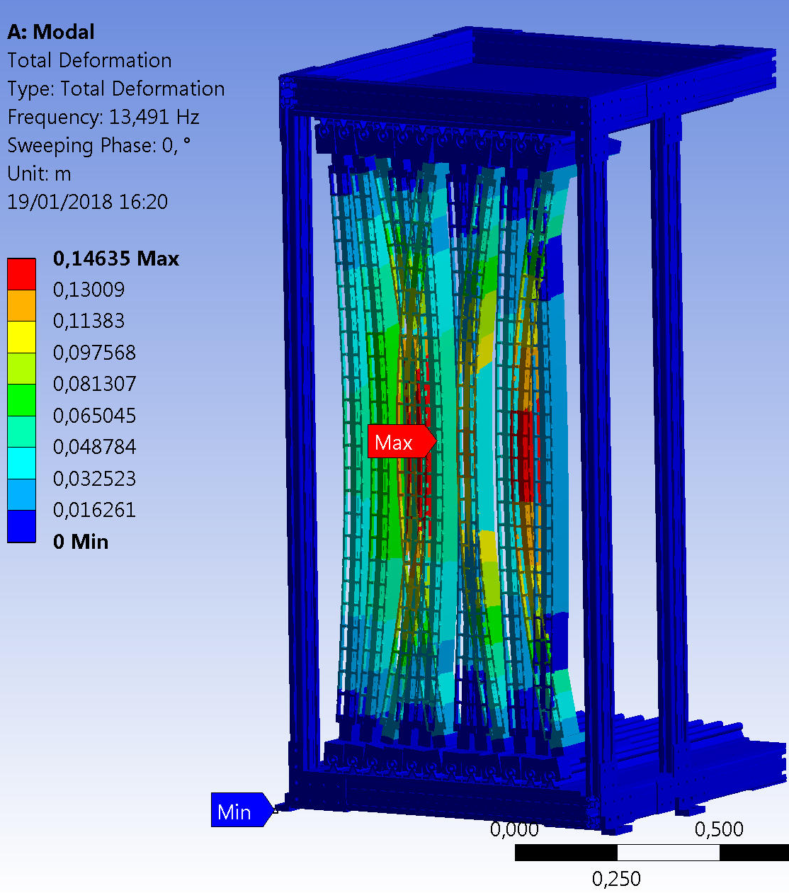
RICH2 PDA design: natural frequency study
Single column natural frequency:
1st Freq= π/2L² x (EI/m’) ^{1/2}
~ 15Hz (analytic) to 25Hz (FEM)
Depending on mass, constraints, etc…
0.5 mm bumpers along colums, leaving 0.5 mm nominal clearance
Rack structure natural frequency:
1st freq. ~ 4Hz,
Set screws
2nd freq. ~12Hz
Stiffer sides
Following modes
concern T-bars
3rd freq. ~13.5 Hz
congruent with
single bar mode
analytic calculation

Slide 7
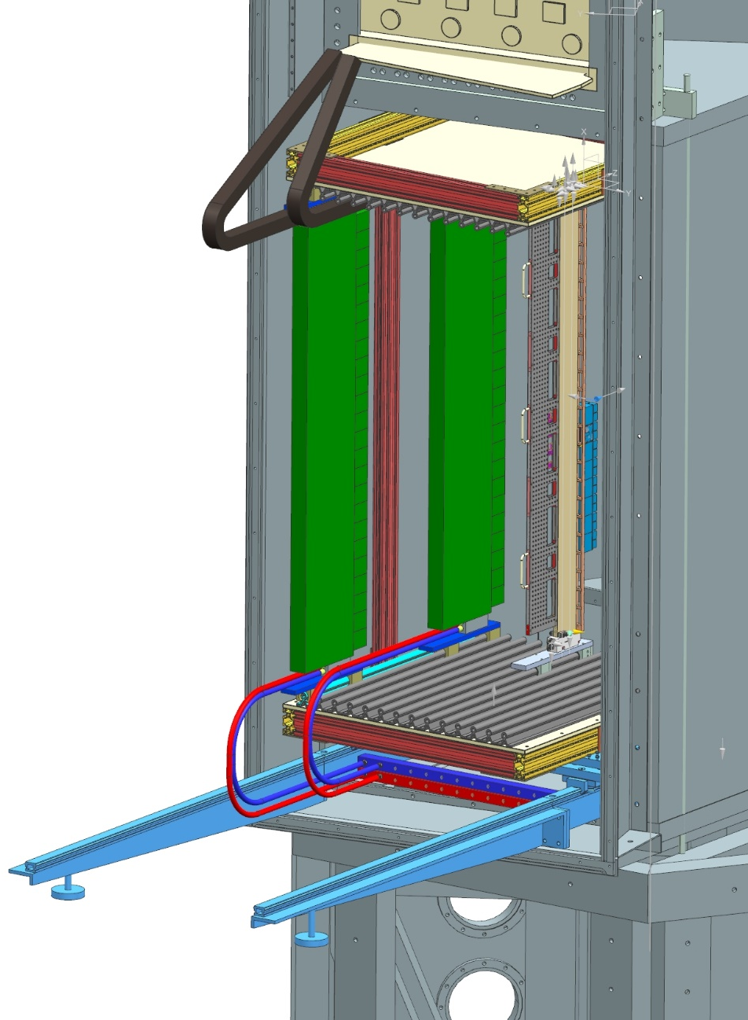
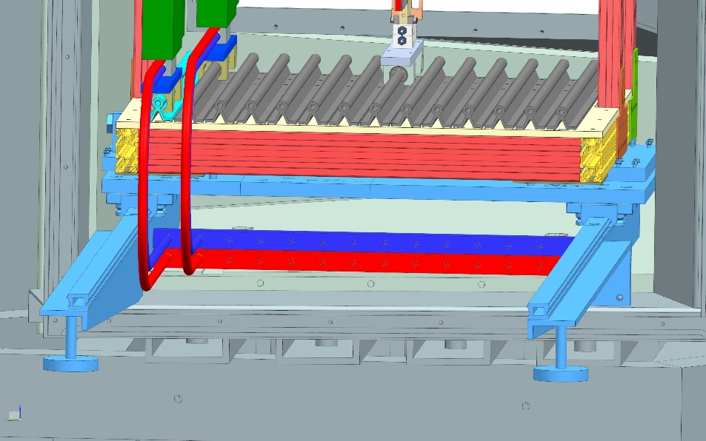
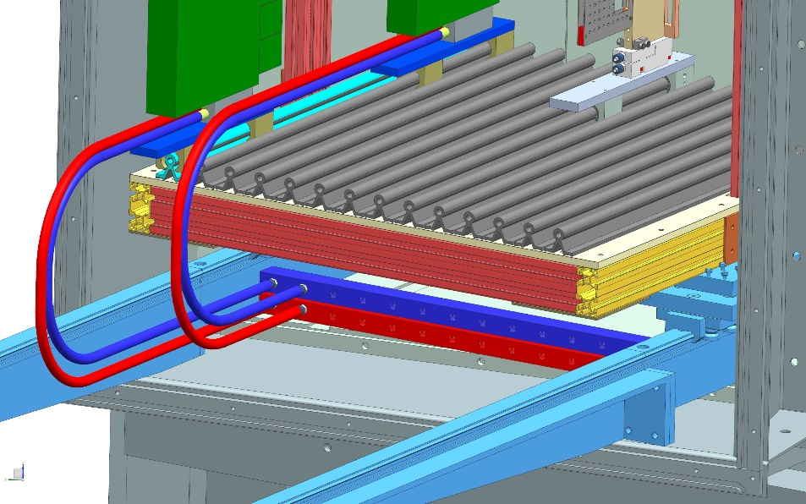
Rack structure and rack rails
Recycling current rails and insertion/adjustment system
Rails at increased pitch:
  improve stability
  allow manifold lodgement in between
Cooling manifolds below rails level, deep drilled bars (stainless steel)
DESO Quick connectors for fast cooling disconnection (if acceptable Dp)
Hoses length ~ 1.4, inner diameter min. 7 mm

Slide 8
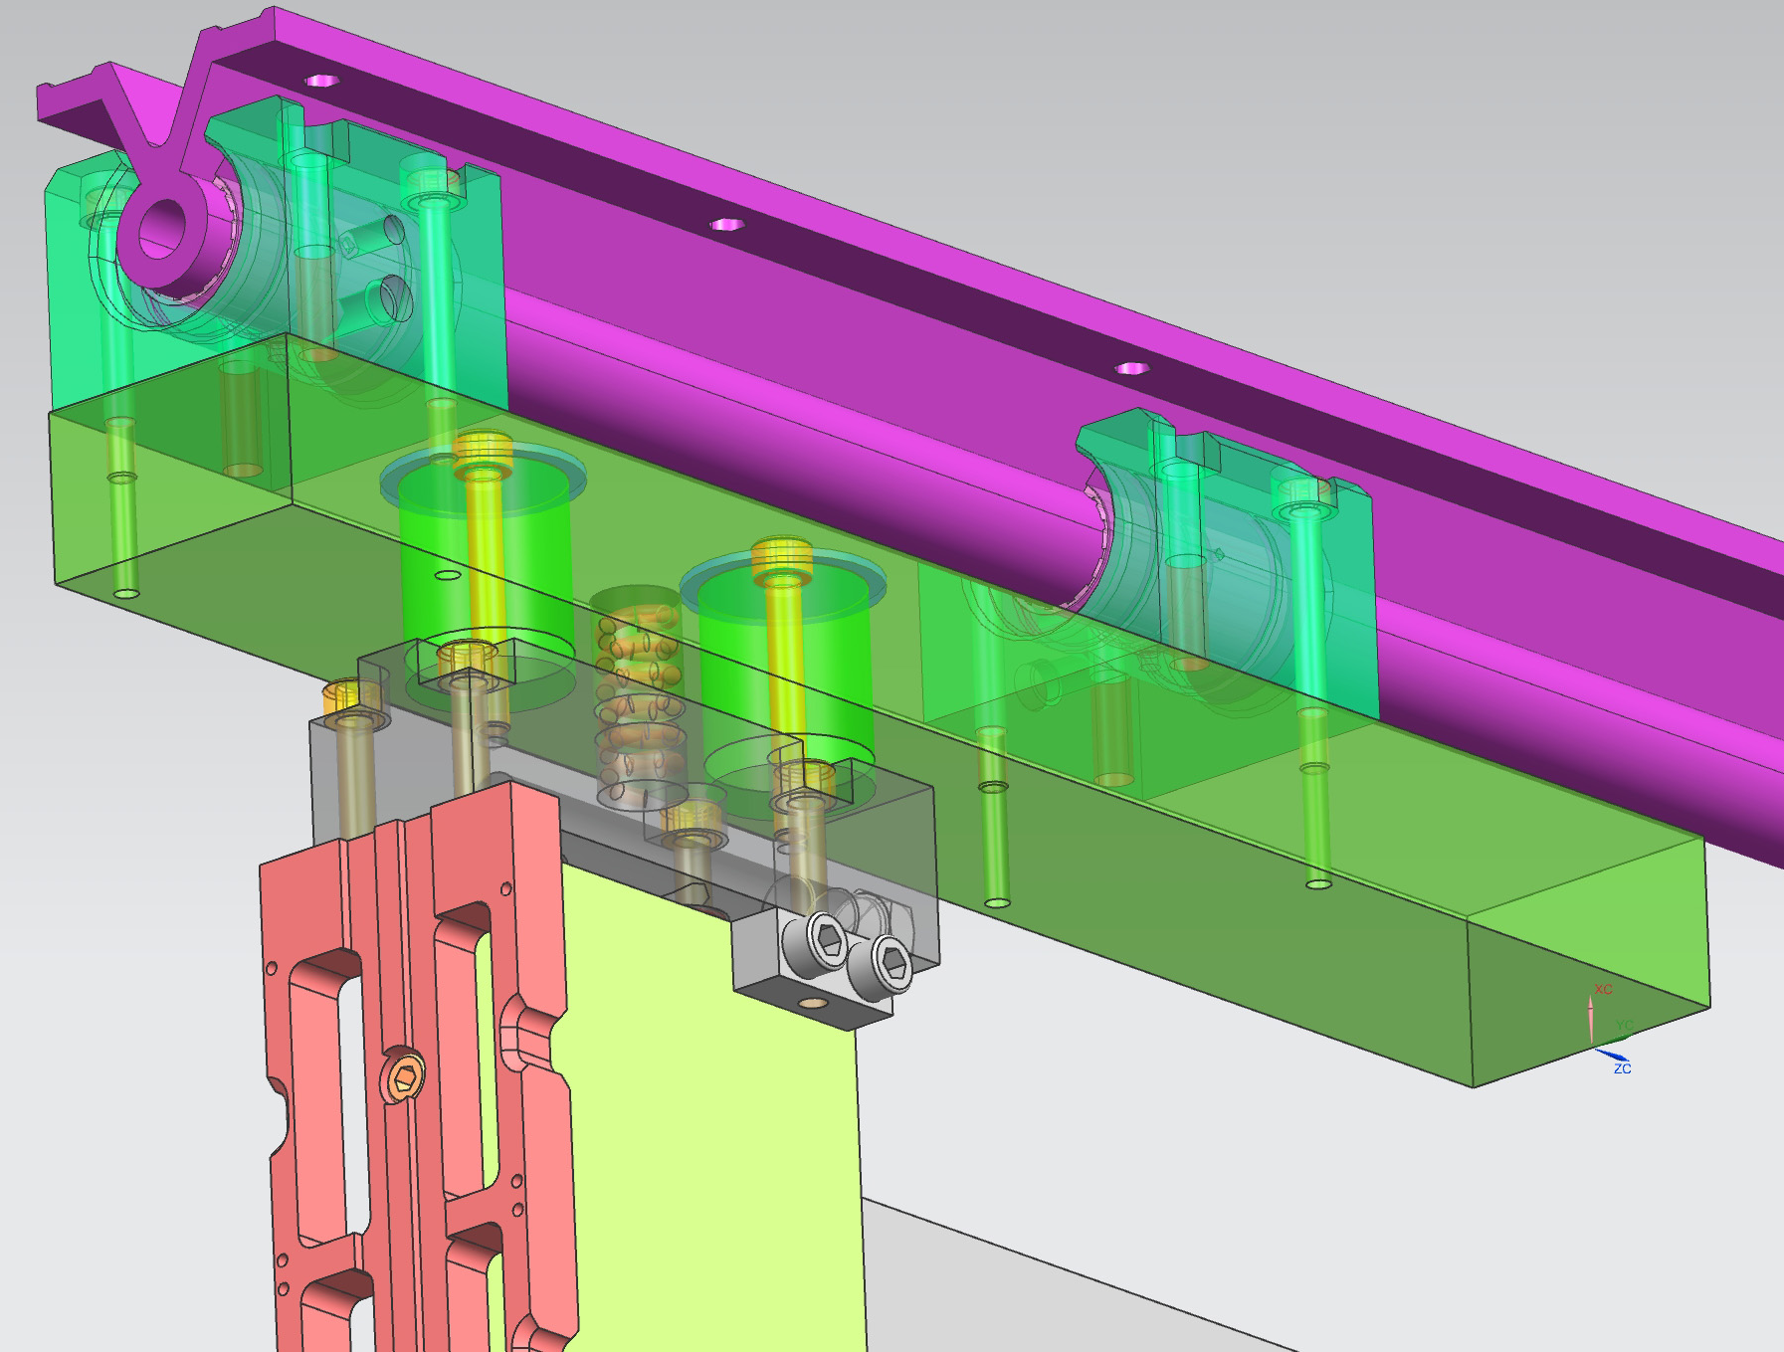
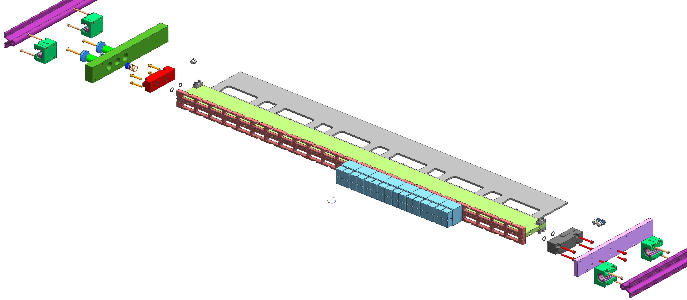
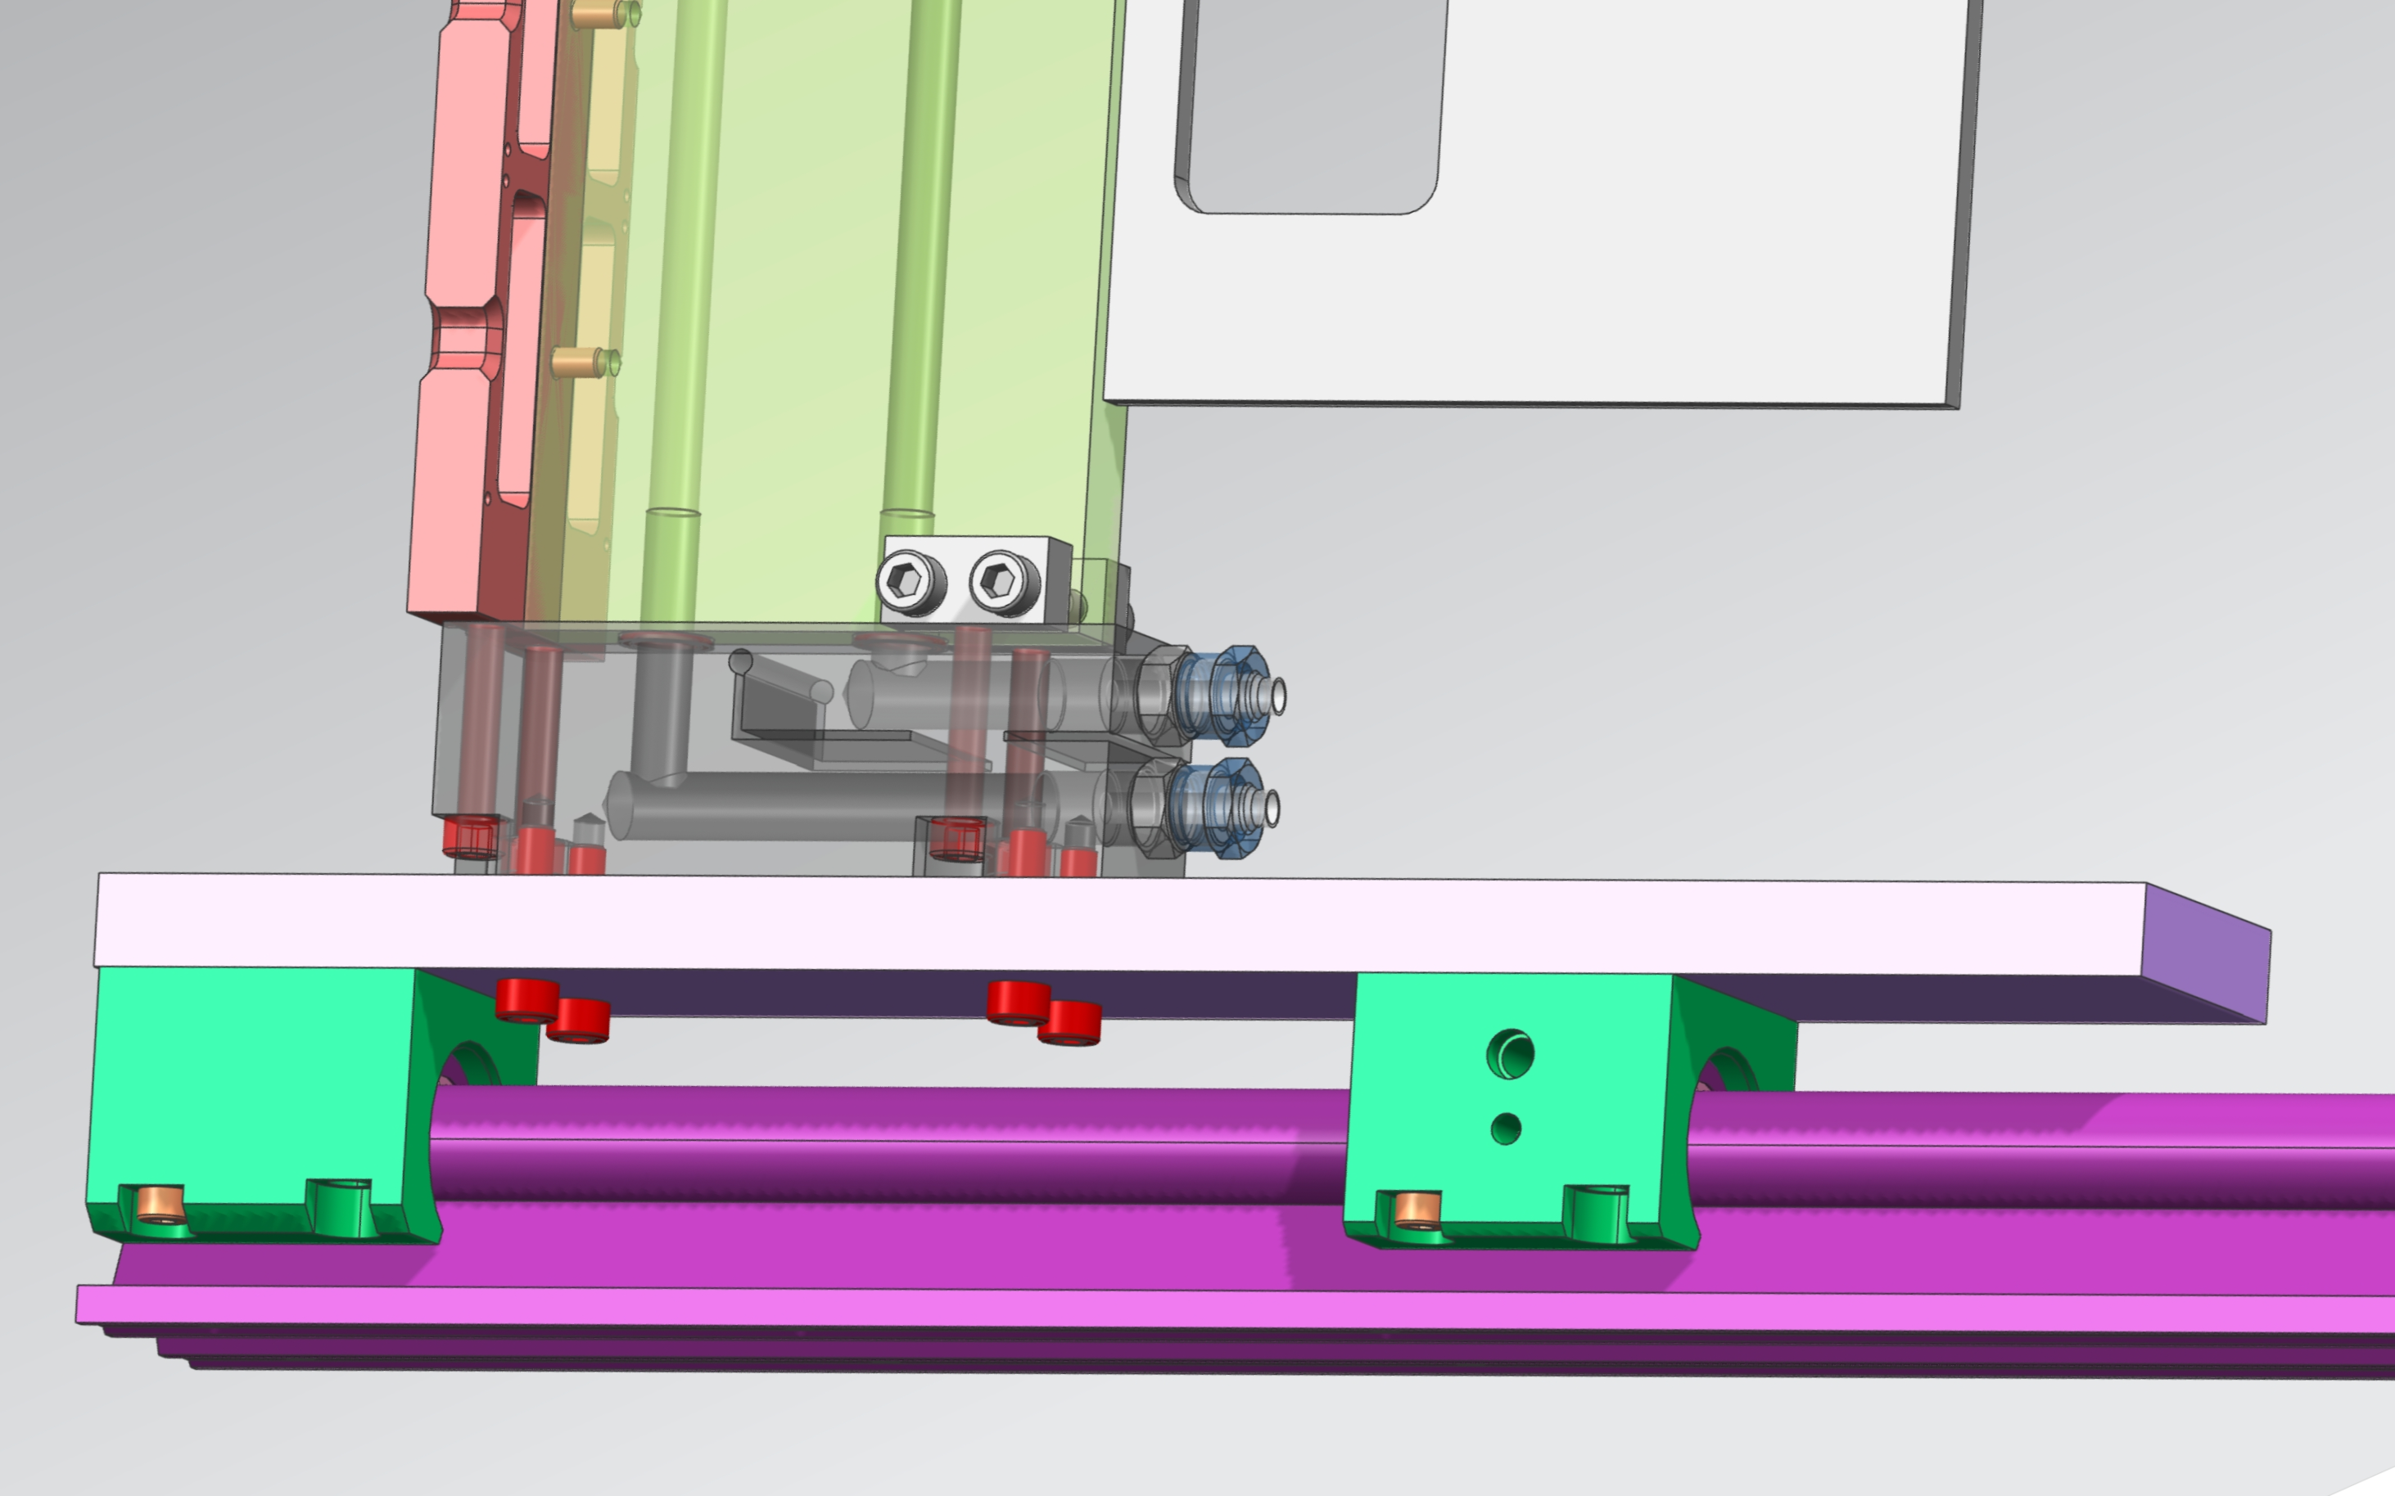
RICH2 column design: bearings and rails
Sliding coupling btw column and top bearings with preloaded
spring to compensate pitch mismatching btw rails thus ensuring smoth movement
Bearings Igus OJUM-06-20 (low friction plastic)
Rails Igus AWMU-20 (drawn aluminum)
Electrical Insulating bearings,
T-bar connection to GND

Slide 9
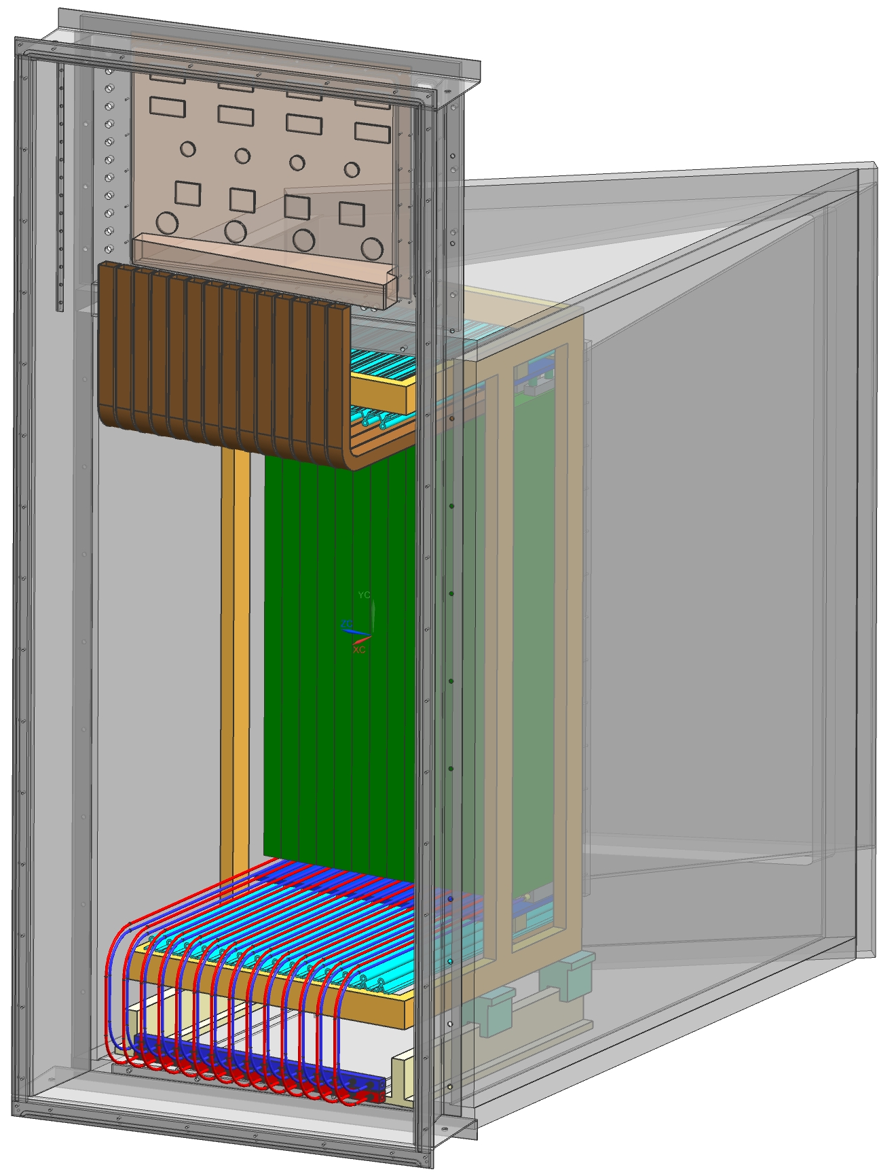
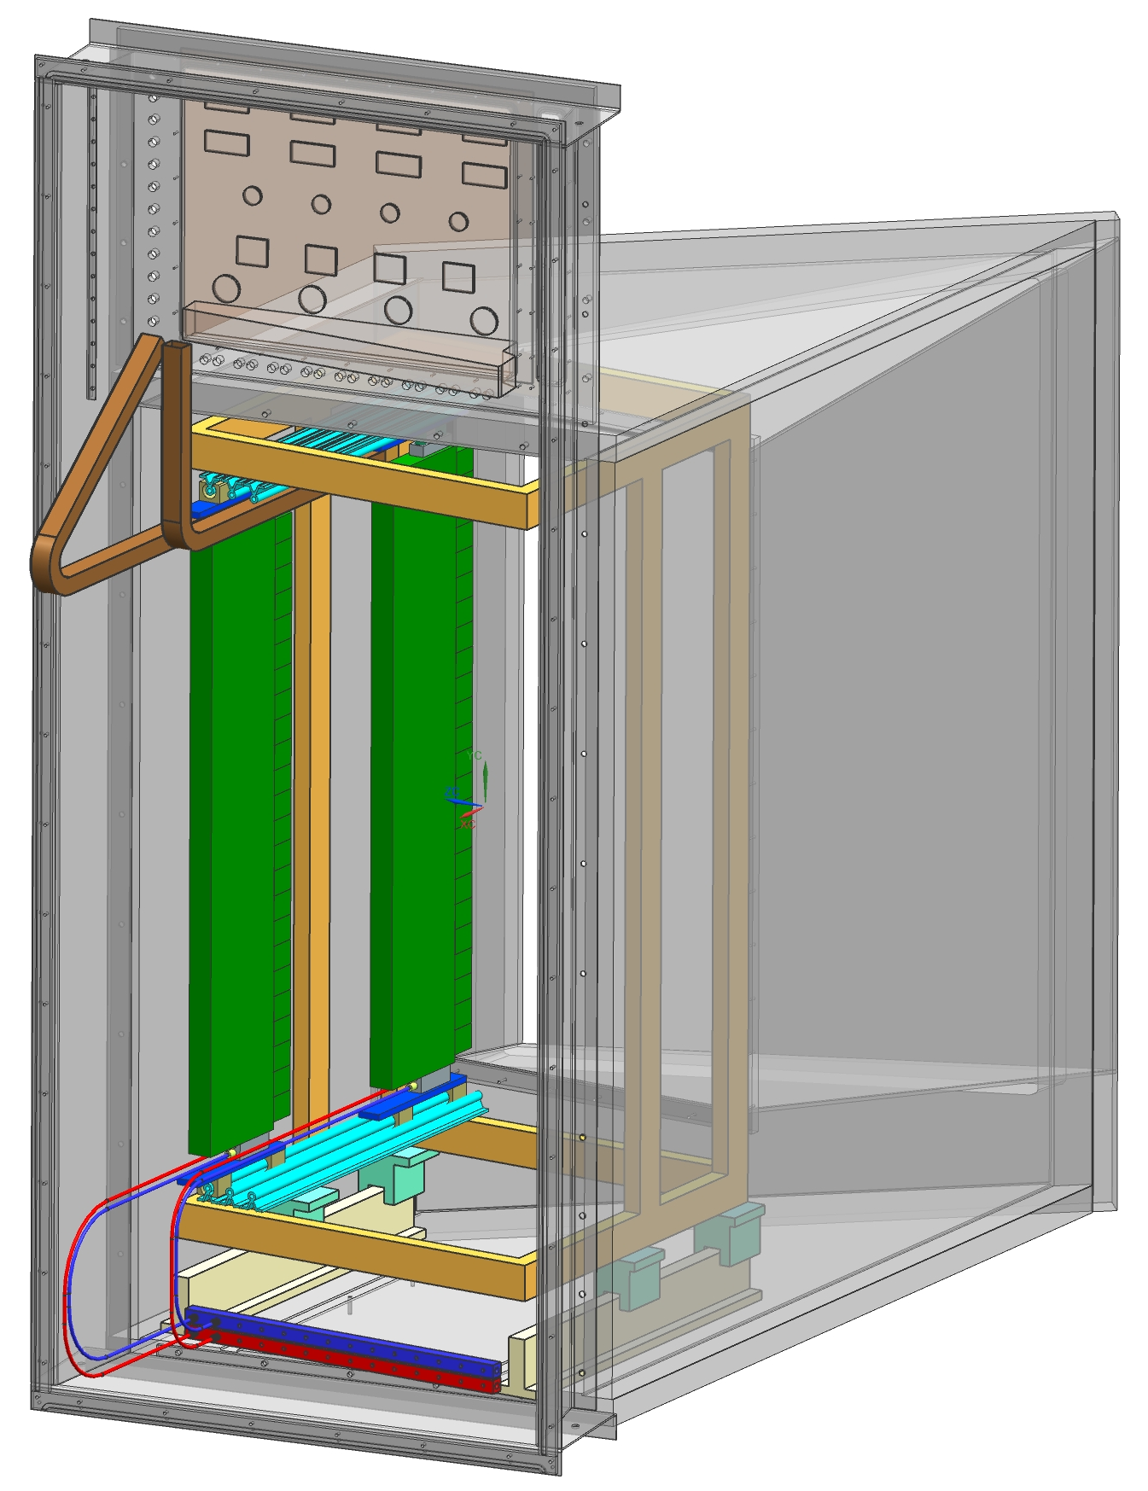
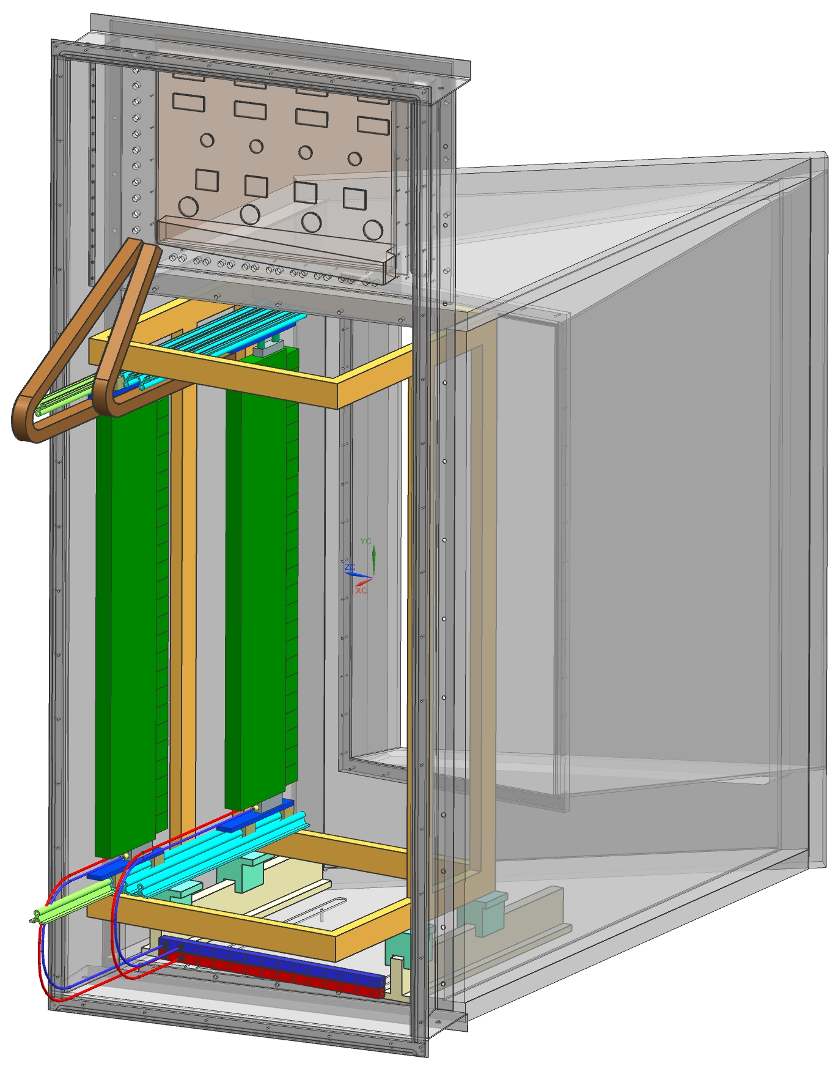
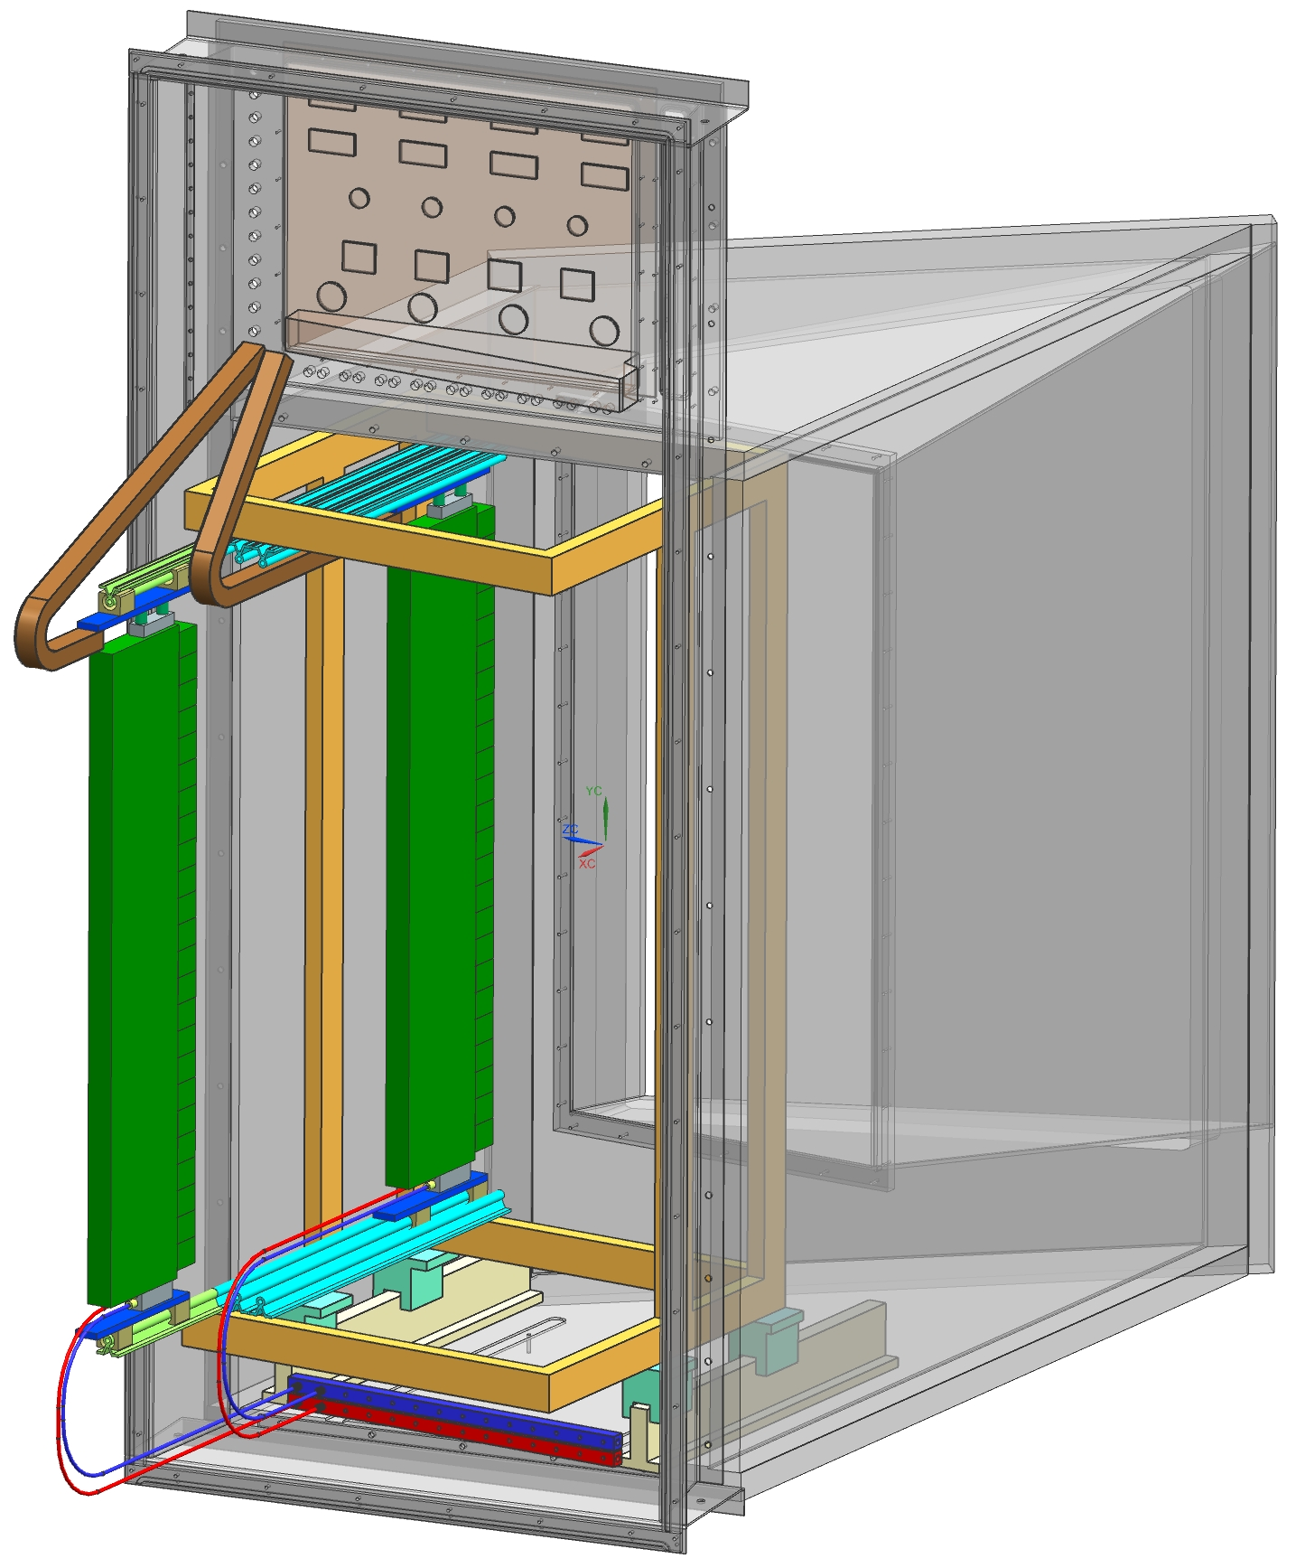
RICH2 “in situ” maintenance: ECs and DBs replacement
Columns maintenance shall be possible without disconnect services
Disconnecting/unsealing cooling circuit should “never” be needed.
Disconnecting services (HV,LV,fibers) should “never” be needed.
Disconnection of services required only to remove/replace one full column, or removal of the full rack …
Single column retracted, columns in the middle fully reachable for maintenance (165mm min. side clearance to access 1st/last columns,
if 12 columns)
Single column and full rack retracted, columns in the middle and one side (Velo side) fully reachable for maintenance
Full rack retracted, single column retracted on rail extension, all columns fully reachable for maintenance

Slide 10
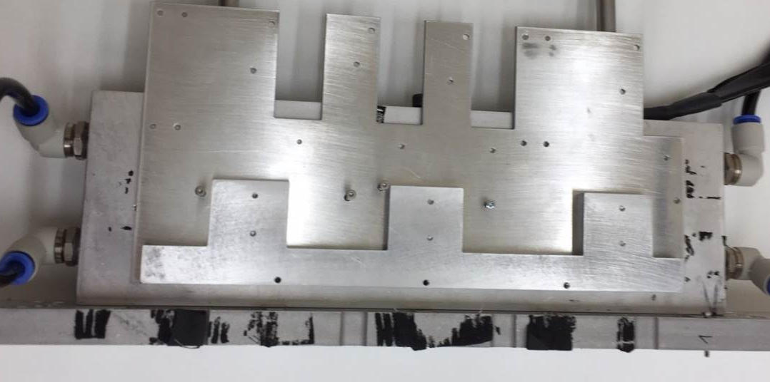
Finalized levelling plate (Christoph et all.)
Various prototypes done
(Didier, Giovanni, Simon,….)
  design refinement in progress
Final design: aluminium plate + screwed spacer to contact FPGA

Slide 11
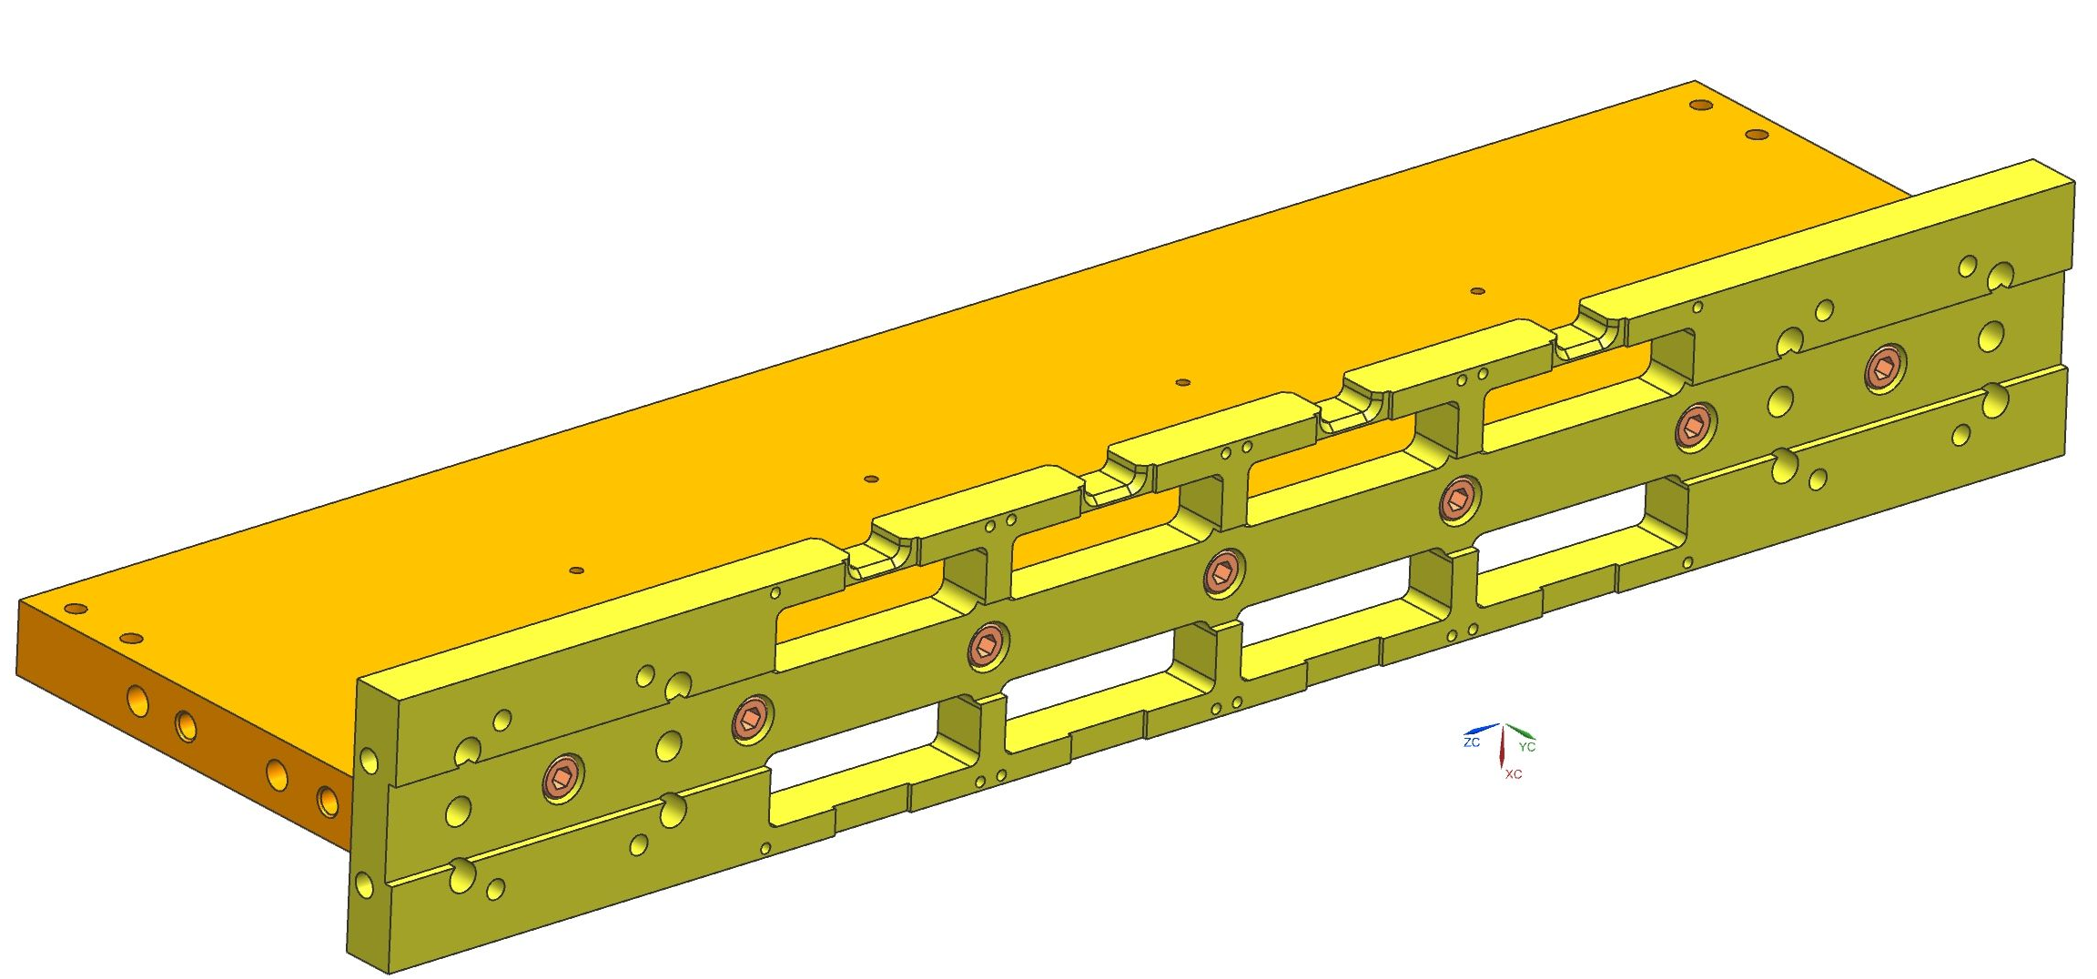
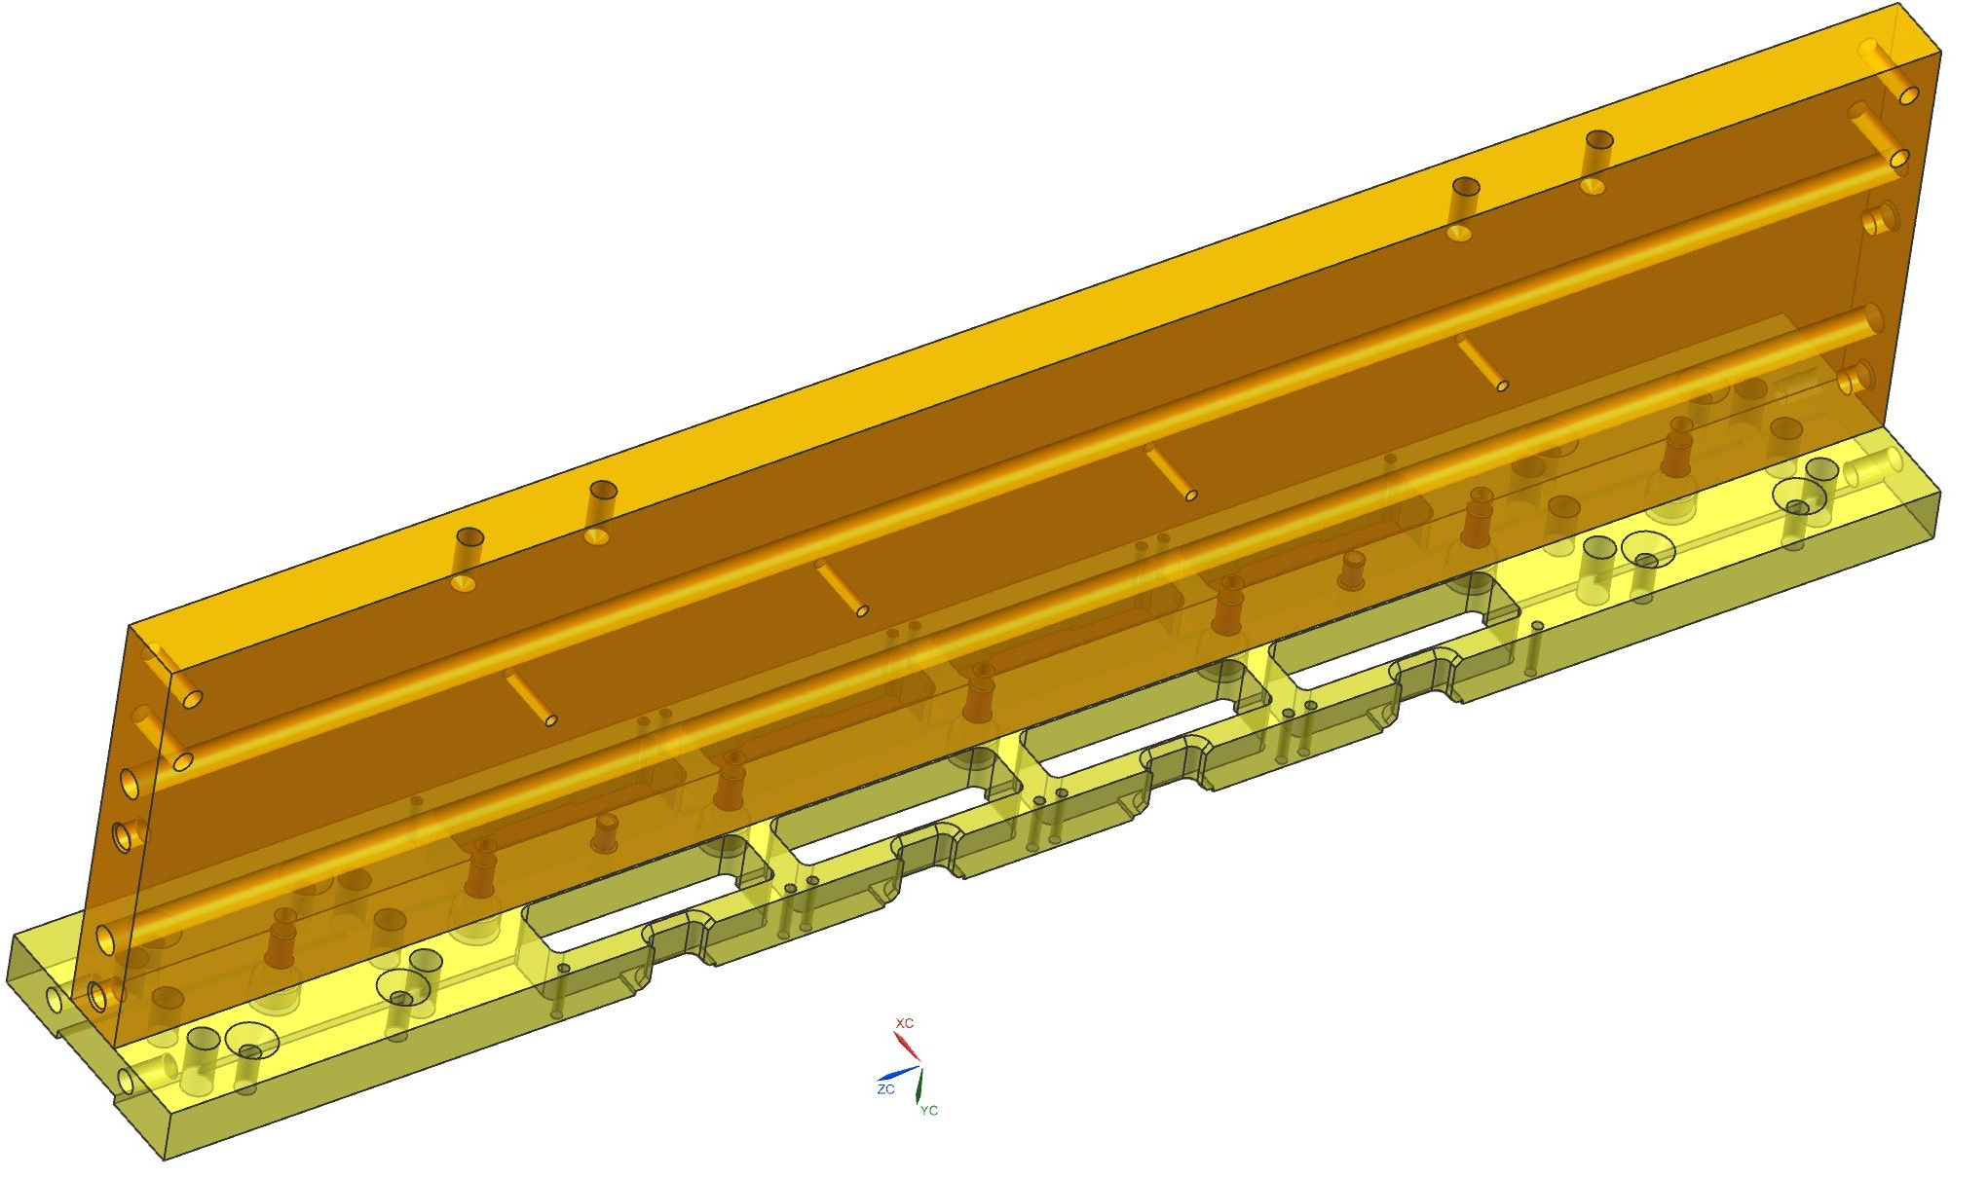
Single PDM T-bar prototype to qualify design
Short T-bars to test machining interfacing ECs, DBs, HV cables
Grooves to avoid EC back-board shorts
Refined shape of slots for connectors to avoid interference to DBs
HV cable grooves on one side, increased size
Holes to fix DB
Holes in btw DB to fix screen / cable holders
Holes for dowel pins between spine and flange
Holes to fix the cable tray / RICH1 columns
(One longer ends for test beam installation)
http://www.pd.infn.it/~bmassimo/LHCb/1711/
11

Slide 12
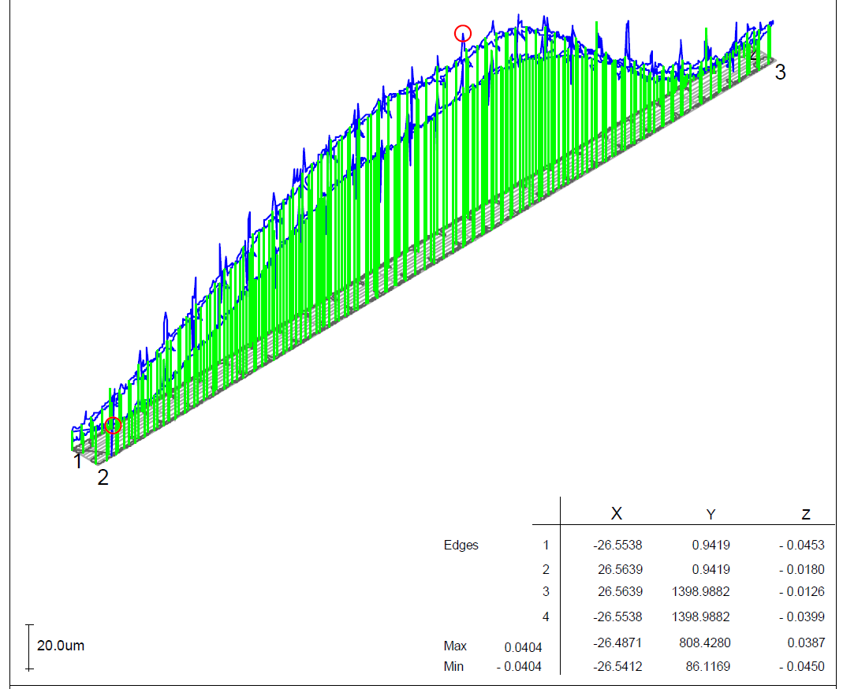
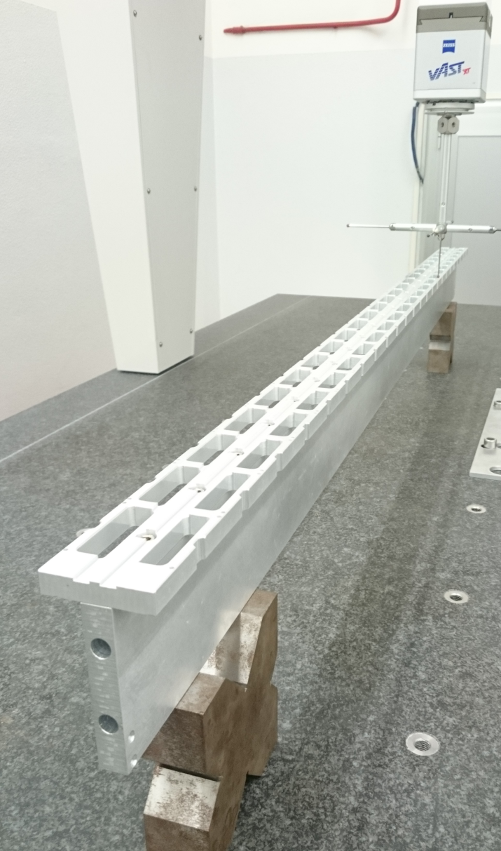
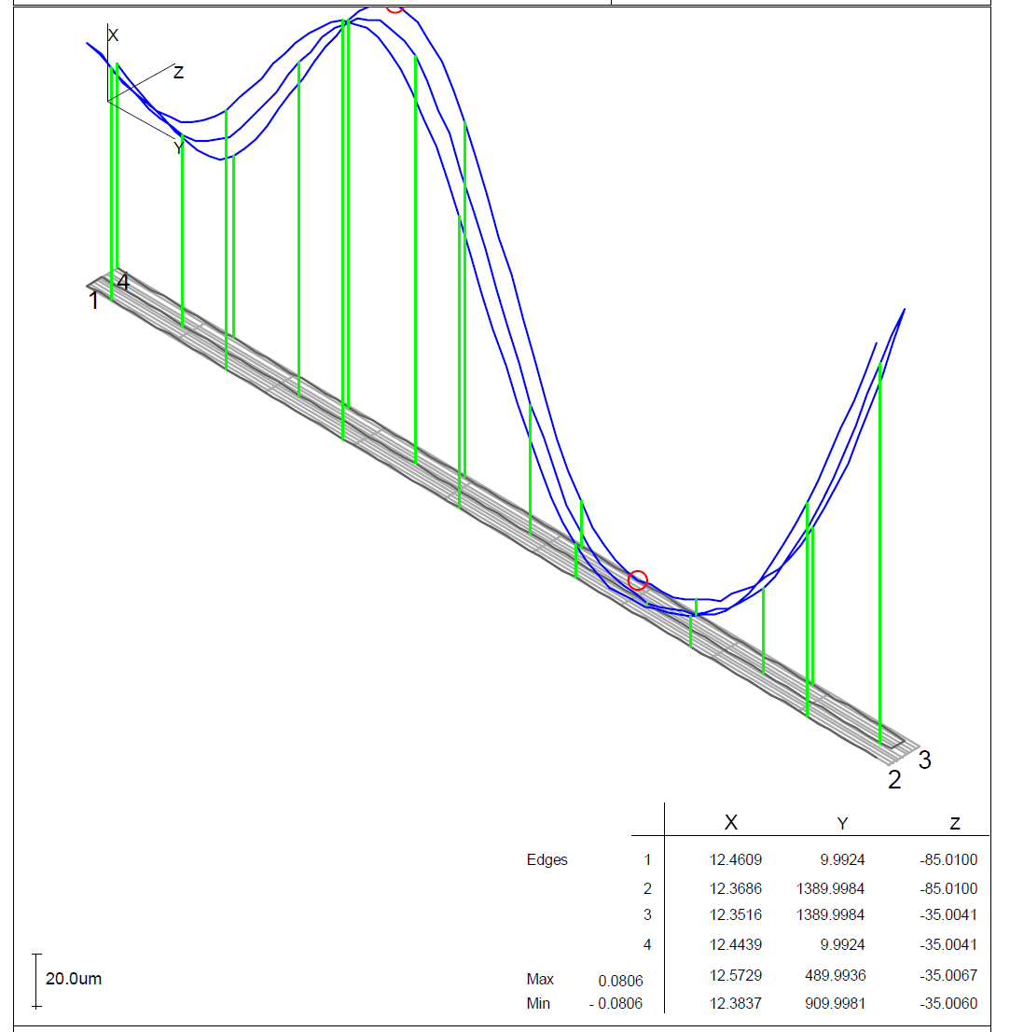
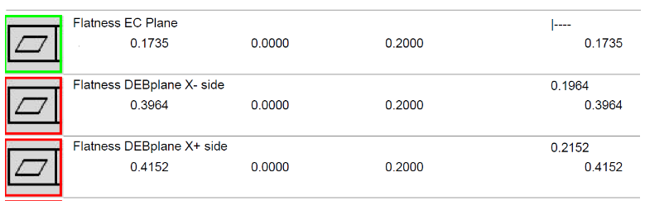
T-bar assembly and geometric quality control
  T-bar composed by two main pieces
  Quick check of straightness/planarity of each single piece on granite table
  CMM measuring of slots position and dimension
  Assembly on granite table
  Final CMM measuring of straightness, flatness, perpendicularity
  Assembly of end-blocks and rails and align and fix on mask on CMM
  Final measurement wrt to dummy rails
“EC” face
“DBs” face(s)
T-bar composed from “bad” plates
T-bar composed from “good” plates
12

Slide 13
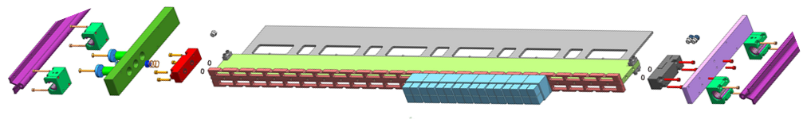
RICH2 T-bar design status: endblocks, bearings and rails
Workshop drawings in: http://www.pd.infn.it/~zago/170922_LHCB/
To be stored on EDMS, as soon finalized: LHCB-0652 Photodetector Support
https://edms.cern.ch/project/LHCB-0652
13

Slide 14
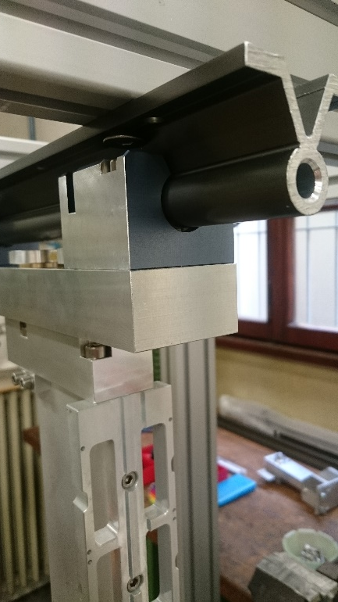
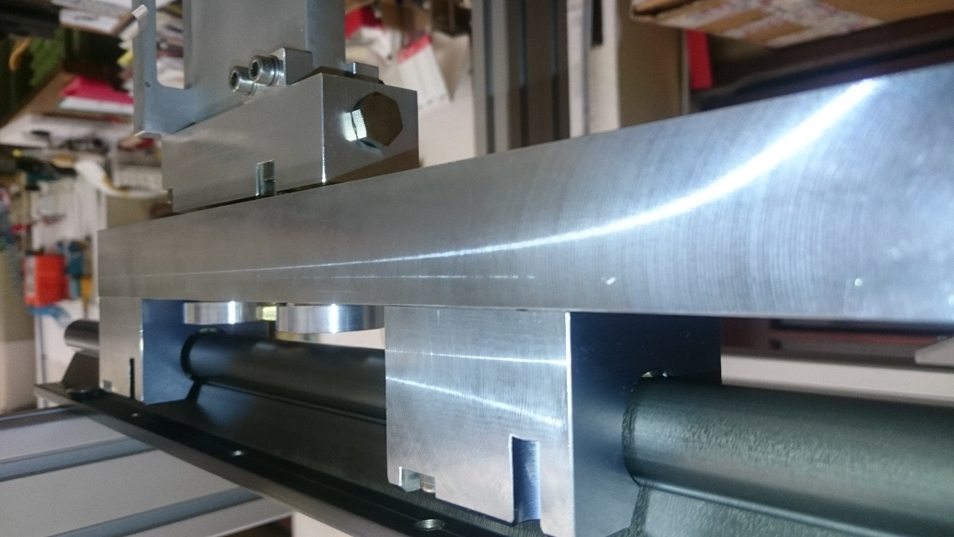
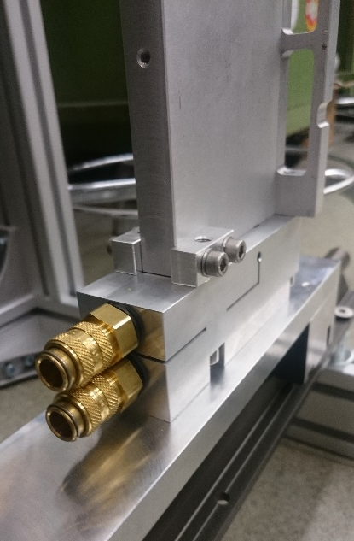
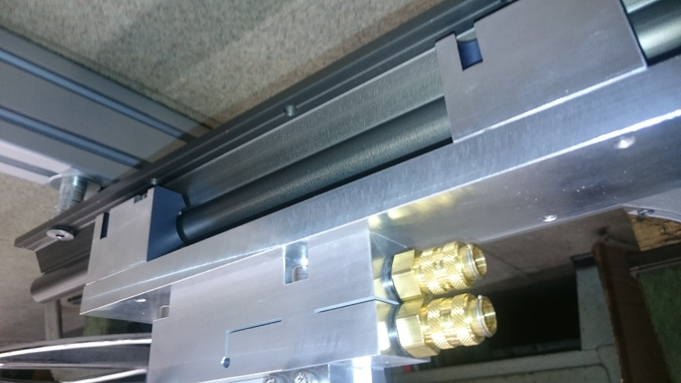
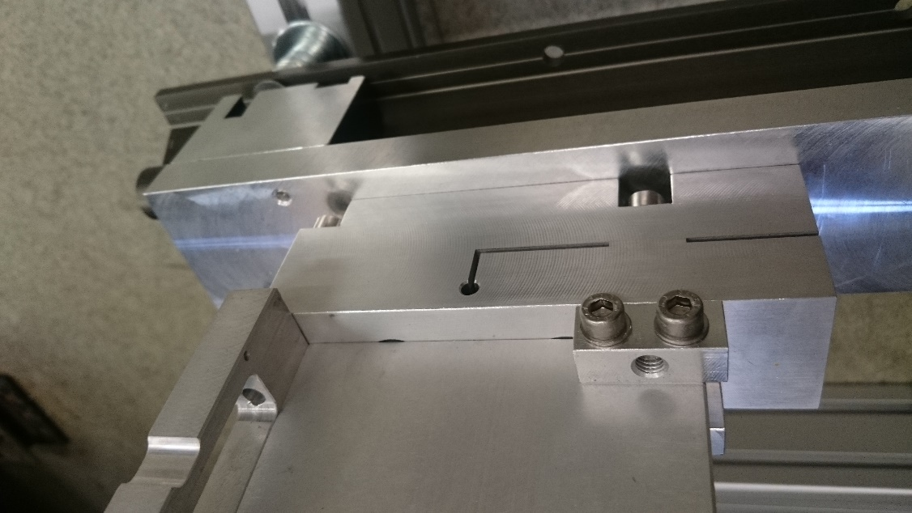
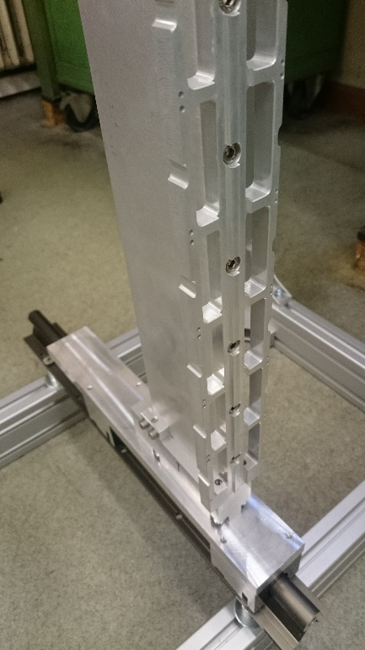
RICH2 T-bar prototype: endblocks, bearings and rails
Sliding fine, no stick slip, acceptable top-bottom misalignment (pitch)
14

Slide 15
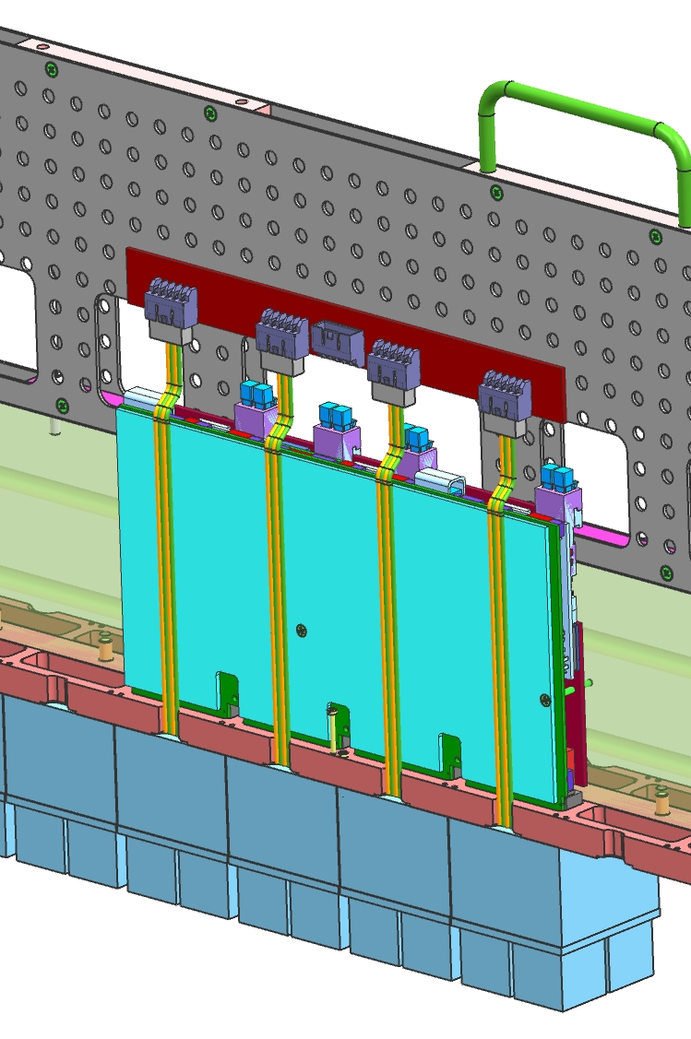
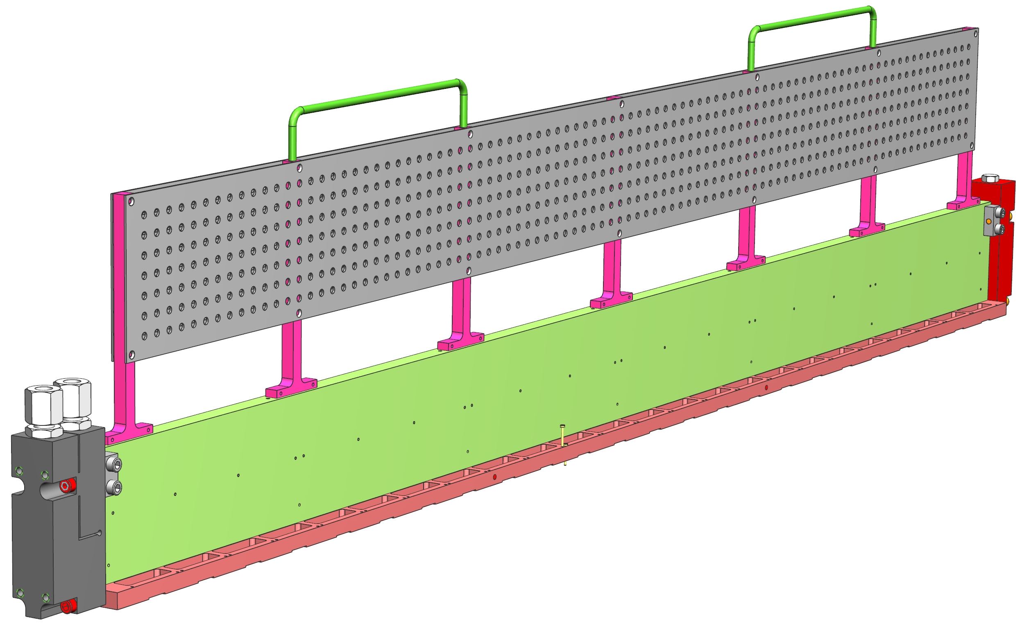
RICH2 T-bar cables and fiber tray
Custom perforated aluminum sheet
Small holes in dedicated positions to lodge tapped rivets
  to fix HV distribution boards, cassette, etc..
Distributed holes array for easy cable fastening with cable ties to fix:
  HV distribution board and HV cables
  LV cables and 2.5V DCDC supply
  Fibers and fibers cassette
15

Slide 16
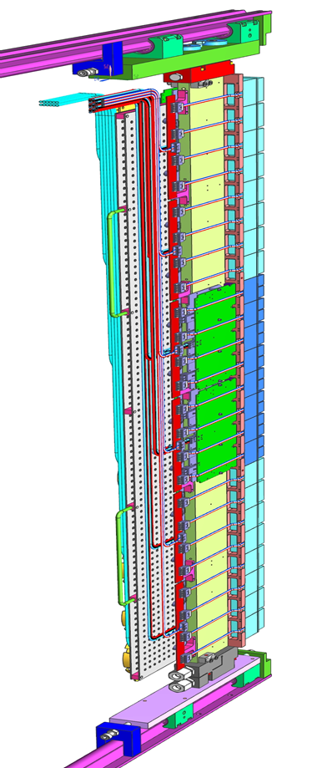
Rich2 T-bar service routing: LV
DCDC to supply 2V5 t.b.defined
placed on T-bar:
  VDD & 2V5 : 2.5 mm2
  GND: 8 mm2 (2x4 mm2)
placed at distribution box
  VDD & 2V5 : 4 mm2
  GND: 10 mm2
DCDC 2V5
16

Slide 17
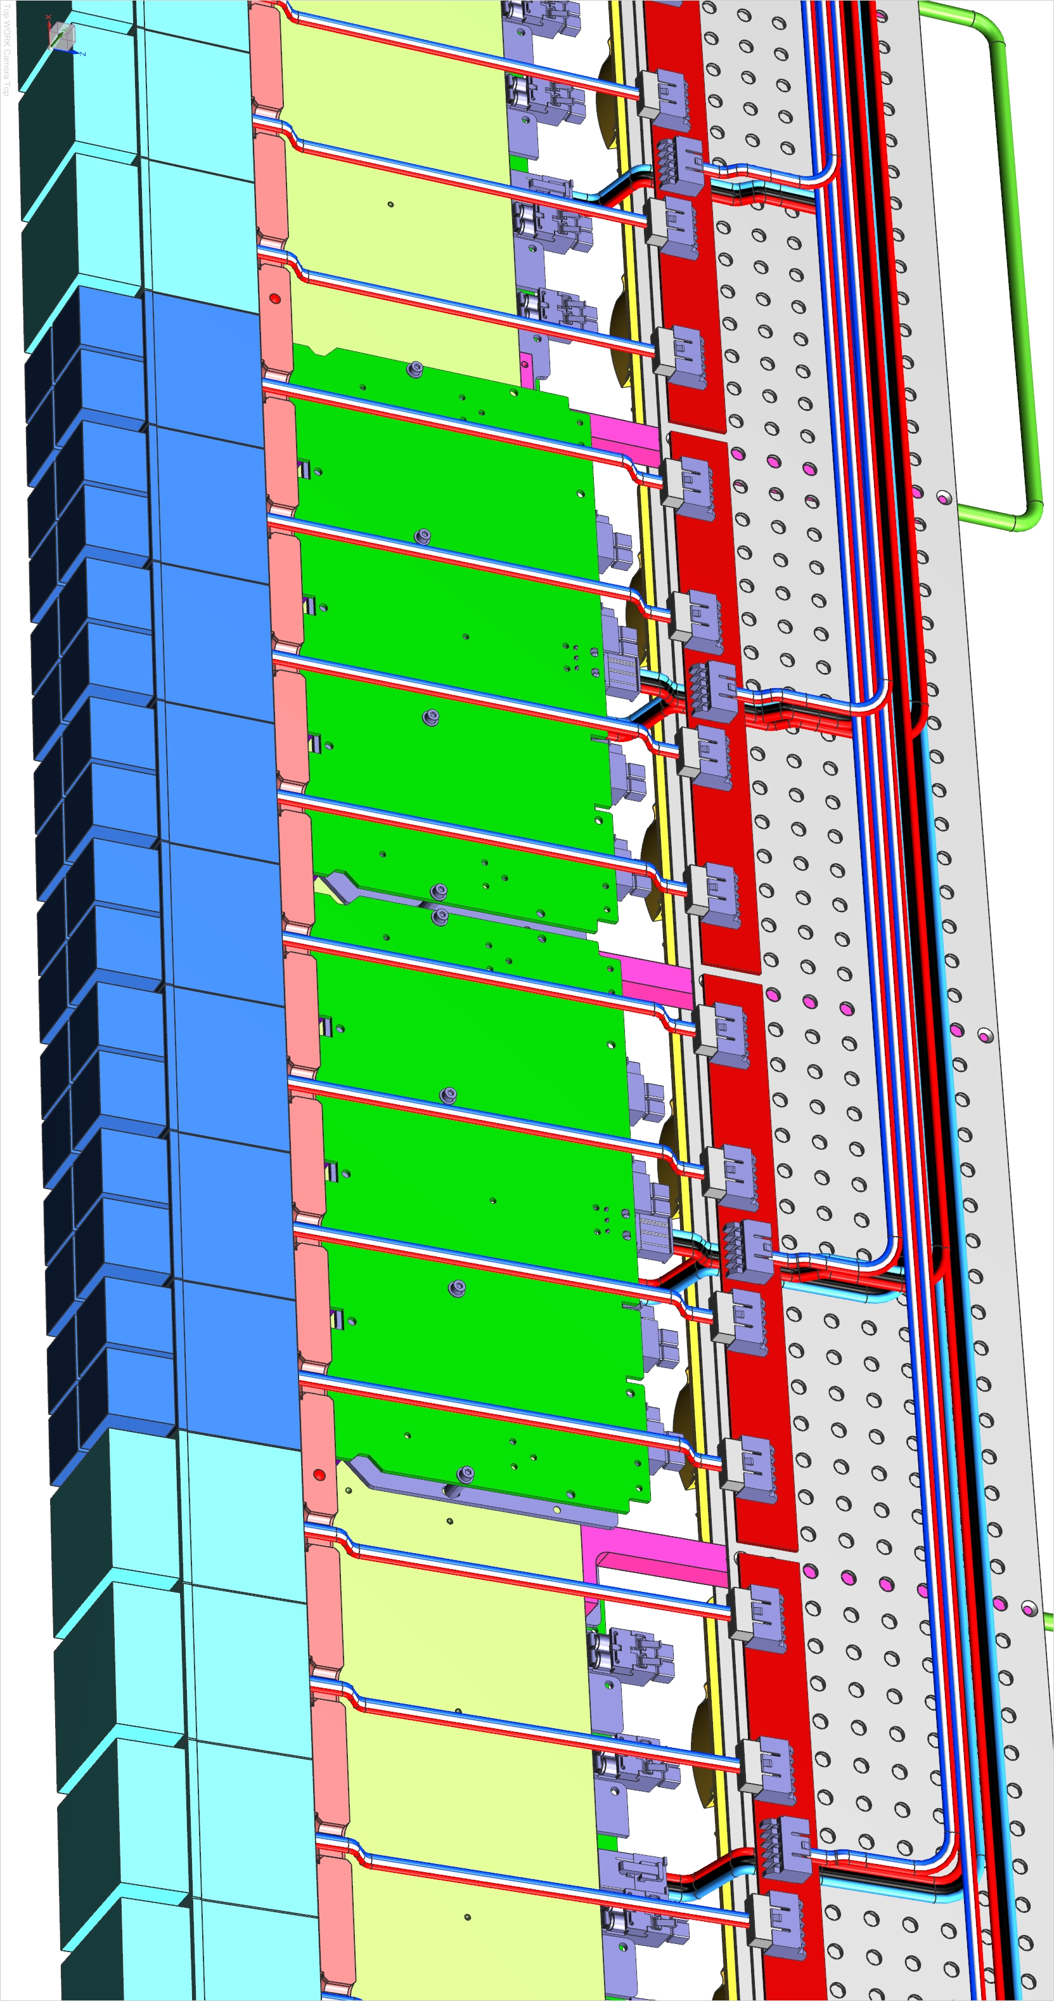
Rich2 T-bar service routing: HV
Distribution board
common with RICH1
Cables from patch panel to distribution board t.b.d.
Cables from distribution board to EC:
Alphawire 39X2205
(0.07 inch outer diam.)
17

Slide 18
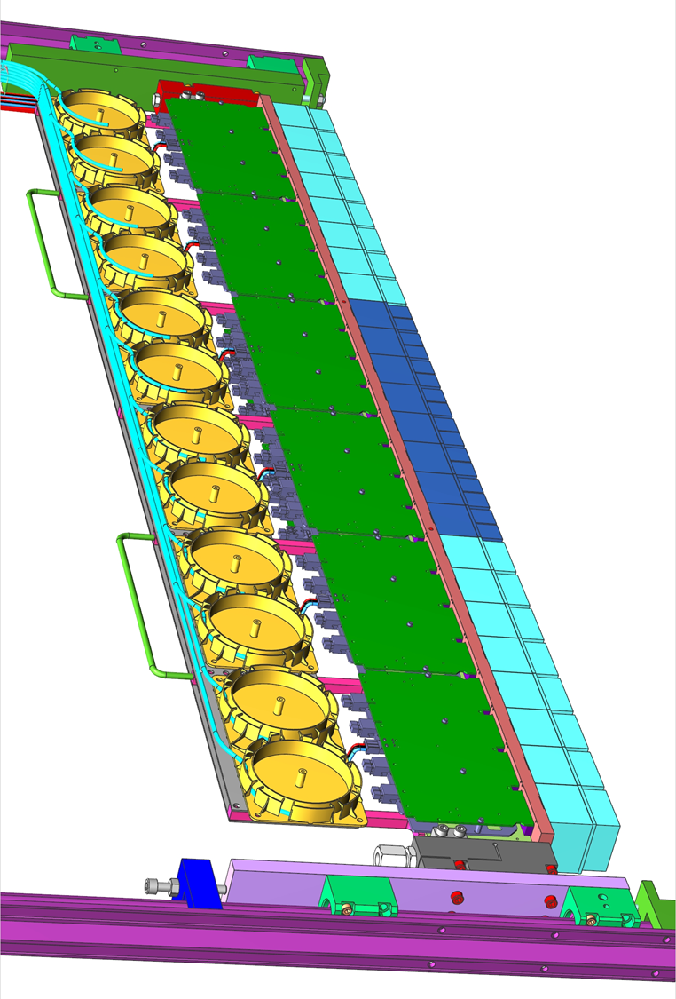
Rich2 T-bar service routing: signals and control fibers
36 signals fibers, 3 bundles x 12f
16 control fibers, 2 bundles x 8f
Cassette to wind up extra length
RICH1 design or 3D printed … tbd
18

Slide 19
RICH2 Cooling circuit main specs
General specifications:
Overall dissipation: ~ 2.1kW / PDA,
Cooling fluid: single phase 3M Novec(™) 649
Cooling Power ~ 175W/column x 12 columns = 2.1 kW/PDA
RICH2: nominal flow of ~ 900 l/h/PDA =~ 15 l/1’/PDA, Flow/column: ~ 1.25 l/1’
Max available drop of pressure at the detector: ~ 0.7 bar
Two drilled ducts inside T-bar, go – U – return, 2.8m overall length, 6 mm diameter
Coolant speed inside column (6mm diam. Ducts) ~ 1.5 m/s
Goals:
PMTs temperature < 30 ^C,
DBs hot chips and DCDC temperature (mostly depending on thermal contact) < 50^C
Components specifications:
10mm O.D./7mm I.D. PU flexible hoses as pigtails of the columns, 1.4m long
Connections of columns pigtails to manifold: double end shut off (DESO) quick connectors
Manifold bars: SS304 deep drilled bar
Fittings and DESO connectors: SS316, a few different to be tested soon.
5 bar working pressure, hose plastics (PU) and seals rubber (NBR) shall be compatible with Novec(™) coolant
Main supply/return to/from manifold in opposite position to equalize paths for all columns
Overpressure valve with “free discharge” outside detector gas volume
Flow sensor, may trigger alarm and/or actuated valves shut off
Circuit prototype to be tested soon at Cern (drop of pressure, components, tightness …)

Slide 20

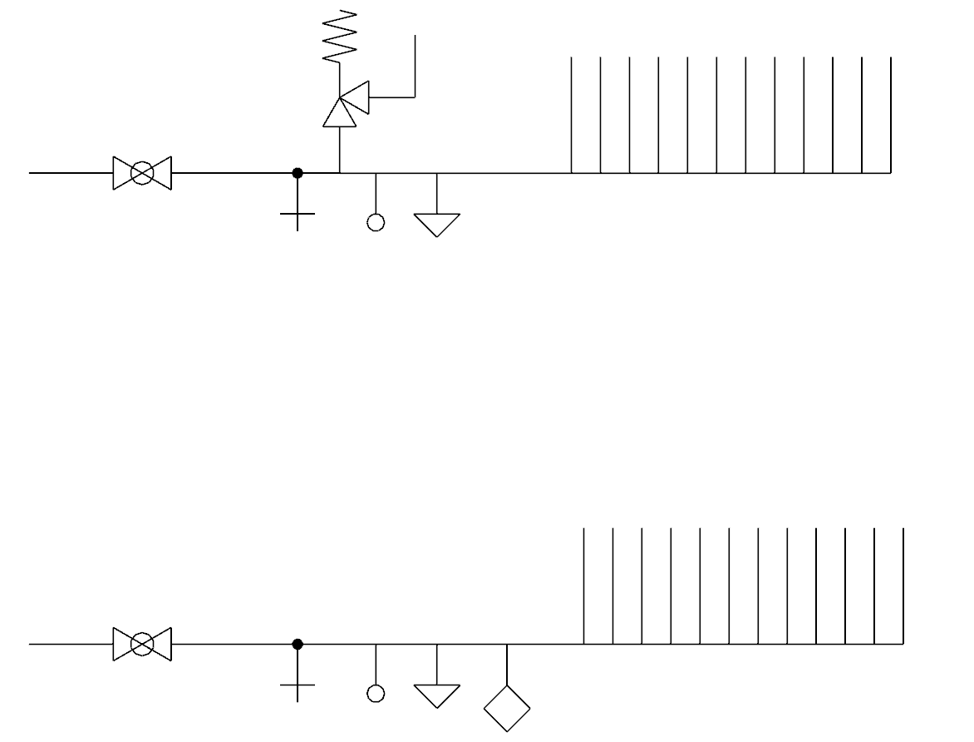
RICH2 Cooling circuit patch panel and manifold
12x supply
toward T-bars
Over-pressure
valve
INLET
Supply manifold bar
IN and OUT main valves
(remote controlled if C6F14)
Pressure sensors
12x return
from T-bars
Flow Sensor (outlet only)
Temperature sensors
Drain/spillage valves
OUTLET
Patch panel
possible
position
(upstream side)
Return manifold bar
Manifold bars
Cooling Patch panel
20

Slide 21
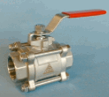
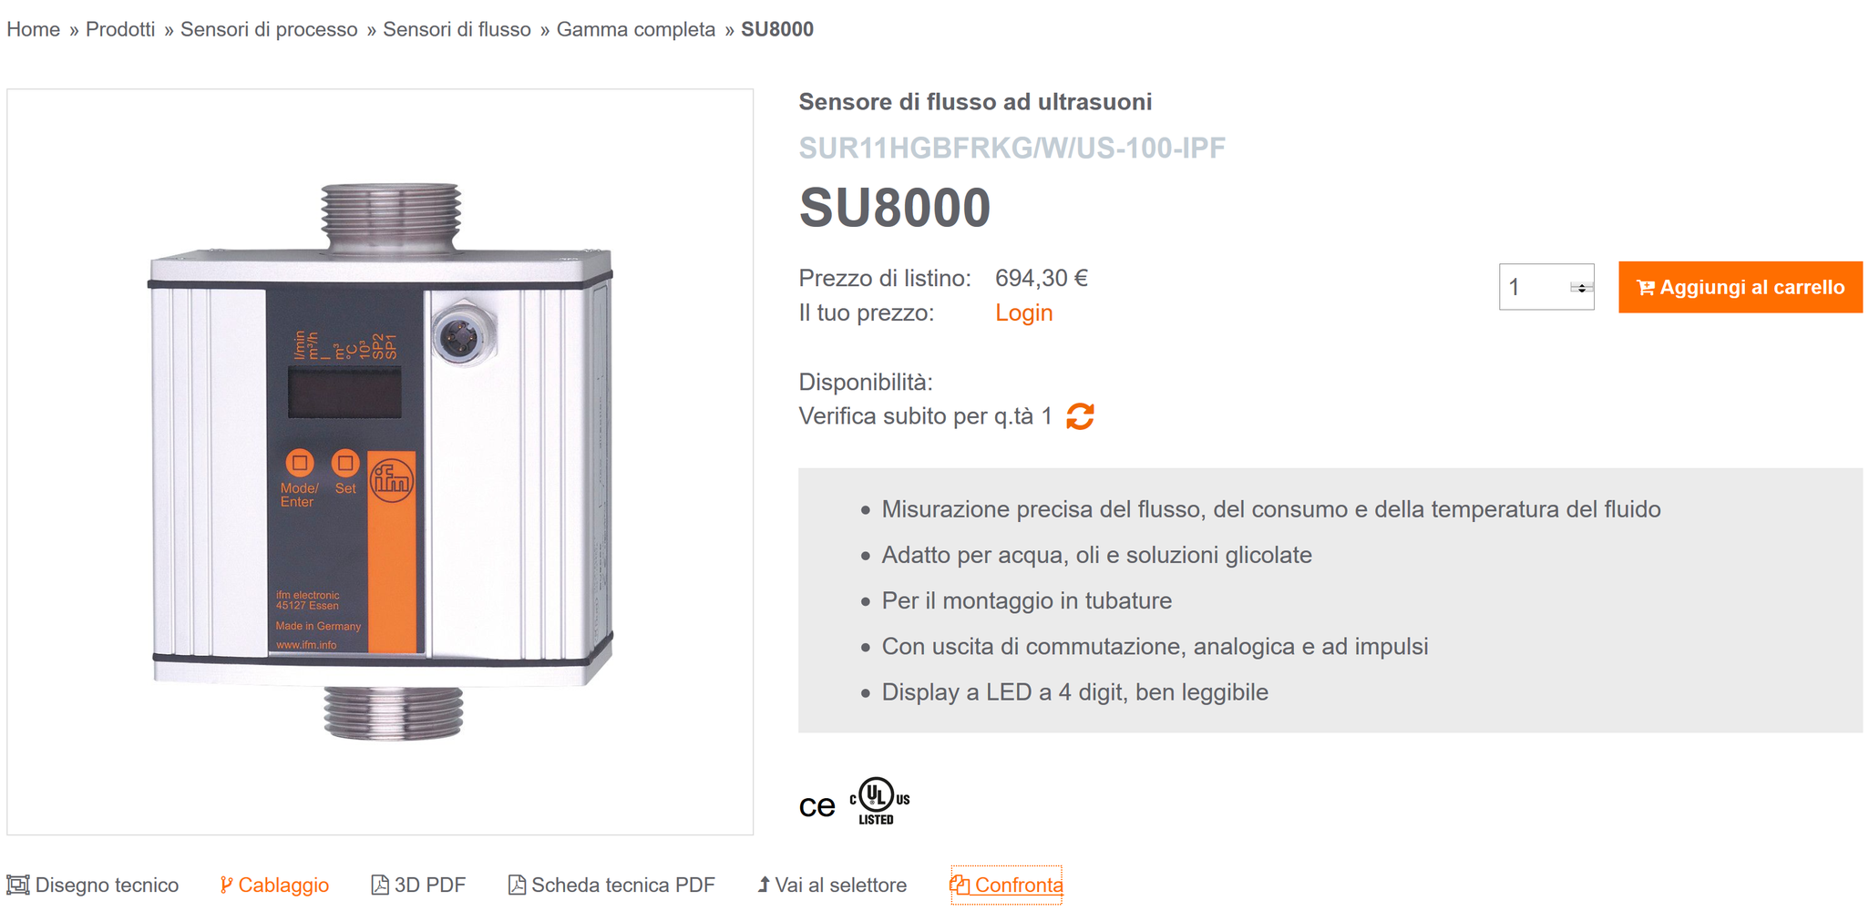
RICH2 Cooling patch panels
Components available at Cern store:
40.40.75.620.9: 1” ball valve (electric and pneumatic versions available)
40.10.61.B : Stainless steel safety valve
22.64.12.026.8: SS pressure sensor (absolute, also relative or differential)
Temperature sensor tbd, large choice, e.g. Siemens QAE30….
Flow sensor can imply high pressure drop …. ultrasounds candidate =>
21

Slide 22
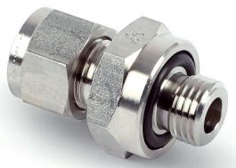
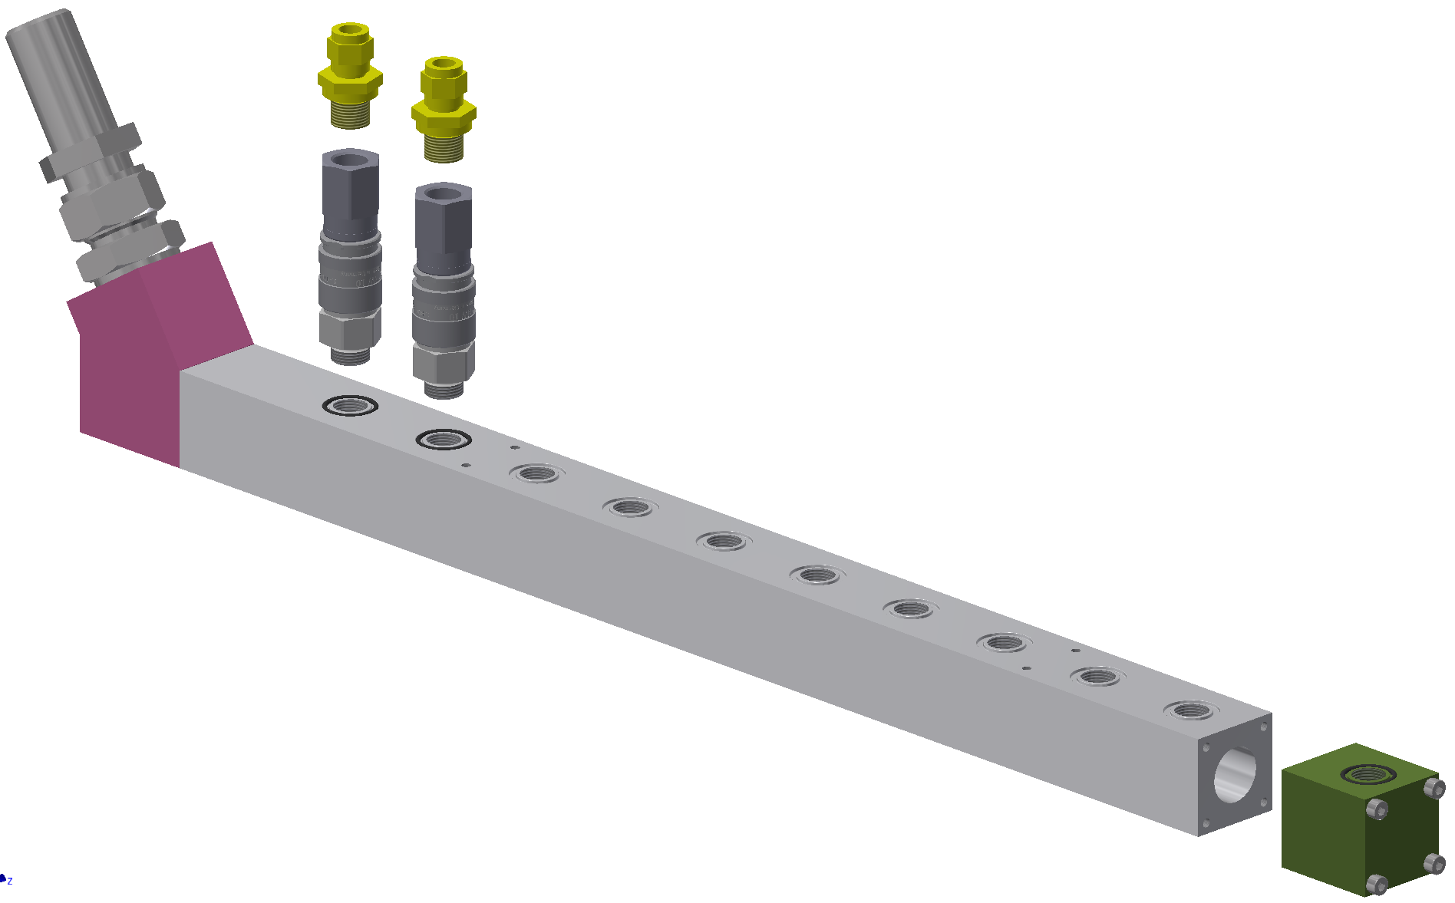
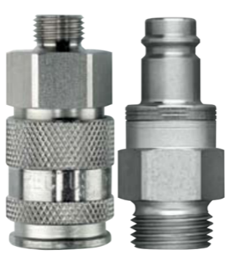

RICH1 Manifold (James Kariuki et all.)
Flexible tubing connector
custom 316 st. st. Rotarex fitting
10 mm O.D tube compression end-connection to column transfer lines (7/10 Legris PU tubing)
Male G 3/8 with integrated o-ring seal
Double shutoff quick release coupling
Parker RECTUS series, 27 KB
316 stainless steel, 10 mm bore diam
3/8 BSPP end connections (female to tube fitting, and male to manifold ports)
22ml air inclusion/spillage volume
Plug-side manifold end block
44.45 mm square Al. bar, 50 mm length
25 mm duct diam
1x 3/8 female BSPP column port with an o-ring seal
Bolted o-ring seal to manifold
Distribution manifold
44.45 mm square Al. bar, 610 mm length
25 mm duct diam
10x female 3/8 female BSPP column ports each with an o-ring seal

Slide 23
Pressure loss estimates (J. Kariuki et all.)
Coolant: Novec(™) 649, ρ = 1600 kg/m³, μ = 0.64 mPas, Q = 1800 L/h per line
Key pressure loss points:
  coolant transfer lines into detector (25.4 mm I.D BUNA-N hose), ΔP ̴ -0.01 bar/m
    may require multiple bends and fittings between magnetic shielding and manifold, not accounted for here
  coolant transfer lines to columns (8 mm I.D PA tubing), ΔP ̴ -0.04 bar/m
  Parker RECTUS 27 double-end shutoff connector: ΔP ̴ -0.03 bar per connector
Total estimated pressure loss* across cooling loop ̴ -0.35 bar (including factor of 2)
  *not accounting for cold bar, full bore connectors and adapters, bends, etc, along cooling loop
Prototype tests at CERN indicate ΔP across the cold bar = -0.25 bar (6 mm duct diam, C6F14, 2.2 L/min)
  for comparison, my estimate (for 6 mm duct diam, Novec(™) 649, 2.7 L/min) is -0.35 bar
Post EDR plan to test a cooling circuit prototype for more accurate pressure drop estimates

Slide 24
To do temptative list toward production
Test small prototypes with finalized DBs and Ecs to validate current design
Finalize T-bar drawings with prototype outcome
merging RICH1 and RICH2 T-bar specs as possible
Review drawings of end-blocks manifolds and rails
Unify as possible nuts and bolts with RICH1: screws, O-rings, threads, fittings, hoses
Review cable tray wrt HV, LV, fibers requirements (e.g. fixing holes)
Check if possible unify other items: cassette, cable fastening ….

Slide 25
RICH2 schedule
Finalize drawings by June
Cern tenders and orders ~ July - August
Receive material > October
Parts QC/acceptance and columns mechanics assembly > November
25

Slide 26
Thanks!
SPARE follows

Slide 27

RICHx T-bar design history
ECs and electronics requirements:
mechanical support
positioning precision
“direct as possible” cooling…
  To Ecs (target temperature < 35 C)
  To DBs (main heat sources)
Thus:
Cooling embedded in the mechanical support
DBs with components facing the T-bar
Final T-bar design:
two plates, 12 and 15 mm thick, 1.4 m long
Cast aluminum plates, pre-milled AW5083
2 drilled cooling ducts, 6mm diam., directly machined in the bar spine to minimize thermal interfaces
coolant flowing in opposite directions to
  group connections at one end
  improve temperature uniformity
27

Slide 28




Cooling study of ducts with\w.o. inserts
First prototype with thicker spine (thinner DBs), suggested to drill large ducts for cooling and weight reduction.
Soon evident by calculation and simulation that would be better to reduce cross section (hydraulic diameter) and/or increase turbulence
Calculations, simulation and test to check effect of:
Coolant type
ducts dimension Φ 10 mm to 18 mm
(deep drilling and wall thickness constraints)
Ducts section shape (e.g. annular)
Baffles inside ducts
Baffles to increase turbulence
Inserts to get annular x-section
28

Slide 29




Preliminary cooling setup, cooled with water
Resistors overall power ~ 350W to simulate Ecs and DBs dissipation. Measurement taken:
Coolant inlet temperature (PT100 probe immersed in flow)
Coolant outlet temperature (PT100 probe immersed in flow)
Pressure drop Inlet to outlet (differential probe)
Flow (optical flowmeter 0 – 2 liters/1')
Surface temperature IR camera

Slide 30



ECs cooling efficiency
IR measurement on EC: M2 screws @ 0.4Nm, w/w.o thermal compound: Δt ~ 8 °C

Slide 31


Cooling study: test with cylindrical inserts and baffles
Water, T_{in} = ~ 21 °C , T_{out} ~= 26 °C, Q~ 1 l/1’, P~350 W
NO BAFFLES
  Average bar temp 28.8 °C
  T min face EC ~ 25 °C
  T max face EC ~ 28 °C
  Max bar temperature ~ 31.5 °C
WITH BAFFLES
  Average bar temp 26.4 °C
  T min face EC ~ 22.5 °C
  T max face EC ~ 26.5 °C
  Max bar temperature ~ 29.5 °C
Fine! but Dprex (water) @1 l/1’: 0.21-0.27 bar/m
C6F14 likely not acceptable
baseline: 6 mm diameter drilled ducts
  No inserts or baffles => simpler production
  Pressure drop < 0.3 bar (ducts only),
  Coolant speed inside ducts ~ 1.5 m/s
  Margin to increase flow if needed & possible
Heat exchange coefficient ~1400 W/m2K:
  2.3x wrt 10mm duct (1st prototype)
  1.4x wrt annular duct 10/8 mm in/out
31

Slide 32

Final cooling design
After reducing spine thickness, found deep-drilling feasible as small as 5 mm => new scenario
Calculations of heat exchange and pressure drop, range 5 to 10 mm diam.
(flow to get Dt out-in of 5^C @ ~ 350W/bar => water: ~ 1 l/1’, C6F14 Qe =1 lw/1’ ~ 2.5 l/1’ )
Small diameters (<7 mm) are more efficient than annular 10/8 mm cyl inserts
5 mm diameter pressure drop seems too high wrt overall 0.7 bar available
=> best compromise: 6 mm diameter
(one duct, 1.4 m long)
32

Slide 33


Cooling test with C6F14 to confirm calculations (Simon, Christoph)
Proportional behavior for flow above 0.5 l/min
10 mm duct flow always higher ΔT compared to 6 mm duct flow -> benefit of a 6 mm pipe in respect of cooling
Δp targeted < 0.7 bar; including manifolds and fittings
Confirms accuracy of calculations
Δp of 5 mm duct becomes close to limit
6 mm duct diameter confirmed best trade-off

Slide 34





DBs thermal interface to T-bar: levelling plate
levelling plate to match DBs hot components to T-bar
thermal pads between levelling plate and dissipating
FPGAs, GBTs, DCDCs, Tx
“DB+plate sandwich ” screwed to T-bar
low roughness & good flatness of bar & LPlates are required to ensure thermal contact and precise positioning
First conceptual design
Updated design, proposing bended copper plates to reach DCDC

Slide 35
T-bar cooling connections
Swagelok example: 3/8” usually similar outer size of ¼” => will modify endblocks
Hoses diam. In 7mm, out 10mm , PU
Quick connectors tbd (test ongoing by Christoph F. @ Cern)
35

Slide 36

Double End Shut Off (DESO) connection, e.g. Swagelok
Swagelok catalog
SS Aisi 316 available
O-rings material: EPDM?, t.b.c.
Size & flow coefficient to be chosen
Probably expensive …
Not really small ….
Miniature size also available, small Cv

Slide 37

Hose for column pigtails, example
In case of C6F14: reinforced hoses, robust and reliable circuit vs spillages
Outer diameter ~ twice of inner diameter
Size and material to be chosen: (1/4”, 3/8”, ½”) - NBR, PA, PE
Size, flow coefficient to be understood

Slide 38


Hoses material vs C6F14
Possible rubber/plastic candidates seem:
Buna / NBR
Polyurethane PU/PUR
Silicone, SIR
To be confirmed …
From
https://detector-cooling.web.cern.ch/detector-cooling/data/Fluoro_Compatibility.htm

