Slide 1
LHCb RICH2 Upgrade EDR – Mechanics
May 18, 2016
Massimo Benettoni, on behalf of RICH2 collaboration
PDA layout
Column layout
ECs and DEBs Cooling
Prototypes
1

Slide 2
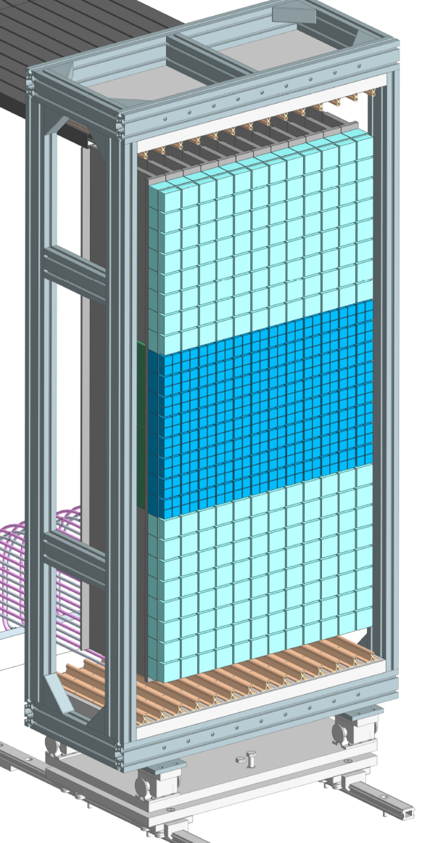
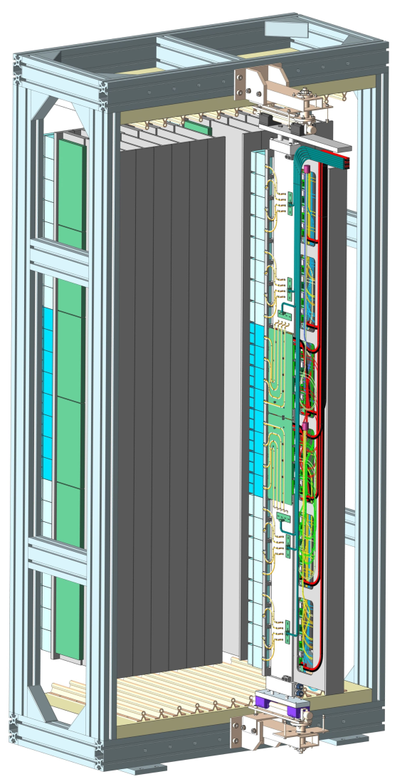
Rack layout
PDA layout similar to actual ones
Two PDAs aside beampipe
PDAs lodged inside racks
PDAs organized in columns
support columns hosting ECs, DEBs, services, cooling
each column sliding on rails for maintenance
full maintenance in situ:
DEBs replacement
ECs replacement
by extracting single column from PDA
12 columns, option to 14.
2

Slide 3
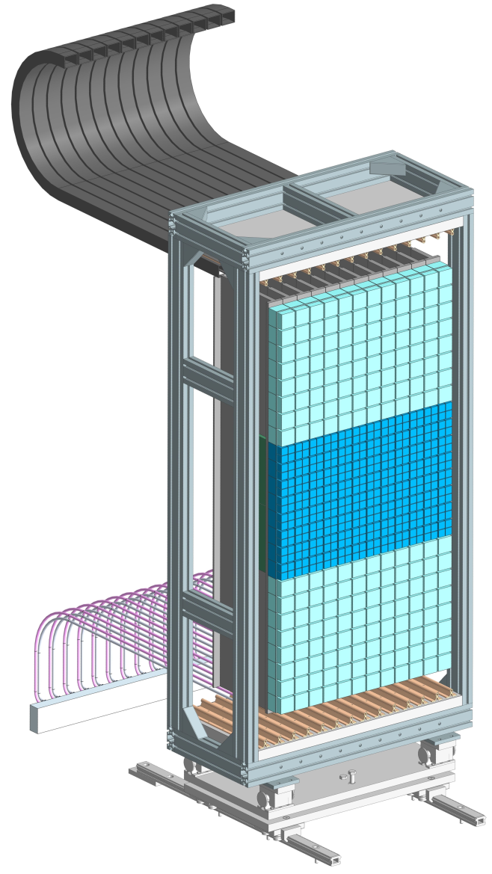
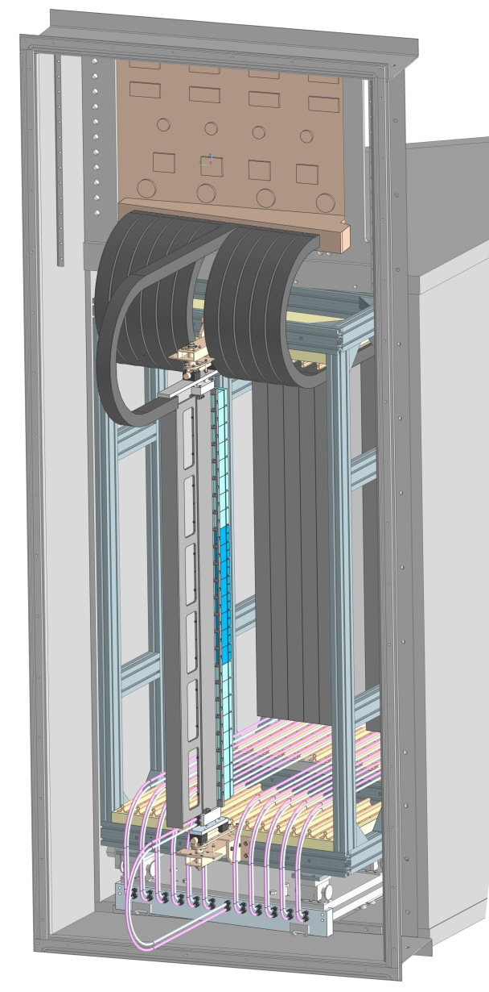
Rack layout
Each rack accessible as nowaday
Racks movable on rails:
  - position fine tuning
  - retracted toward door for maintenance
each column sliding on rails for access and maintenance
full maintenance in situ:
DEBs replacement
ECs replacement
by extracting single column
Design ongoing to retract rack and column to maintenance position without disconnect services
LV, HV, signal from patch panel via cable chains
Cooling from manifolds on the floor to fittings on the bottom of columns
Services extralenght to allow rack and column retraction and access without disconnection
3

Slide 4
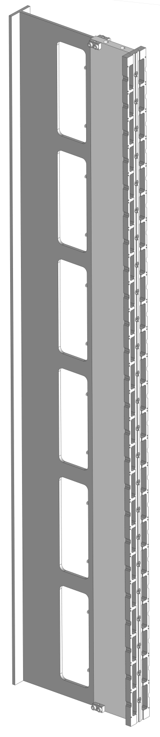
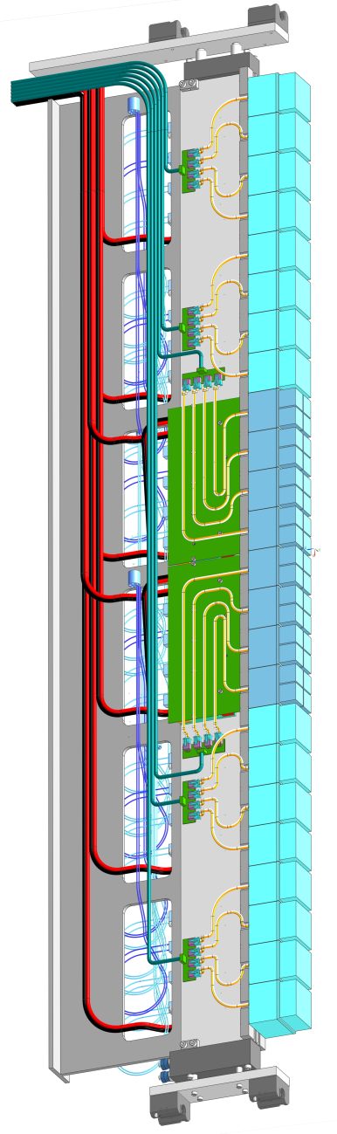
Columns provide: precise interfaces to support ECs and DEBs geometrical references – support and fixing features cooling interfaces services housing and support
ECs: positioning/alignment relative pitch to match DEBs connectors thermal contact for FEBs and Base Board dissipation maintenance by replacing
DEBs: positioning/alignment to match connectors on ECs thermal contact for DEBs dissipating components maintenance by replacing
Services: cables and fibers lodging and support along column
HV PDM patch panels
Routing to ppanel through cable chains
Cooling: embedded in the column uniformity and efficiency suited for C6F14 and possible replacement coolant
Support and positioning: rails and bearing at two column ends columns pitch
Column layout
4

Slide 5
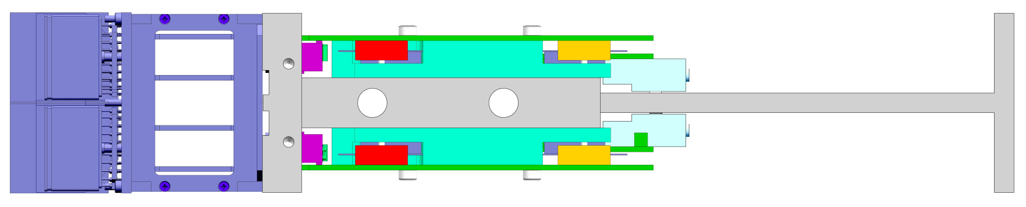
Column layout
T-bar 15 mm thick
DEBs and Ecs interface: cast aluminum plate AW 5086 (geometrical stability)
2 drilled cooling ducts, 8 to 10 mm Φ, flowed in opposite direction
Cable tray: e.g. from laminated profile
5

Slide 6
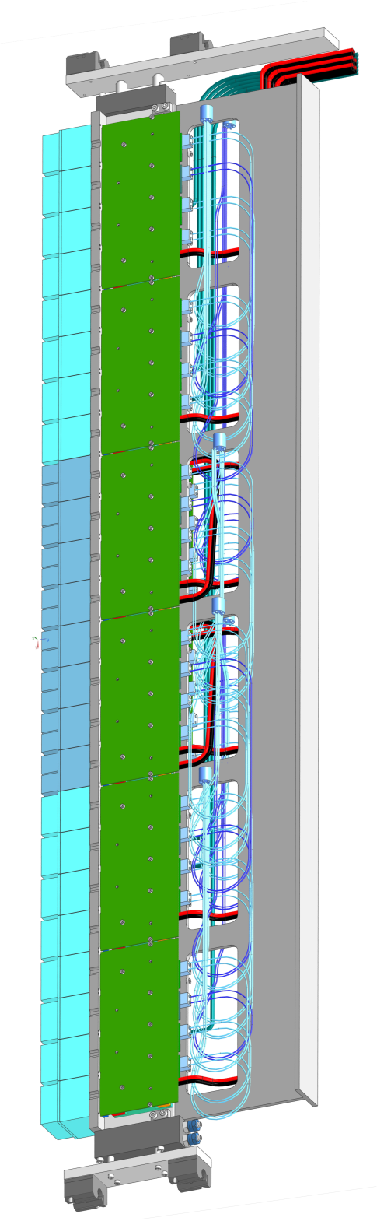
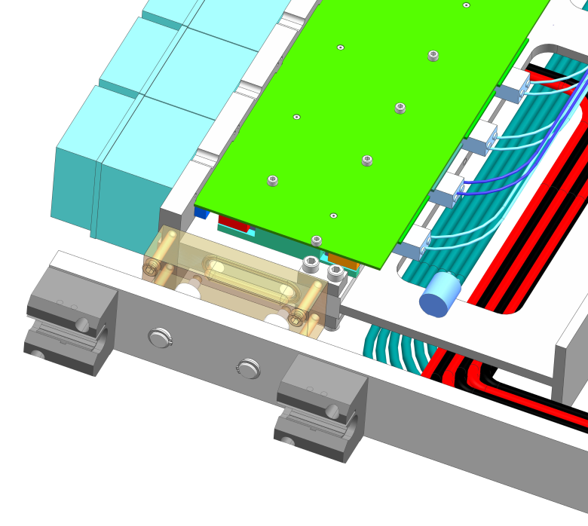
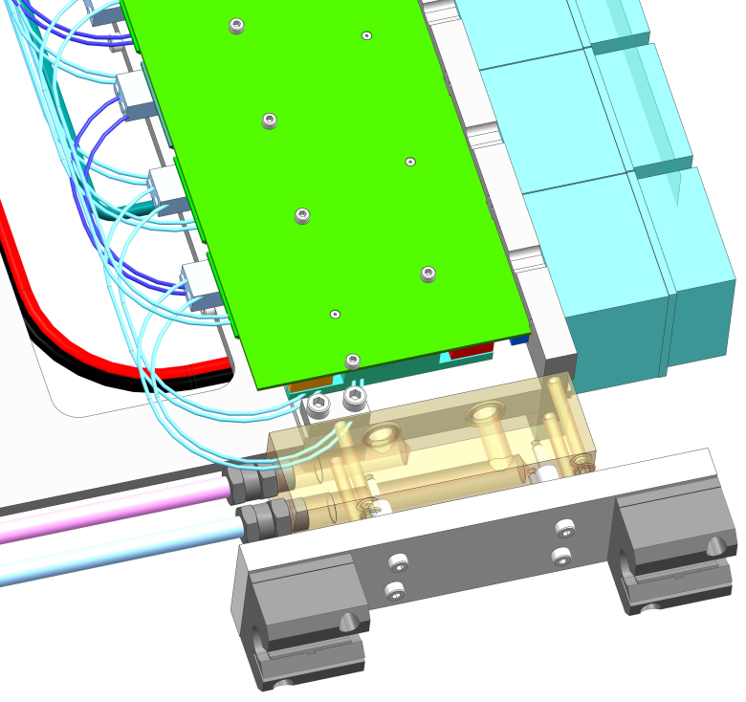
Column layout
Top end-block: cooling return & connections to bearings trolley
Bottom end-block : cooling manifold & connections to bearings
Industrial grade O-ring sealing
Low-friction polymeric cylindrical bearings
Free bearing pitch to match rails pitch, preload springs
Iterating design to increase precision and stiffness of sliding system
6

Slide 7
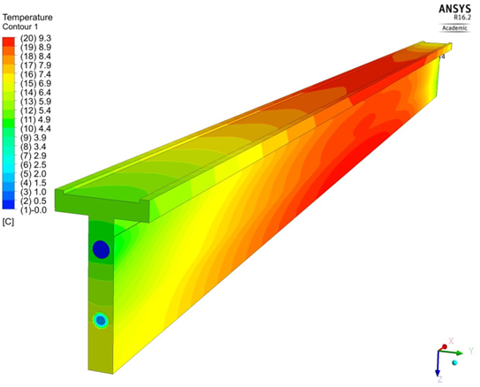
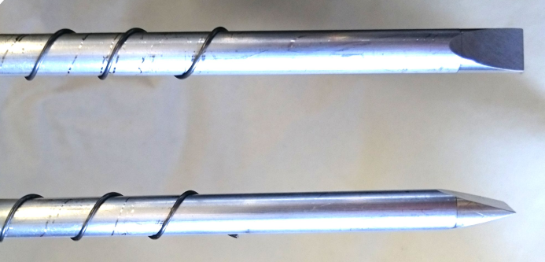
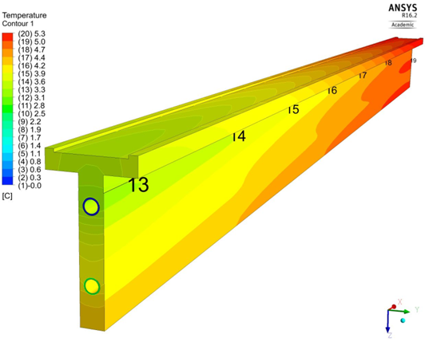
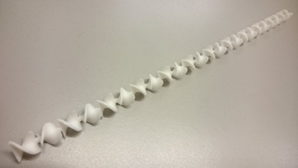
Column cooling
Baseline layout with two longitudinal ducts
Calculations, simulation and test to check effect of:
Ducts position vs temperature uniformity
Coolant type
Ducts dimension: Φ 8 to 10 mm
(deep drilling and wall thickness constraints)
Ducts section shape (e.g. annular)
Baffles inside ducts
Inserts to get annular x-section
Baffles to increase turbulence

Slide 8
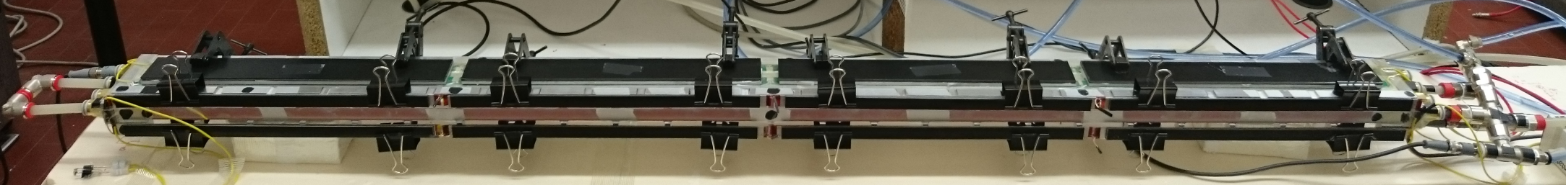
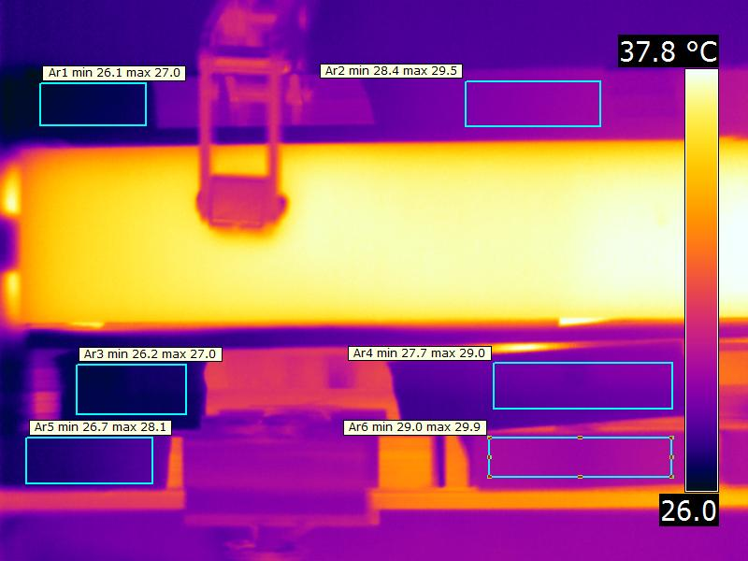
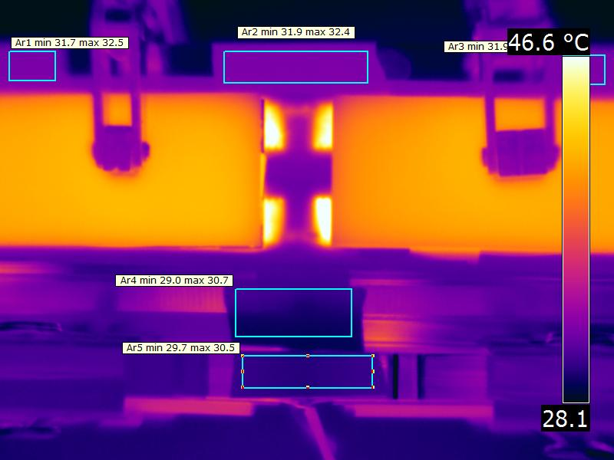
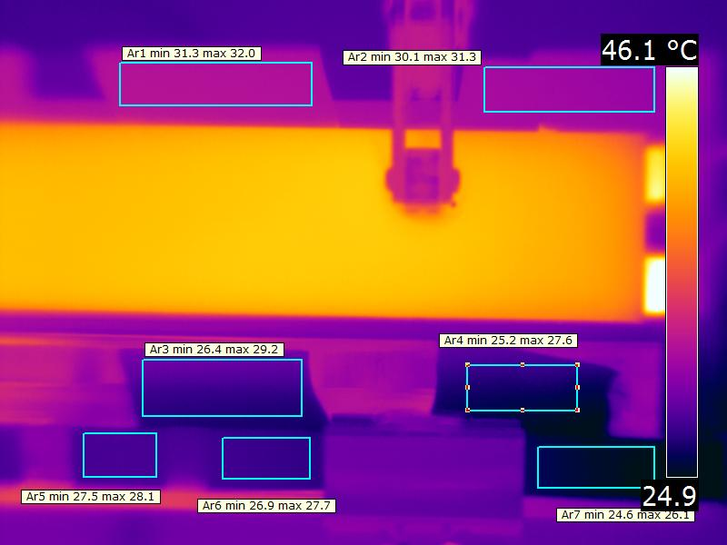
Test setup of T-bar to study cooling efficiency
Resistors overall power ~ 360W to simulate Ecs and DEBs dissipation
Measured:
T inlet water (PT100 probe immersed in flow)
T outlet water (PT100 probe immersed in flow)
Pressure drop Inlet to outlet (differential probe)
Flow (optical flowmeter 0 – 2 liters/1')

Slide 9
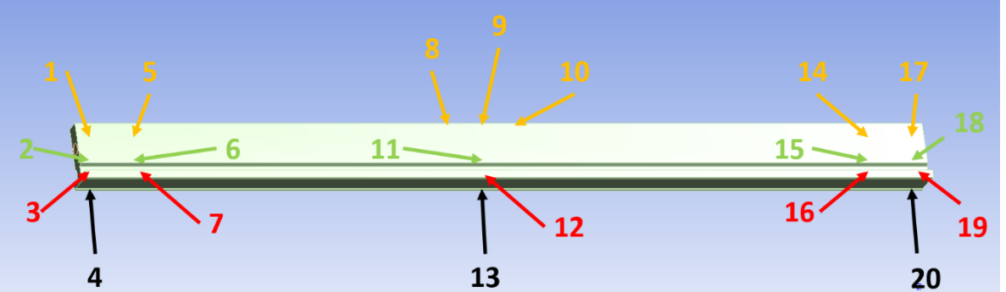
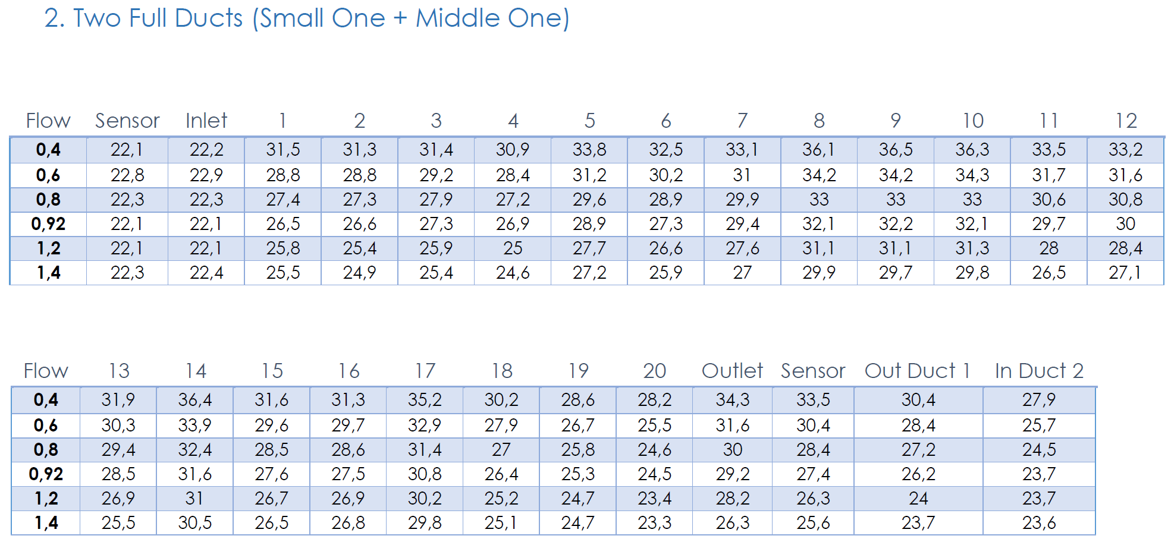
OUT
IN

Slide 10
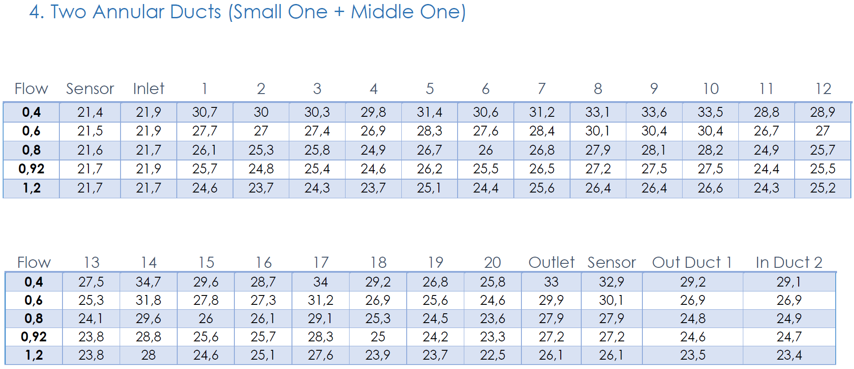
OUT
IN

Slide 11
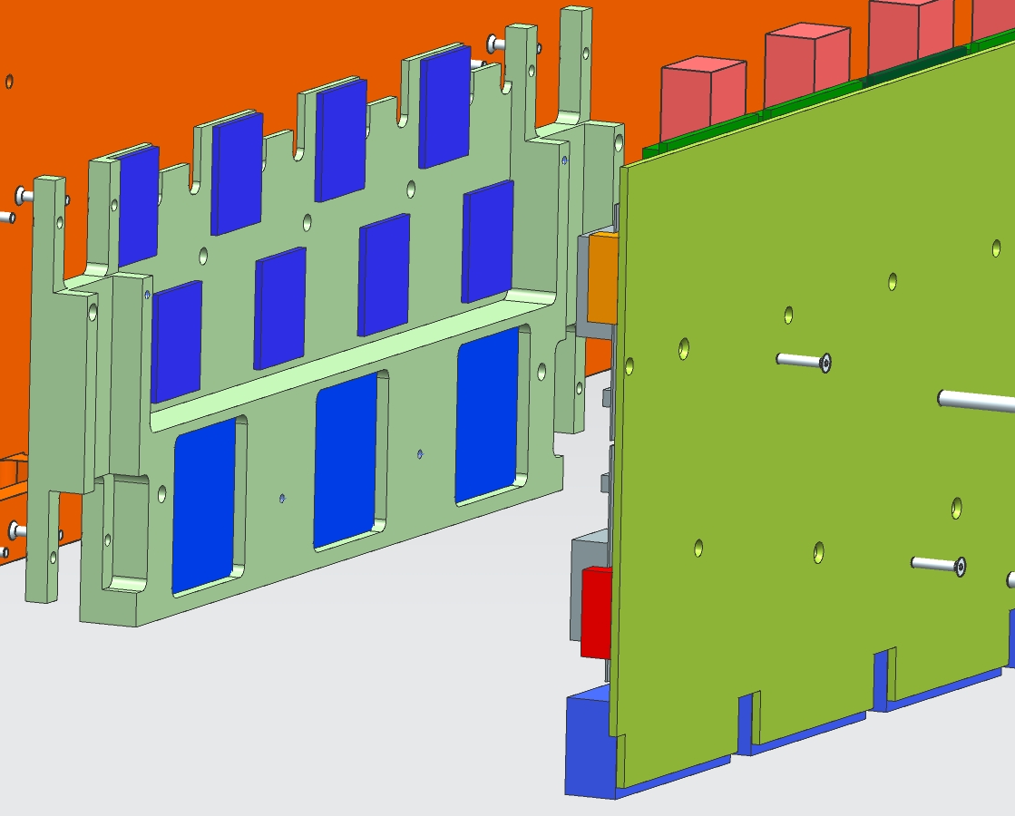
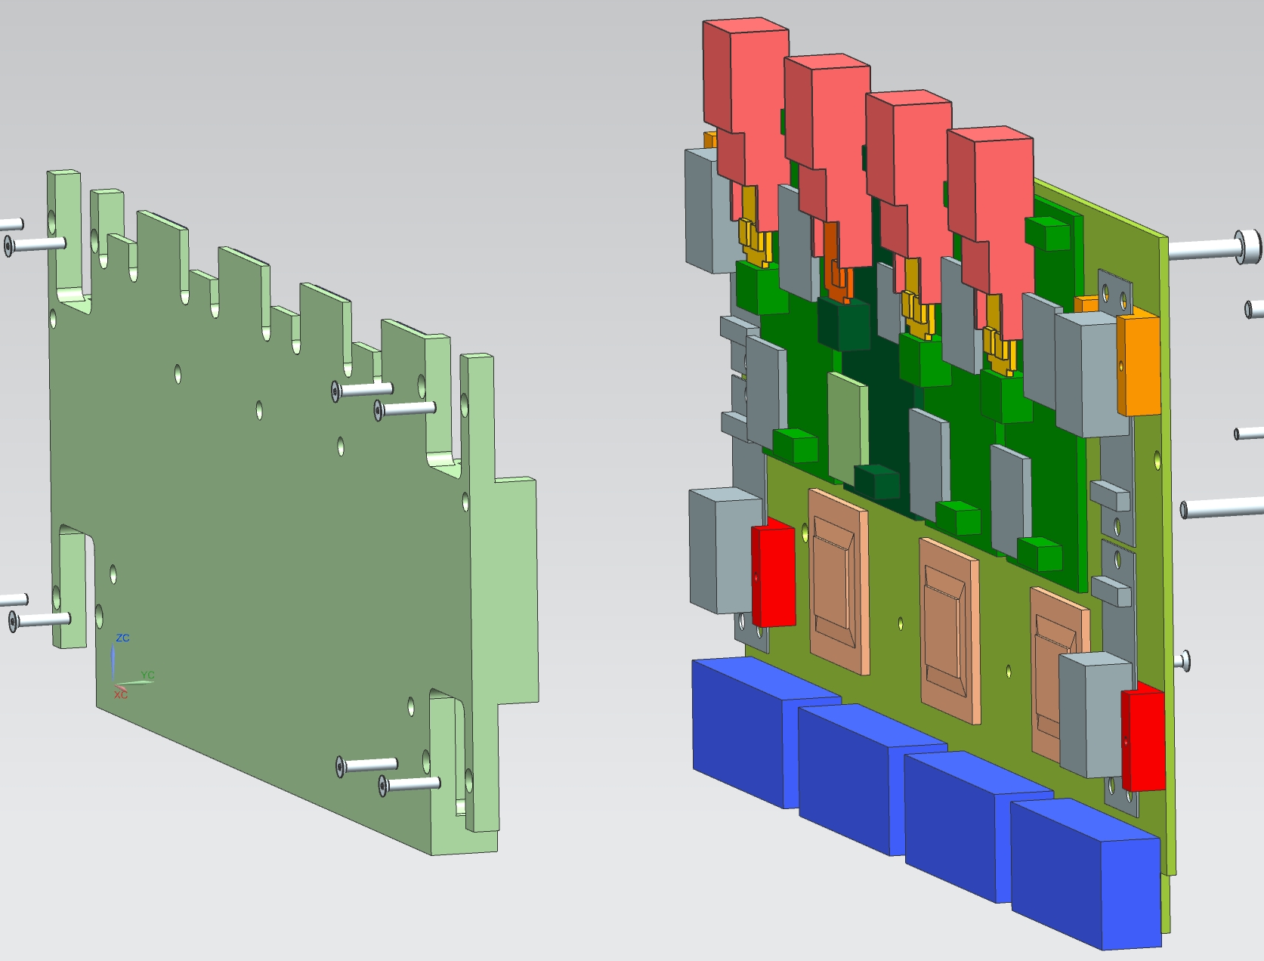
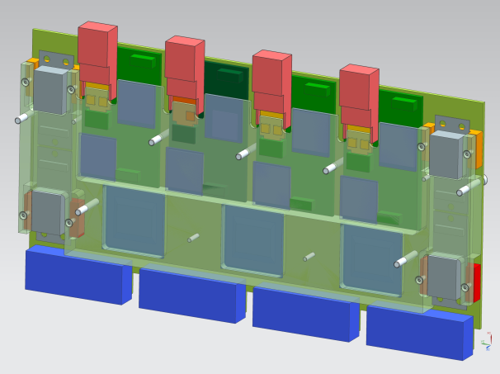
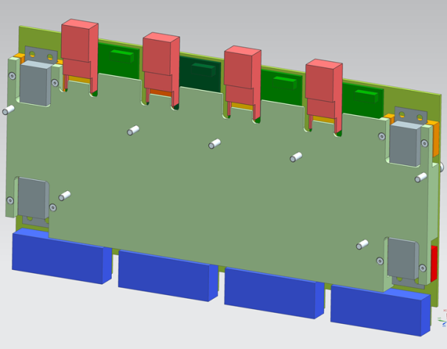
DEBs thermal interface
levelling plate to match DEBs hot components to T-bar
thermal pads between plate and dissipating chip
DEB screwed to levelling plate
“DEB+plate” sandwich screwed to T-bar
low roughness & flatness of bar & interface plate
thermal contact to be studied vs pads, grease ….
11

Slide 12
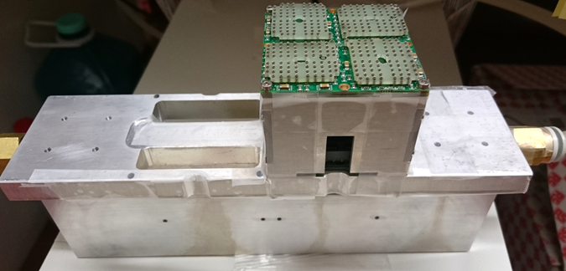
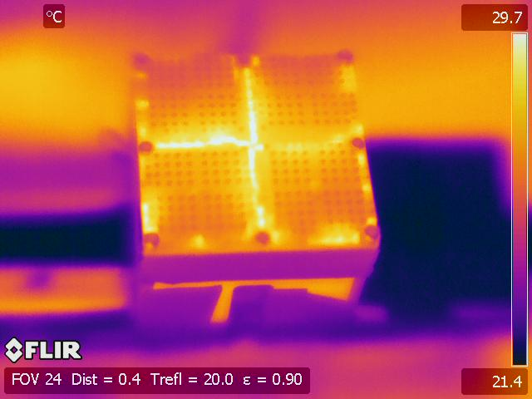
ECs thermal interface
IR measurement on EC: M2 screws @ 0.4Nm, w/w.o thermal grease: Δt ~ 8 °C

Slide 13
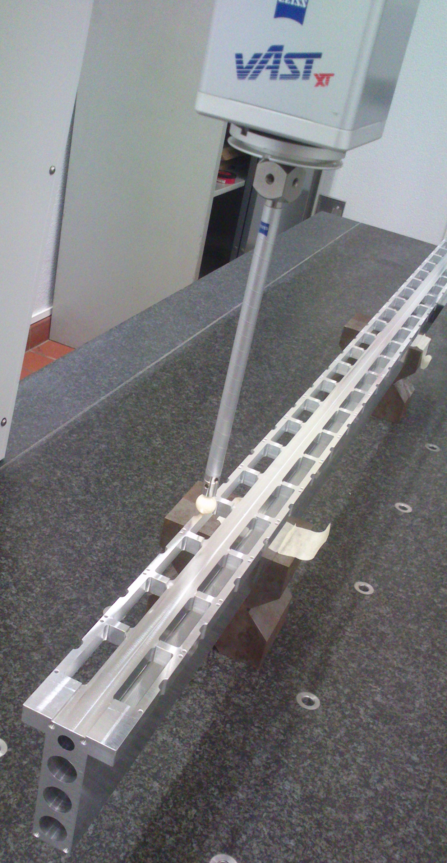
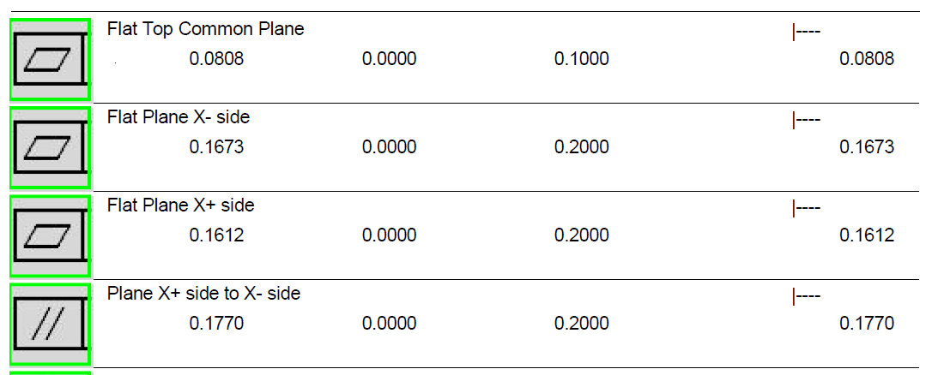
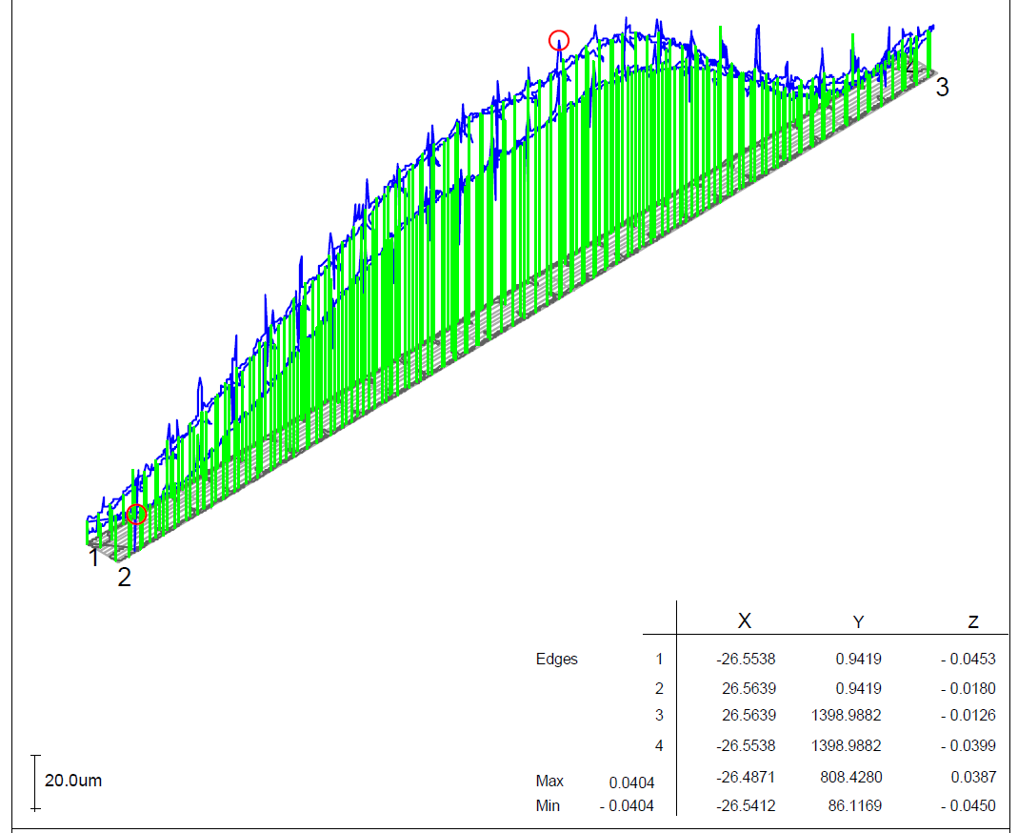
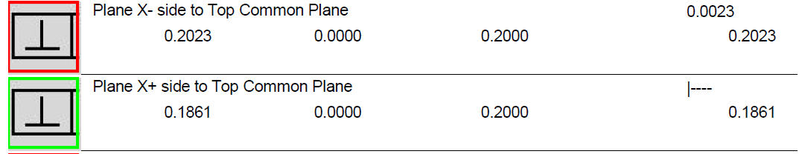
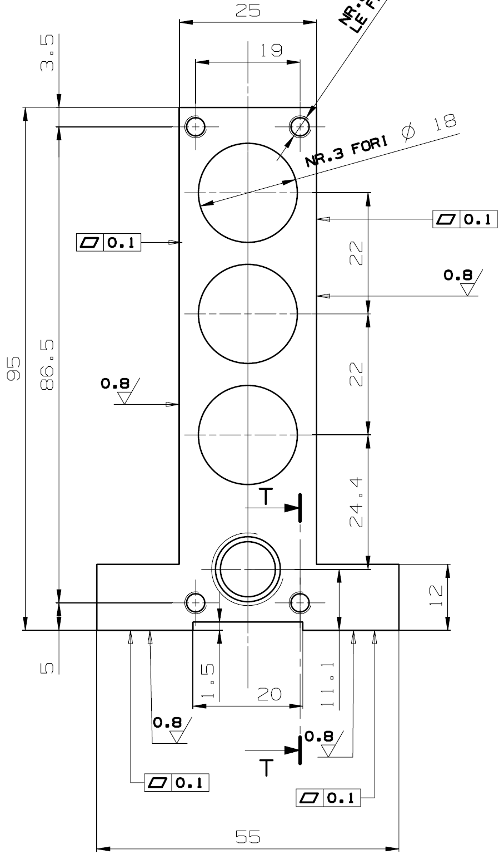
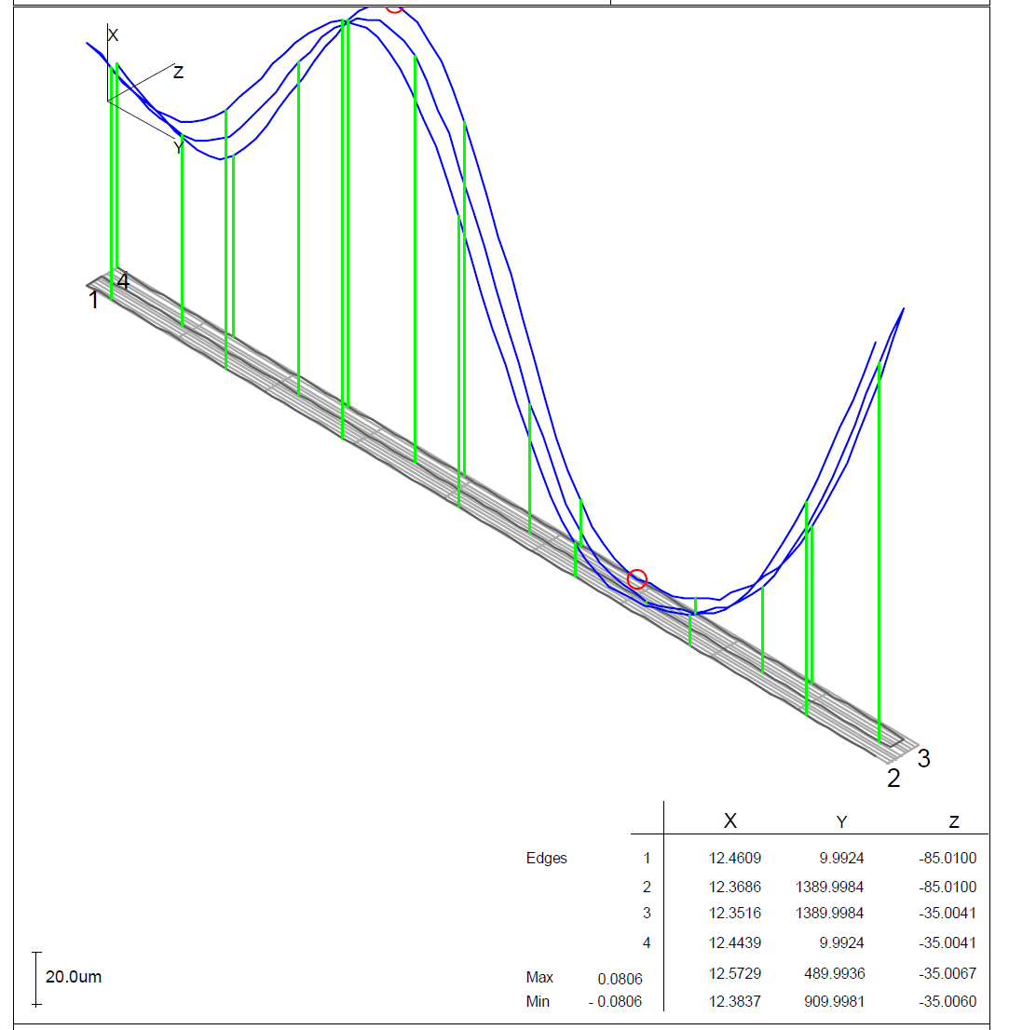
T-bar protoype
“EC” face
“DEBs” face(s)
Slots pitch: < +/-0.05mm
Slots position wrt to ref. End: < +/-0.05 mm
Bar lenght: < +/- 0.05 mm
Two DEB faces strightness/planarity < 0.2 mm
Two DEB faces distance <+/- 0.1 mm
Two DEB faces parallelism ~0.2 mm
DEB faces to EC face perpendicularity: ~0.2 mm
Ducts mismatching @ bar center <1 mm

Slide 14
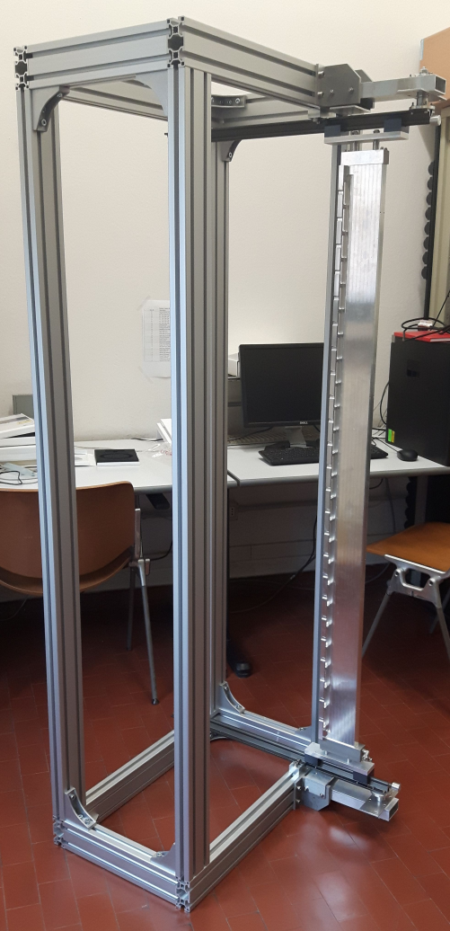
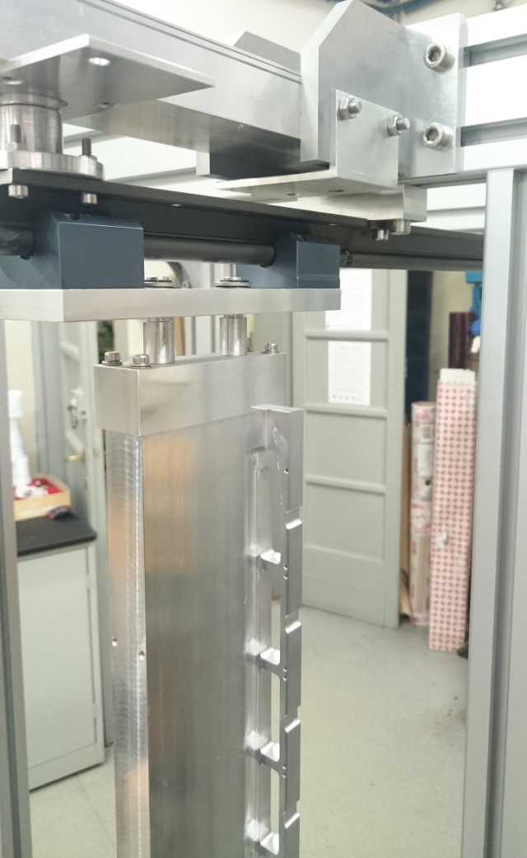
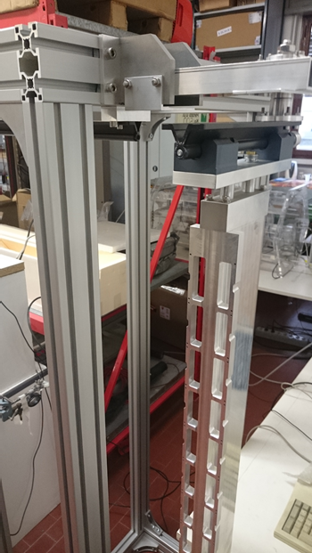
Rack protoype
Support rails and extraction movement on rails extension
Further test in progress: compressive vs tensile preload…
Column rotation vs services t.b.c.
Final design vs services, cable chains, extraction procedure in progress

