Slide 1
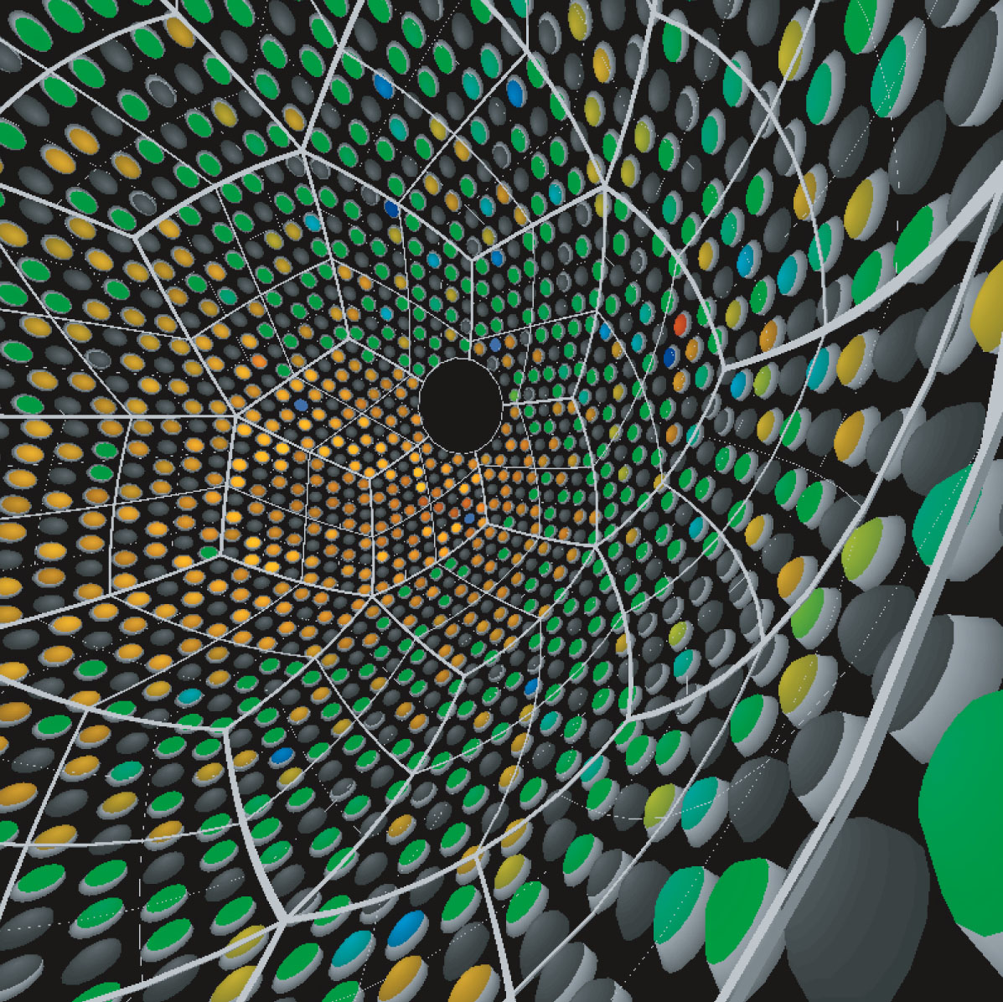
KamLAND :
Studying Neutrinos from Reactor
Atsuto Suzuki
KEK :
High Energy Accelerator Research Organization
KamLAND Collaboration

Slide 2
Outline
KamLAND Overview
Reactor Neutrinos
ν_{e} Detection in Liquid Scintillator
Reactor Neutrino Event Rate
Oscillation Analysis
One More Nuclear Reactor
Conclusions

Slide 3
1. KamLAND Overview
History
October 1994 : KamLAND proposal
October 1997 : Full budget (~ 25 M$) by JSPS
April 1998 : Construction of detector & underground facility
October 1999 : US-KamLAND proposal was approved by DOE
January 22, 2002 : KamLAND launched data-taking
June 2004 : ⁷Be solar neutrino budget by JSPS (~ 6 M$ / 5 yrs)
June 2005 : KamLAND operation and upgrade by MEXT
(~ 20 M$ / 5 yrs)
August 2009 : New budget proposal (Xe ββ decay in KamLAND)
will send to the government

Slide 4
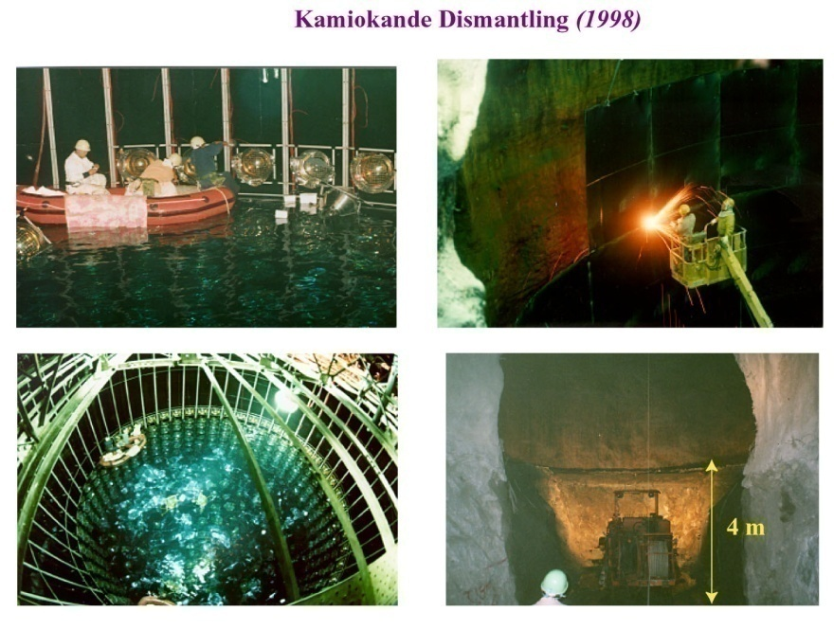

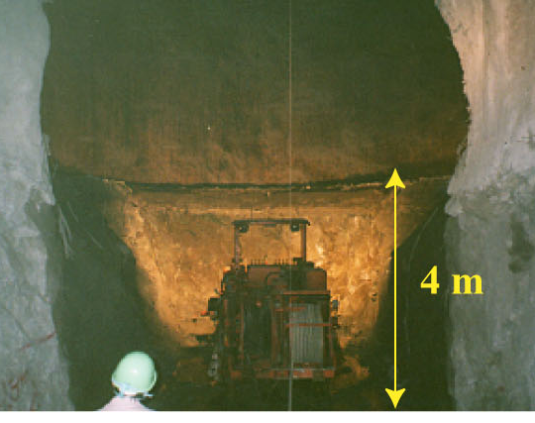
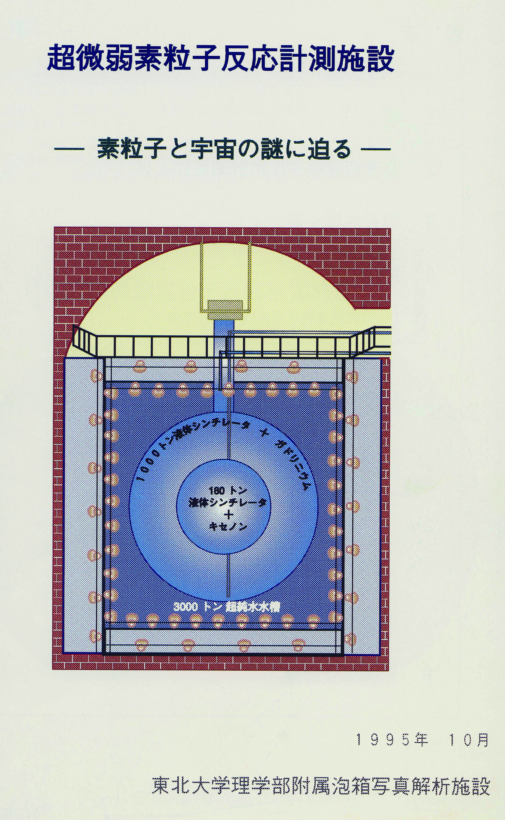
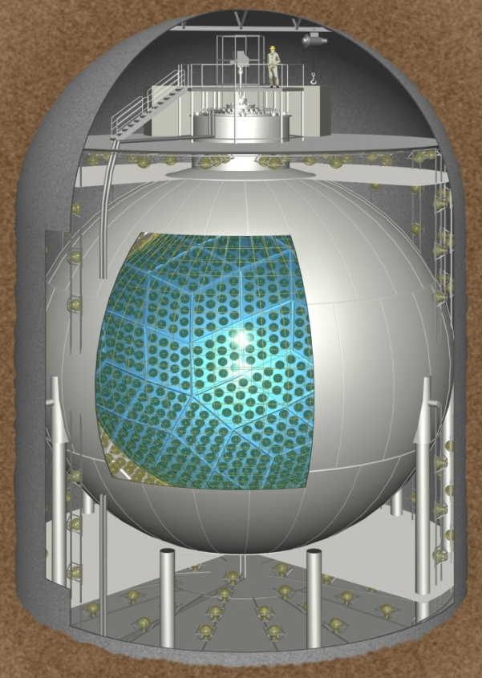
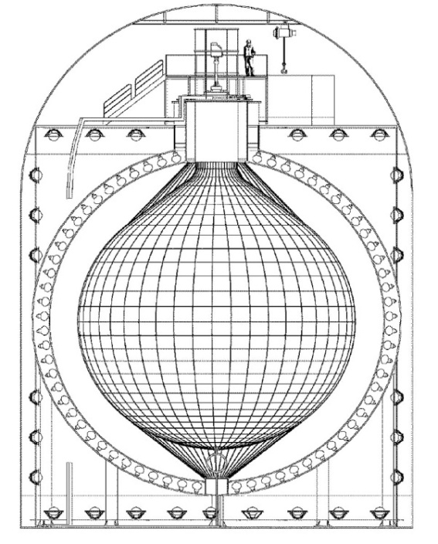
KamLAND Detector
original design
1000 ton liquid scintillator
: 80% (dodecane)
+ 20% (pseudocumene)
+ 1.52 g/l PPO
: housed in spherical plastic balloon
present
LS (Gd)
LS (Xe)
water : Kamiokande
13 m
1325 17-inch + 554 20-inch PMT’s
18 m

Slide 5
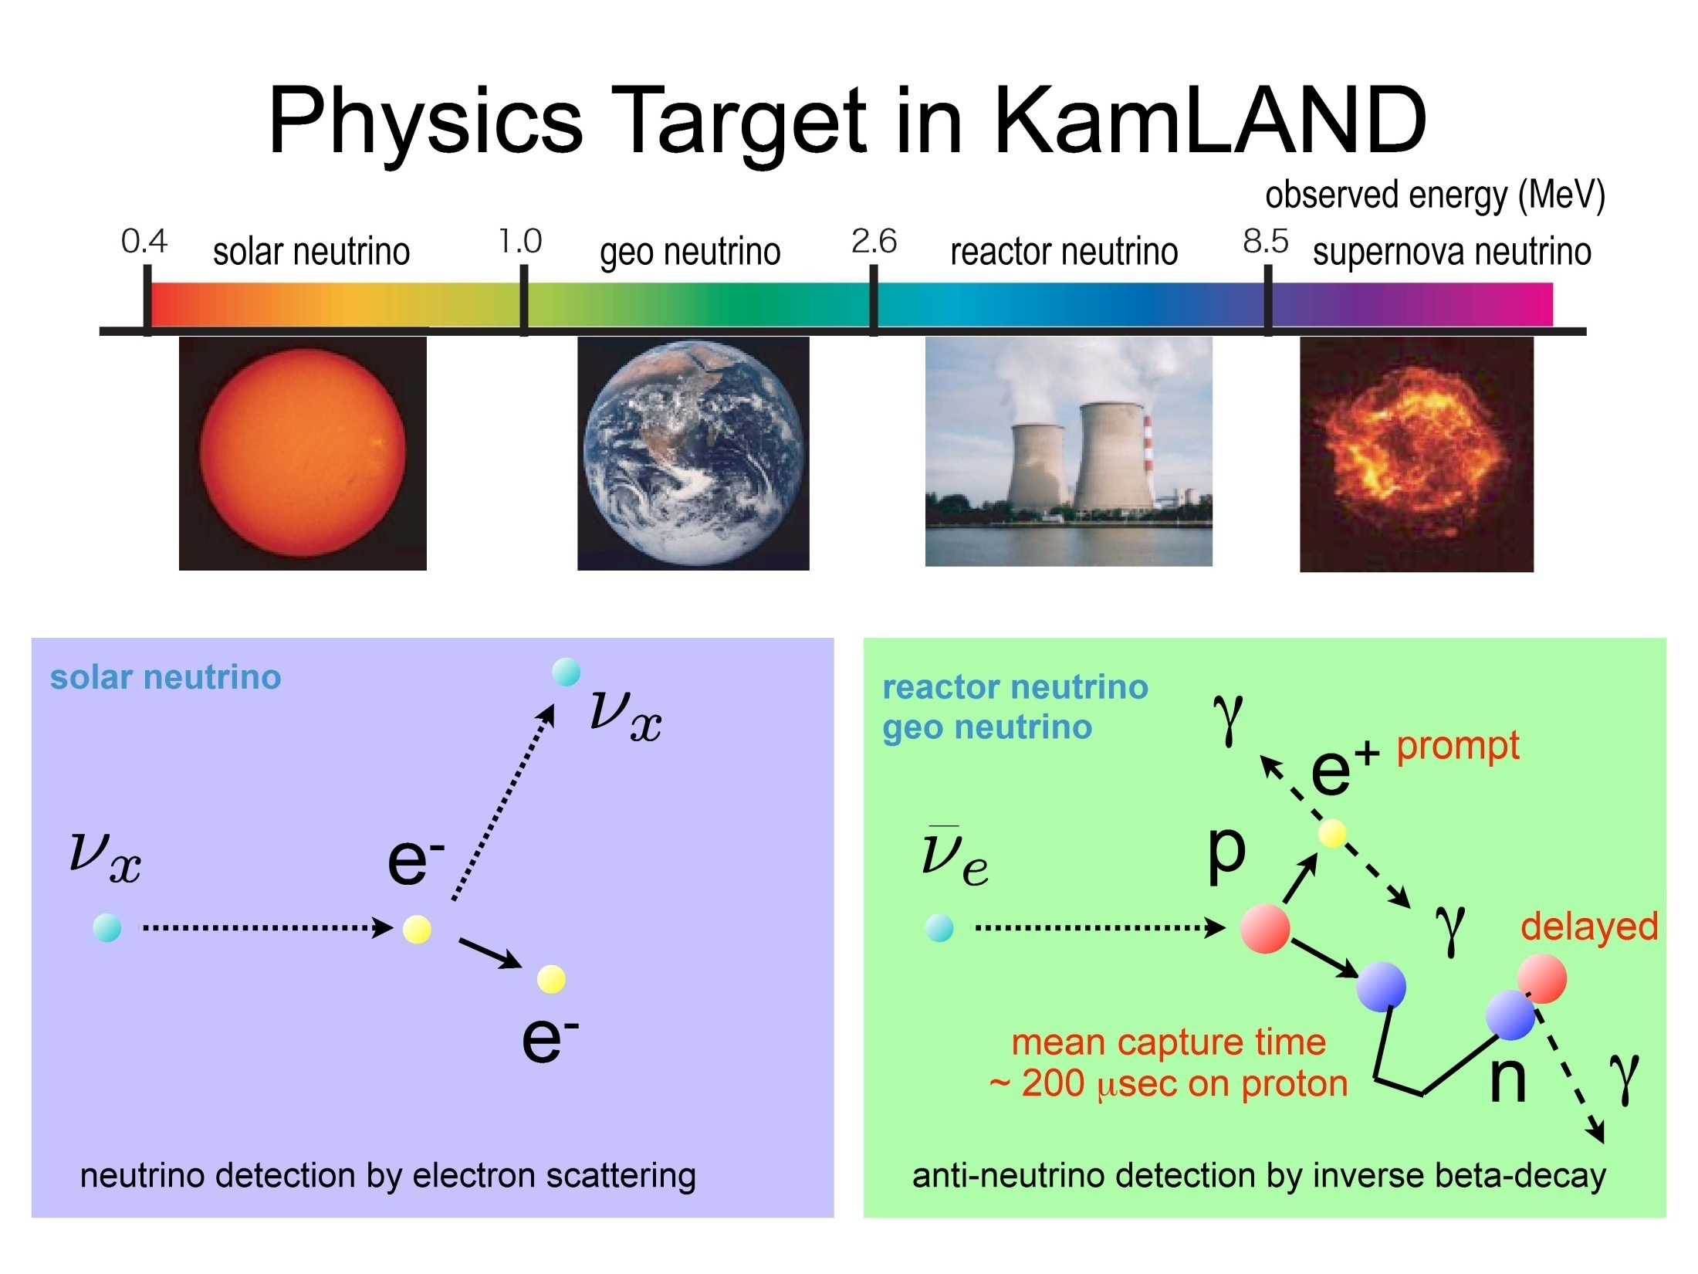
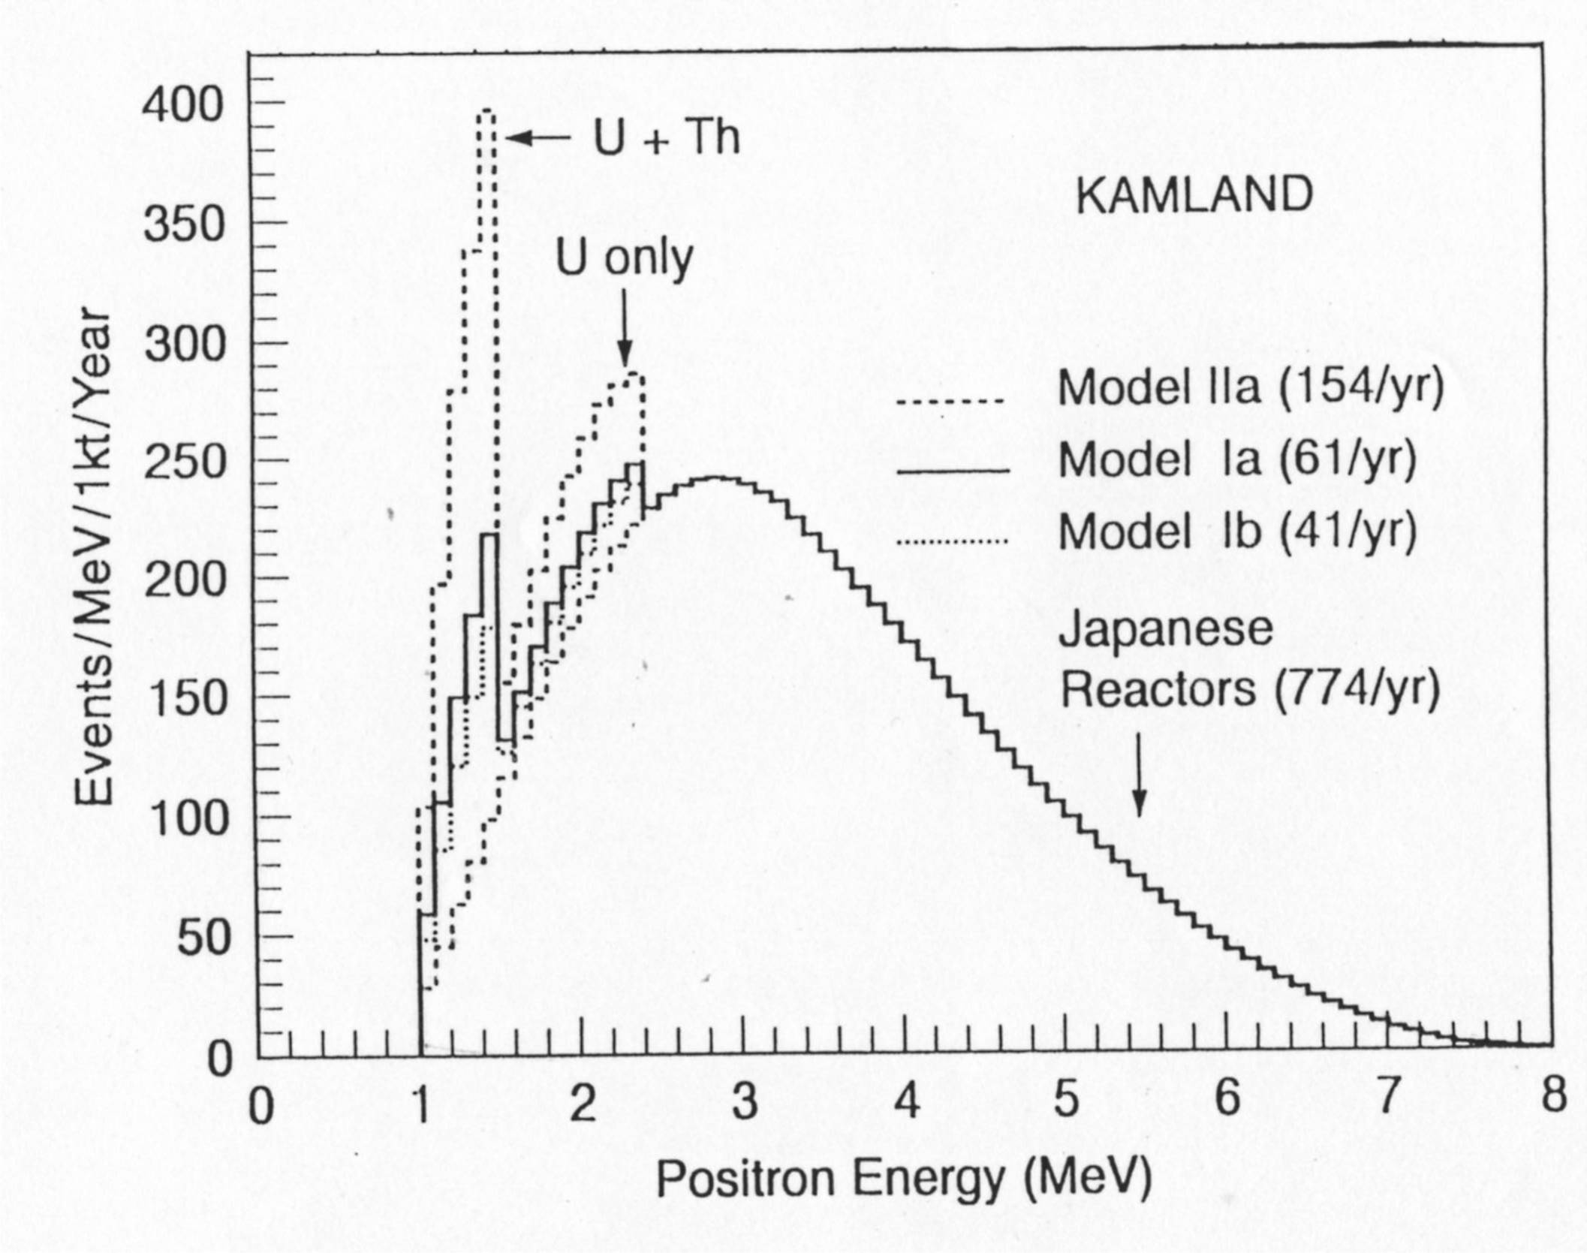
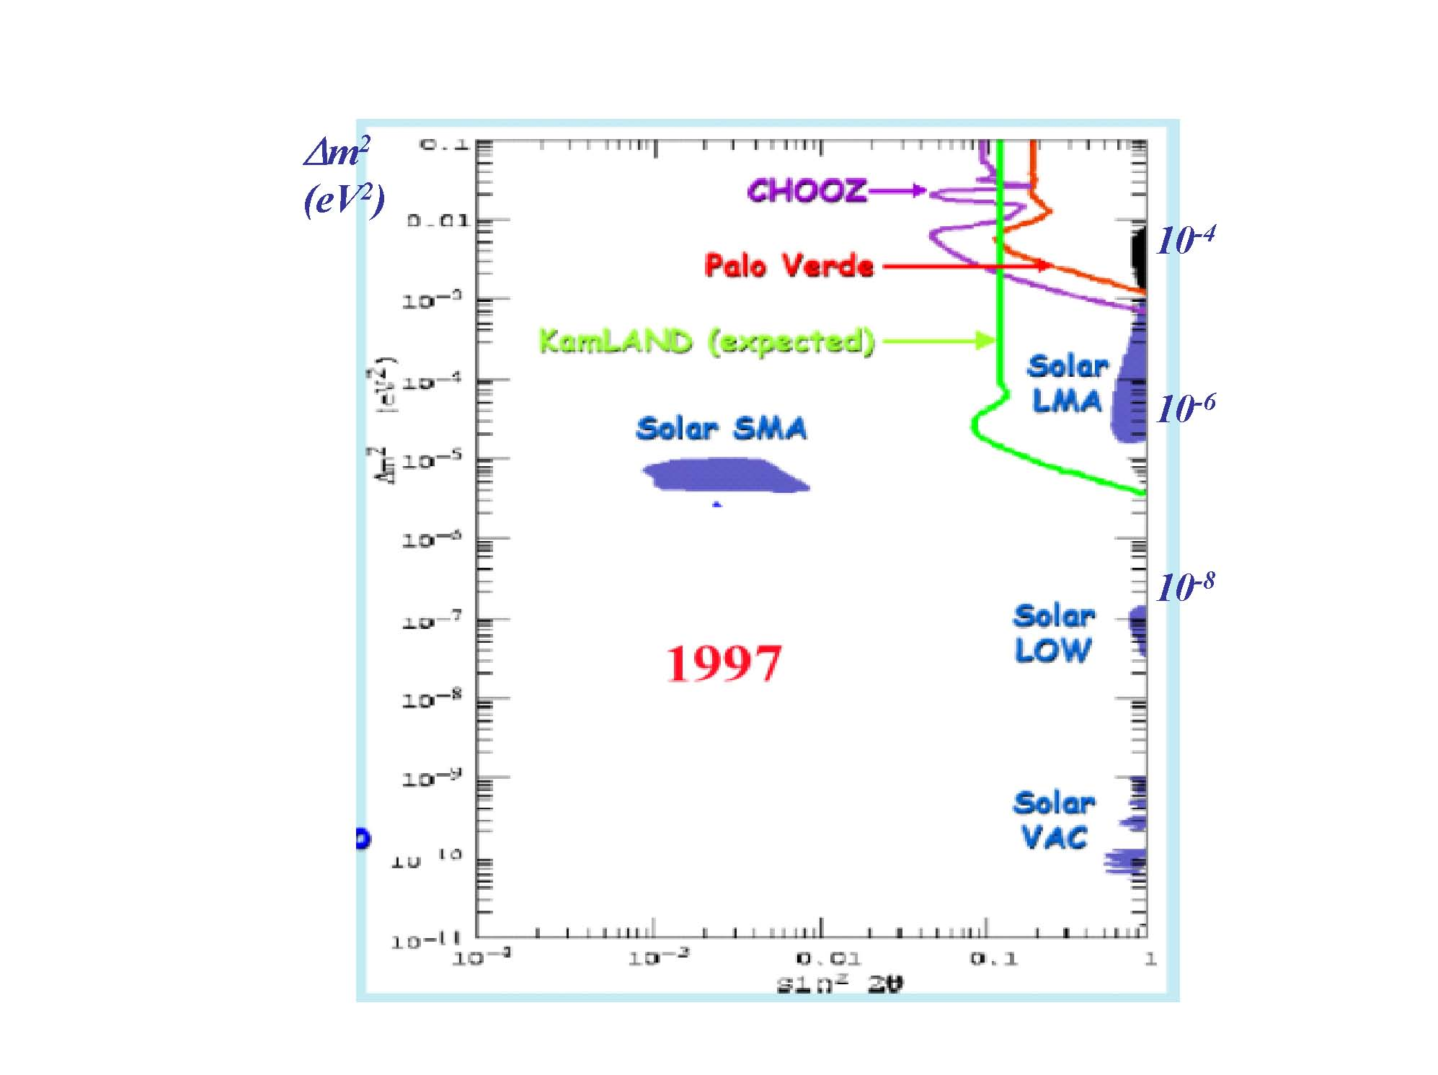
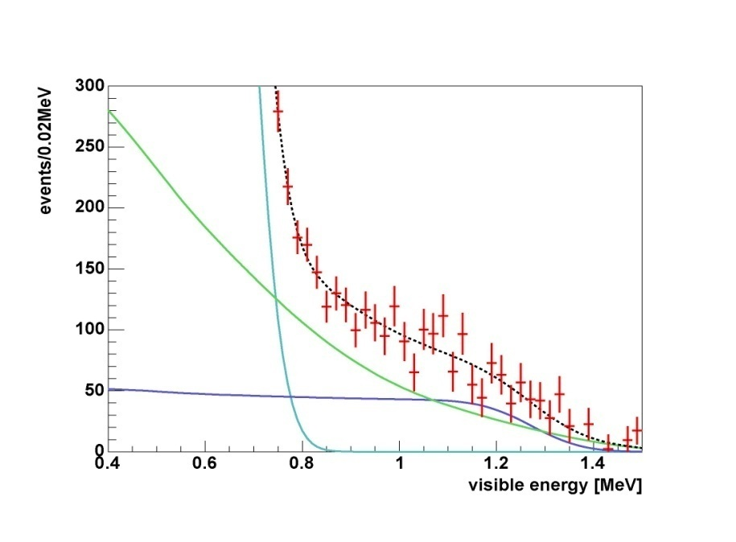
KamLAND
Physics
Goals
ν_{e}
Geo
PRL 80 (1998) 635
> 100 km long baseline
Δm²
ν_{e}
Solar
⁷Be
background subtracted
3 years data
CNO
ν_{e}
reactor
pep
sin²2θ
0.01
0.1

Slide 6
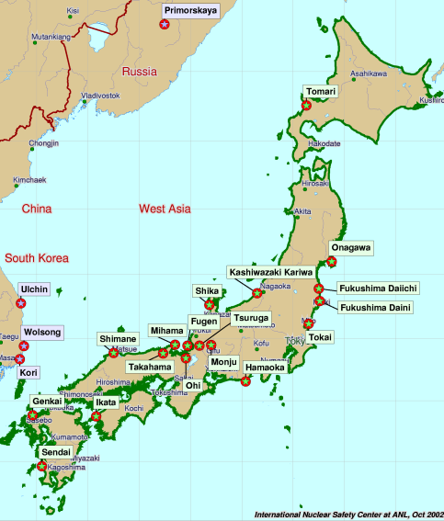
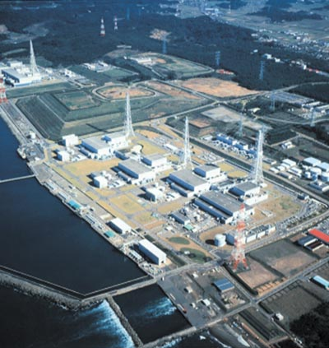
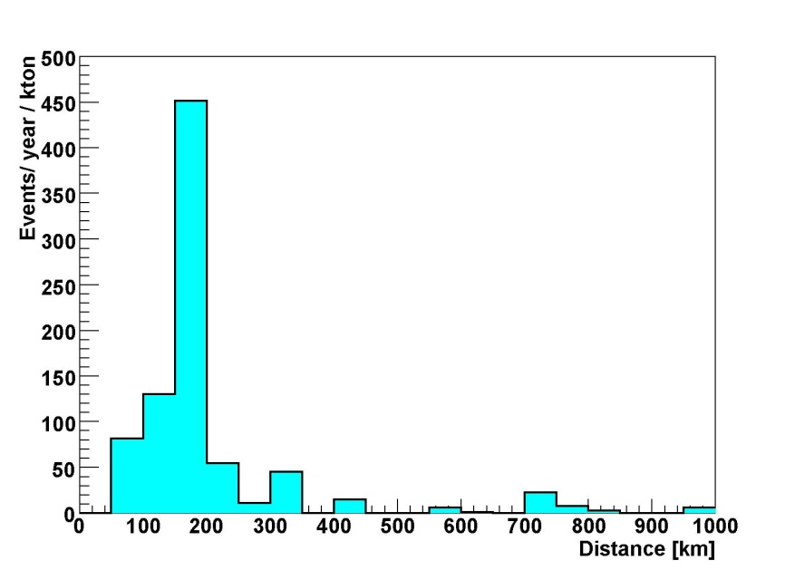
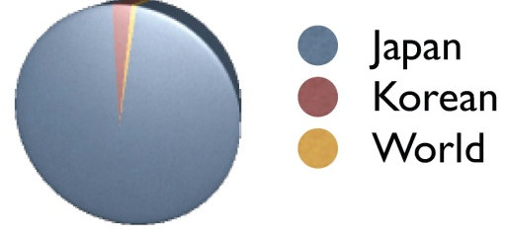
2. Reactor Neutrinos
Nuclear reactors : very intensive sources of ν_{e}
55 commercial nuclear power reactors : nominal output ~155 GW
70 GW (~12 % of global
nuclear power)
at
L ~ (175 ± 35) km
effective baseline : ~ 180 km
Kashiwazaki power
station : 24.3 GW
Korean reactors : 3.2 %
(World + Research)
reactors : 0.96 %
Kamioka

Slide 7
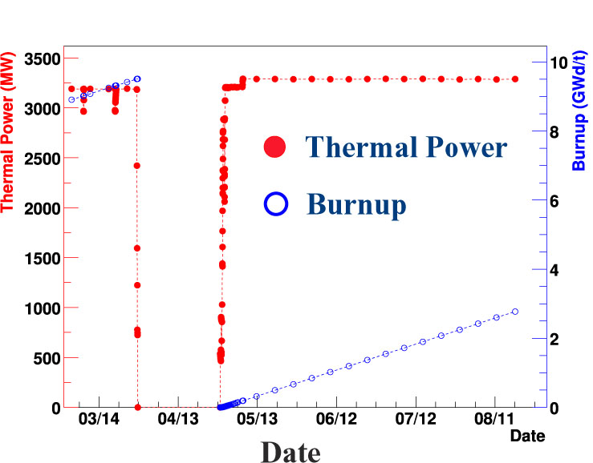
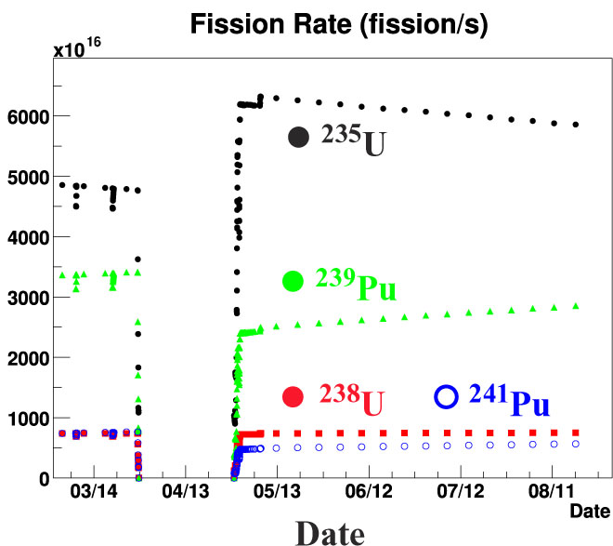
Reactor Records from Power Companies
thermal power generation, fuel burn-up,
fuel exchange and enrichment
Thermal Power
99.9% of ν_{e} from ^{235,238}U and ^{239,241}Pu
2002
2002

Slide 8
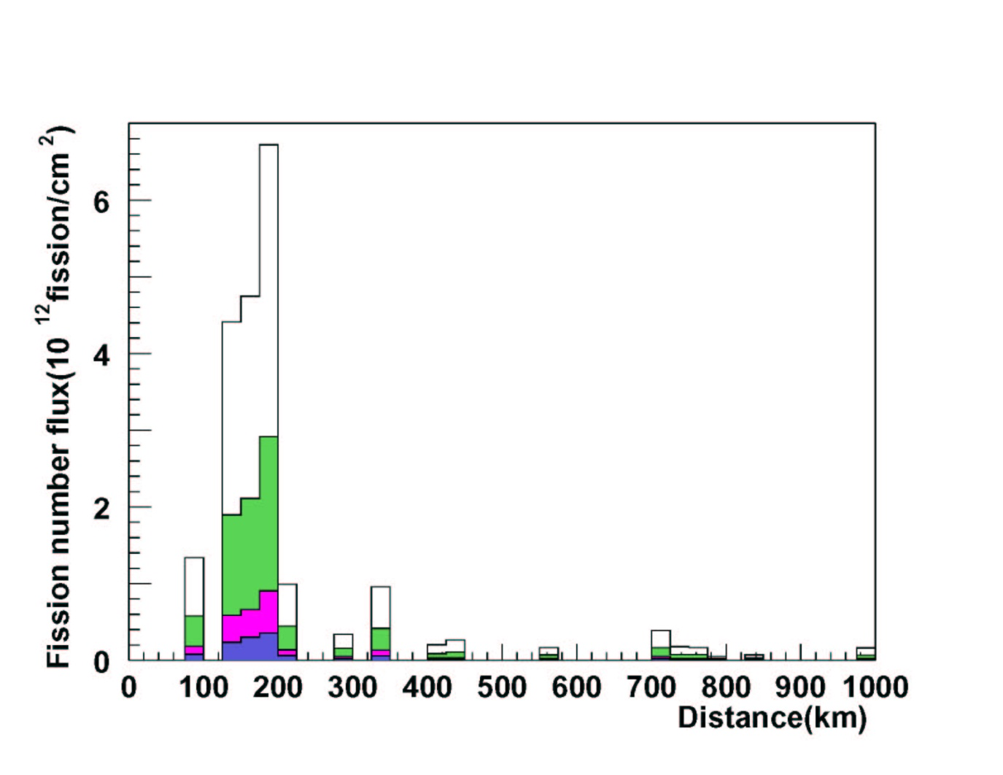
Fission Yields & ν_{e} Energy Spectrum
March 9, 2002 – January 11, 2004
Fission yields for 4 fissile elements
²³⁵U
Reactor neutrino energy spectrum
at Kamioka
²³⁹Pu
²³⁸U
²⁴¹Pu

Slide 9
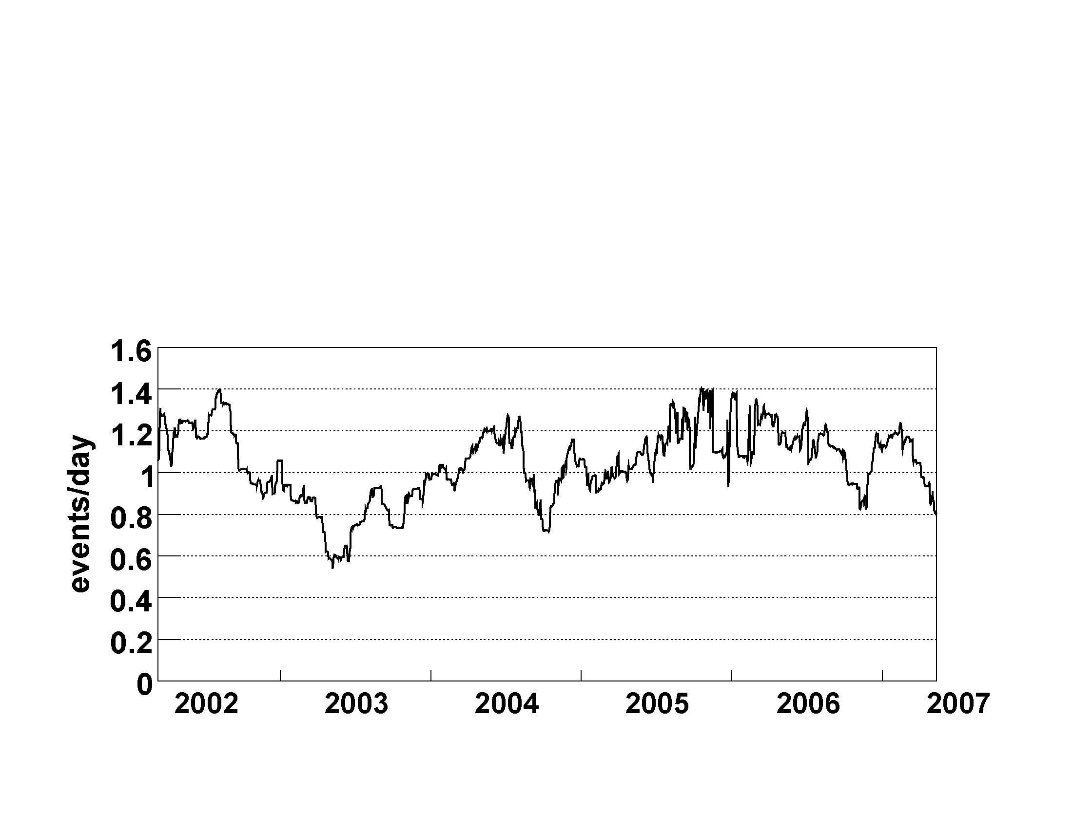
Reactor Operation Histories
New nearby reactor
being turned on and off
Many reactor
inspections
Steam pipe rupture
Big earthquake
KL1
KL2
KL3
KL1
1st result : March 2002～October 2002, PRL. 92, 071301 (2003)
“Evidence for Reactor Antineutrino Disappearance ”
KL2
2nd result : March 2002 ～January 2004, PRL. 94, 081801 (2005)
“Evidence for Spectral Distortion”
KL3
3rd result : March 2002 ～May 2007, PRL. 100, 221803 (2008)
“Evidence for Neutrino Oscillation Cycle”
“Experimental Investigation of Geoneutrinos” , Nature 436, 400 (2005)

Slide 10

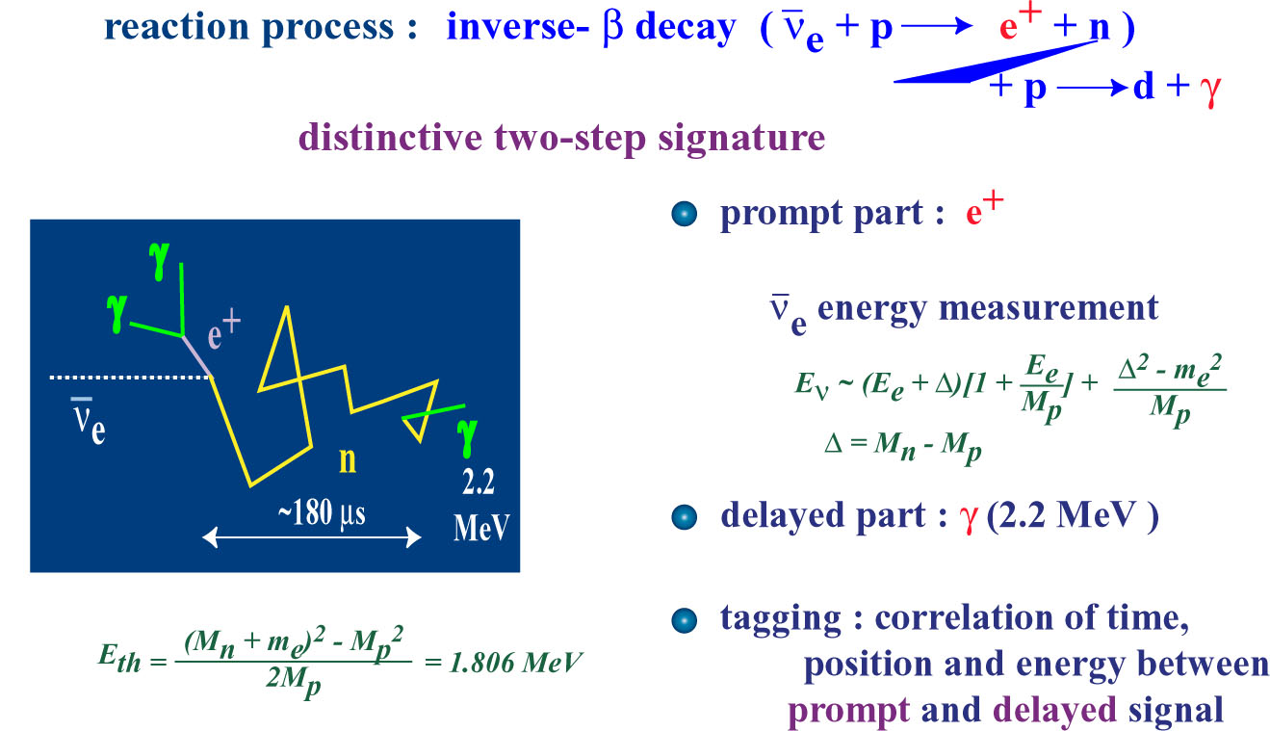
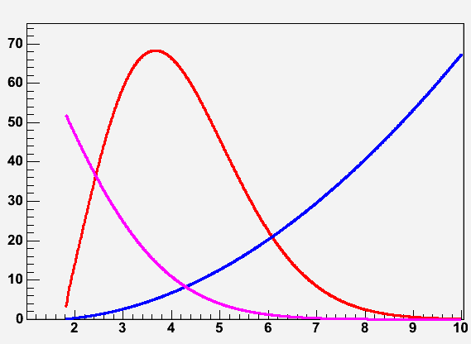
3. ν_{e} Detection in LS
E_{th} = 1.8 MeV
Distinct 2-step signature :
prompt : e⁺ ionization, annihilation
delayed : γ from thermal neutron
capture on p
or on ¹²C (γ : 4.9 MeV)
ν_{e}+p→n+e⁺
cross section
E_{prompt} (e⁺) = E_{ν} - 0.8 MeV
~
E_{delayed} (γ) = 2.2 MeV, Δt ~ 200 μs
E_{v} (MeV)

Slide 11
Systematic Errors for Reactor Neutrino Detection
at KL1
radioactive sources, laser system, LEDs,
cosmic-ray μ, μ –induced spallation products
Systematic | %
Fiducial volume | 4.7
Energy threshold | 2.3
Cuts efficiency | 1.6
Live time | 0.06
Reactor P_{thermal} | 2.1
Fuel composition | 1.0
Time lag | 0.01
Antineutrino spectrum | 2.5
Antineutrino x-section | 0.2
Total | 6.5
γ
n
¹²N, ¹²B,…
μ

Slide 12
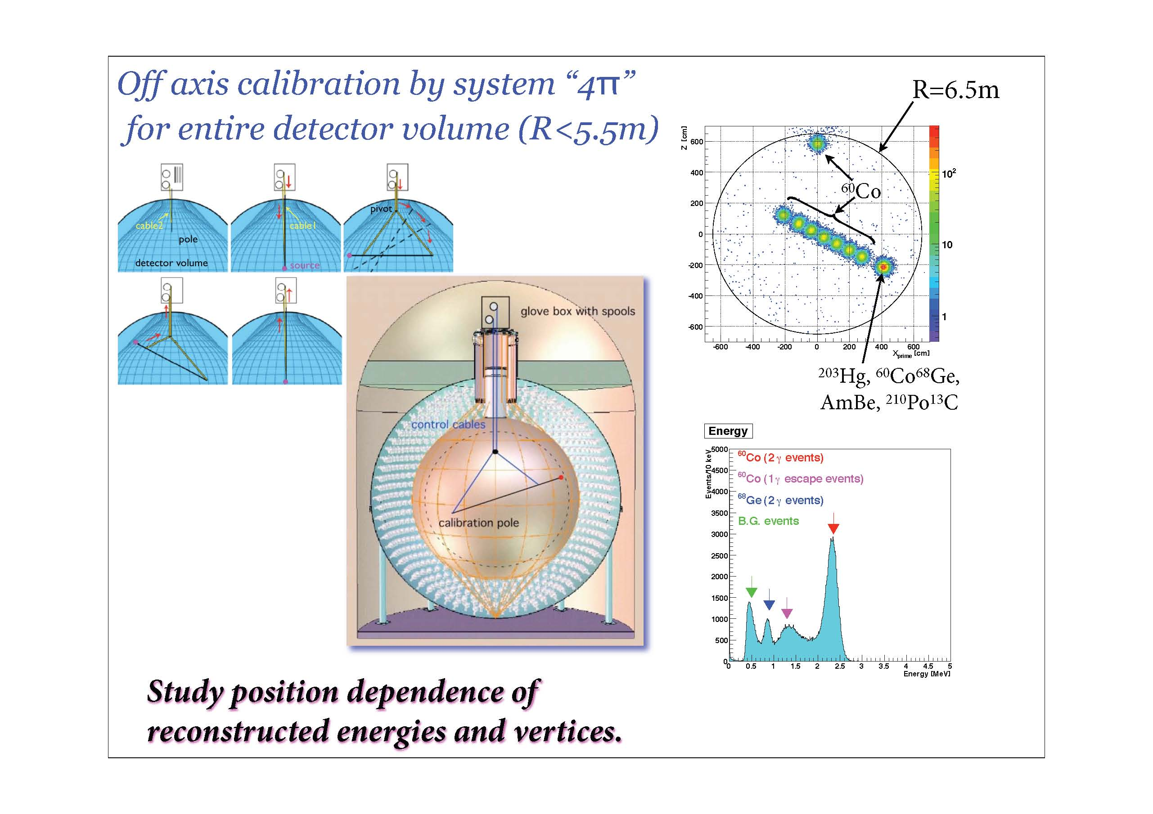
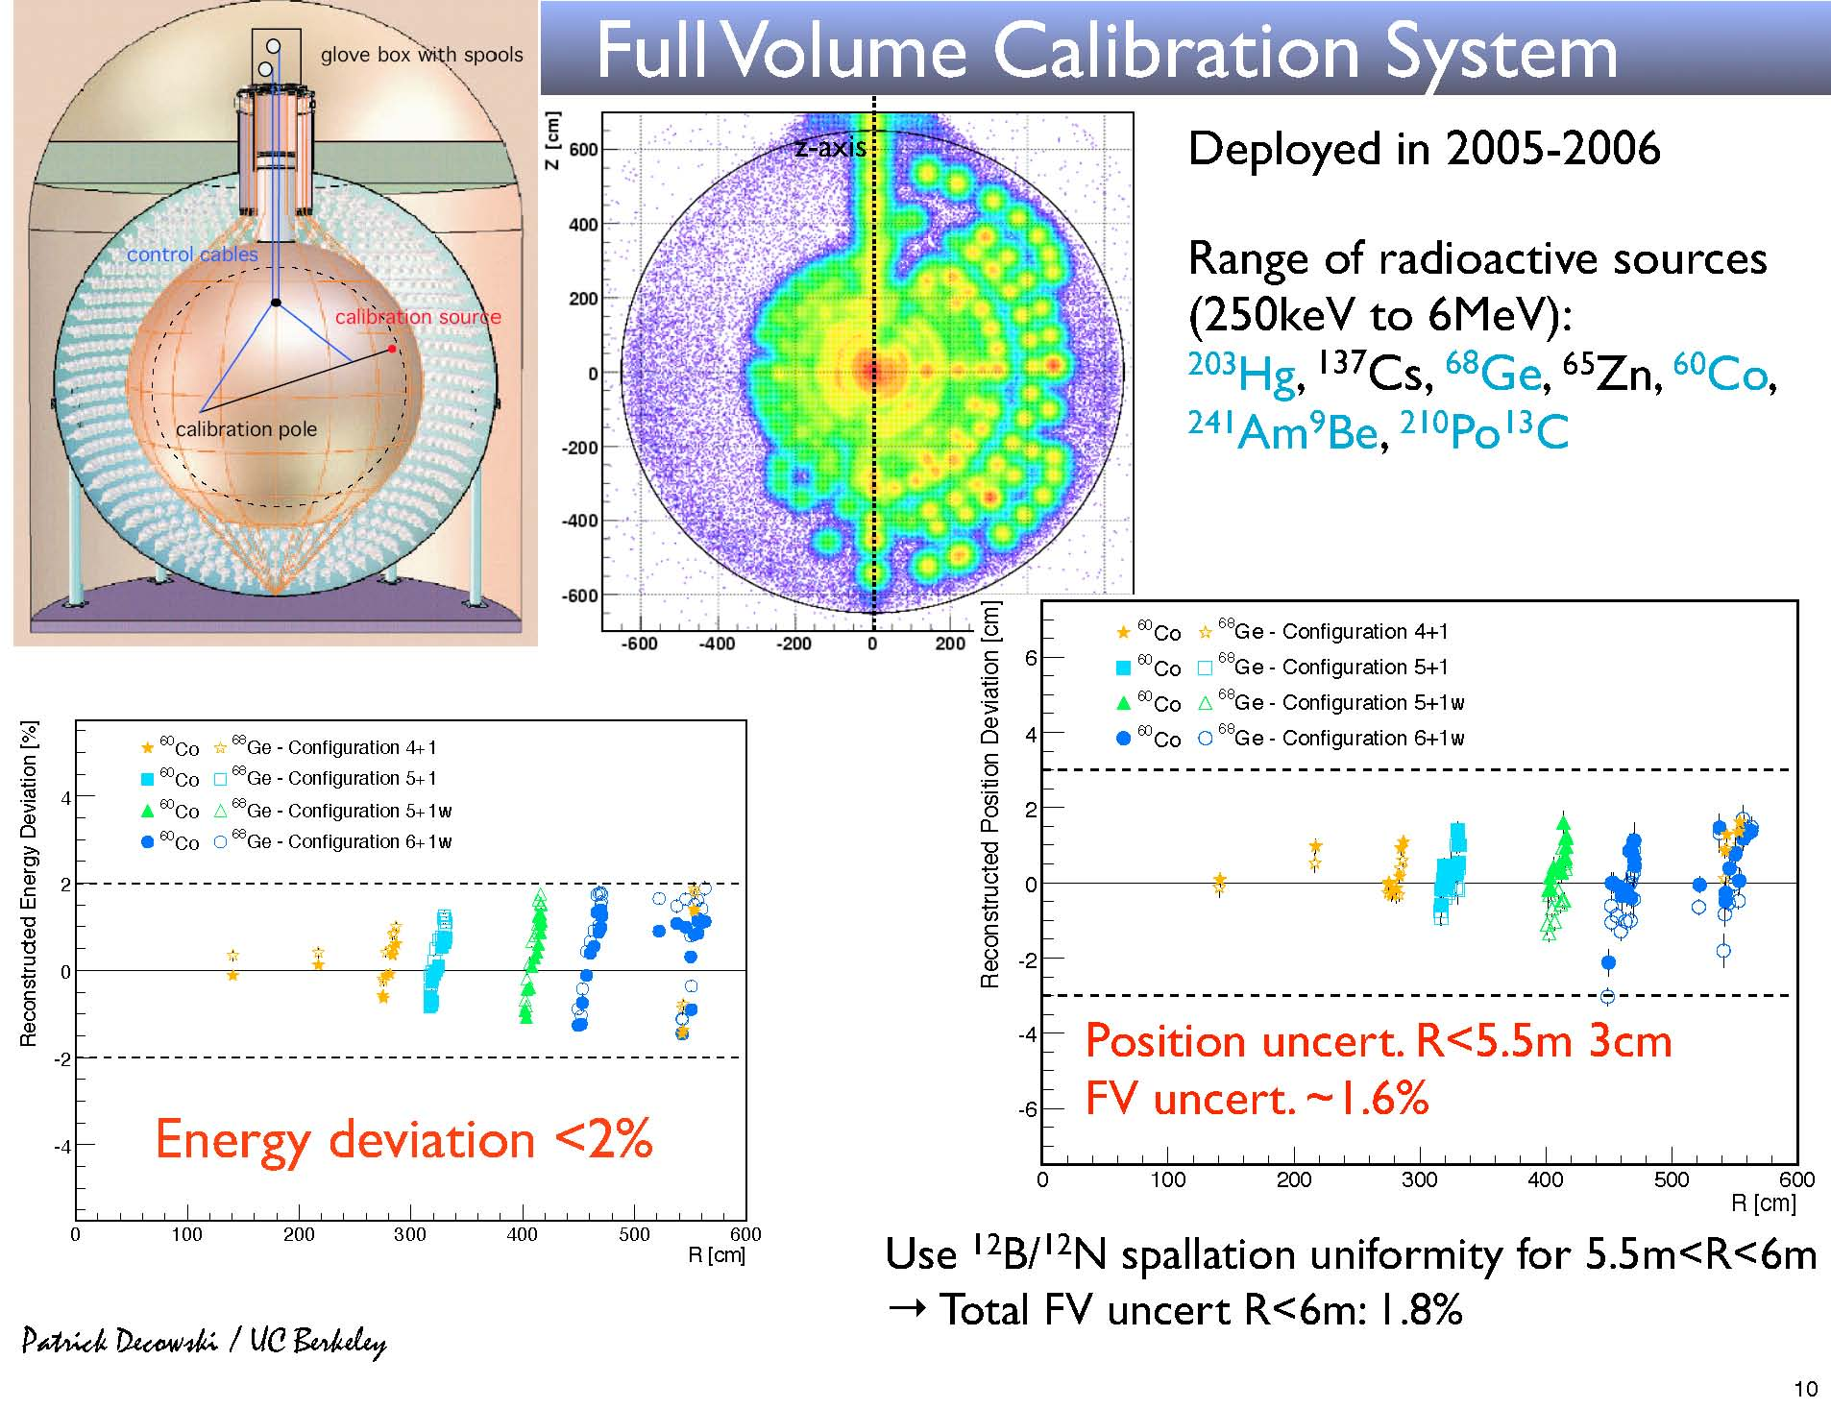
Full Volume Calibration
reconstructed energy deviation[%]
R<5.5 m
R(cm)
reconstructed position deviation[cm]
4.7 %
(KL1)
R(cm)

Slide 13
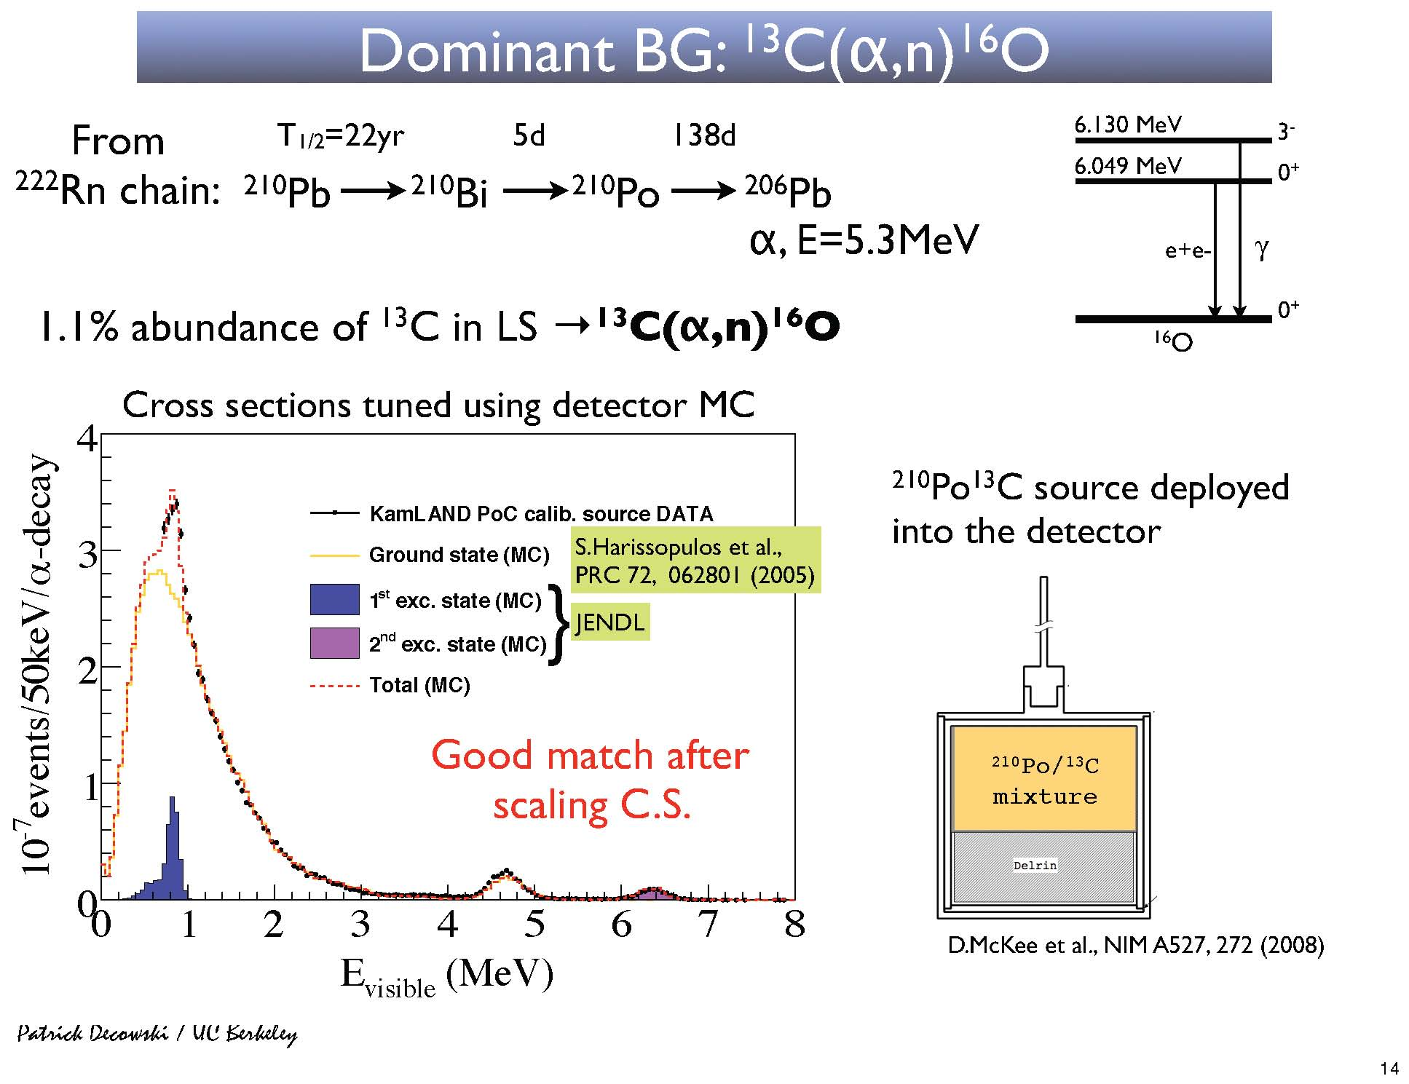
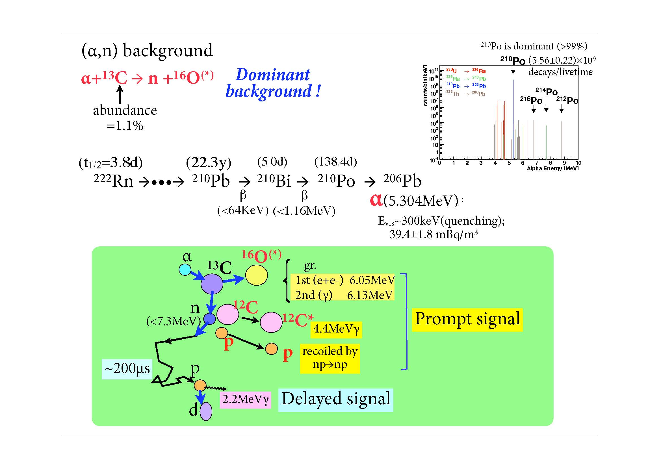
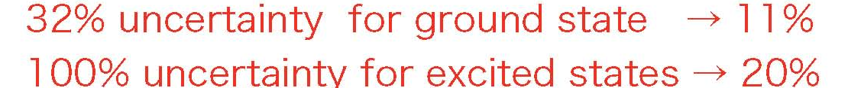
Dominant Background Source : ¹³C(α,n)¹⁶O
Annihilation γ (1st excited state) Neutron capture on ¹²C
Proton recoil (ground state) γ (2nd excited state)

Slide 14
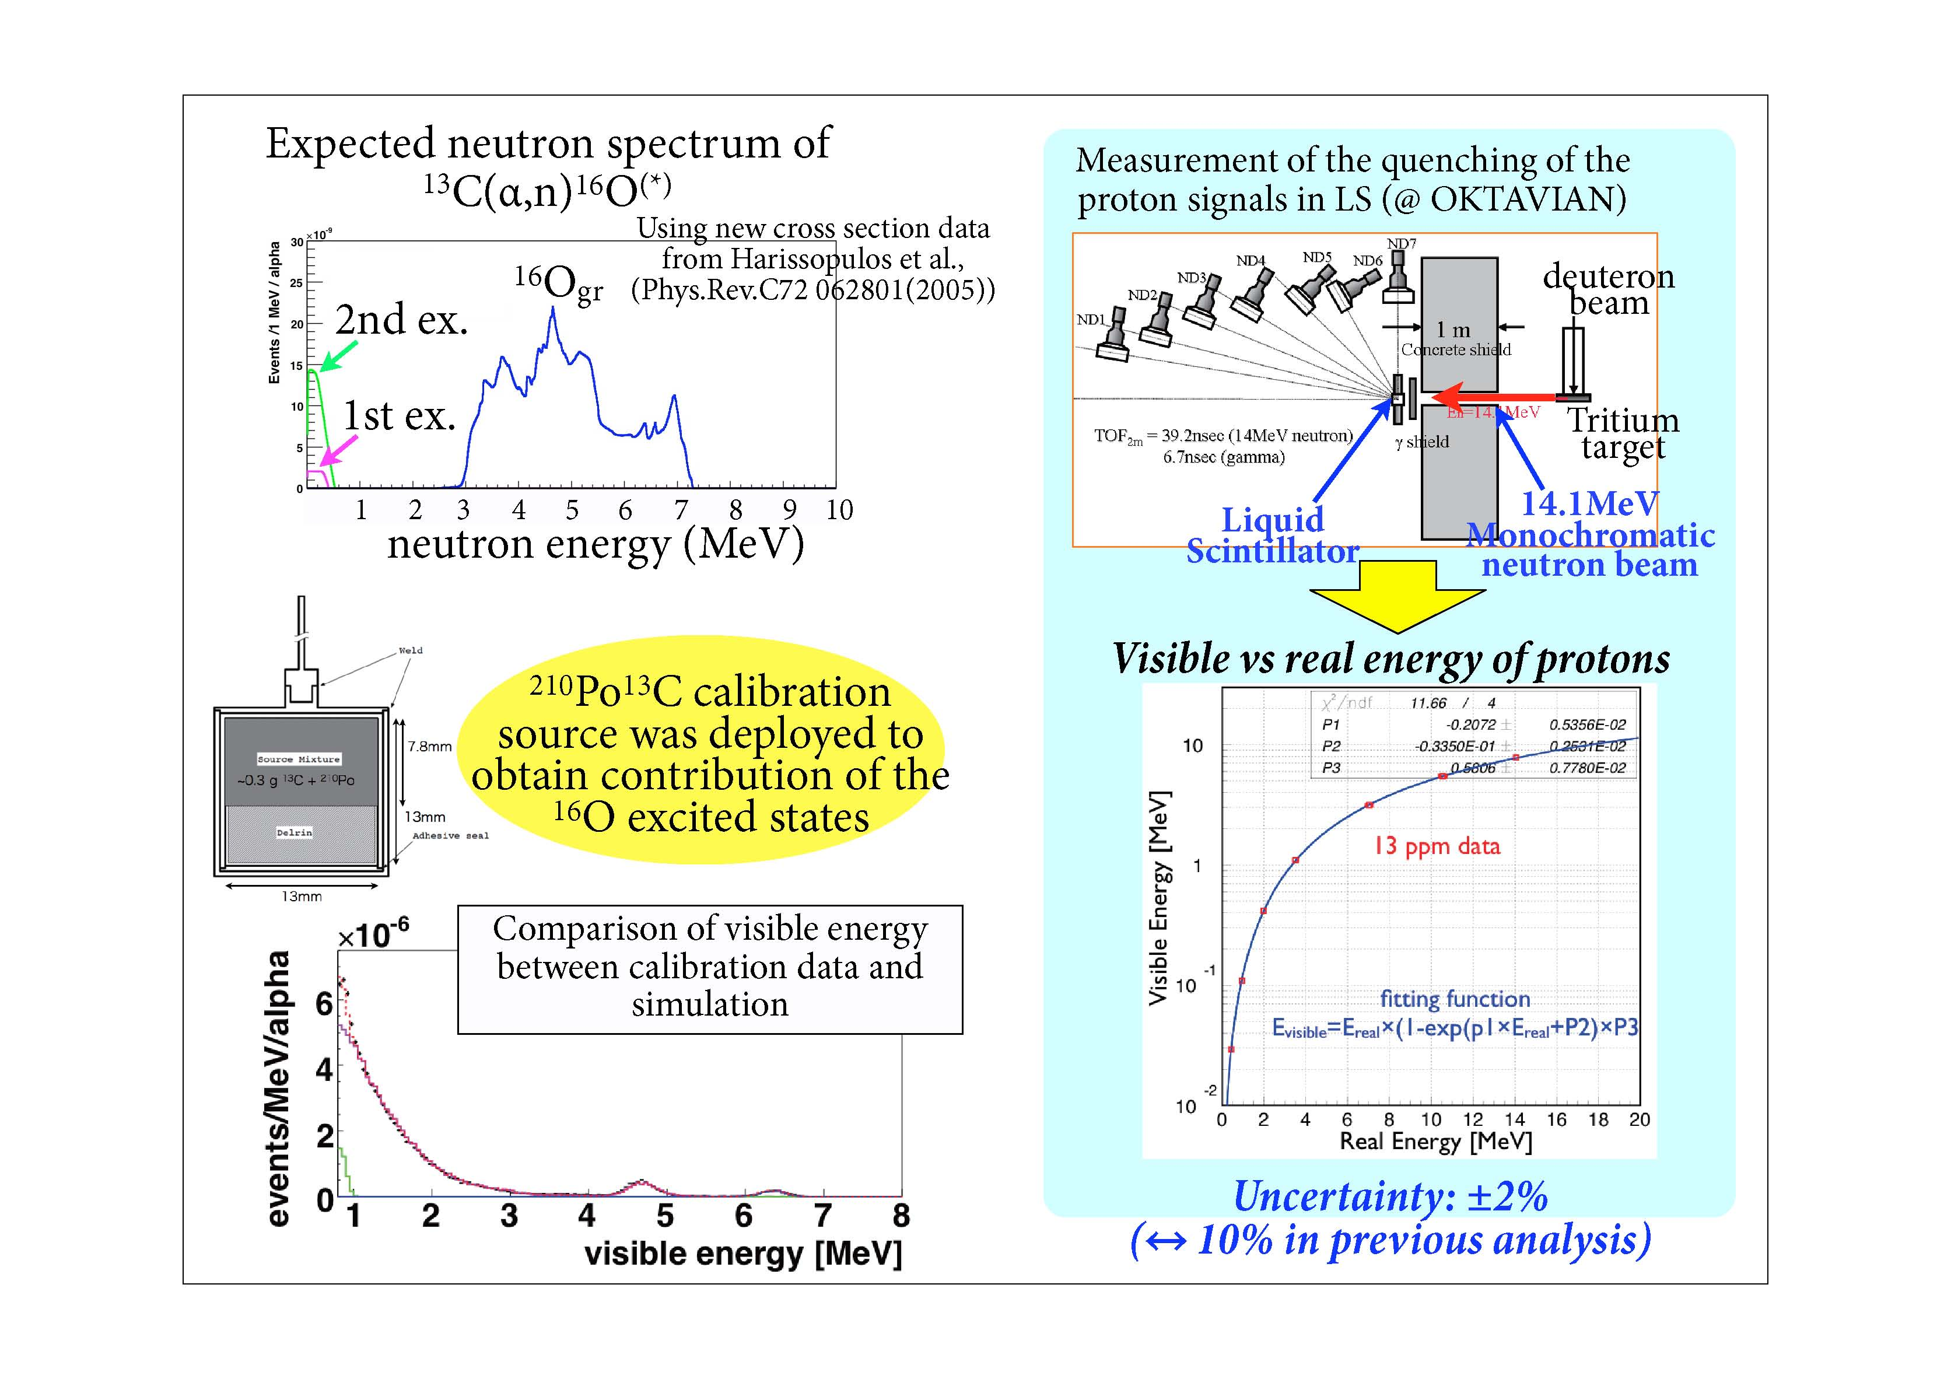
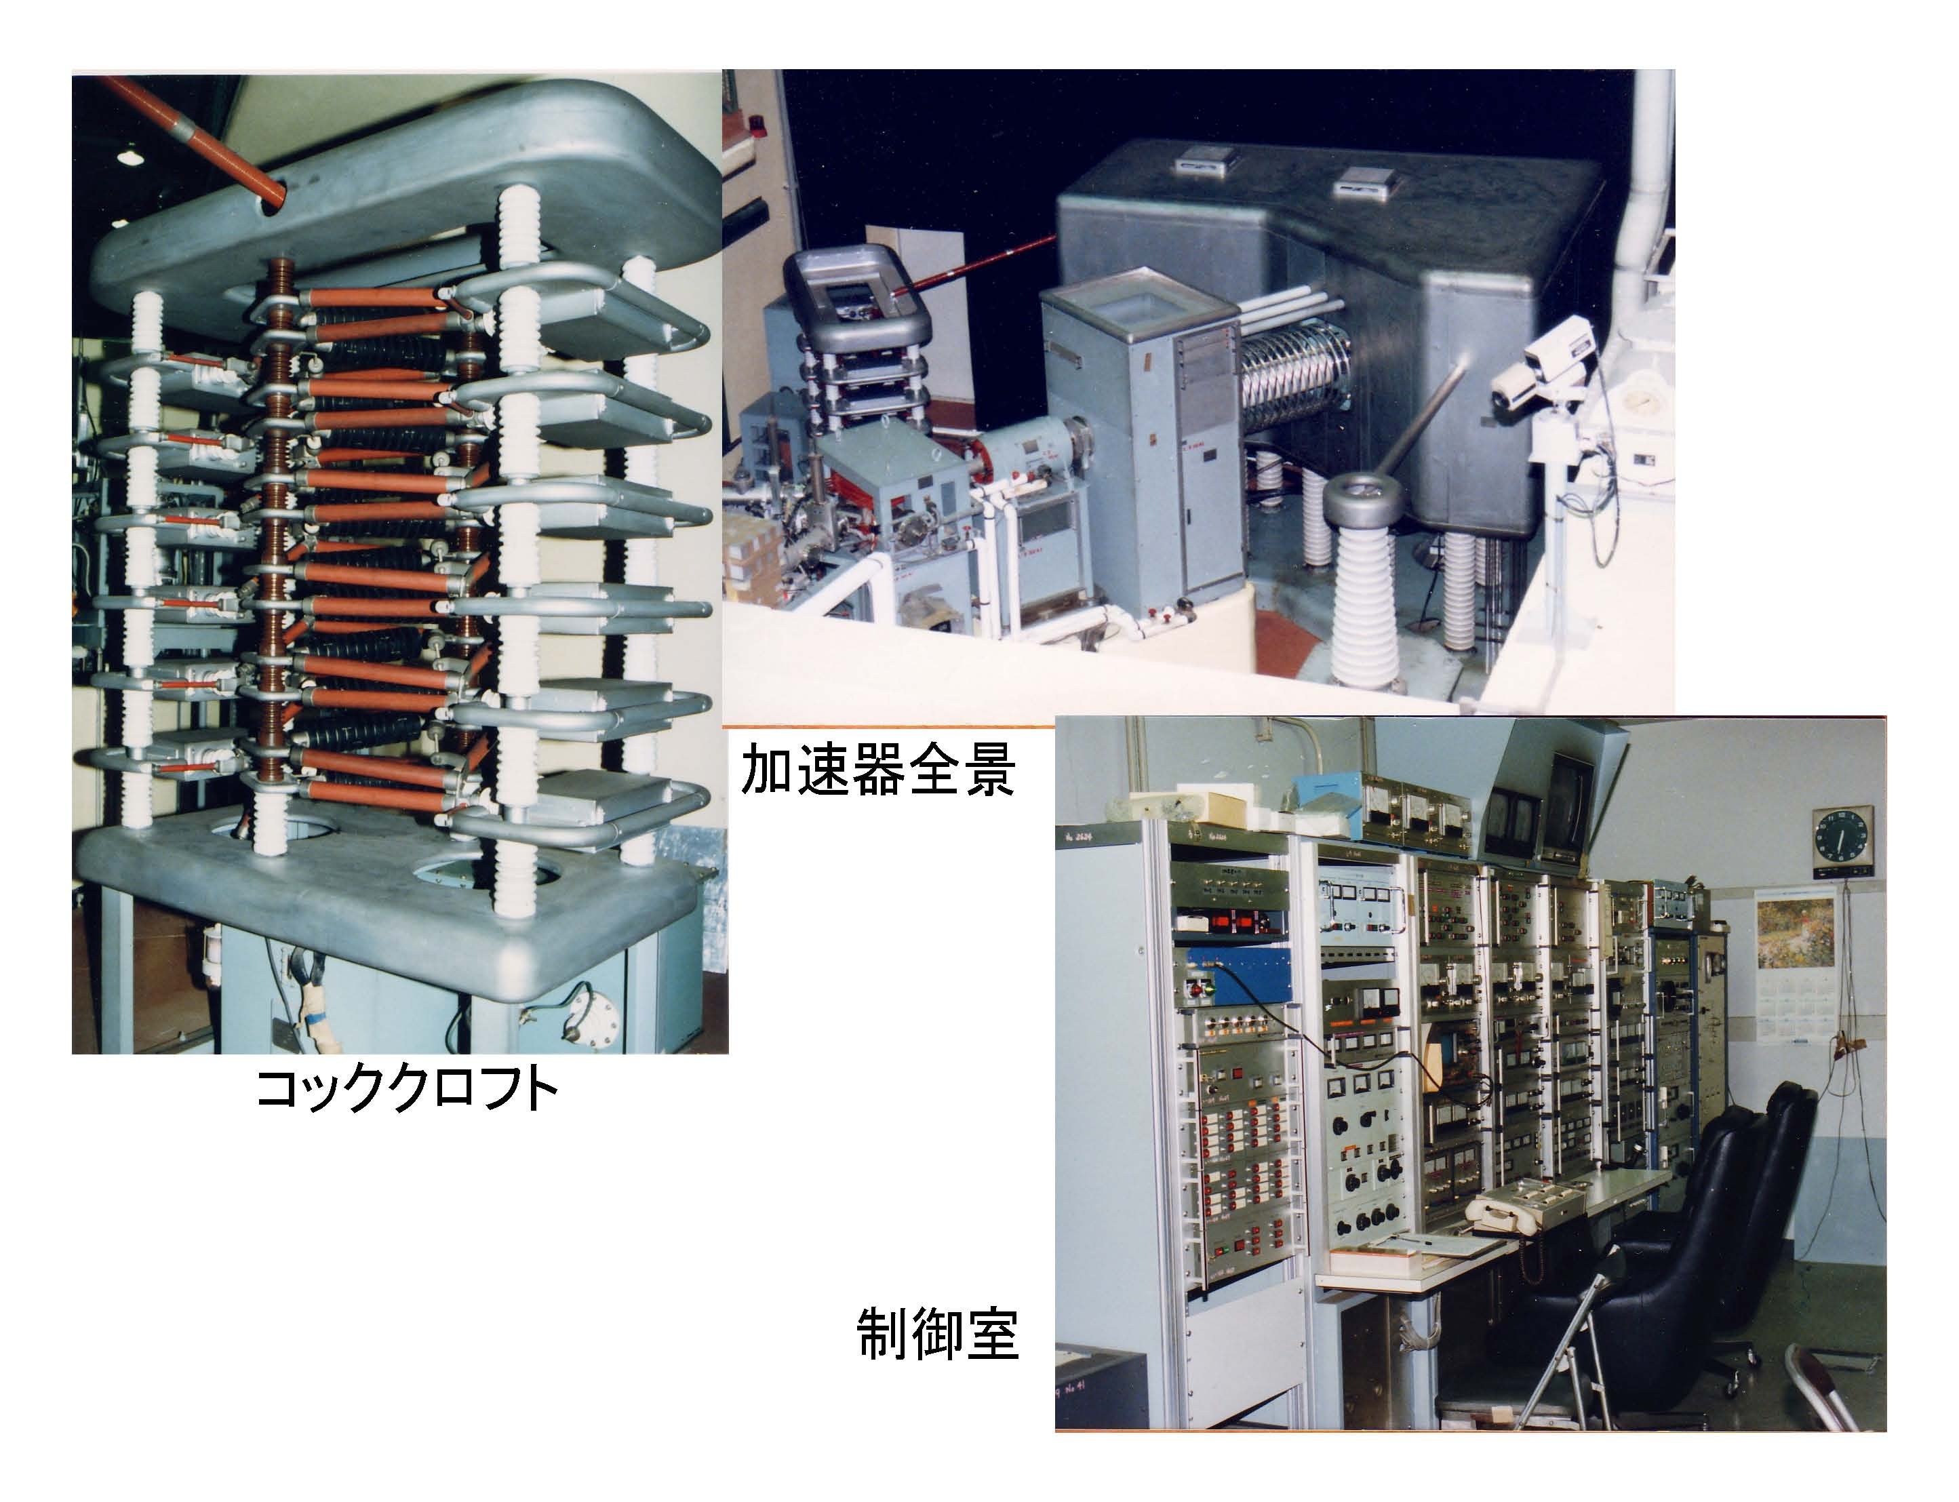
Measurement of Quenching for Proton Signals in LS
OKTAVIAN @ Osaka Univ.

Slide 15
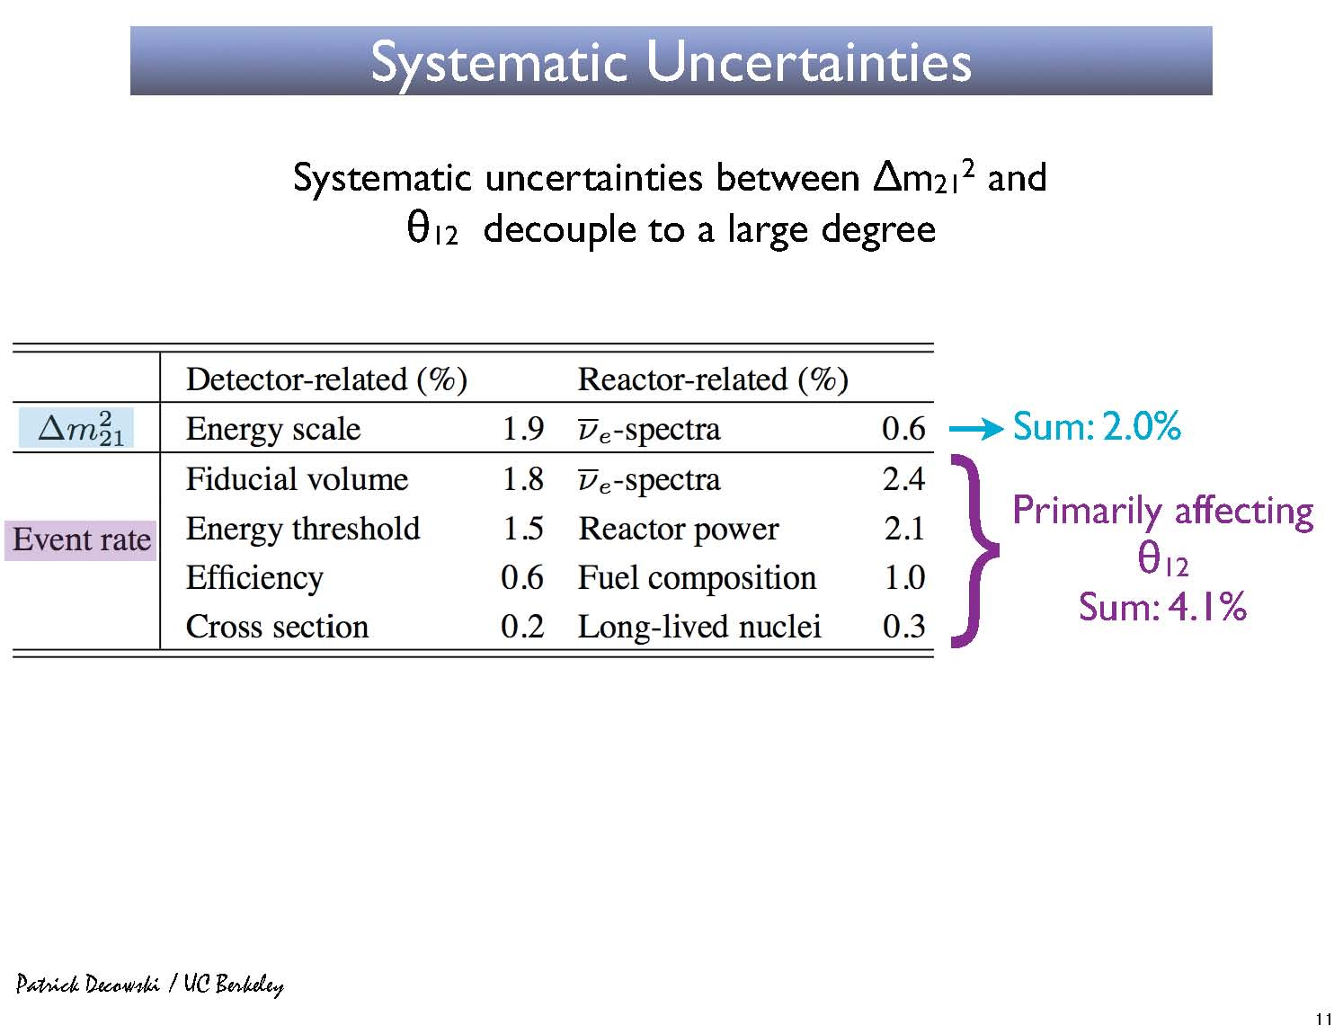
Summary of Updated Systematic Uncertainty
Total systematic error : 6.4 % >>> 4.1 %
(4.7)
(2.3)
Other improvements from KL1
Fiducial volume : R = 5.0 m >>> 6.0 m
Energy threshold : 2.6 MeV >>> 0.9 MeV
Improved ¹³C(α,n)¹⁶O background estimation

Slide 16
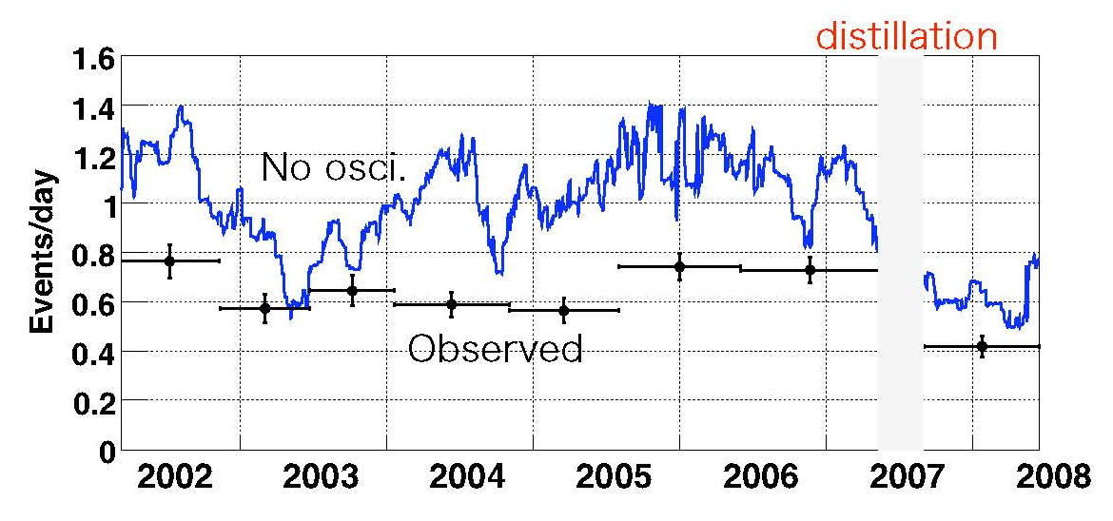
4. Reactor Neutrino Analysis :
Event Rate

Slide 17
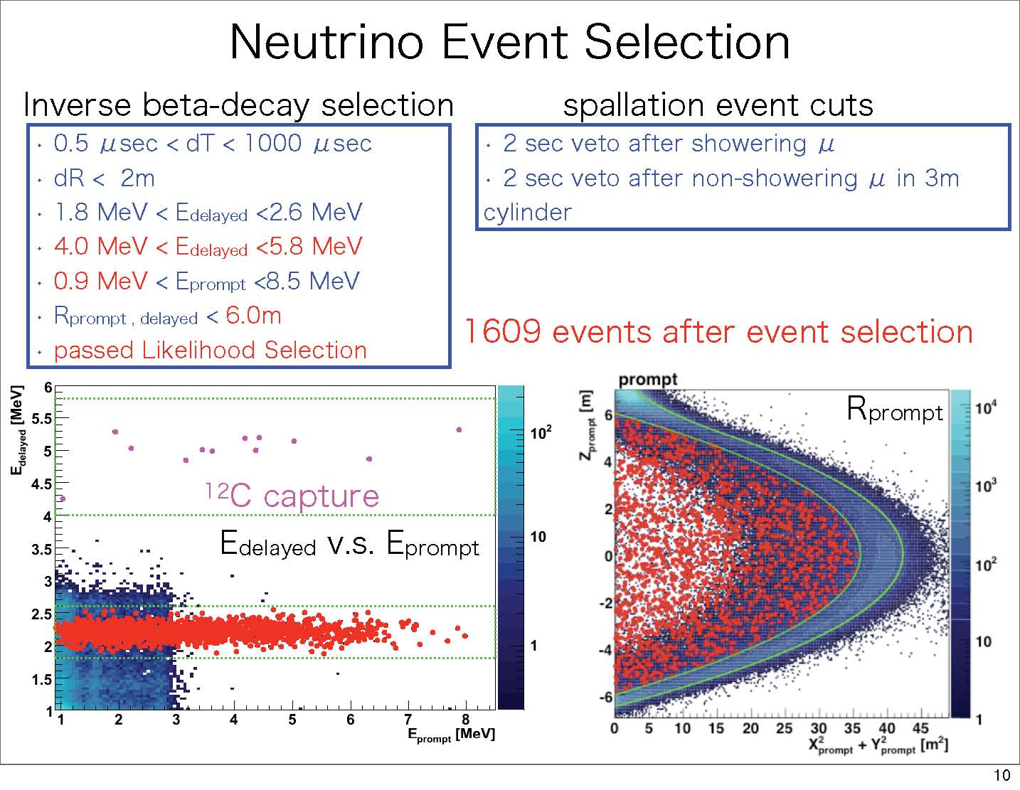
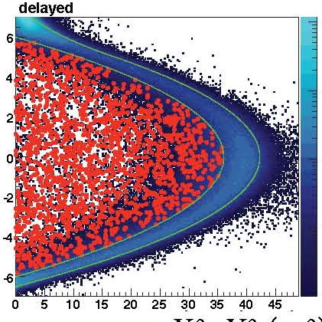
Event Selection in KL3
prompt
delayed
E_{delayed}(MeV)
Z [m]
E_{prompt}(MeV)
X² + y² [m²]

Slide 18
# of Observed and Expected Events
KL1 KL2 KL3
Exposure (ton•yr) 162 766 2881 Observed ev. 54 258 1609
(E_{prompt} : MeV) (>2.6) (>2.6) (>0.9)
Expected ev. 86.8 ± 5.6 365.2 ± 23.7 2179 ± 89
Background ev. 0.95 ± 0.99 17.5 ± 7.3 276.1± 23.5
accidental 0.0086 2.69 80.5
± 0.0005 ± 0.02 ± 0.1
⁹Li/⁸He (β, n) 0.94 ± 0.85 4.8± 0.9 13.6± 1.0
fast neutron 0 ± 0.5 < 0.89 < 9.0
¹³C(α, n)¹⁶O_{gs, 1st, 2nd} 10.3 ± 7.1 182.0 ± 17.7
(N_{obs} –N_{back}) / N_{expect} 0.611 0.658 0.593
(±stat ±syst) ±0.085±0.041 ±0.044±0.047 ±0.020±0.026
99.95 % CL 99.995 % CL 8.5 σ

Slide 19
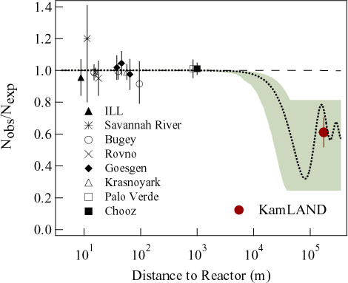
Ratio = (N_{obs} – N_{back}) / N_{expect}
LMA:
Δm² = 5.5x10⁻⁵ eV²
sin² 2Θ = 0.833
KL2
Ratio
KL1
KL3

Slide 20
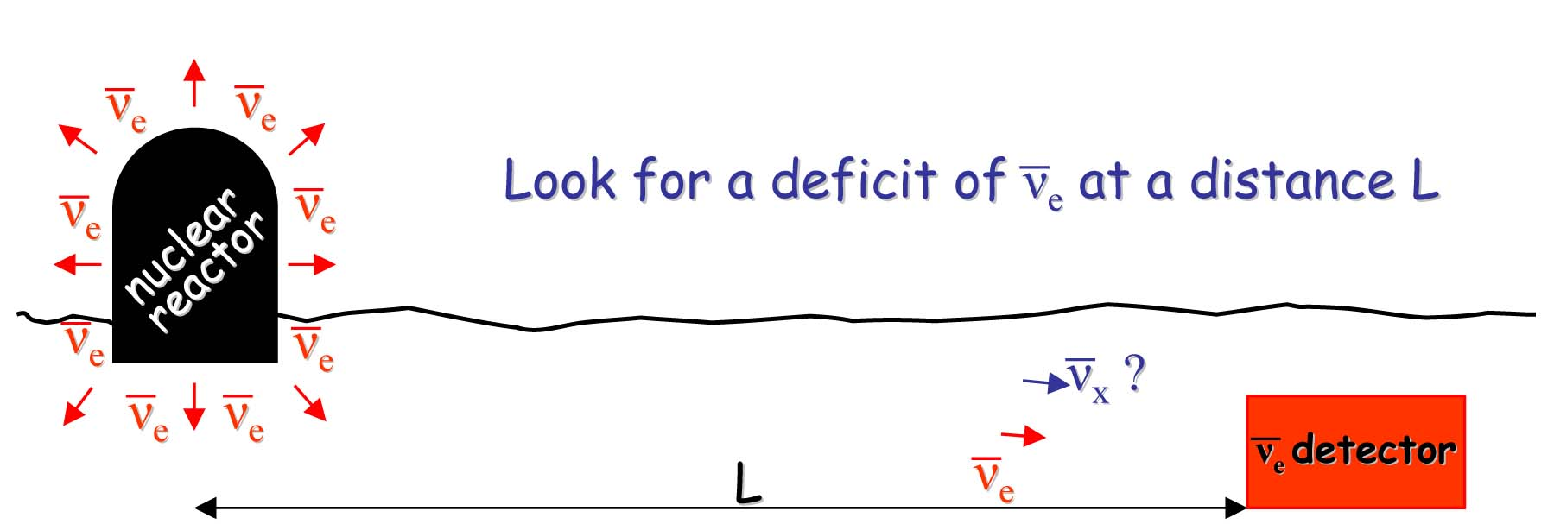
5. Oscillation Analysis

Slide 21
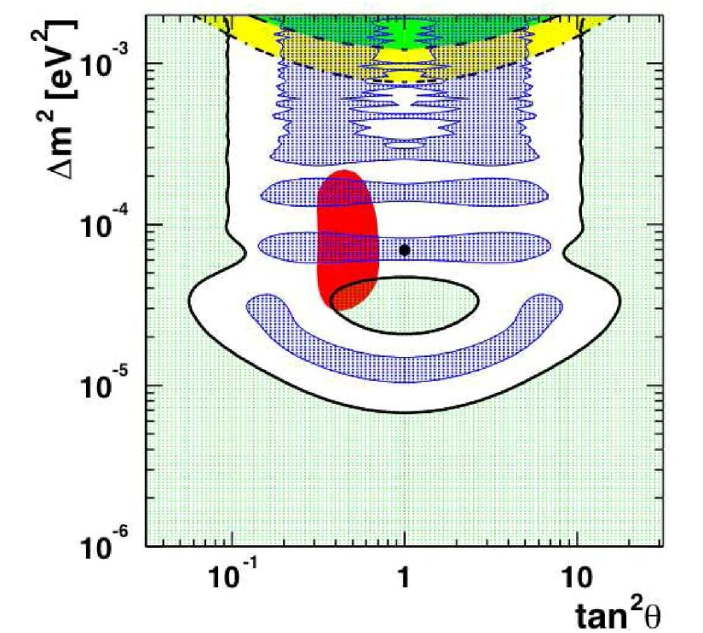
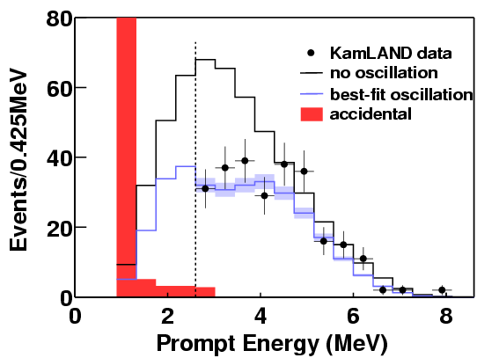
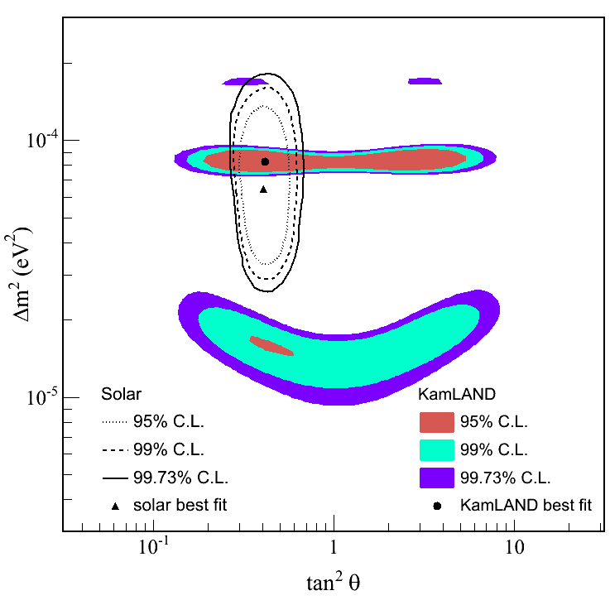
2-Flavor Analysis
KL1
solar
KL2

Slide 22
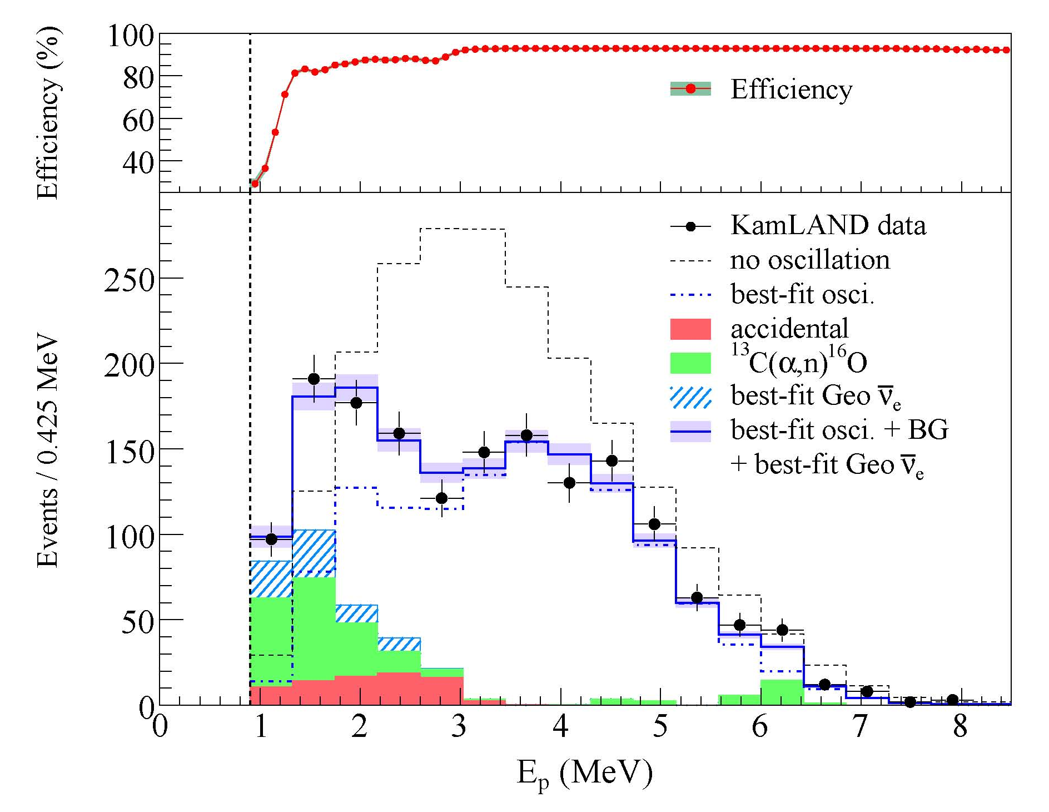
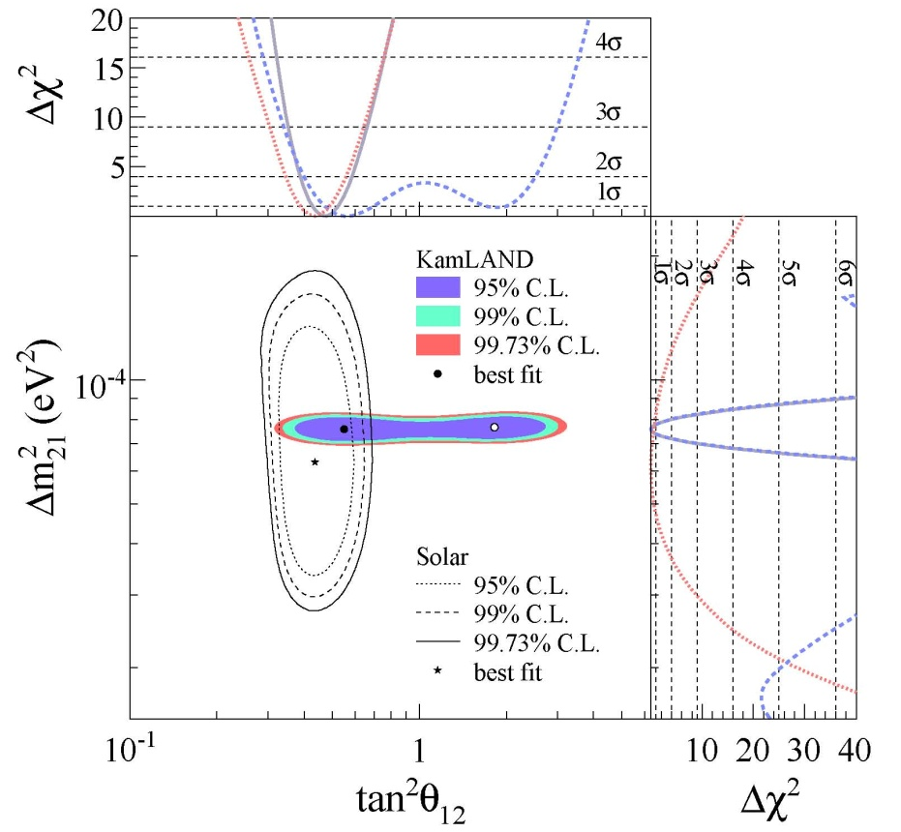
KL3
+ 0.21
Fit to scaled no-oscillation spectrum
: exclude at 5.1 σ
Δm² = 7.58 x 10⁻⁵eV²
- 0.20
+ 0.14
tan²θ = 0.56
- 0.09

Slide 23
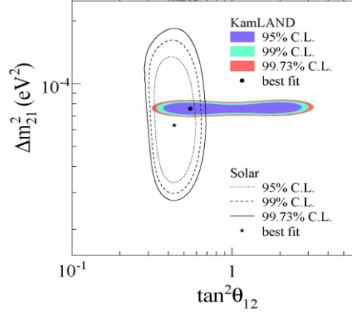
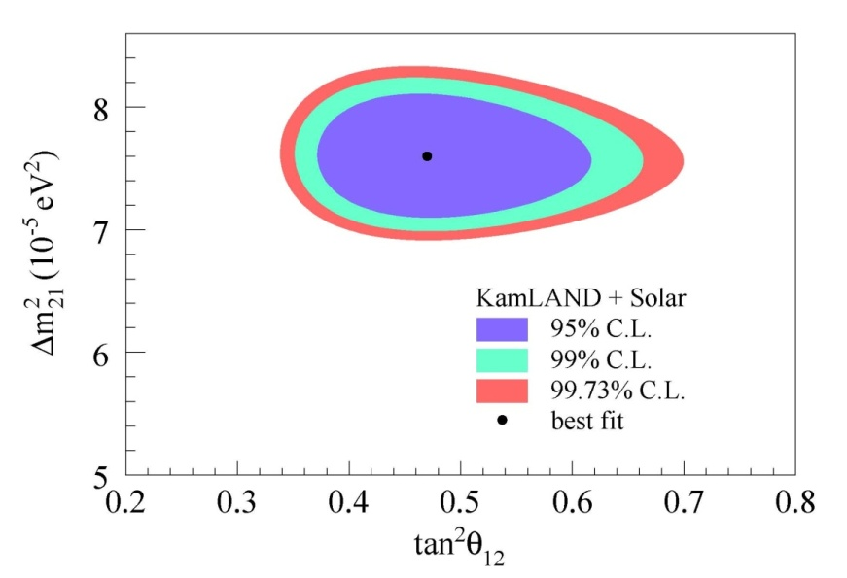
KL2
KL3
KL1
+ 0.06
KamLAND
+ Solar
tan²θ = 0.47
- 0.05
+ 0.21
Δm² = 7.59 x 10⁻⁵eV²
- 0.21
+ 0.21
Δm² = 7.58 x 10⁻⁵eV²
KamLAND
- 0.20
+ 0.14
tan²θ = 0.56
- 0.09

Slide 24
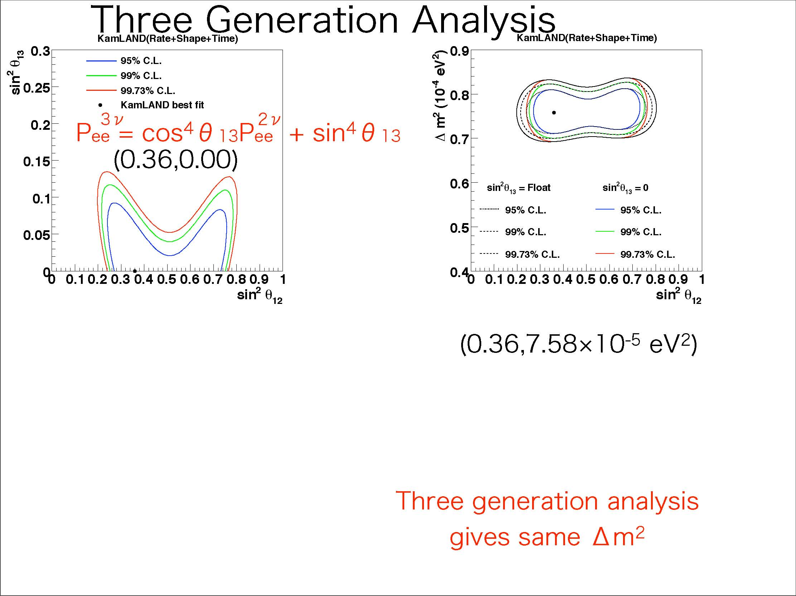
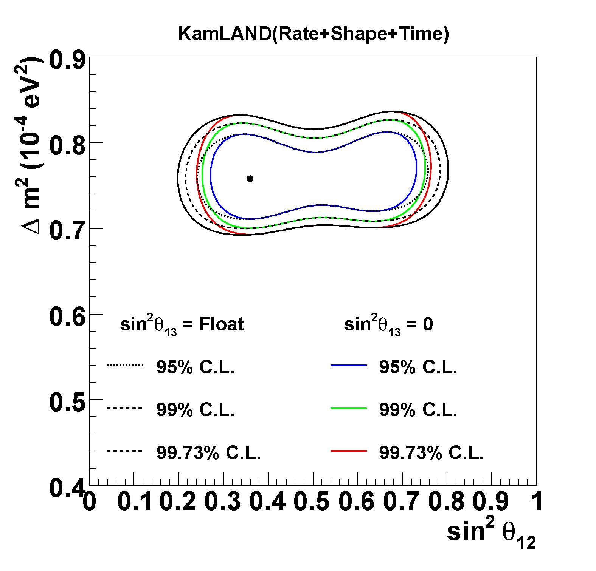
3-Flavor Oscillation Analysis
KamLAND
best fit
+ 0.21
Δm² = 7.58 x 10⁻⁵eV²
- 0.20
+ 0.14
tan²θ = 0.56
- 0.09

Slide 25
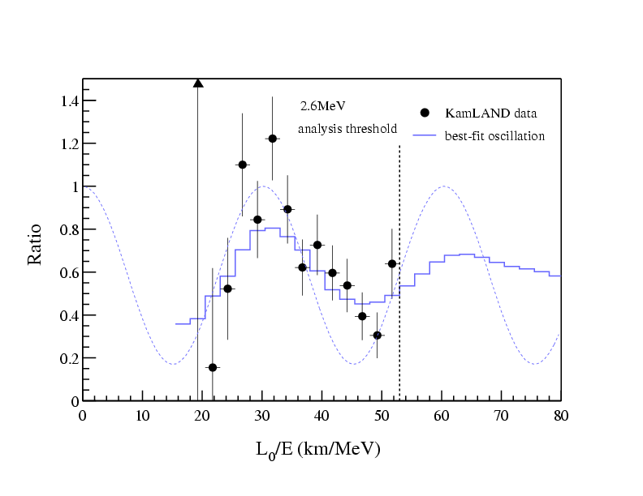
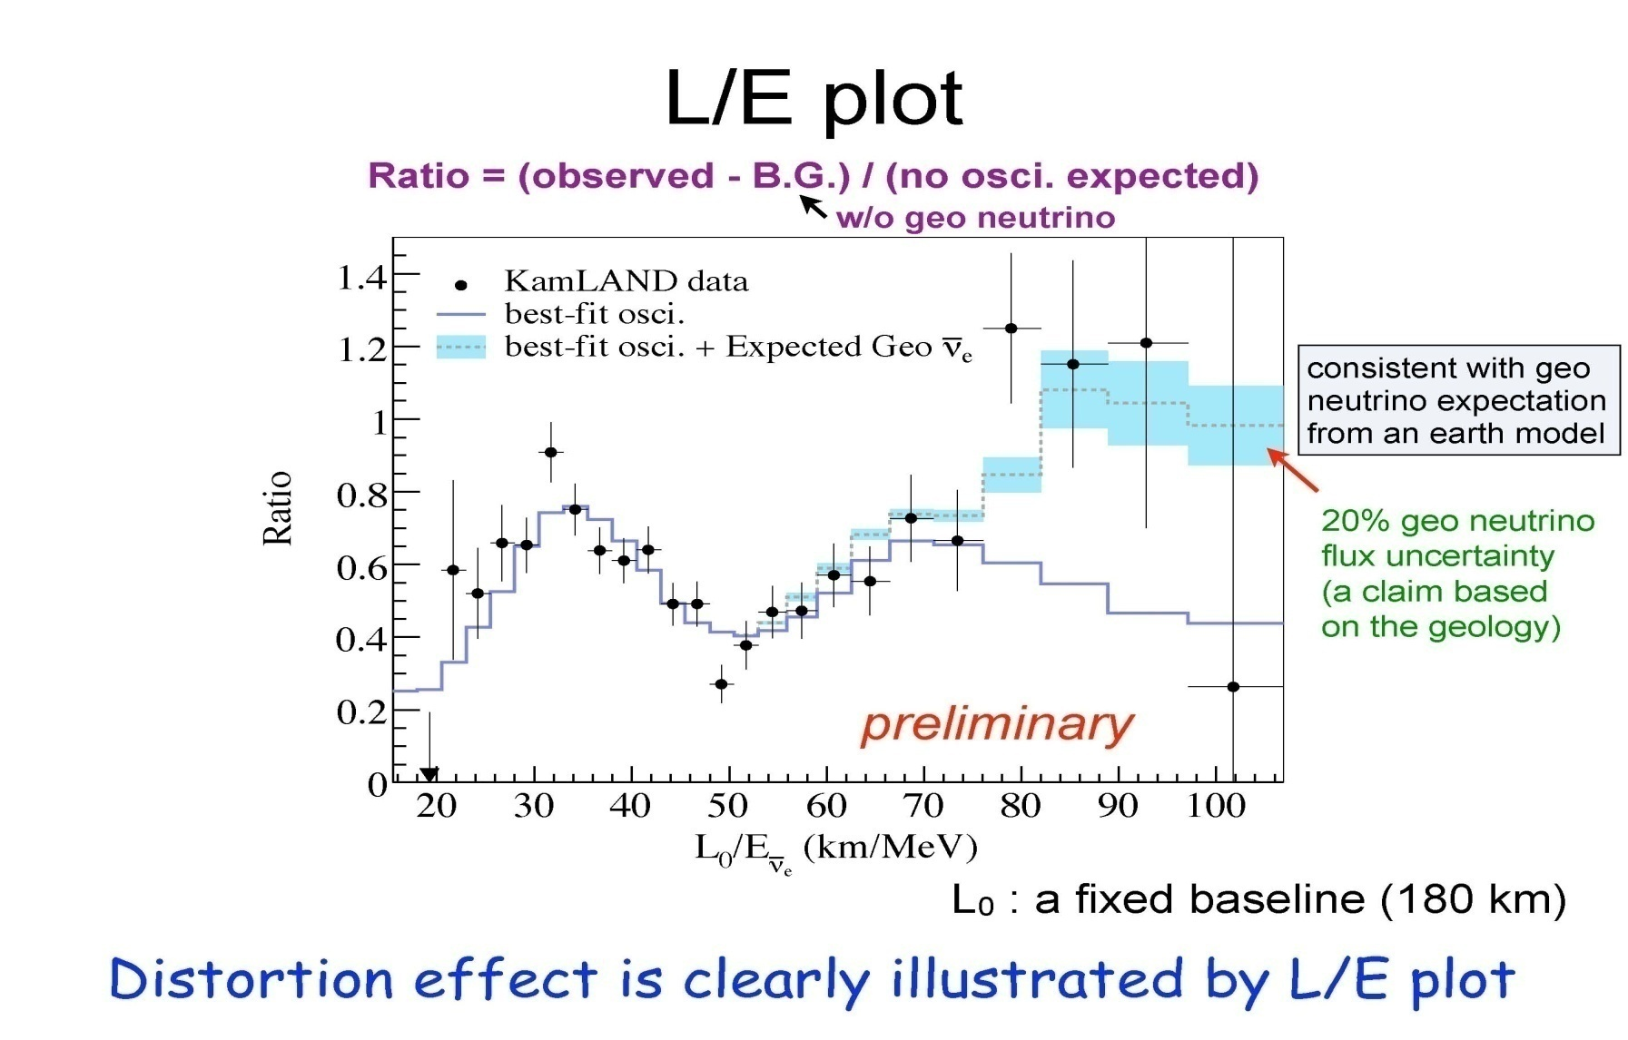
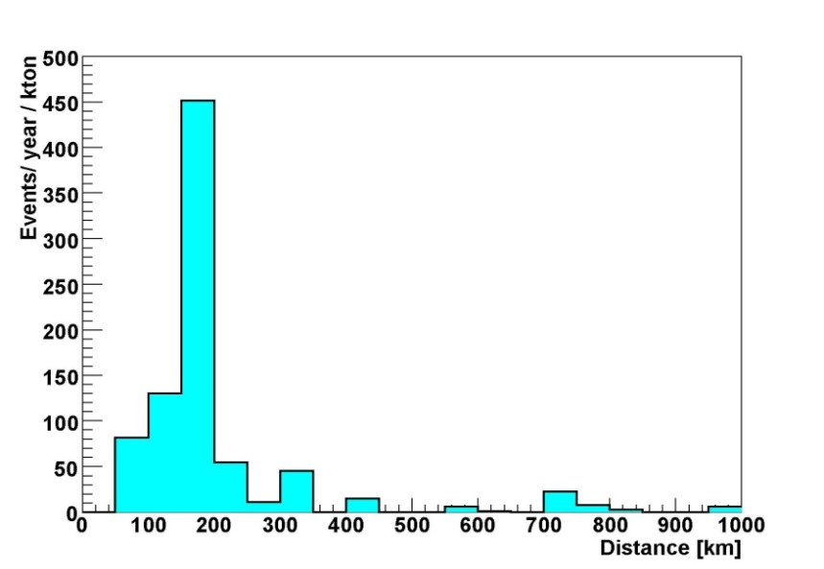
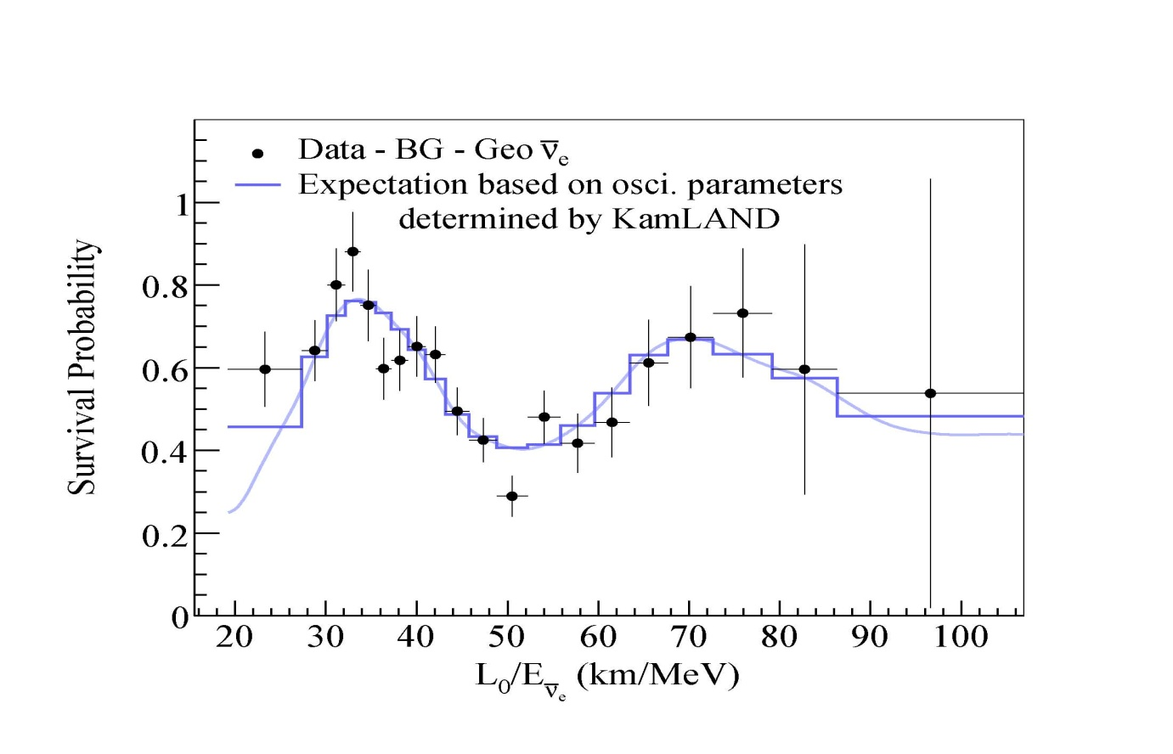
Neutrino Oscillation Cycle
KL2
effective :
180 km
KL3

Slide 26
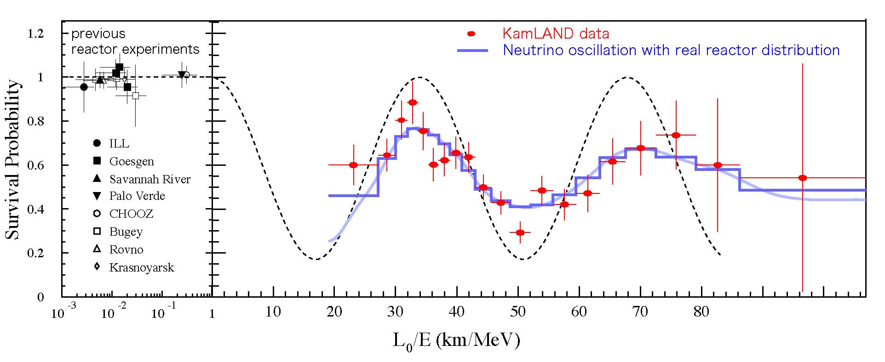
L_{o}/E Oscillatory Shape : L_{o} = 180 km
KL3
L/<E>

Slide 27
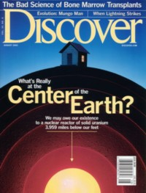
6. One More Nuclear Reactor
Natural Nuclear Reactor at the Earth Center

Slide 28
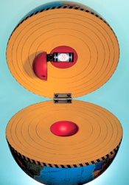
Geo-Reactor
Natural nuclear reactor in the center of the Earth was proposed in 2001 as the energy source of geo-magnetic field.
Not a mainstream theory, but not ruled out by any evidence.
Explains mechanism for flips of the geo-magnetic field.

Slide 29

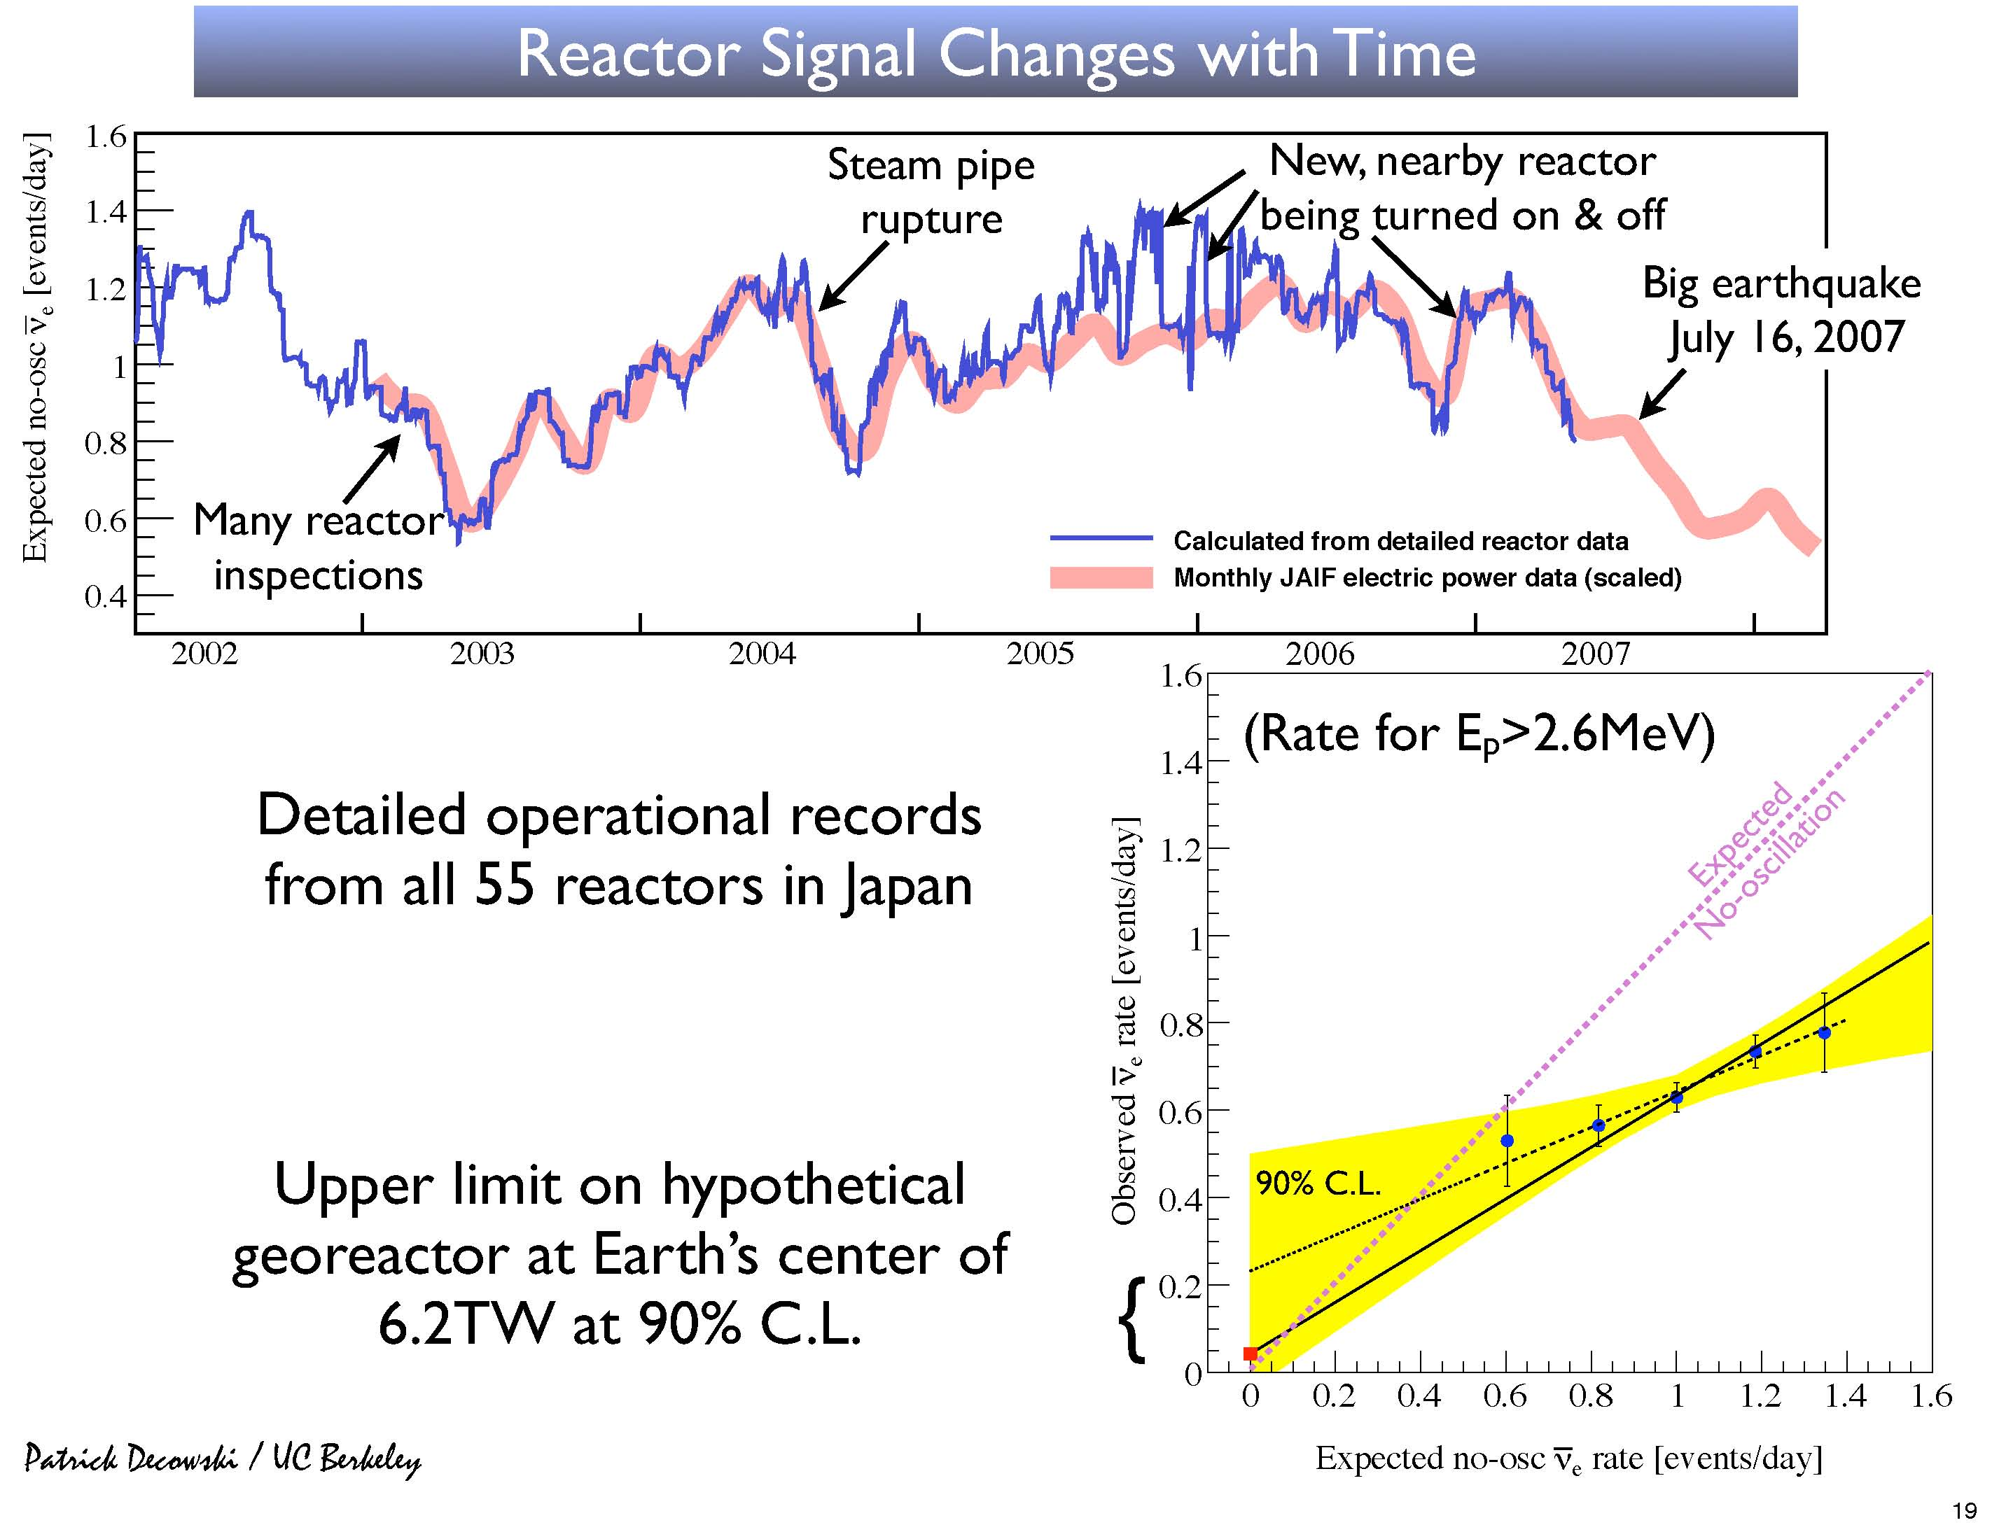
Signature from Geo-Reactor
big earthquake
Kashiwazaki power
station : 24.3 GW
2008 2009
Y-intercept :
Geo-Reactor + BG
theoretical prediction : 3 TW

Slide 30


7. Conclusions
disappearance
precise measurement of
oscillation parameters
oscillation cycle

Slide 31




Next Step :
Solar Neutrino Detection
⁷Be
CNO
pep

